Slide 1
Blood Brothers.
LO: To use explorative strategies to understand some of the key characters.

Slide 2
Learning Outcomes.
By the end of the lesson you should be able to…
Recall what the key explorative strategies are.
Describe the importance of understanding a character.
Explain why we use explorative strategies.

Slide 3
In groups… 4
Prepare the scene where Mrs L confronts Mrs J.
One pair to act out the scene. One pair to use though tracking.
Careful consideration must be taken as to when the thought tracking will be used and why.

Slide 4
Perform and Evaluate

Slide 5
In pairs…
Create a Role on the Wall
For one of the characters.

Slide 6
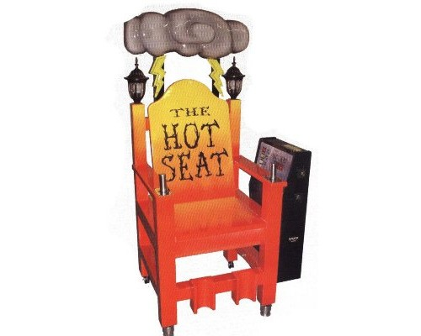
In opposite pairs…
Hot seat your opposite
Characters. Make sure
You write down the
questions and answers
That are given.

Slide 7
Theory Stuff…
Explorative Strategies.
Role Play
Thought tracking
Role on the wall
Hot seating
Drama Medium.
Use of voice.
Use of spoken language
Use of movement and gesture
Elements of Drama.
Action/plot/content
Characterisation

Slide 8
Independent Learning
Drama diaries up to date.
TAKING THEM IN NEXT LESSON!!!!
NO EXCUSES!!!!!!!!

