Slide 1
Edexcel A2 Business
1.5.2 Entrepreneurial
motives and characteristics
Revisionstation

Slide 2
Worksheet

Slide 3
From Edexcel
a) Characteristics and skills required
b) Reasons why people set up businesses:
financial motives:
profit maximisation
profit satisficing
non-financial motives:
ethical stance
social entrepreneurship
independence
home working

Slide 4
Starter
What skills do you have? Can you sew, sing, play an instrument, juggle, drive, grow plants, write songs etc?
What motives do you have in life? Are you motivated by your family, your friends, money, status in life?
Are motives and characteristics the same thing?
Notes:
This should start an interesting discussion and it’s a great opportunity to make the definition of skills and motivations.

Slide 5
Definition: Entrepreneur
An entrepreneur is a person who sets up a business and takes risks in the hope of a profit, reward or for a social purpose e.g. to help the community

Slide 6
Definition: Entrepreneurial characteristics
An entrepreneurial characteristic is the skill, quality or trait of the person starting the business e.g. creativity

Slide 7
Definition: Entrepreneurial motives
An entrepreneurial motive is the factor that drives a person to start a business e.g. to be their own boss

Slide 8
Characteristics and skills required

Slide 9
Entrepreneurial characteristics
There are lots of characteristics that an entrepreneur should have, these are the six that the exam board would like you to be able to discuss. Get ready to make some notes on the next few slides:
Creativity
Hard-work
Resilience
Initiative
Self-confidence
Risk-taking

Slide 10
#1 creativity
Entrepreneurs need to be creative people, it helps when designing or inventing new products or services
In dynamic markets the consumers are faced with a huge variety of products from trusted brand names
New products onto the market need to be more creative in the ways that they add value to stand out from the established products
Watch the video – why is this an example of creativity?

Slide 11
#2 hard-work
Starting a business can mean hard work. Some entrepreneurs will put 100s of hours into their own business to get it off the group and may have to continue working long hours to get the business established
This can include time working on the website, on social media, selling to customers, developing products, or even just thinking about the next move
Watch the video – in what way is this entrepreneur hard working?

Slide 12
#3 resilience
Resilience means; strong, hardy, tough, robust, durable, feisty, quick to recover.
An entrepreneur may get many knock backs before their business is a success.
Karen Jonga started her own dressmaking business in Derby. At the start many people told her that it would not be a success. She had many problems along the way – but by having resilience she has been able to keep the business going.
Have a look at her website, can you see how she is resilient?

Slide 13
#4 Initiative
Initiative means; inventiveness, enterprise, ingenuity, or resourcefulness
Many entrepreneurs may start a business because they have a good idea and want to take it to market
Watch the wand company present in the den. Here is the website:
Dragons Den – Wand company
Have a look at their website. What are their new products? How do they show initiative?
Entrepreneurs Chris Barnardo and Richard Blakesley

Slide 14
#5 self-confidence
Self-confidence is how an entrepreneur feels about their own abilities.
It is easy for an entrepreneur to become frustrated and give up if they lack self-confidence in their own ability and in their products and services
Watch the video from the Den.
Levis roots and reggae reggae sauce, his website is here:
http://www.leviroots.com/
Why is Levis Roots a good example of self-confidence in an entrepreneur?

Slide 15
#6 risk taking
Entrepreneurs who want to start their own business will need to be able to take a risk
There is a risk of leaving a secure job to start up on your own
There is also a financial risk of losing any money that is put into the business, if the business fails
What other risks do you think there may be if a person gives up a secure job to start their own business?
Notes:
Could lose car, job, arguments in a marriage etc

Slide 16
Entrepreneurial skills
There are lots of skills that an entrepreneur should have, these are the six that the exam board would like you to be able to discuss. Get ready to make some notes on the next few slides:
Communication
Team working
Problem solving
Organisation
Numeracy
IT

Slide 17
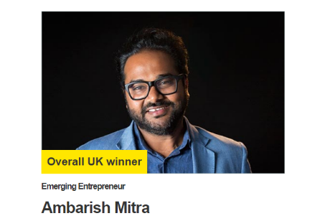
#1 Communication
Entrepreneurs need to be good communicators
They may need to write exciting product descriptions on their websites
They may have to talk to customers or clients fact to face or on the phone
They may need to negotiate deal with suppliers

Slide 18
Suggested activity - communication
1) The entrepreneur is trying to get a larger company to invest in the business
2) The entrepreneur is trying to persuade a computer programmer to work for free on a project that could ultimately make them lots of profit
3) The entrepreneur is trying to recruit some staff to work in the business
The previous slide had a range of ways that an entrepreneur needs to be able to communicate
Discuss why an entrepreneur would need communication skills in the following scenarios
What would be the best communication method?
What problems or barriers to communication might the entrepreneur face?

Slide 19
#2 team working
An entrepreneur may decide not to work alone but as part of a pair or a team
Working with others has advantages and disadvantages
The advantages are that there are more ideas and more capital in the business
Who are the guys in the photo and what did they invent?
Notes:
They are Steve Jobs and Steve Wozniak who founded Apple Computers on 1 April 1976

Slide 20
#3 Problem solving
Entrepreneurs will come across many problems when setting up and running their business, they will need to be good at working out cost effective solutions that help to move the business forwards.
James Dyson’s initial problems were in the creative process that went into creating the bag-free, "cyclone technology" design, including the 15 years and 5,127 prototypes it took before the first model, DC01, would ultimately prove successful in 1993.
There are countless times an inventor can give up on an idea. How many prototypes would you have made before giving up?

Slide 21
#4 Organisation
Entrepreneurs need to be organised
When first staring the business they will have to develop a range of systems for dealing with enquiries, suppliers and orders from customers
They may need to buy stock, sell to customers, make products all in the same day, which takes organisation skills
Watch the video and explain why the entrepreneurs developing Beezer.com business demonstrates organisation

Slide 22
#5 Numeracy
Entrepreneurs will need to be numerate.
They will need to complete their own tax returns when they first start. They will have to balance sales books, keep records of goods and services purchased to keep the business running. They will have to complete cash flow forecasts if they wish to attract more funding from lenders.

Slide 23
#6 IT
Entrepreneurs need to be IT literate
If the business is online they will need some web design skills
If the business is not online they may still need to know how to process an order, send and print invoices, keep databases of customers, process accounts on a spreadsheet etc.
Watch the video and explain why these entrepreneurs would need IT skills in their business

Slide 24
Financial motives for setting up a business

Slide 25
Profit maximisation
An entrepreneur may aim to make the highest amount of profit possible
This is the difference between revenue and costs, so they will seek to minimise costs and maximise revenue
The advantages to a sole trader are larger wages can be drawn from the profit
The advantages for a Ltd company and a PLC is dividends will be larger on shares, this may attract more investors

Slide 26
Profit satisficing
An entrepreneur may aim to make just enough profit to keep the business moving plus another aim at the same time
For example a business may want to make a profit and:
Reward employees with higher wages
Invest in environmental project
Serve the community in some way

Slide 27
Non-financial motives for setting up a business

Slide 28
Non-financial motives
Sometimes an entrepreneur will start a business for reasons other than profit. There are lots of reasons, but these are the 5 that you exam board would like you to know. Get ready to make some notes about these from the next few slides:
Independence
Flexibility
Ethical reasons
Social purpose
Personal challenge

Slide 29
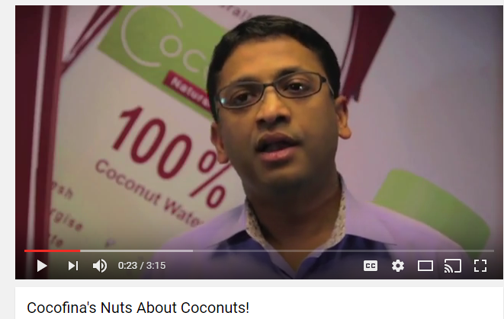
#1 Independence
For many entrepreneurs the idea that they can work for themselves and no longer have to commute to work for someone else is all the motivation that they need to set up their own business
Every week Dragons’ Den shows many entrepreneurs keen to launch a product or get a business off the ground to work for themselves

Slide 30
#2 Flexibility
Many entrepreneurs seek to start their own business to gain flexibility in their life
It can be hard to balance the needs of a family with the requirements of work
This work life balance can better achieved if the entrepreneur can work from home or for themselves
Kirsty Henshaw was a single mum with a great idea HERE

Slide 31
#3 Ethical reasons
Some businesses may decide to trade in a more ethical way
For example:
Environmental trading at their heart e.g. Starbucks
Animal rights e.g. Body Shop
Fair wages for workers in African nations e.g. Fairtrade products
Organic, anti-GM crops
Ethics e.g. Ethical superstore

Slide 32
#4 Social purpose
Social enterprises are businesses trading for social and environmental purposes.
(Learn that bit)
Many commercial businesses would consider themselves to have social objectives, but social enterprises are distinctive because their social and/or environmental purpose is absolutely central to what they do.
their profits are reinvested to sustain and further their mission for positive change.

Slide 33
#5 Personal challenge
Some entrepreneurs may find working for another business as boring and unchallenging. They may decide to set up their own business instead
This should give them the daily challenge and excitement that they seek
Some entrepreneurs set up more than one business as they wish to keep challenging themselves
Watch the video HERE
Deano Jackson of HUUB wetsuits

Slide 34
Profit reasons for starting a business | Non-profit reasons for starting a business | Ethical reasons for starting a business

Slide 35
Profit reasons for starting a business | Non-profit reasons for starting a business | Ethical reasons for starting a business
Want to make more money than at current job | Want to start a business as a legacy for children to take over | Want to help others e.g. fair trade / ethical trading
Want to earn more than minimum wage | Want flexibility and work life balance | Want to make a difference to the planet – eco-friendly
Want to be self employed | Want control in their life, and to be independent, and to be more creative | Want to start a business for the benefit of others e.g. community cafe
Want earnings to be unlimited | Want to be their own boss – don’t want to be ordered around | Want to give something back to society

Slide 36
Motivations are NOT characteristics
Characteristics
Motivations

Slide 37
Motivations are NOT characteristics
Characteristics
Motivations
Resilient
Hard-working
Determined
Creative
Self confident
Lots of self initiative
Risk taker
To be own boss
For social reasons (to help the community)
To make a profit
To have more control over working life
To turn a hobby into a revenue generator
Increase income
Become independent
Driven by personal passion
To sell something new

Slide 38
Revision Video

Slide 39
Sample Edexcel A2 questions
Notes:
No sample A2 questions again so I have borrowed a sample Edexcel AS question for practice

Slide 40
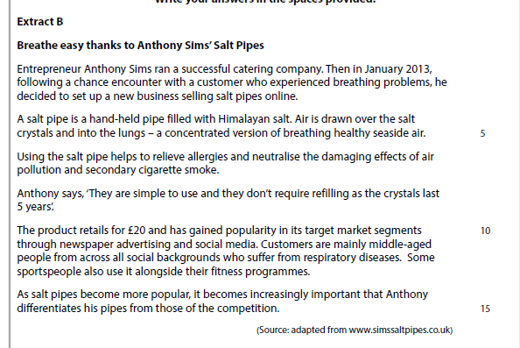
Case study for question 1

Slide 41
Sample question 1
Knowledge 1
Application 2
Analysis
1

Slide 42
Answer sample question 1

Slide 43
Glossary
profit maximisation; the aim of the business is to make as high profits as is possible in the time frame
profit satisficing; the aim of the business is to make just enough profit to satisfy the owners but with other managers objectives
ethical stance; to trade in a way that is respectful of people, animals, or the environment.
social entrepreneurship; to trade with the goal of helping the community in some way
Independence; to trade in a way which meets the entrepreneur's own goals and allows them to be their own boss
home working; to work from home, for example an eBay business

