Slide 1
Edexcel A2 Business
2.5.2 Legislation
Revisionstation

Slide 2
Worksheet

Slide 3
From Edexcel
a) The effects on businesses of:
consumer protection
employee protection
environmental protection
competition policy
health and safety

Slide 4
Starter
Have you ever had anything that you had to take back to a shop? What happened?

Slide 5
Definition: Legislation
A set of laws suggested by government and made official by parliament

Slide 6
The effects on business of legislation

Slide 7
Legislation introduction
You don’t need to know the dates of the laws
You do need to be able to discuss the effect of the law on business e.g. how the new minimum wage will increase the costs of the business and so the business is less profitable as a result
Legislation falls into these 5 categories:
consumer protection
employee protection
environmental protection
competition policy
health and safety
Get ready to make some notes on these laws
consumer protection
employee protection
environmental protection
competition policy
health and safety

Slide 8
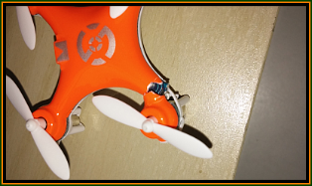
#1 Consumer Protection Law
Consumer Rights Act 2015
The law protects consumer rights when they buy goods or services.
Customers have legal rights if the item you bought is:
broken or damaged ('not of satisfactory quality')
unusable (‘not fit for purpose’)
not what was advertised or doesn’t match the seller’s description
Can you match the problems to the photos?
A
B
C

Slide 9
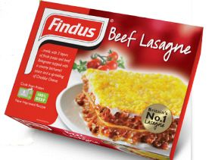
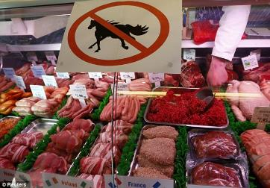
#1 Consumer protection effect on business
Under the consumer protection act a business must not give false or misleading information about products
E.g. fake designer handbags marked as genuine are in breach of the act
Under the act, unhappy consumers can claim a refund, replacement, repair or price reduction, what kind of impact will this have on cost, reputation and profitability?

Slide 10
#2 Employee protection
The UK government has, over time, passed lots of laws designed to help and protect the UK worker.
These acts makes sure the UK worker gets paid when they are sick, gets paternity and maternity pay, is not discriminated against, gets a fair wage and is treated equally.
A UK business has to follow these laws, what kind of impact will this have on costs and global competitiveness?
Employment Rights Act 1996
Minimum Wage Act 1998
Working Time Regulations 1998
Pensions Act 2008
Equality Act 2010

Slide 11
#2 Employee protection: Employment Rights Act
States duties and rights of the employer and employee
Includes the employee’s rights to maternity and paternity leave
Details regarding termination of employment
Right to a written contract of employment within 60 days of starting work

Slide 12
#2 Employee protection: National Minimum Wage Act
Applies to nearly all workers and sets hourly rates below which pay must not be allowed to fall
Paying the minimum wage will raise costs for a business
This may have an impact on their profit margins or profitability
Failure to do so can result in fines or prosecution
Watch the video, can you now explain minim wage?

Slide 13
Suggested activity – minimum wage
Carry out some research into the current levels of minimum wage
What is the amount for your age group?
How much would this be for a 48 hour week?
What is the National Living Wage?
How is this different from the minimum wage?

Slide 14
#2 Employee protection: National living wage
The National Living Wage is higher than the National Minimum Wage - workers get it if they’re over 25.
This is projected to rise to £9 an hour by 2020
Businesses that fail to pay it could face maximum penalty of £20,000 per worker.
Watch the video, can you now explain the national living wage rate and how it compares to the minimum wage?
Notes:
For over 25s

Slide 15
#2 Employee protection: Working Time Regulations 1998
These regulations makes sure that there is a limit of 48 hours in a working week (though workers can choose to work more if they want to)
Workers also have the right to 11 hours rest a day and the right to a day off each week and the right to an in-work rest break if the working day is longer than 6 hours and the right to 4 weeks paid leave per year
How will these regulations have an impact on employee productivity and profits?

Slide 16
#2 Employee protection: Pensions Act 2008
Under the Pensions Act 2008, every employer in the UK must put their qualifying employees into a pension scheme and pay contributions. This is called ‘automatic enrolment’
Once the business has set up a pension scheme and put their eligible staff into it, then they must continue to make the payments that are due into the scheme every month
The Pensions Regulator monitors the contributions that are paid into workplace pensions, and will fine the business is they are not being paid
How will this have an impact on business competitiveness and costs?
Can you explain what a pension is and what your rights are when you start a job?

Slide 17
#2 Employee protection: Equality Act 2010
The Equality Act 2010 legally protects people from discrimination in the workplace
It replaced previous anti-discrimination laws with a single Act
A business needs to make sure that it complies with the law during recruitment and during the contract term of the employee
Watch the video, can you now explain how the Equality Act 2010 protects employees from discrimination?

Slide 18
#3 Environmental protection
Polluted air, noise pollution and chemical spills are some examples of how business can have a negative impact on the environment
The Environmental Protection Act of 1990 attempts to control pollution in terms of business waste that is disposed of in the air, on land and in the sea
How do you think this act will impact a business?
Notes:
Raise costs

Slide 19
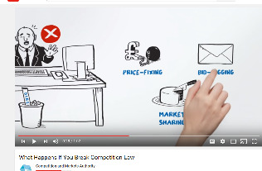
#4 Competition policy
Legislation in place by the government designed to prevent collusion – price fixing by businesses getting together and agreeing a price to charge for their products
CMA is the competition and Markets Authority who are independent regulators
The CMA aims to “promote competition for the benefit of consumers”
They investigate mergers that restrict competition
Watch the two videos then try the activity on the next slide

Slide 20
Suggested activity – CMA investigation
Have a look at the CMA website and click on the CMA cases
Find a case you are interested and dig a little deeper into the detail, make some notes about the case
Explain to your group about the case, why the CMA are involved and what the current status of the case is.
How will being investigated by CMA impact a business?
Notes:
May stop a merger, which could be very expensive if paperwork and negotiations have already taken place.

Slide 21
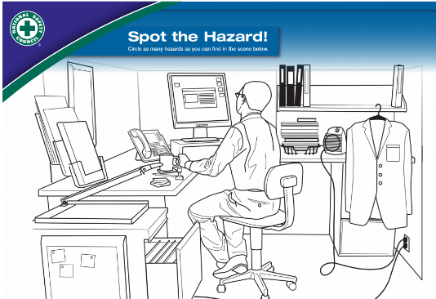
#5 Health and Safety at Work Act: workplace hazard
In general, health and safety laws apply to all businesses
As an employer, or a self-employed person, they are responsible for health and safety in the business
Health and safety laws are there to protect the owners, the employees and the public from workplace dangers
Spot the workplace hazard, click on the graphic to download a PDF with several examples and answers

Slide 22
#5 Health and Safety at Work Act: employer duties
Prevent accidents and cases of work-related ill health by managing the health and safety risks in the workplace
Provide clear instructions and information, and adequate training, to ensure employees are competent to do their work
Engage and consult with employees on day-to-day health and safety conditions Implement emergency procedures – evacuation in case of fire or other significant incident.
Maintain safe and healthy working conditions, provide and maintain plant, equipment and machinery, and ensure safe storage / use of substances

Slide 23
#5 Health and Safety at Work Act
All workers have a right to work in places where risks to their health and safety are properly controlled.
Health and safety is about stopping you getting hurt at work or ill through work.
The employer is responsible for health and safety, but the employees must help.
Watch the video, can you explain the impact that Health and Safety might have on a business
Notes:
Costs would rise

Slide 24
Impact of legislation on business cost
A business will have to meet all of the consumer, employment and recruitment laws
This may mean additional costs
Training staff
Protection equipment for staff e.g. hairnets or googles
Cost of paying NMW
How will higher costs have a an impact on the business?
Notes:
Impact on profit margins

Slide 25
Impact of legislation on business training needs
Businesses will need to make sure that all their employees are trained and that the training is up-to-date
This will make sure that the business is legally compliant
This way the owners of the business will not face fines or prison
Have you ever had any training?
Notes:
Some students may have jobs that include H&S training like working at height or lifting

Slide 26
Impact of legislation on business recruitment
Race, sex, age or disability discrimination is illegal in UK business, so businesses must be careful to recruit within the equality law
They must offer equal pay and promotion opportunities for women and ethnic minorities

Slide 27
Sample Edexcel A2 questions

Slide 28
Case study for question 1

Slide 29
Sample question 1
Knowledge 2
Application 2
Analysis
3
Evaluation
3

Slide 30
Answer sample question 1

Slide 31
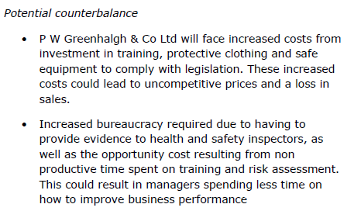
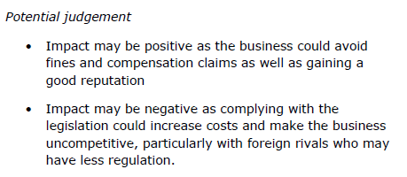
Answer sample question 1

Slide 32
How to level sample question 1

Slide 33
Case study for question 2

Slide 34
Sample question 2
Knowledge 2
Application 2
Analysis
3
Evaluation
3

Slide 35
Answer sample question 2

Slide 36
Answer sample question 2

Slide 37
How to level sample question 2

Slide 38
Glossary
consumer protection; legislation put in place to make sure that consumers are protected when buying products or services in the UK
employee protection; legislation put in place to protect the rights of employees in UK businesses
environmental protection; legislation put in place to ensure that business recycles and managers their waste effectively
competition policy; legislation put in place to promote competition for benefit of consumers, prevent abuse of monopoly power, prevent collusion and prosecute cartels
health and safety; legislation put in place to ensure the health and safety of every worker in a UK business regardless of their trade

