Slide 1
Edexcel A2 Business
3.5.1 Interpretation of financial statements
Revisionstation

Slide 2
Worksheet

Slide 3
From Edexcel
Statement of comprehensive income
(profit and loss account):
key information
stakeholder interest
b) Statement of financial position
(balance sheet):
key information
stakeholder interest

Slide 4
Starter
Have a think about your life for a moment. Any volunteers to discuss:
1) What tech you own e.g. Phone, Xbox, laptop and so on.
2) What money you owe to other people e.g. £10 to a mate, £5 on school food bill

Slide 5
Statement of comprehensive income
(profit and loss account)

Slide 6
Statement of comprehensive income defined
This used to be called the profit and loss account, so if you are googling for revision you may need to know that. This is part of the legal documents that must be published each year by ltd or plc companies.
This document shows if the business has made a profit or a loss during the year

Slide 7
Key information on a profit and loss? (SOCI)
Revenue
Gross profit
Expenses
Operating profit
This is a sample paper 2 from Edexcel, this is a mixture of the balance sheet and the profit and loss – which is why the title says “adapted”

Slide 8
Revenue
Revenue is money into the business through ordinary trading. It is also known as turnover or income.
Formula for sales revenue is
Q x P
Where Q = quantity and P = price

Slide 9
Gross profit
GP = Revenue – cost of sales
The cost of sales is the cost of the stock that is to be sold as part of ordinary trading for the business
Gross profit is used by the mangers of the business

Slide 10
Expenses
Expenses are costs to the business that have nothing to do with stock or the making of the product
Examples are;
Administration
Advertising
Petrol

Slide 11
Operating profit
Operating profit = GP-expenses
Operating profit is a true measure of how much profit (or loss) the business has made over the year – before tax is deducted
This information is used by potential investors of the business to see how hard their money would work if it was invested into the business

Slide 12
Examples
The really awesome thing about financial accounts is that every business has a slightly different way of showing the details
They also have different terms e.g. revenue might be called turnover or income
So they all look different, the key is to look at as many examples as possible – see the next few slides
Notes:
Also point students to look at online company accounts of businesses that they are interested in.

Slide 15
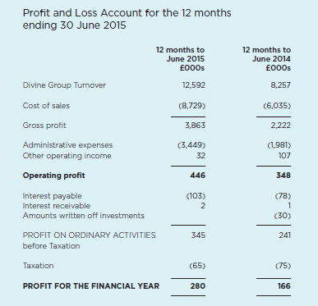

Slide 16
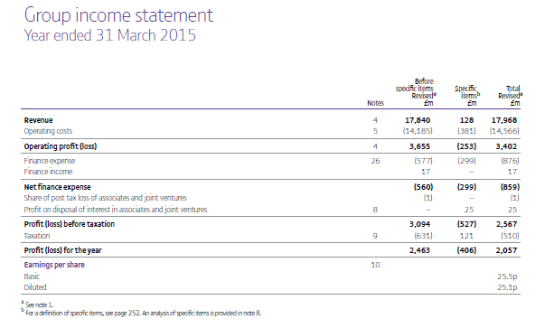

Slide 17
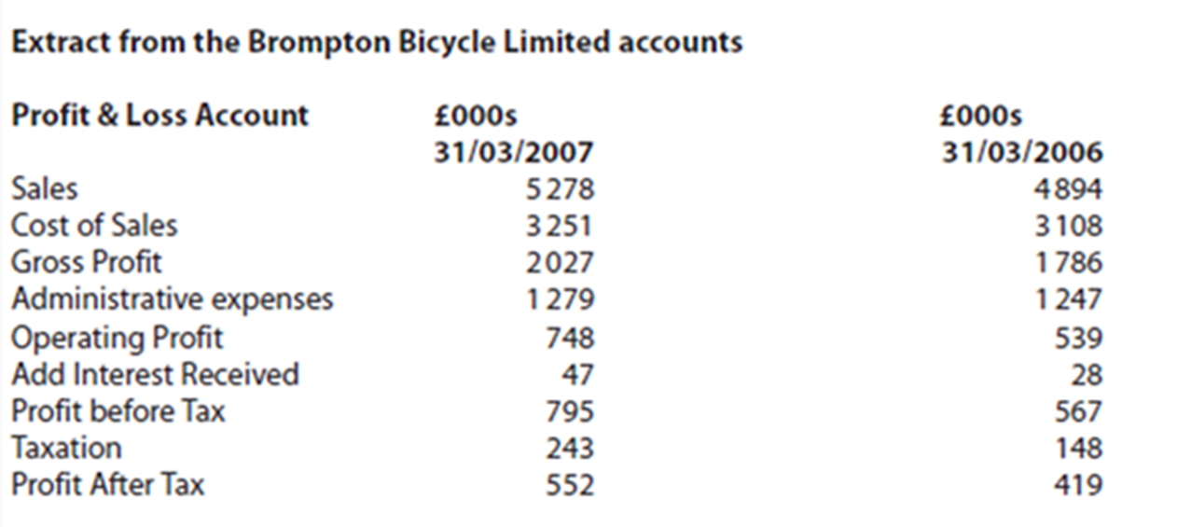

Slide 18
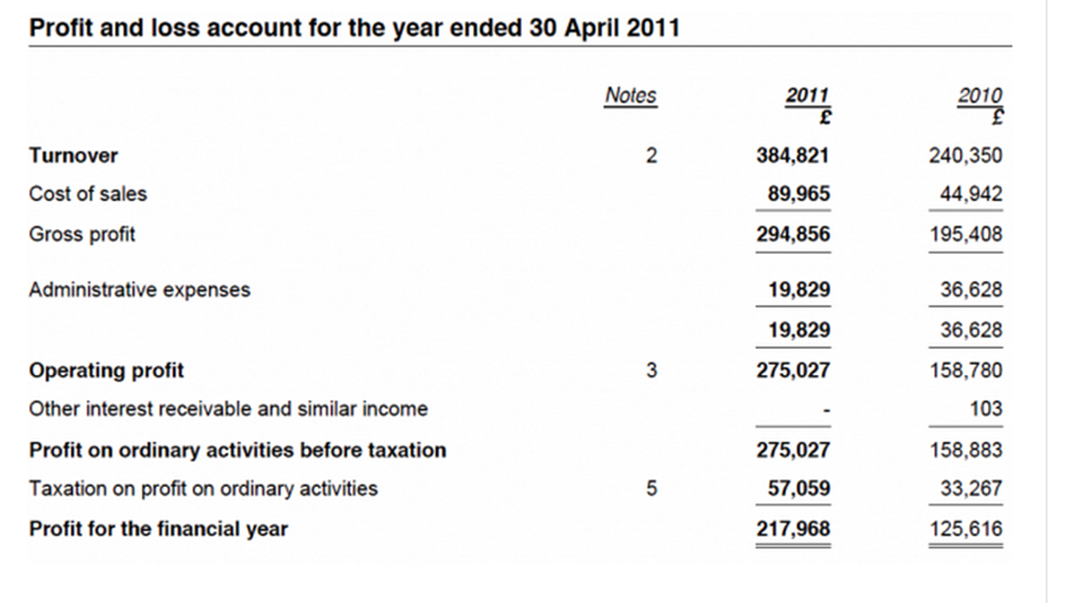

Slide 19
Sales
Cost of sales
Gross profit
Admin expenses
Operating profit
Add Interest received
Profit before tax
Taxation
Profit after tax

Slide 20
Sales | Sales revenue or sales turnover is the money made by the business in normal trading, this is only recorded when goods are delivered to customers
Cost of sales | Cost of sales, or cost of goods is the direct costs to make the goods that have been sold; raw materials , wages, labour
Gross profit | Gross profit = SR - COS
Admin expenses | Expenses are costs not involved in producing the goods; advertising, promotion, wages of admin staff
Operating profit | OP = GP – expenses
Add Interest received | Interest received form any retained profits kept in a bank or investments made
Profit before tax | This used to be called net profit
Taxation | Corporation tax paid to the government
Profit after tax | How much the business can keep, retained profit to reinvest next year

Slide 21
Stakeholder interest
Shareholders – want to know the final profit figure which dividends will be paid out on
Investors – want to know the profitability of the business – is it worth investing or will it be a risk?
Employees and managers – may wish to know the expenses of the business

Slide 22
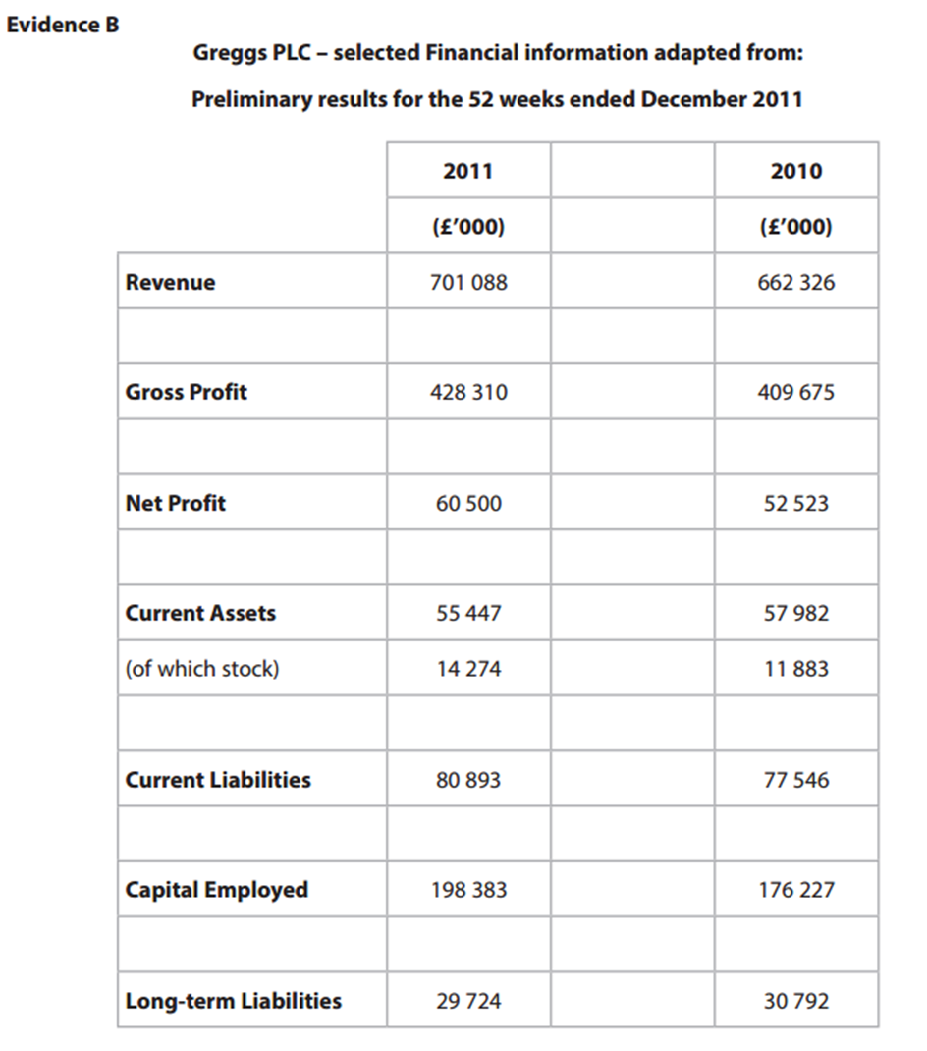
A word of caution
Edexcel like to mix the profit and loss and balance sheet information to suit the question – so don’t expect to see it neatly divided sometimes they mix it up – but not always!

Slide 23
Statement of financial position
(balance sheet)

Slide 24
Statement of financial position defined
This is the other document that needs to be published as part of the annual business accounts. This document used to be called the balance sheet – for googling purposes.
This document shows what the business owns and owes on one day of the year.
It is often described as a snapshot of the business.
A = L + C
Where assets = liabilities plus capital
In other words - What did the money in the business get spent on?
The two sides must balance – hence the term balance sheet

Slide 25
Key information on a balance sheet (SOFP)
Current assets
Non-current assets
Current liabilities
Long-term liabilities
This is an exam question Jun 17 Paper 2
This is a mixture of the two statements
Profit shown is from the profit and loss statement

Slide 26
Current assets
Current assets are items that the business owns that will pay the business in under 1 year. Three things fall into this category:
Stock (inventory) because it will be sold and turned into cash within 1 year
Debtors – those that owe the business money, such as customers who will pay within 1 year
Cash - already is cash
Stock – current asset

Slide 27
Non-current assets (fixed assets)
Fixed assets are items that a business owns but that will pay the business back after 1 year
Examples;
Machinery e.g. plant equipment
Vehicles e.g. company van
Property e.g. factory, warehouse that is owned by the business
Digger – fixed asset

Slide 28
Current liabilities
These are items that the business owes, that need to be paid by the business, within 1 year
Example;
Trade payables, this means payments that need to be paid to suppliers
Supplier – current liability

Slide 29
Long-term liabilities
These are items that the business needs to pay, but that is not due for total payment within one year
Example;
Loan e.g. 10 year loan with monthly payments
Retirement provision e.g. pension fund monthly payments
Loan - long-term liability

Slide 30
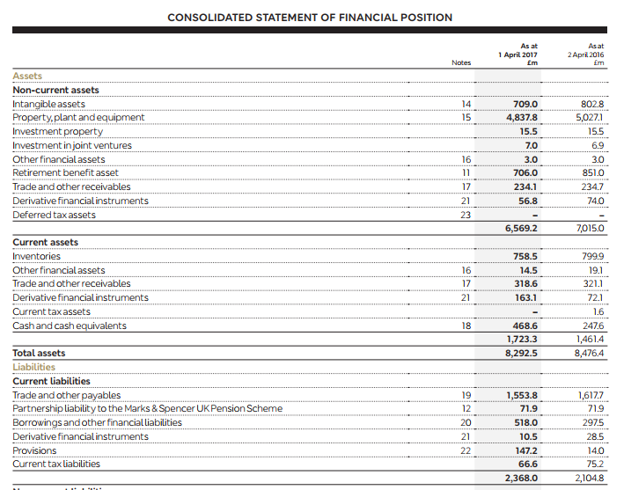

Slide 31
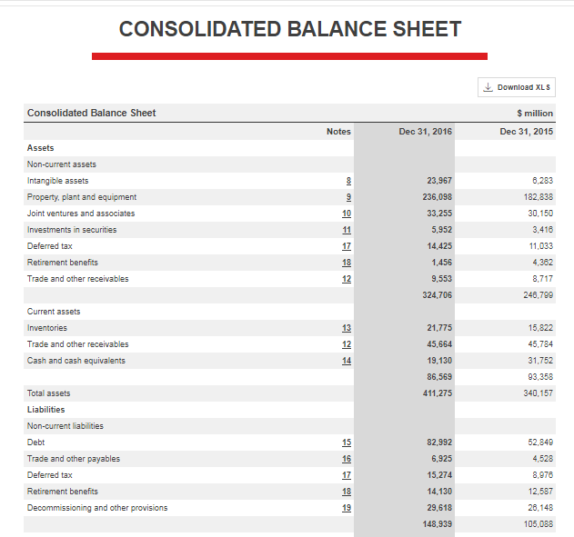

Slide 32
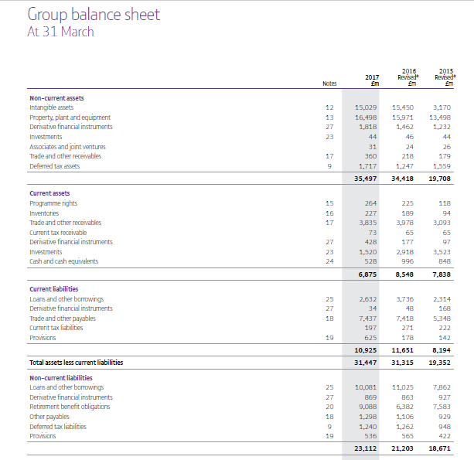

Slide 33
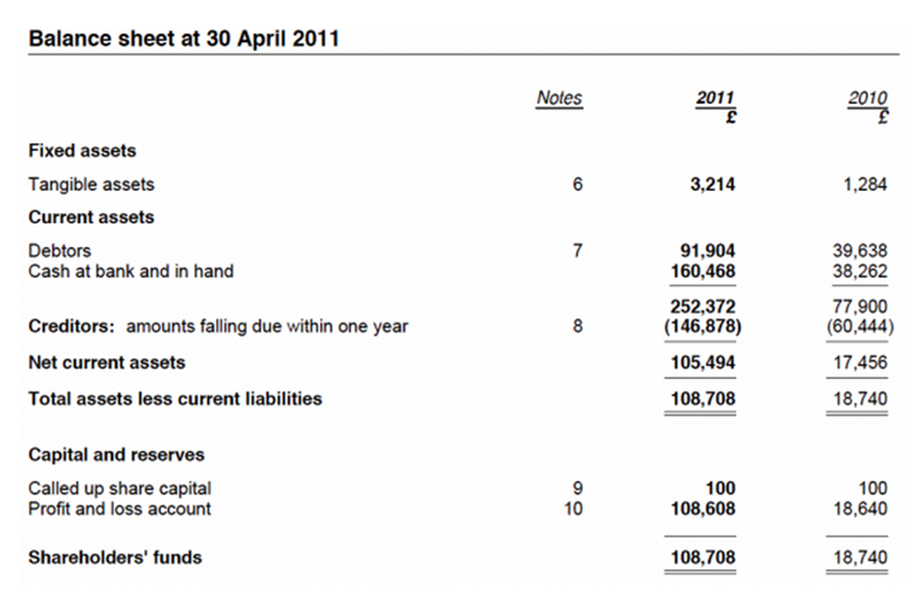

Slide 34
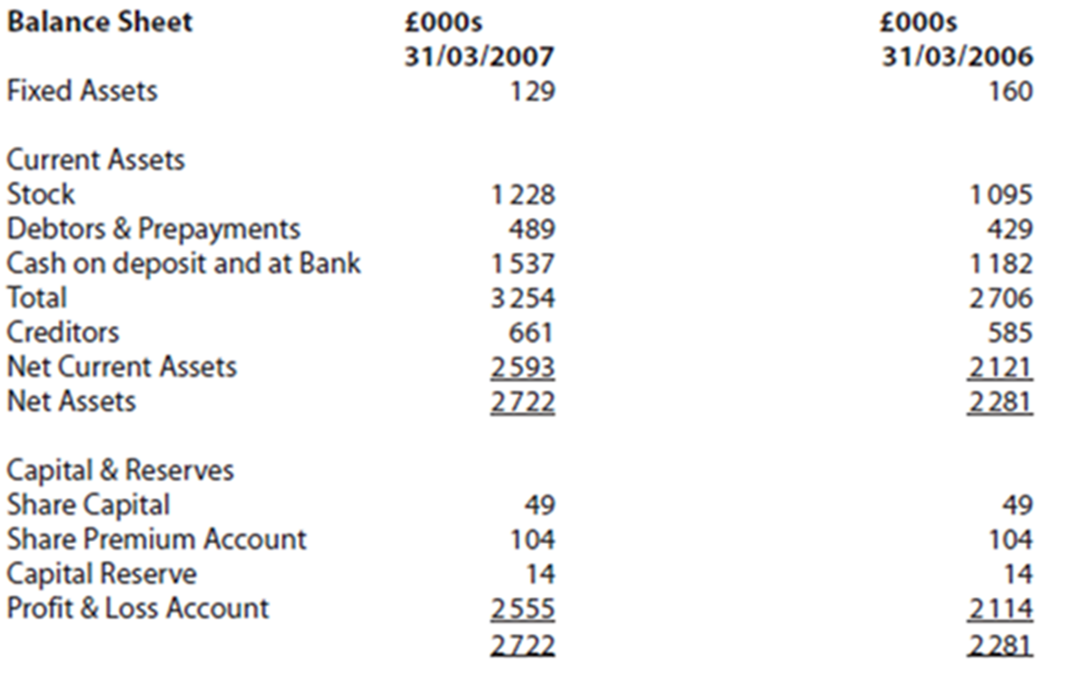

Slide 35
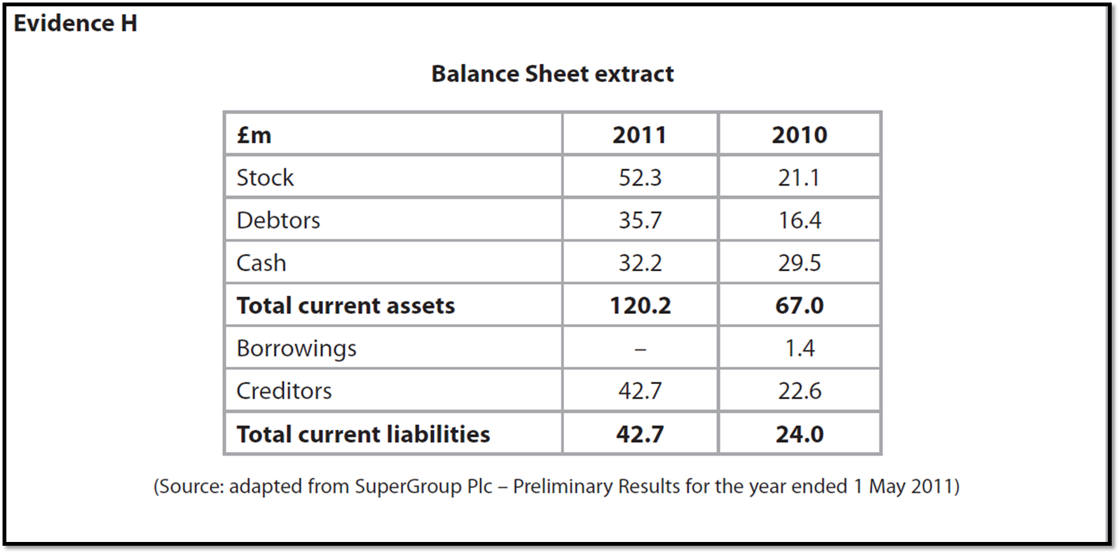

Slide 36
Fixed assets
Current assets
Stock
Debtors and Prepayments
Creditors
Capital reserves and share capital
Share premium account

Slide 37
Fixed assets | An item that the business owns that it intends to use for more than one year in trading e.g. van, machine
Current assets | Items in the business which it intends to turn into cash within a year, include stock, debtors, cash
Stock | Stock includes work in progress and finished goods not yet delivered to customers
Debtors and Prepayments | Debtors owe the business and will pay within a year, a prepayment may be on a bill that has to be paid in advance of the year it is used
Creditors | Creditors are suppliers to the business that money is owed to
Capital reserves and share capital | Share capital, amount of money paid by shareholders for shares when originally issued, not the current value of shares Capital reserves are the increase of some fixed assets, for example land may be worth more now than it was purchased for years ago, that value must go somewhere
Share premium account | Difference between nominal (original) value of the share and the issued value

Slide 38
Stakeholder interest
Governments will use the financial information to calculate the amount of tax (VAT and corporation tax) that a company has to pay
Shareholders will analyse the accounts and decide whether their investment capital is being used effectively
Directors and senior managers will use the accounts to assist their medium and long-term planning
Potential investors will analyse the accounts to determine whether or not the company would make a good investment
Creditors will use the accounts to ascertain the company’s ability to pay their bills

Slide 39
Sample Edexcel A2 questions

Slide 40
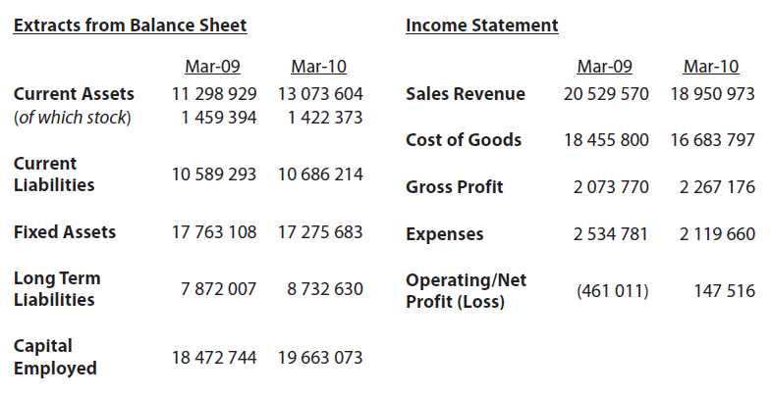
Case study for question 1

Slide 41
Sample question 1
Notes:
Probably won’t be able to do this question until you tackle 352

Slide 42
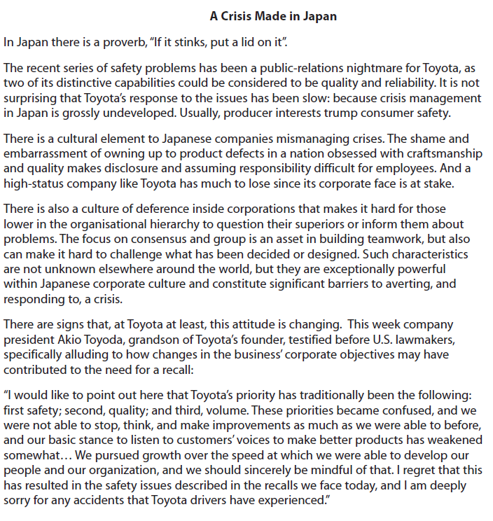
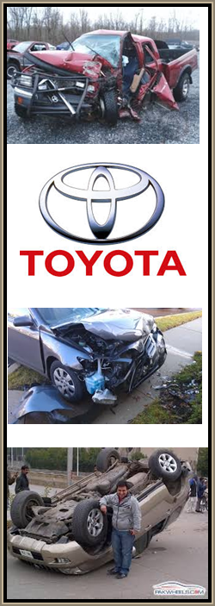

Slide 43
Answer question 1 - calculations
 | 2009 | 2010
Gross Profit Margin | 10.10% | 11.96%
Net Profit Margin | -2.24% | 0.77%
ROCE | -2.49% | 0.75%
Current ratio | 1.06:1 | 1.22:1
Acid ratio | 0.92:1 | 1.09:1
Gearing | 42.61% | 44.41%
Students need to give the formulas for the ratios for knowledge marks. This is how they should kick start the question
Notes:
GPM – gross profit margin
NPM – net profit margin
ROCE – return on capital employed

Slide 44
Answer question 1 – analysis, continued on next slide
e.g. Toyota’s profitability as measured by the GPM and NPM and ROCE has
Improved, this means that Toyota is turning sales/ capital into profits more
effectively
e.g. liquidity as measured by the current and acid test ratio has also improved
e.g. liquidity was below 1 as measured by the acid test ratio in 2009 which
suggested Toyota was unable to meet its current liabilities
e.g. small difference between acid test and current ratios reflects lean
operations at Toyota
e.g. Gross Profit Margin has not changed a huge amount, so it is
suggested that expenses for Toyota was the problem in 2009 (due to the
costs of recalls)
e.g. other relevant information might include: sales information; reputation;
diversification of the business; business growth etc.

Slide 45
e.g. NPM rising, but still low which suggests expenses associated with recall could still be harming profit
e.g. Gearing creeping up, which is not a problem in a low interest environment, but would be if interest rates began to rise.
e.g. The financial information might say one thing, but intangible measures such as reputation and brand trust might have been lost forever.
e.g. financial performance of the business is only one aspect – this will be of interest to shareholders and managers
e.g. the car industry has been affected by difficult external economic factors
(recession) and it would be useful to compare Toyota’s information to a range of Competitors
e.g. in the past Toyota has been concerned with the long-term profitability of the business and will be less worried about short-term decreases as long at the brand value is maintained
e.g. the short-term expense of the recall will be worth it if the reputation and safety of the business and its customers is safeguarded.
e.g. financial information is only a ‘snapshot’ of performance and may be inaccurate; therefore judgements made on this should be kept in context.
e.g. Toyota is a business in a highly competitive market and therefore financial performance is paramount in determining its success. Ratio analysis suggests they have had a very difficult period between 2009 and 2010 however this has occurred

Slide 46
Glossary
Profit and loss; A Legal financial document that shows the revenue and expenditures of a business over a year
Balance sheet; A legal financial document that shows the valuation of a business on one particular day
Asset; An item owned by the business
Liability; Monies owed by the business to others
Capital; Financial resources in a business
Solvency; The degree to which the current assets of a business exceed the current liabilities
Liquidity; How easily the business can convert their assets into cash
Profitability; The ability of a business to earn a profit

