Slide 1
Edexcel A2 Business
3.2.3 Organic Growth
Revisionstation

Slide 2
Worksheet

Slide 3
3.2.3 Organic Growth
a) Distinction between inorganic and organic growth
b) Methods of growing organically
c) Advantages and disadvantages of organic growth

Slide 4
Starter
Cargo Throwing? Garroting Chow? Warthog Coring? A Torching Grow?
Notes:
All anagrams of Organic Growth

Slide 5
Organic Growth defined
Organic growth is the process of business growth which comes from within the business, as opposed to mergers and takeovers.

Slide 6
Distinction between inorganic and organic growth

Slide 7
Organic Growth
Organic growth does not involve another business taking over or merging with it. This can be achieved through:
> new product launches
> opening new stores/branches
> expanding into foreign markets
> increasing the workforce

Slide 8
Assess the strength behind Greggs strategy:
https://www.theguardian.com/global/2016/mar/05/greggs-conquered-britain-bakery-profit-sausage-rolls

Slide 9
Adv: > Less expensive in SR > Less risk (greater control) > Maintain management & cult. > Easier to plan
Dis:
> Slow > Limits growth availability compared to competitors

Slide 10
How I Started The UK's Fastest Growing Company: My Gymshark Story | Ben Francis
https://youtu.be/MpftE7RwQnM
Summarise the ways in which Gymshark grew organically.

Slide 11
BBC Start Up Stories: Innocent Drinks
https://youtu.be/SFcCqkT4ATQ
Summarise the ways in which Innocent Drinks grew organically.

Slide 12
Inorganic growth
This means that a business has grown by buying its way into being larger, this may be through;
A merger
A takeover (also known as an acquisition)
A joint venture
Example: SmithKline Beecham plc (UK) and Glaxo Wellcome plc (UK) in 2000 to become GlaxoSmithKline

Slide 13
Organic growth
Organic growth means that the business has grown from within
The business has grown within itself without a merger or takeover with another business
This may be through;
Increasing the product range
Opening more branches
Taking on more staff

Slide 14
Methods of growing organically

Slide 15
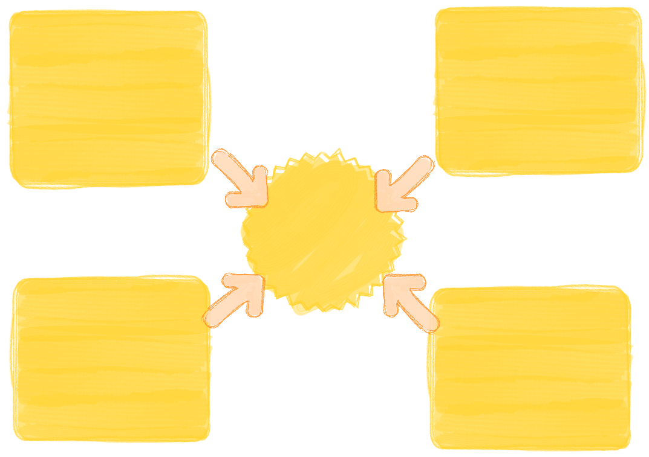
Methods of organic growth
There are lots of ways that a small business can grow , many are industry specific, but the ones your exam board would like you to know are:
New product launches
Opening new stores or branches
Expanding into foreign markets
Expansion of the workforce

Slide 17
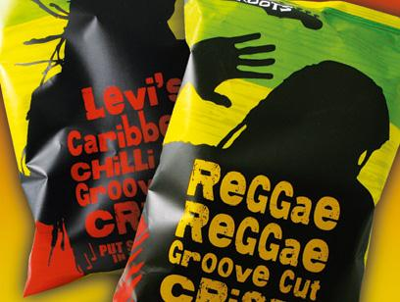
#1 New product launches
A business can grow from within by launching new products
If the risk pays off then the business will be able to enjoy increased revenue and profits
Tesco Komodo Dragon Chillies hit the shelves see video here
Reggae, Reggae crisps, and drinks
See here

Slide 18
#2 Opening new stores
A business can grow organically by opening a series of new stores or outlets
In 2016 H&M’s expansion target was 10-15% with a planned opening of 400 new stores in the UK, China and America

Slide 19
#3 Expanding into foreign markets
A business can grow organically by expanding into foreign markets
For example Marks and Spencer aims to open 250 stores outside the UK, including 20 sites in India
It also plans to open 20 stand alone food stores in Paris and some new stores in the Middle East
Marks and Spencer annual report 2017

Slide 20
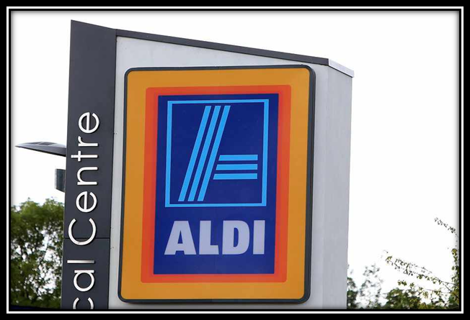
#4 Expansion of the workforce
A business can expand organically by taking on new staff
Discount supermarket Aldi has unveiled a £600 million expansion which includes hiring 8,000 more staff and opening hundreds of new stores
The supermarket is aiming to increase its UK workforce to 35,000, as well as open 130 new stores in the two-year planned investment, which it says will lay the foundation for 25 years of growth.

Slide 21
Advantages and disadvantages of organic growth

Slide 22
Advantages of organic growth
This avoids all the risks and pitfalls of merging with another business
Cheaper than merging
Retains the company culture
Can be planned for unlike a takeover
Higher production means EOS and lower average costs
More influence comes with more market share, can start setting prices for the industry

Slide 23
Disadvantages of organic growth
This is a very high risk strategy, opening lots of stores and taking on thousands of new staff is very risky and capital intensive
Long period between investment and return on investment
Growth may be limited and is dependent on reliability of sales forecasts
New markets and countries can be dangerous to enter into without buying a business already operating in that country
Starbucks failed in Australia as they tried to teach the Australian people what and how to drink coffee “decaff mocha grande” Video here

Slide 25
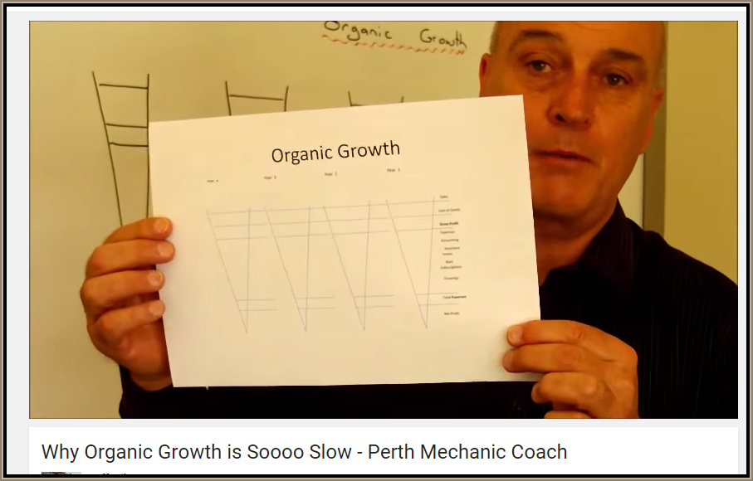
Revision Video

Slide 26
Sample Edexcel A2 questions

Slide 27
Case study for question 1

Slide 28
Sample question 1
Knowledge 2
Application 2
Analysis
4
Evaluation
4

Slide 29
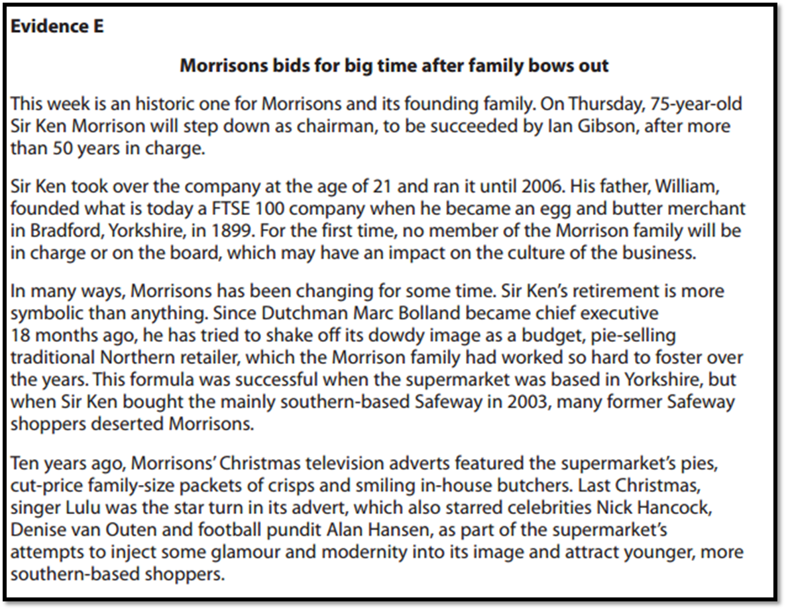
Case study for question 2

Slide 30
Sample question 2
[4]
Knowledge 2
Application 2

Slide 31
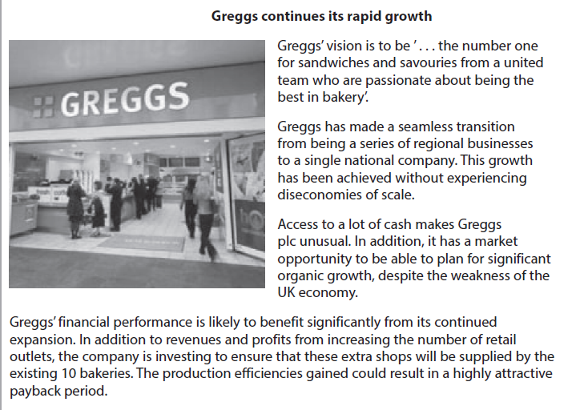
Case study for question 3

Slide 32
Sample question 3
[4]
Knowledge 1
Application 1
Application 2

Slide 33
Glossary
Organic growth; growth of a business that does not involve another business
Inorganic growth; growth through mergers, takeovers (acquisitions) or joint ventures which all involve other businesses
Cash flow; the inflow and outflow of cash in a business
Liquidity; the ability of a business to turn its assets into cash to pay its liabilities
Economies of scale; the benefit of growing larger to a business
Diseconomies of scale; the disadvantage of growing too large for a business
Income elastic; demand for a product may depend on price, how much that demand changes determines the elasticity of the item e.g. insulin is inelastic as a patient who needs it will need to buy it no matter what the cost

