Slide 1
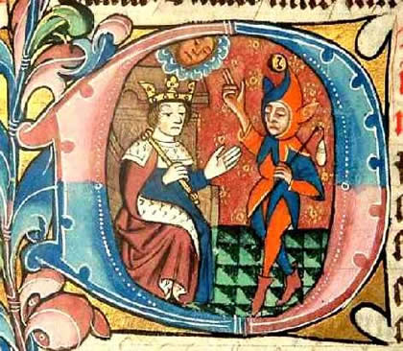
Fools of Logic
Key question:
How can I avoid sounding like a muppet in
my exam answers?

Slide 2
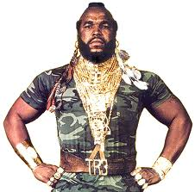
Fools of Logic
I pity the fool!
How not to be one

Slide 3
Vocabulary of Non-muppetry
absolute – always true/always false; no exceptions
relative – sometimes true/sometimes false; it depends
subjective – a matter of feelings or opinion
objective – a matter of fact
spurious – false, untrue
oxymoron – something that is a contradiction in terms (e.g. a red albino)
https://www.youtube.com/watch?v=U-jHM-mDkrc

Slide 4
What is proof?
Logical arguments have four possible outcomes:
The argument is proven to be correct.
The argument is likely to be correct.
The argument is likely to be incorrect.
The argument is proven to be incorrect.

Slide 5
What is proof?
Very few philosophical arguments from any side of a debate can actually prove something beyond all doubt.
This is not a great surprise because if it were proven beyond all doubt why would anybody be debating it?
Most good philosophical arguments strongly suggest something is true or make it likely that it’s true but don’t quite prove it.
Some philosophical arguments are poor.
Be therefore very careful of the words ‘proof’ and ‘proven’.

Slide 6
Warning:
The following slides contain some categories of real-life idiocy.
Intelligent, sarcastic viewers may find some slides utterly contemptible.
This presentation aims to be even-handed by bashing theists and atheists in equal measure.
This may be unsuitable for people who take themselves too seriously.

Slide 7
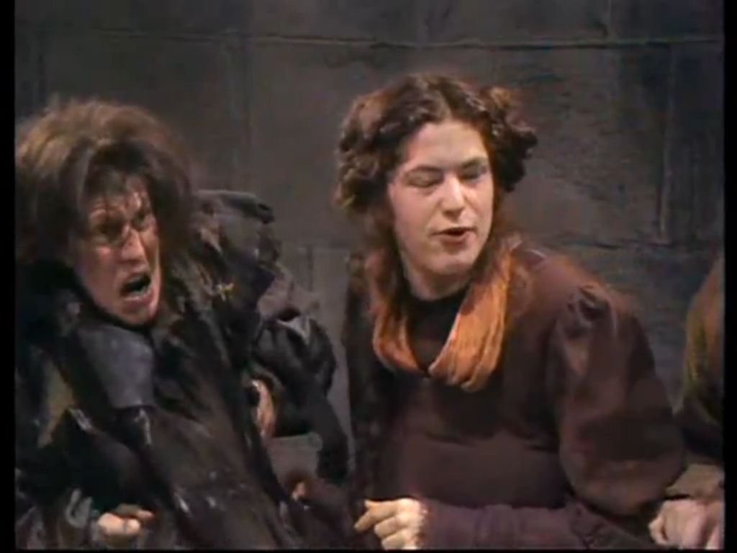
Subjective statements presented as fact
LOOK AT HIS HAIR!
His hair proves it.

Slide 8
Subjective statements presented as fact
‘Subjective’ means something that is a matter of feelings or opinion.
Textbooks and the media sometimes present opinions as facts.
This is misleading because you are being forced into accepting something that might not be true.
You should avoid doing this in your exam answers.

Slide 9
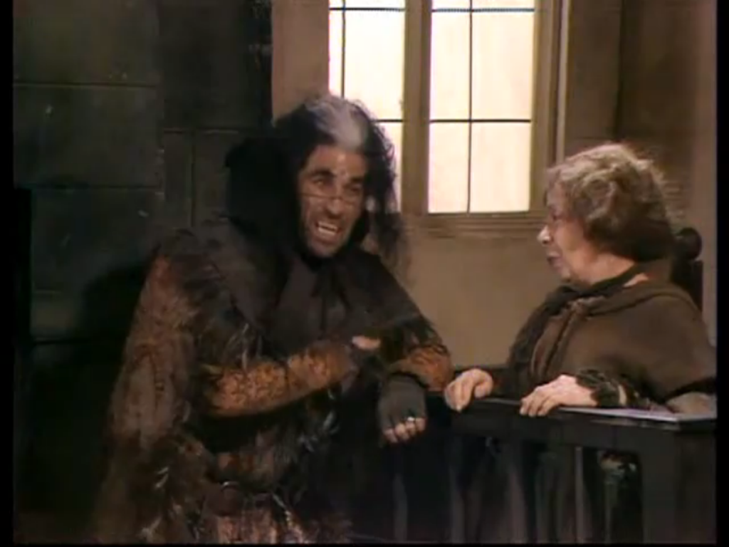
Evidence presented in a slanted way
Information my be biased and inaccurate.
Emotive language designed to make you think a certain way.
Certain important facts left out in order to keep you in the dark.
Can anyone see this son of Satan here in the court?

Slide 10
The circular argument
God exists
God says that the Bible is true.
The Bible is true.
The Bible says that God exists.

Slide 11
The circular argument – David Hume
Miracles don’t exist.
A miracle is a breaking of the laws of nature.
A law of nature is when people have observed that something always happens (e.g. gravity).
Anyone who observes that a law of nature has not happened cannot be believed.

Slide 12
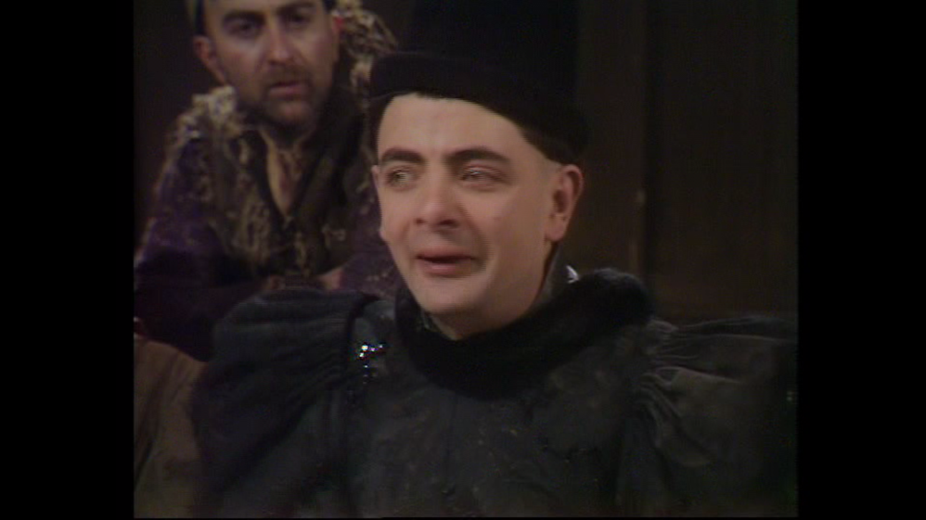
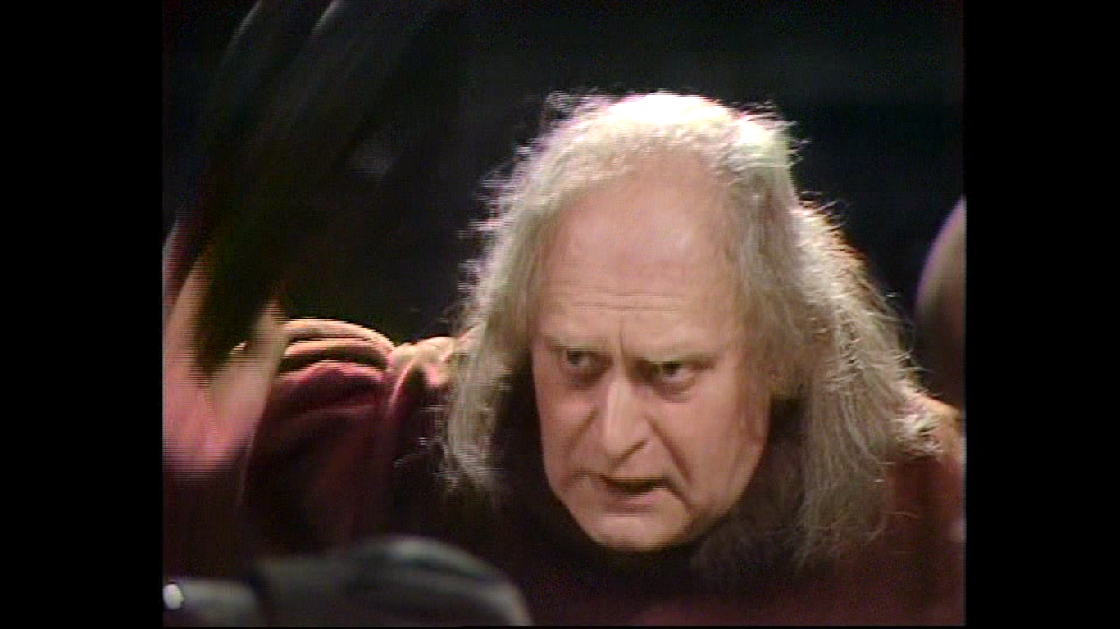
The logical leap
Next you’ll be telling me that washing your hair in bat’s droppings stops you going bald?
But it’s true! I couldn’t find enough bats and look what happened.
This is when the conclusion has been jumped to even though the evidence does not prove it.

Slide 13
The logical leap
Global temperatures are the highest on record.
CO2 is a greenhouse gas produced in greater amounts than ever before by humans.
Therefore human activity is causing global warming.
Overlooked facts:
CO2 is only 0.04% of the earth’s atmosphere even now.
Historic climate changes happened long before humans took over the earth (e.g. the end of the Ice Age).
Changes in solar activity and volcanic activity rates affect the earth’s atmospheric temperature.

Slide 14
The logical leap
In pairs examine what is wrong with this logic.
Eye witnesses say it goes cold when a ghost is around.
My room was cold last night.
There must have been a ghost in my room.

Slide 15
The oxymoron
This is when an argument contradicts itself.
‘All generalisations are wrong.’
‘There are no absolutes of right and wrong.’
This statement is absolute and therefore disproves itself!

Slide 16
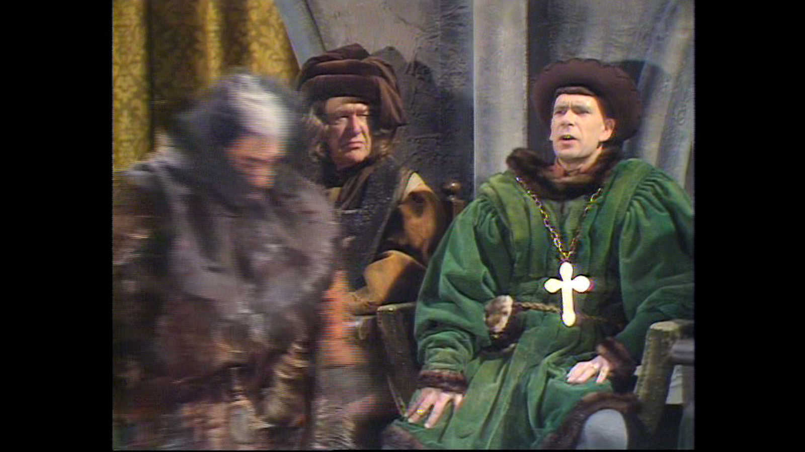
Dismissing the evidence unfairly
Who will defend the accused?
… Oh yes, that’s me.
My lord, how can we listen to the pleadings of a man who may himself be a witch?
You’re absolutely right. That concludes the case for the defence.
This statement is absolute and therefore disproves itself!

Slide 17
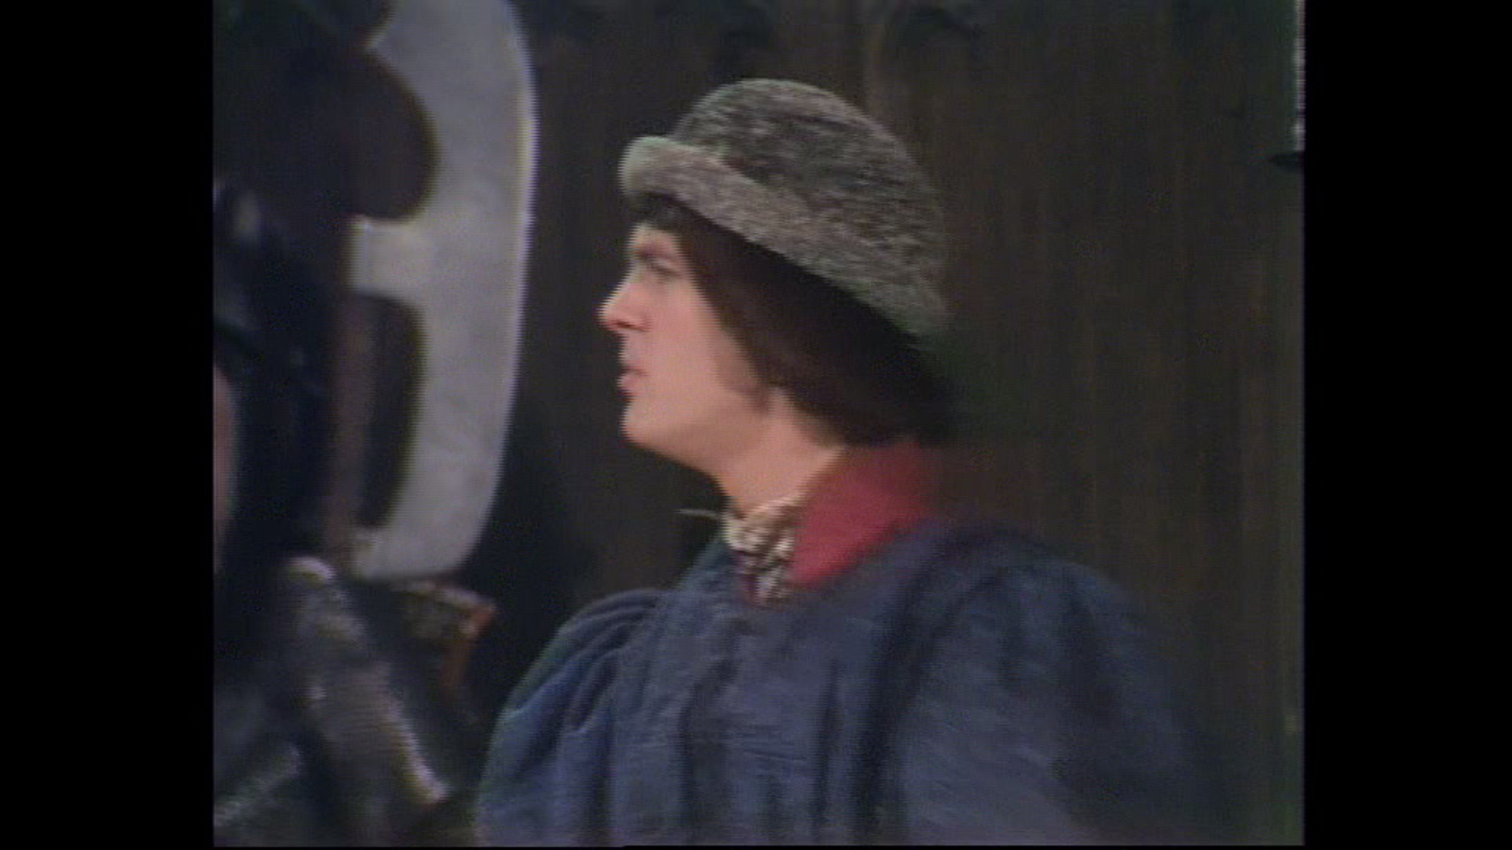
Dismissing the evidence unfairly
Thank you, Lord Percy.
‘The Bible was written a long time ago so there’s no reason why we should believe it.’
‘John Stewart Mill was an atheist so his point of view on the Design Argument is biased and should not be believed.’
Discuss and write down what specifically in detail is wrong with these two statements.

Slide 18
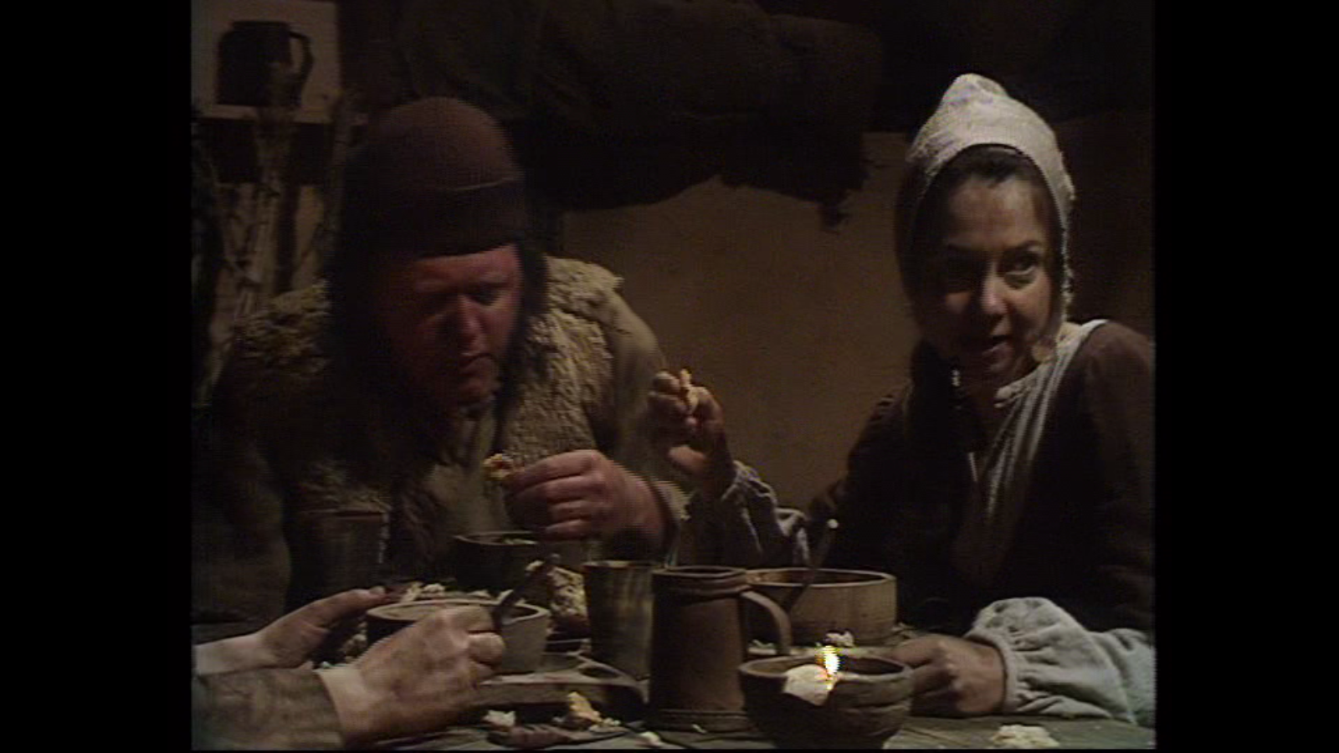
Ideas with no evidence
Now we’ve found out about the rats there’ll be no more plague again.
You know what they’re saying; a rat a day keeps the plague away.

Slide 19
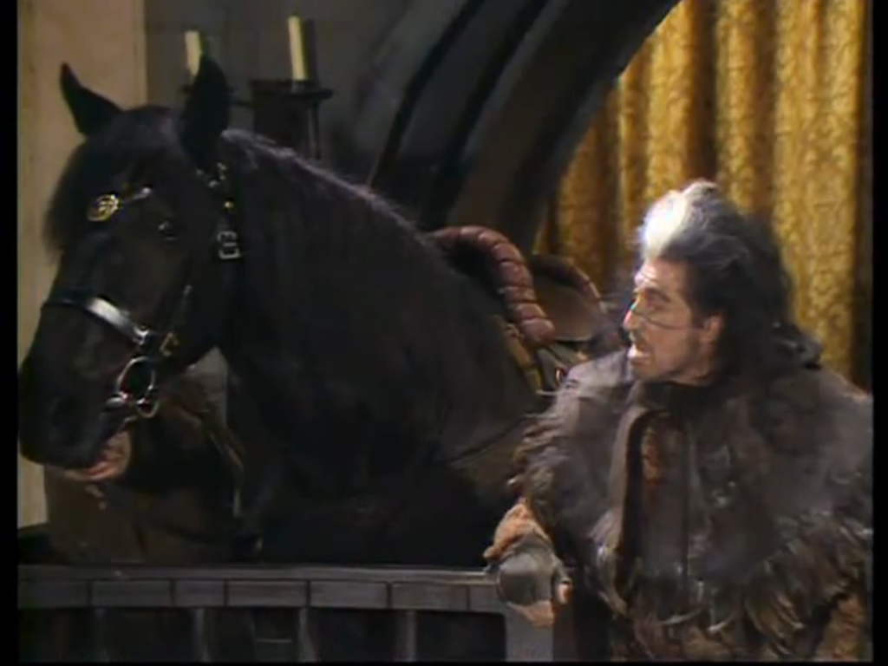
The argument from silence
Satin, you’re not replying… Are we to assume this horse has something to hide?

Slide 20
The argument from silence
This is when the absence of evidence is used as evidence.
This can be reasonable but it usually cannot prove anything.
The Exodus story says the Israelites stayed in the Sinai desert.
There are no archaeological findings of the Israelites in the Sinai desert.
The Exodus story is not true.

Slide 21
Exam candidate’s folly
Avoid ‘I’.
Instead of ‘I think xyz’ write ‘The evidence suggests that xyz is true.’
Your personal belief system is not reason and evidence for a conclusion on something else.
“I am a bonehead. Please give me no marks.”
“Yes, I think God exists because I am a Christian.”
“No, I think God doesn’t exist because I am an atheist.”

Slide 22
How to be non-fools of logic
Use proper logic.
Discuss both sides of the debate in exam questions (where appropriate).
Be balanced and fair, no matter how stupid the other side is!
Do not conveniently ignore evidence that condemns what you are trying to say.
Point out the difficulties with your view but show why the difficulties can be explained or accounted for.
Use conclusions that are actually backed up by the evidence.
Don’t say ‘proves’ when it only ‘suggests’.

