Slide 1
Edexcel A2 Business
4.2.4 Reasons for global mergers or joint ventures
Revisionstation

Slide 2
Worksheet

Slide 3
From Edexcel
a) Spreading risk over different countries/regions
b) Entering new markets/trade blocs
c) Acquiring national/international brand names/patents
d) Securing resources/supplies
e) Maintaining/increasing global competitiveness

Slide 4
Joint venture defined
A joint venture is a commercial enterprise undertaken jointly by two or more parties which otherwise retain their distinct identities, this is only a temporary arrangement
In other words two business come together to collaborate on one project, but will still remain separate businesses

Slide 5
Merger defined
A merger is where two businesses come together to become one, on a permanent basis e.g. Orange and T mobile became EE

Slide 6
Starter
Are these joint ventures or mergers?
Sony Ericsson
Hero Honda
Exxon Mobil
Mars Wrigley
Notes:
First two are joint ventures last two are mergers

Slide 7
Spreading risk over different countries/regions

Slide 8
Spreading risk and joint ventures
Moving production or sales into another country can be very complex and risky for a single business to go it alone
Often a business might decide to enter into a joint venture to share the risk, perhaps with a business already trading in that country – which can help them navigate the paperwork and cultural differences

Slide 9
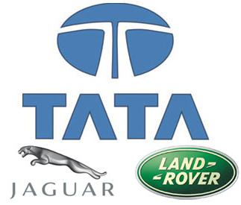
Spreading risk and mergers
Risk can also be reduced by entering into a more long term arrangement with a merger
Ford wanted to sell Jaguar and Land Rover
In 2008 Tata the Indian company bought the two companies from Ford
They wanted the brands for different markets and different countries
The purchase gave Tata the opportunity to expand its presence in the passenger car market beyond India and gave it the clout necessary to compete with international players.

Slide 10
Entering new markets/trade blocs

Slide 11
Joint ventures and the Chinese car market
Renault-Nissan alliance became the latest car group to sign a joint venture to produce electric vehicles with long time partner Dongfeng Motor Corporation, based in Wuhan
This is a good way for Nissan to get into the Chinese car market and to bypass the expensive import tariffs

Slide 12
Joint ventures in Japan
A joint venture with another company in Japan may be an excellent opportunity for a business to grow without the complexities of making an outright purchase of another company
For example Dow Chemical went into a Joint Venture with Ube to produce batteries in Japan

Slide 13
Mergers and new markets
The Italian firm behind Ferrero Rocher chocolates and Nutella spread has agreed to buy British chocolate retailer Thorntons for £112 million, striking a rare deal to expand in Europe's biggest confectionery market.
Ferrero International said it was buying Thorntons to expand its business in the UK, where the Italian firm has operated for 60 years.
Notes:
And it gets to avoid rising corporation taxes by manufacturing in the UK – a smart move

Slide 14
Advantages of joint ventures
Access to knowledge and resources such as capital, staff and technology
Access to new opportunities such as new markets or greater distribution reach
Shared exposure to risks, financial responsibility and workload
A 50:50 joint venture between UK-headquartered Jaguar Land Rover, itself a subsidiary of Tata Motors of India; and Chinese state owned automaker Chery, it was formed to allow production of Jaguar Cars and Land Rover vehicles in mainland China.

Slide 15
Disadvantages (risks) of joint ventures
A large number of joint ventures fail because of the many risks involved and the complexity of integrating operations and work culture of two different companies
Coping with differing cultures, management styles, and working relationships that are in each company
50% of all joint ventures fail

Slide 16
Acquiring national/international brand names/patents

Slide 17
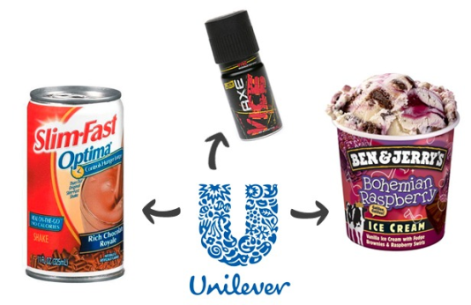
Brand name acquisition
A business may look to merge with another business in order to acquire a lucrative brand name
For example Ben and Jerrys sold their company to the Anglo-Dutch company Unilever in 1999.
They loved Ben & Jerry's but never wanted to sell it, but Unilever offered so much money that, in the end, responsibility to the shareholders won out.

Slide 18
Brand acquisition – Disney Pixar
On May 5, 2006 the two companies Disney and Pixar merged.
Disney acquired shares worth $7.4 billion in Pixar and made it Disney’s subsidiary.
Since then it has been reported as one of the most successful mergers of times.

Slide 19
Brand Acquisition – Quaker and Snapple
In 1994 Quaker Oats purchased Snapple, for $1.7 billion. Snapple failed to sell into the larger shops and just didn’t take off
After just 27 months, Quaker Oats sold Snapple for $300 million (or, for those of you doing the maths, a loss of $1.6 million for each day that the company owned Snapple).

Slide 20
Patent acquisition
A joint venture allows inventors to move their products to market quickly with much less financial risk
Inventors can team up with manufacturing companies who will help them; design, build and make the prototypes necessary to help get the product to market
The joint venture could be with an overseas manufacturer who will make the product for a reduced price in exchange for overseas marketing rights ARTICLE

Slide 21
Securing resources/supplies

Slide 22
Joint ventures to secure resources
A business in one country may need resources that are only found in another country and so they may enter into a joint venture to secure access to these resources
For example Chinese Railway and electric co went into a joint venture with the Gecamines in the Congo which mine nickel, cobalt and copper
The Chinese company provide technology and know-how and in return secure 10 million tonnes of copper

Slide 23
Maintaining/increasing global competitiveness

Slide 24
Maintaining global competitiveness
A joint venture or merger may be essential to ensure that the business remains competitive in a dynamic global market
The local partner may be able to provide critical market data, local knowledge on the domestic market and information on customers, tastes and trends which will help the parent business to maintain competitive advantage

Slide 25
Revision Video

Slide 26
Sample Edexcel A2 questions

Slide 27
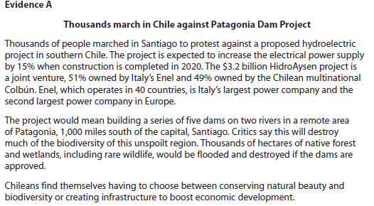
Case study for question 1

Slide 28
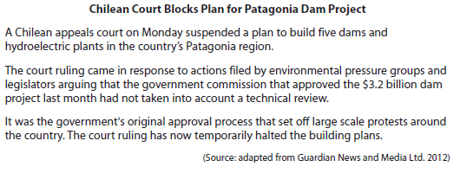

Slide 29
Sample question 1
[6]
Knowledge 2
Application 2
Analysis
2
Notes:
Another legacy 6 mark question

Slide 30
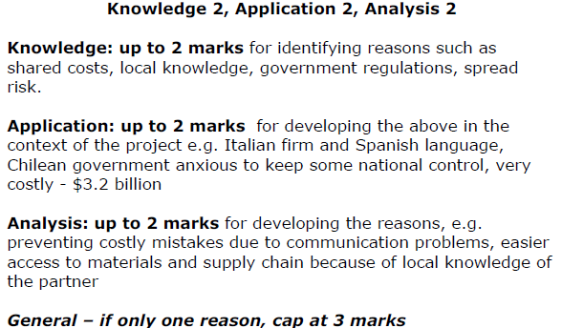
Answer sample question 1

Slide 31
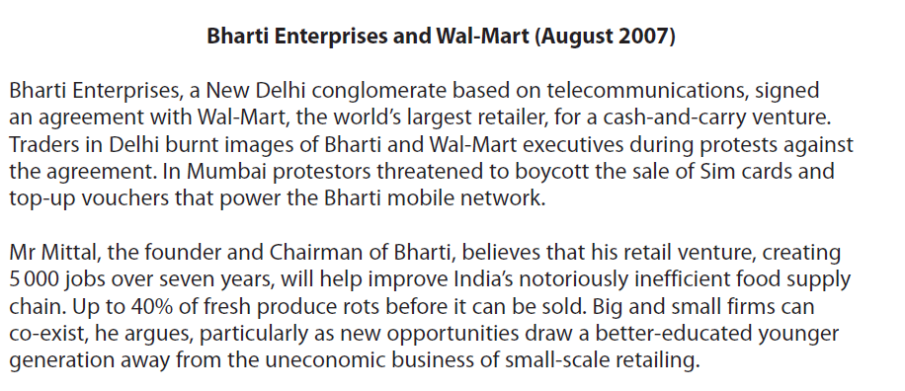
Case study for question 2

Slide 32
Sample question 2
[8]
Knowledge 2
Application 2
Analysis
2
Evaluation
2

Slide 33
Answer sample question 2
e.g. For a successful global multinational such as Wal-Mart having a joint venture partner is a good way of expanding and entering new markets
e.g. Having a joint venture makes entry much easier and reduces the risks involved. Local firms may have valuable knowledge and expertise. In the case of markets such as India and China there are also Government regulations regarding the entry of foreign firms. This makes entry into potentially lucrative emerging markets much easier
e.g. looks at the downside of such arrangements, risks may be shared but so too are profits. Some control is lost, there may be breakdowns in trust and communication, or a clash of corporate culture. These must be weighed against the benefits.

Slide 34
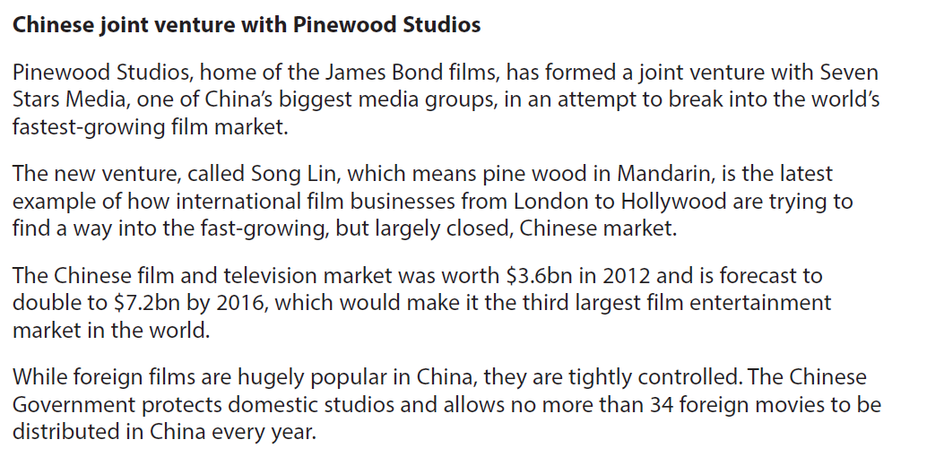
Case study for question 3

Slide 35
Sample question3
[8]
Knowledge 2
Application 2
Analysis
2
Evaluation
2

Slide 36
Answer sample question 1
e.g. difficulty in getting access to Chinese market due to government Restrictions
e.g. access to previously inaccessible Chinese market and increased sales and profits caused by the growing size of the market which in turn is powered by rising incomes
e.g. local knowledge and advice which helps to avoid bureaucratic obstacles and hold-ups which delay output and increase costs
e.g. shared costs which means that more and bigger projects can be launched,
e.g. reduced risk from the above points makes investment safer and more viable
e.g. identifies possible risks - clash of cultures and communication problems, which can mean at worst a collapse of the venture (Danone may be used a s an example here)
e.g. difficulties in Chinese market such as theft of IPR, even with a JV this can happen causing a loss of profitability
e.g. sharing costs is an advantage but it also mean that profits are shared too

Slide 37
Glossary
Merger; two companies or more merging to become one on a permanent basis
Joint venture; two independent businesses collaborating on a specific project, this is on a temporary basis

