Slide 1
Edexcel A2 Business
1.4.3 Organisational Design
Revisionstation

Slide 2
Worksheet

Slide 3
You will need a ruler and selection of colours

Slide 4
From Edexcel
a) Structure:
hierarchy
chain of command
span of control
centralised and decentralised
b) Types of structure:
tall
flat
matrix
c) Impact of different organisational structures on business efficiency and motivation

Slide 5
Starter
Do you know someone who is terrible at communicating?
Without naming them can you tick the ways that they fail to communicate effectively:
Interrupts
Talks about themselves too much
Over dramatize everything
Lies
Talks too fast
Doesn’t discuss important issues
Constantly criticises
Too sarcastic
Always negative
Rambling
Notes:
This should open a discuss about the importance of effective communication, won’t be too hard to swing this round to a business context.

Slide 6
Definition: Organisational design
Organisational design refers to a diagram or chart which shows the lines of authority and layers in the hierarchy of the business.

Slide 7
Structure

Slide 8
Hierarchy
A hierarchy is a system in a business where employees are ranked due to their status and authority
Traditionally those at the top of the hierarchy are more important than those at the bottom
Employees during their career will seek to move up the hierarchy to improve their salary and working conditions

Slide 9
Chain of command
The chain of command in a business is the flow of information power and authority through the organisation
Those at the top have more power and authority
They can delegate tasks to those subordinate to them in the hierarchy (below them)
Complaints and status reports flow up the chain, orders flow down the chain. Both need to be handled at the lowest level possible
Head teacher
Head’s Secretary
Head of English
Head of Business
Head of Maths
Notes:
In some schools there is no line of assistant deputy heads to delegate to – but in many schools there are – you can adapt the diagram with the students to draw a hierarchy then show how the chain of command goes down the organisation.

Slide 10
Span of control
This is a number
An employee that works as a Head of Department in a school may have 6 teachers working for them. Their span of control is therefore 6.
This is the number of subordinates that they can delegate to

Slide 11
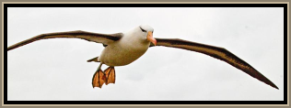
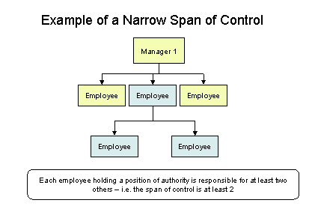
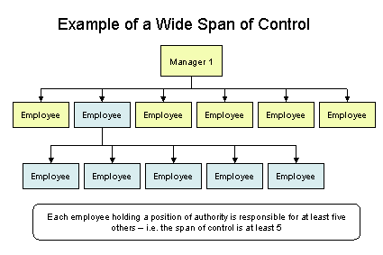
Span of control – the number
In a hierarchy it’s the number of people that a manager is responsible for.
Where there are small spans of control there will be a tall hierarchy and jobs will be very specialised.
A wide span of control will mean a flat hierarchy and employees will be given more responsibility and larger roles
Think wing span of a bird

Slide 12
Decentralisation / centralisation
Decentralisation – where a business divides up the organisation of its business into areas for example: north, south, east, west or UK, Europe, and Africa. The business will have separate budgets for each area
Centralisation – where a business has its organisation of management and administration at one central head office. The business has one central shared budget

Slide 13
Centralisation
Midlands branch
Scotland branch
Head Office
London branch
South Coast branch
Wales
branch

Slide 14
Centralisation
Less delegation, the management at Head Office will make all the key decisions
Branches follow direction from
Head office, for example they receive all deliveries of stock bought by the Head Office buying department team
Midlands branch
Scotland branch
Head Office
London branch
South Coast branch
Wales
branch
All recruitment is carried out at head office, all accounts are made here - all decisions about product lines, sales, stock are made here
Only small decisions
such as rotas and stock merchandising
can be made at branch level

Slide 15
Decentralisation
Divisions operate without a Head Office
Europe division
African division

Slide 16
Decentralisation
The Europe division manages its own budget and makes all decisions relevant to Europe
Authority and power are given to the divisions to make decisions that affect
that division, important when working in countries with different cultures
Decentralisation:
Divisions operate without a Head Office
Europe division
African division
Quicker decisions can be made as they do not have to go through a central office for approval, this is
important in dynamic markets e.g. fashion
The African division holds own budget and makes all decisions relevant to Africa

Slide 17
Types of structure

Slide 18
Suggested activity – draw an organisational chart for your life
It is possible to draw a diagram of the employees in an organisation
This shows everyone who works in the organisation, who they report to and who they are responsible for
You can even draw one for your family network – try that now
Grandad
Mum
Dad
ME
MY SISTER

Slide 19
What does an organisational chart show?
Names of departments e.g. production, finance, marketing and HR
Job roles e.g. Directors, Managers, supervisors
Responsibilities and accountability e.g. definition of duties
Lines of authority (who is the boss)
Lines of communication flow (horizontal and vertical) in the organisation
Chains of command in the organisation

Slide 20
Different types of organisational structure
There are three main types of organisational structure that you need to know for the Edexcel exam:
Tall Structure
Flat Structure
Matrix Structure
You will not need to be able to draw them but you need to know the differences and which businesses they are most suitable for
Get ready to make some notes on these from the next few slides

Slide 21
#1 Tall structure
In a tall structure there maybe lots of opportunity for promotion
Information takes a long time to get from the bottom to the top of the organisation, it takes a long time for decisions to be made
Work is shared among more people so less stress
Everyone knows where they are in the hierarchy, so very orderly and organised

Slide 22
#1 Tall hierarchical structure
Advantages
Disadvantages

Slide 23
#1 Advantages of a tall hierarchical structure
Supervisors normally have a small span of control so they can get to know their subordinates really well
Knowing subordinates means they can delegate the right tasks and make sure their team is well trained

Slide 24
#1 Disadvantages of a tall hierarchical structure
Lots of layers and a long chain of command can mean that the business is very inflexible
It can also mean that communications within the organisation are slow
This is expensive as there are more managers and supervisors

Slide 25
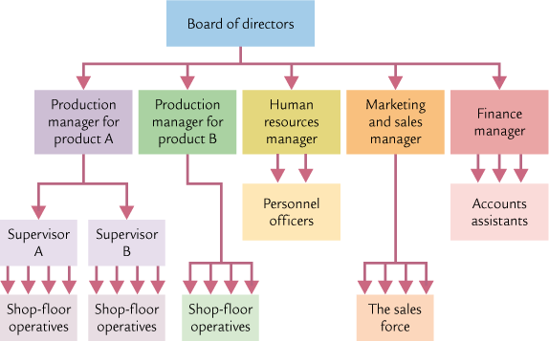
#1 Example of a tall hierarchical structure

Slide 26
#2 Flat structure
Many restaurants and web design companies have a flat structure. They have a wide span of control and a short chain of command so information flows quickly throughout the organisation.
Manager
Coach
Chef
Chef
Bus Boy
Cleaner
Cleaner
Waitress
Waitress
Bar
Bar

Slide 27
#2 Flat structure
Advantages
Disadvantages

Slide 28
#2 Advantages of a flat structure
Fewer layers of hierarchy between the bottom and the top of the organisation may mean that communication is fast
Lots of delegation means that staff are given greater responsibility, which might mean more opportunities to use their abilities

Slide 29
#2 Disadvantages of a flat structure
Staff can be overstretched or overworked in a flat structure as there is less supervision, this can cause stress and demotivation
Can create a power struggle if the manager is rarely around as subordinates jostle for roles and responsibilities
Wide span of control means managers have too many staff to manage and may lose touch with them

Slide 30
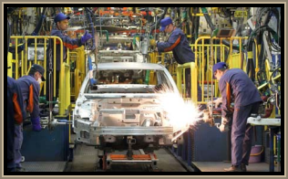
#3 Matrix explained
In a business where there are more than one product or more then one project running at a time a matrix structure is more suitable than a standard hierarchy
For example: Members of the production team sit on meetings for all 3 projects and advise on production matters – can it be built? Can it be built to the quality required? Have we got the materials to build it?
Car manufacturers operate in this way, for example project 1 might be a design of a family car, project 2 a sports car and project 3 a 4x4.

Slide 31
#3 Matrix structure
Advantages
Disadvantages

Slide 32
#3 Advantages of the matrix structure
Matrix structure is ideal for a business that works on a project-by-project basis
Very flexible structure means that staff from different departments can jump in and out of different job roles
Perfect to exploit the specific skills of staff

Slide 33
#3 Disadvantages of a matrix structure
Possible co-ordination problems between departments
Conflict of interest across projects
Staff stretched across different projects, not spending time in their own departments

Slide 34
#3 Matrix structure
Production
Finance
Marketing
Human Resources
Project 1
Project 2
Project 3
Notes:
© Diagram S Hilton

Slide 35
Impact of different organisational structures on business efficiency and motivation

Slide 36
 | Efficiency | Motivation
Matrix
Tall
Flat

Slide 37
 | Efficiency | Motivation
Matrix | Matrix organisations are only suitable when the business works on a project by project basis. For a business that has a lot of projects running at the same time, this type of organisation is very efficient | Staff are involved in a series of projects which can be more interesting than just one job, which means it can be more motivating
Tall | Communication is slow in a tall hierarchy as there are many layers for the information to pass through This can lead to delayed decision making | Staff can be motivated because there are lots of opportunities for promotion, with lots of layers in the hierarchy
Flat | Flat structures can be very efficient because those employees that are most effected by a rota can be involved in the writing of the rota of who works when | Staff are motivated in a flat structure as they are given more responsibility Also staff are motivated because they have had a hand in managing and running the business e.g. waitresses take turns in organising the rota
Notes:
Students can use common sense to add to this

Slide 38
Glossary
Hierarchy; a system in an organisation where people are ranked according to the authority that they have
Span of control; this is the number of subordinates that a supervisor or manager is in charge of
Chain of command; this is the route that orders travel down in an organisation and complaints travel up
Flat structure; This is a hierarchy design which has few layers and short chain of command but a wide span of control
Tall Structure; This is a hierarchy design which is the opposite to a flat structure, it has a long chain of command but a short span of control
Matrix structure; This is a hierarchy design which groups by project and function
Authority; This is the power or right to give orders in an organisation
Delegation; This is the act of passing a job or order down to a subordinate

