Slide 1
Edexcel A2 Business
4.2.5 Global competitiveness
Revisionstation

Slide 2
Worksheet

Slide 3
From Edexcel
a) The impact of movements in exchange rates
b) Competitive advantage through:
cost competitiveness
differentiation
c) Skill shortages and their impact on international competitiveness

Slide 4
Starter
Where did you last eat out?
Somewhere else ?
Notes:
These two businesses follow separate strategies for competitive advantage internationally but we will come back to that point – good stimulus for discussion.

Slide 5
The impact of movements in exchange rates

Slide 6
Exchange rates defined
Exchange rates are defined as the value of one currency in terms of another
For example:
Today the exchange rate of £1 to the US Dollar is ___________
Today the exchange rate of £1 to the Euro is______________
Today the exchange rate of £1 to the Japanese Yen is __________
Today the exchange rate of £1 to the Russian Ruble is __________
Notes:
You will need to add in these values – a quick google search should provide them – or get the kids to look it up on their phones / tablets / laptops

Slide 7
SPICED (revision)
Strong
Pound
Imports
Cheaper
Exports
Dearer
What is the opposite – with a weak pound?
Notes:
WPIDEC

Slide 8
Appreciation and exports
If the £pound appreciates, gets stronger against other currencies then UK exports to other countries will be more expensive
This may mean that the business that exports, out of the UK, has lower sales or may have to reduce their prices in other countries to keep demand levels up

Slide 9
Appreciation and imports
As the pound appreciates – gets stronger – against other currencies then imports to the UK will be cheaper
This will be good news for all those who like a bottle of French wine with their Nandos, or who like a nice French cheese with some biscuits
Businesses that sell imports will have lower costs, and therefore may enjoy higher profits

Slide 10
Depreciation and exports
If the £pound depreciates - gets weaker against other currencies it will make exports to those countries cheaper
The business can decide to either:
Keep prices to other countries the same and enjoy the higher profit
Lower prices to other countries and gain market share and more revenue from extra sales
Jonnie Walker Whisky sold to 180 countries

Slide 11
Depreciation and imports
If a business imports while there is depreciation it will make those imports dearer
If the imports are raw materials to make other products in the UK then these products will cost more to make and be more expensive for the consumer which may affect demand, sales revenue and profit

Slide 12
Competitive advantage

Slide 13
Competitive advantage defined
“A competitive advantage is an advantage over competitors gained by offering consumers greater value, either by means of lower prices or by providing greater benefits and service that justifies higher prices.” Michael Porter (1985).

Slide 14
Two ways to achieve competitive advantage
Your exam board would like you to be able to discuss the two main methods of achieving competitive advantage:
1) Low cost leadership
2) Differentiation

Slide 15
#1 Low cost leadership
With this strategy a business will seek to produce the same quality products as its competitors at a lower price
The industries typical of this strategy are standard mass produced items
Large businesses typically do well as they can benefit from the largest reduction in average costs and EOS
They may gain cost leadership due to;
Good resources management
Efficient production methods
Waste minimisation

Slide 16
#2 Differentiation
With this strategy a business will produce a unique product or give a unique service
They may be similar products but each will have some attributes which set it aside from the competition. Kotler suggested;
Performance
Style – TGI restaurants
Design
Consistency
Durability
Reliability – Eveready battery bunny
Reparability
With a uniqueness the business can charge a premium price to its market segment

Slide 17
Which strategy is this business following? (Low cost or differentiation)
Notes:
Low cost

Slide 18
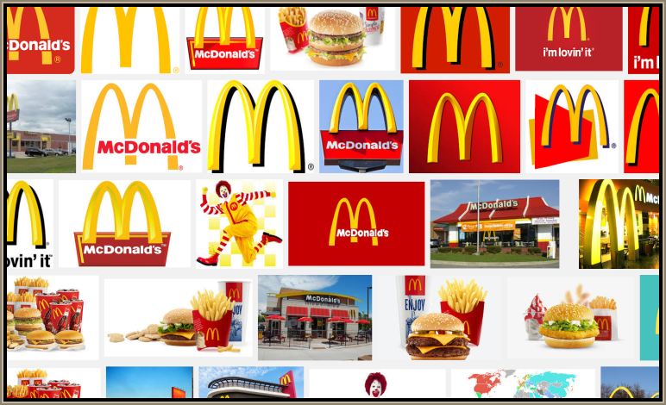
Which strategy is this business following? (Low cost or differentiation)
Notes:
Low cost

Slide 19
Which strategy is this business following? (Low cost or differentiation)
Notes:
Differentiation

Slide 20
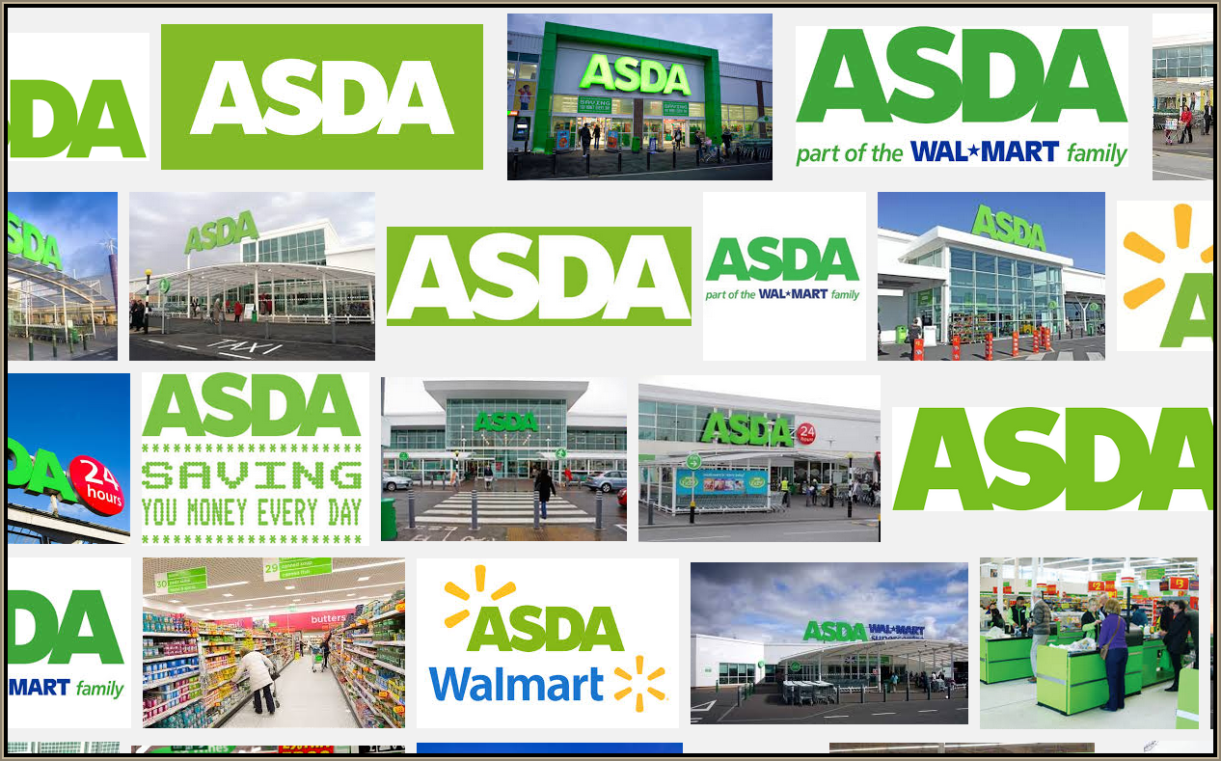
Which strategy is this business following? (Low cost or differentiation)
Notes:
Low cost

Slide 21
Which strategy is this business following? (Low cost or differentiation)
Notes:
Differentiation

Slide 22
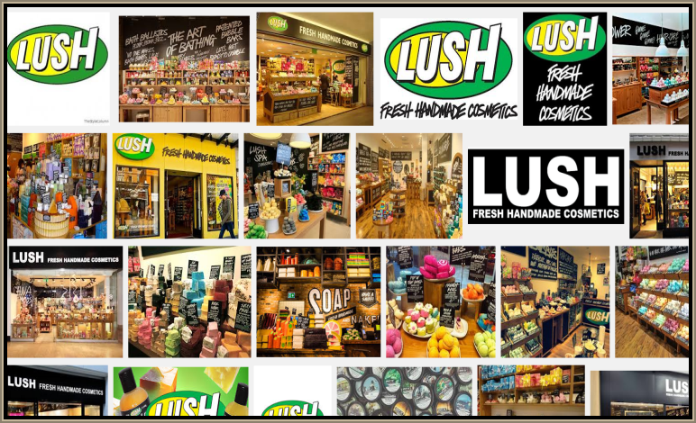
Which strategy is this business following? (Low cost or differentiation)
Notes:
Differentiation

Slide 23
Skill shortages

Slide 24
Skill shortages and their impact on international competitiveness
The lack of ability to find skilled workers can cause a decline in competitive advantage
Those businesses that follow a differentiation strategy will suffer the most from skills shortages

Slide 25
Skills shortages and competitive advantage
Not enough talent coming through to take UK businesses into the digital era to make them competitive on a global scale
Many careers are developing and very fluid due to the fast changing world of IT, telecoms and the Internet
Skills shortages of critical jobs will cause UK business to lose their competitive advantage

Slide 26
Revision Video

Slide 27
Sample Edexcel A2 questions

Slide 28
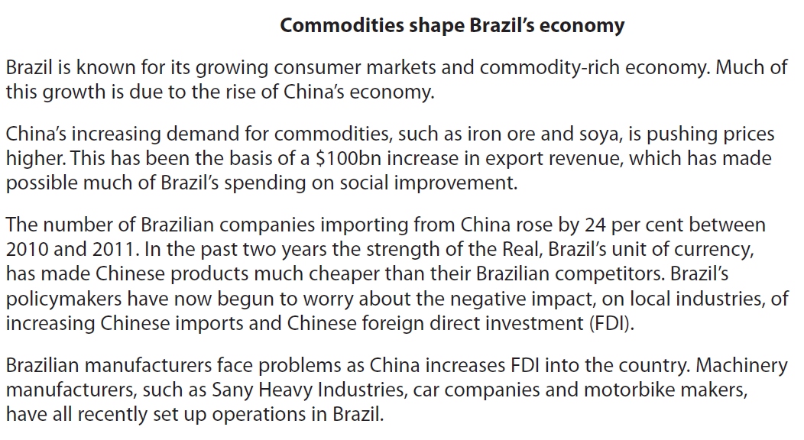
Case study for question 1

Slide 29
Sample question 1
[8]
Knowledge 1
Application 1
Analysis
2
Per effect

Slide 30
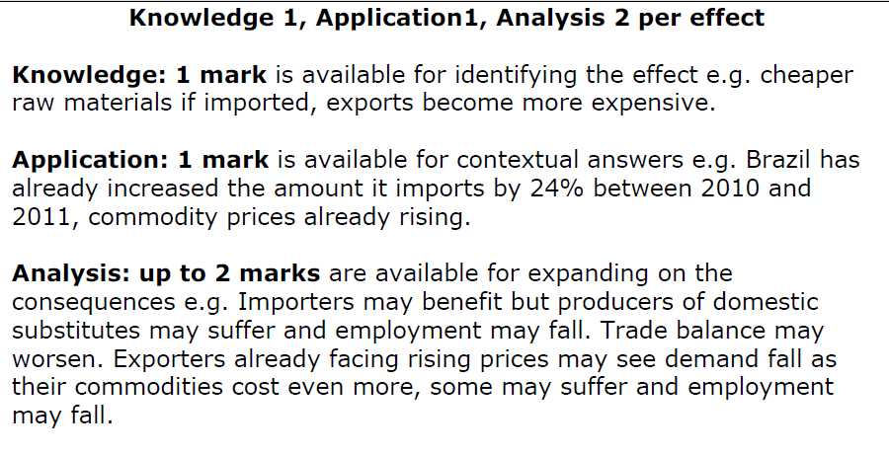
Answer sample question 1

Slide 31
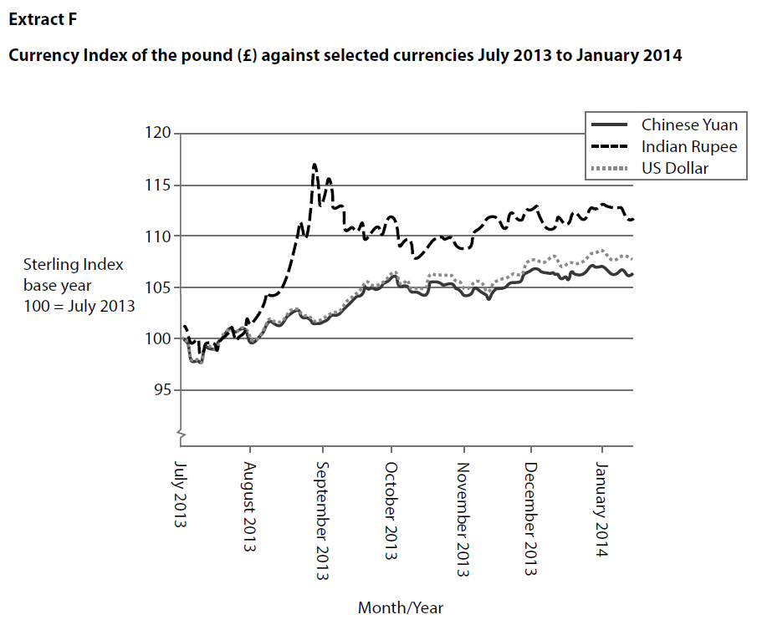
Case study for question 2

Slide 33
Sample question 2
Knowledge 4
Application 4
Analysis
6
Evaluation
6

Slide 34
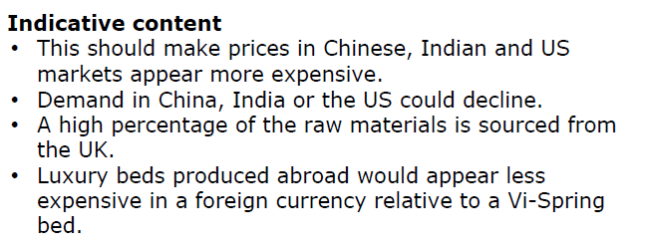
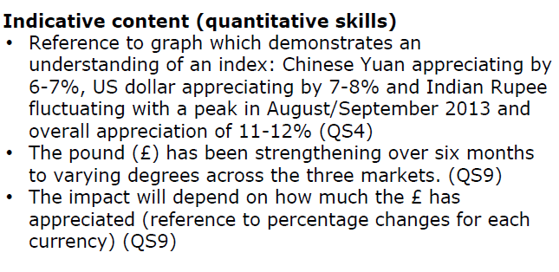
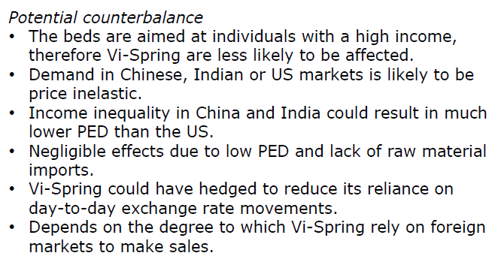
Answer sample question 2

Slide 35
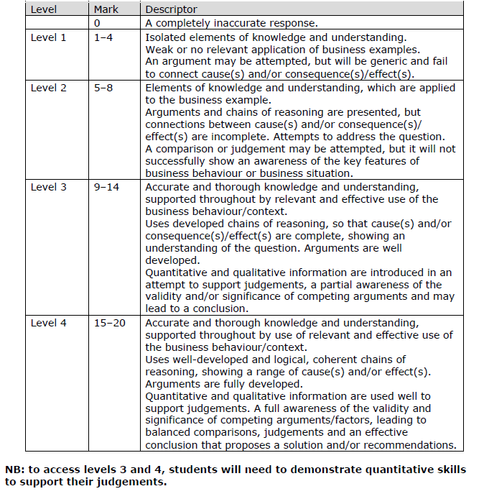
How to level sample question 2

Slide 36
Glossary
Exchange rate; The value of one currency against another
Appreciation; When the £pound is strong against another currency
Depreciation; When the £pound is weak against another currency
Skills shortages; A lack of qualified workers with the right skills
Competitive advantage; When a business sustains profits that exceed the average for its industry, the business is said to possess a competitive advantage over its rivals
Differentiation; a strategy which seeks to find a segment and market a unique product to them

