Slide 1
The Written Paper
Section B: Scripted Piece.
Blood Brothers

Slide 2
Learning Outcomes.
By the end of the lesson you should be able to…
Recall specific lines from your chosen play.
Describe how you performed those lines in terms of movement, voice and facial expressions.
Explain why you performed the character in the way that you did.

Slide 3
Important Information
Section B should be about a script you have studied.
Answer ONE question in section B. Question 2 or question 3. There are two parts to a question. Both 05 and 06 OR both 07 and 08.
You are not allowed to take your books in so make sure you learn at least two of the extracts and learn some of the lines.

Slide 4
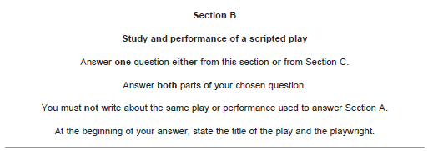
READ THE PAPER!!!

Slide 5
DO WHAT YOU ARE ASKED!!!
The play we have been studying is ‘Blood Brothers’ by Willy Russell.

Slide 6
Choose the correct question

Slide 8
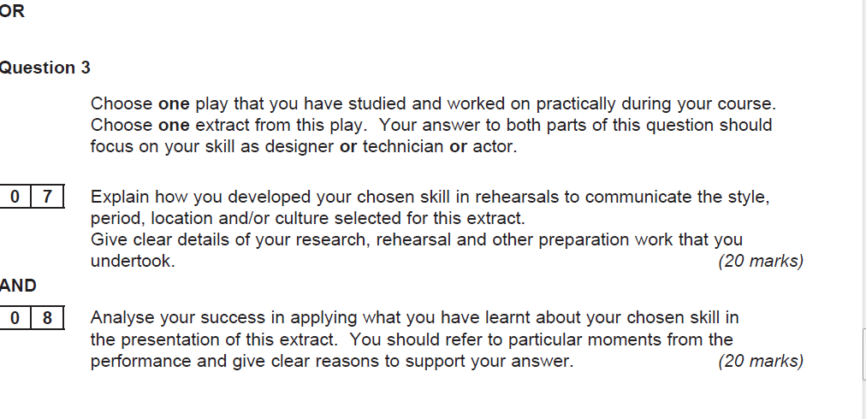

Slide 9
Important Information
Make sure you are specific to the work that you are
doing.
Be precise and get straight to the point. Don’t waffle!!
Remember to always say WHAT you did, WHY you did it and HOW you did it.
Write down notes on the question paper before
you start, then tick them off as you use them. Even quotes are useful to write down.

Slide 10
Parts 05 or 07
. Rehearsal
. Other preparation
. Application to the role

Slide 11
Parts 05 or 07
You state the title and the playwright.
You give a brief explanation to what the play is about.
The question asks you for one extract so talk about the character you played in that extract. Actually say… ‘ In the extract I have chosen I played the character of ……’
Then give a brief explanation of that character.

Slide 12
Parts 05 or 07
You are NOT ALLOWED to take the play into the exam so you must revise specific scenes from the play. Also try to memorise some of
the key lines within the extracts this will help you achieve higher marks when talking about how you would perform a line if you can
refer to it.

Slide 13
Parts 05 or 07
Quote what you remember from the extract…. Then support it.
.What you did------why you did it-----------how you did it.
.Audience intentions. What are you trying to create for your
audience?

Slide 14
Key Information
The actual moments from the script/ the words spoken/ the stage directions/ the themes/ the story. This is what you did.
Creating tension/ atmosphere/ showing the relationship between characters/creating a climax/ showing the characters emotions is all why you did it!!
All to do with your acting skills, so talk about your acting skills.
Voice, movements, levels, facial expressions/ space. That is how
you did it.

Slide 15
What the examiner is looking for.
reference to the information provided in the original script, for example:
to the playwright’s stage directions
to the characters actions and/or speech
to outcomes in performance

Slide 16
What the examiner is looking for.
identification and understanding of a specific role and description of the role in terms of the character’s age, gender, status and relationships to other characters
reference to research, rehearsal and other preparatory work undertaken:
identification of scripted aspects of character and some practical realisation of them

Slide 17
What the examiner is looking for.
explanation of the preparation process in terms of the interpretation of the role, for example:
development of acting skills:
􀂃 voice – accent, pitch, tone, volume, emphasis
􀂃 movement, gesture, posture
􀂃 facial expressions
􀂃 interaction with other characters on stage
decisions about blocking and movement
intentions for the audience.

Slide 18
Band 1
Band 1
17-20marks
Candidates will demonstrate knowledge and understanding of the play through a very clear explanation of the aspects taken from the script to realise their character through acting skills or interpret the extract through design or technical skills. There will be purposeful reference to the acting, design or technical skills involved in the process of creating a character or interpreting the extract.

Slide 19
Parts 06 or 08
. Ability to analyse and evaluate the effectiveness of the skills
required.
. Ability to analyse and evaluate the effectiveness of the production

Slide 20
Parts 06 or 08
This question will ask you to either comment on one moment or
moments from the script. So make sure you find out which one it is.
Talk about your role… what did you overcome. With these as a whole. characters you could mention the age difference and how you were
able to get into character. Be specific when answering this question
doesn’t just say ‘we did lots of things’ as it is too general.
You need to show that you have a good understanding of the play.
Talk about moments of success and how you develop your skills into
a final performance.
You must always say how you have done something.

Slide 21
Key Information.
. Audience reaction
. Recognition of a creative journey
. Team work
. Level of commitment
. Improvement of acting skills
. Establishment of relationship between mickey and eddie/ or mickey and Linda
. Creation of tension: when Mrs L visits Mrs J in the kitchen
. Strengths/ weaknesses

Slide 22
What the examiner is looking for.
a summary of the playwright’s intentions as perceived by the candidates or outline of the group’s interpretation
an analysis of the candidate’s success in realising either the playwright’s intentions or their group’s interpretation in relation to, for example:
the communication of the message(s) or theme(s) of the play
appropriate interpretation of character(s)
the creation of an appropriate mood/atmosphere
the creation of an appropriate period and/or location
the creation of an appropriate performance style
competence in performance skills in relation to physical, vocal and facial expression

Slide 23
Band 1
Band 1
17-20 marks
Candidates will offer a very clear analysis of their personal success in presenting the extract as the playwright or their group intended. There will be purposeful reference to particular moments from the performance in support of their analysis.

Slide 24
Structure
What you are trying to do
**** quote****
3. How you are going to achieve this in terms of…
• voice (pace, pitch, power, pressure, pause)
• movement
• gestures
• facial expressions
• proxemics (space on the stage)
• levels
• Relationships between the characters.
4. Why you have chosen to do this (audience reaction, creating tension/atmosphere etc.

Slide 25
Willy Russell.
Willy Russell was born in 1947 into a working-class family near to Liverpool. He left school at 15 without academic qualifications and became a hairdresser. By the age of 20 he felt the need to return to education and, after leaving university, he became a teacher at a comprehensive school in his home city.
During this time Russell wrote songs for performers and for radio shows. One of his early plays was about the Liverpool pop group the Beatles. He has a love of popular music and this can be seen in many of his plays, but especially in Blood Brothers.

Slide 26
Background on the play.
Blood Brothers was completed in 1981, two years after the Conservative party leader Margaret Thatcher became Prime Minister. She felt that British manufacturing industry had become uncompetitive and saw the cause as weak employers and overly strong trades unions who were, she felt, only too willing to call their members out on strike. She reduced the powers of the workers’ unions and privatised (‘sold off’) many publicly owned companies. She closed many uncompetitive coal mines, too.

Slide 27
Background on the play.
A short-term result was that Britain suffered an economic downturn and unemployment soared. This particularly affected industrialised working-class areas in the north of the country and Willy Russell would have seen this first hand in his home city. Liverpool’s famous docks, a traditional source of local employment, were allowed to run down and thousands of households fell into poverty; crime levels increased; housing was allowed to deteriorate and illegal drug use became more common. Some of this context is directly reflected in the play, for example, Russell shows the terrible effects of unemployment on Micky's self-esteem

Slide 28
Background on the play.
One of Thatcher’s central political beliefs was that success came to those who chose to work hard. In Blood Brothers, Russell contradicts this view. He shows a divided society by having Mickey and Edward attend very different schools and live in different houses.
That money and influential connections are necessary to become successful is written into the play. Mickey's failure, despite his good character and hard work, is the basis of the tragedy in the drama

Slide 29
Background on the play.
Marilyn Monroe was a very famous Hollywood actress. Her image was well known even to people who did not watch her films. She was presented by the media as a kind of ‘perfect’ fantasy woman and she was shown to live a glamorous and carefree lifestyle. The reality was often very different. She needed anti-depressants and eventually died from an overdose of pills.

Slide 30
Background on the play.
Russell uses references to Monroe throughout the play. At each point he refers to a different aspect of her life and public image. Mrs Johnstone enjoys the glamour of Monroe's public image. Later in the play Mickey becomes hooked on anti-depressant ‘nerve pills’ and this is compared to Monroe's own depression.
In the 1950s society went through massive changes. As a result of young people gradually having more money, popular culture (music, TV and film) flourished, becoming accessible to a much wider public. Even the poorest in society, people represented in the play by the fictional Johnstone family, would have had the chance to go to the cinema or to a club for dancing.

Slide 31
Background on the play.
Think about the various ways characters in Blood Brothers are influenced by music, film and, especially, fantasy. Mr. Johnstone’s attitude toward his wife is based on her likeness to Marilyn Monroe. Mrs Johnstone’s love of ‘dancing’ is a love of escape from her everyday life. The boys’ love of playful but ‘violent’ games, playing at cowboys and gangters is influenced by films.

