Slide 1
Edexcel A2 Business
3.4.3 Shareholders vs stakeholders
Revisionstation

Slide 2
Worksheet

Slide 3
From Edexcel
a) Internal and external stakeholders
b) Stakeholder objectives
c) Stakeholder and shareholder influences:
stakeholder: that the business considers all of its stakeholders in its business decisions/objectives
shareholder: that the business should focus purely on shareholder returns (increasing share price and dividends) in its business decisions/objectives
d) The potential for conflict between profit-based (shareholder) and wider objectives (stakeholder)

Slide 4
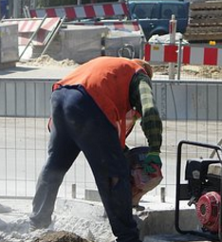
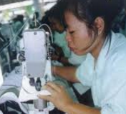
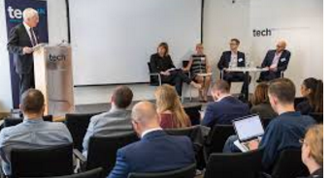
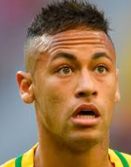
Starter
Spot the odd one out – which of these is NOT a stakeholder of a business
Notes:
Neymar da Silva Santos Júnior (Portuguese pronunciation: [nejˈmaʁ dɐ ˈsiwvɐ ˈsɐ̃tus ˈʒũɲoʁ]; born 5 February 1992), commonly known as Neymar or Neymar Jr., is a Brazilian professional footballer who plays as a forward for French club Paris Saint-Germain and the Brazil national team – that’s him in the yellow top

Slide 5
Stakeholders Defined
A stakeholder is anyone who has an interest in the business, or who may be affected by the activities of the business
Notes:
http://www.creative-commons-images.com/clipboard/shareholder.html

Slide 6
Shareholders Defined
A shareholder is a person, business or organisation that owns at least one share of a company
A shareholder is a stakeholder of the business
Notes:
http://www.creative-commons-images.com/clipboard/shareholder.html

Slide 7
Internal and external stakeholders

Slide 8
Internal stakeholders
A stakeholder is anyone that has an interest in the business and is affected by the actions of a business.
Internal stakeholders are those inside a business who may be affected by corporate decision making;
Employees
Managers
Owners

Slide 9
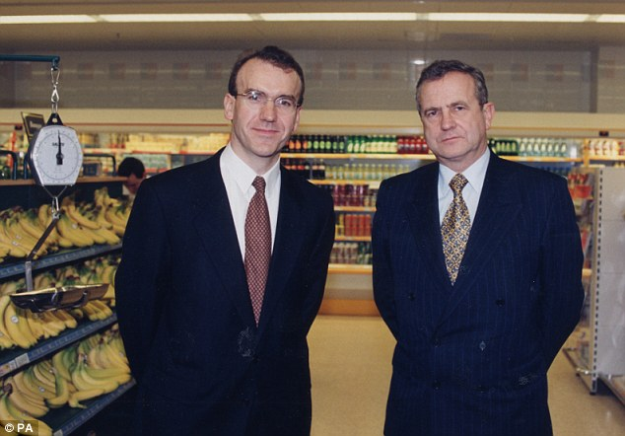
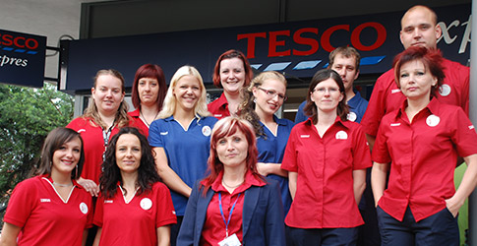
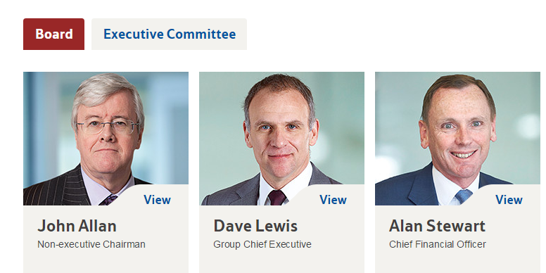
Internal stakeholders Groups or individuals within an organisation who have an interest in the business
Tesco’s managers – want to know about budgets, targets, profit, promotion and bonuses
Tesco’s employees – want to know about job security, 310,000 employees in the UK
Tesco’s board of Directors – want to know about strategic objectives, and profit

Slide 10
External stakeholders
External stakeholders are those outside the organisation who are affected by decisions made by the business. These vary depending on the business and its location, but the main general ones are;
Customers
Competitors
Suppliers
Community groups (pressure groups)
Unions

Slide 11
External stakeholders Groups or individuals outside of an organisation who have an interest in the business
Customers – interested in product availability, prices, promotions
Unions – interested in pay rates and worker’s rights
Community groups – interested in effect on locals of store opening
Suppliers – interested in credit terms, contracts and profit margins
Competitors – interested in market share, market size, promotions, customer loyalty

Slide 12
Analysis of stakeholders Some questions to ask when carrying out analysis
Who are they?
Unite union
Are they internal or external to the business?
External
What power do they have?
310,000 employees who are members, union representatives meet with Directors and speak on behalf of the workers (collective bargaining)
What interest do they have in the business?
Demanding better conditions for workers – see article here
What influence do they have?
Influence over Directors as they can threaten a strike or a sit in, negative PR for the company – see the YouTube video of the protest here
Is the influence positive or negative?
Positive for the workers, negative as it will cost the business more
Do their objectives conflict with those of the Directors / Owners?
Yes, Directors will want to keep profits high so shareholders can get dividends. This will mean keeping costs low so their priority may not be better working conditions as this will just cost money and not make any more revenue
Now try this with the suppliers of Tesco – they are in conflict with the Directors as well (Farmers/ milk)

Slide 13
Stakeholder objectives

Slide 14
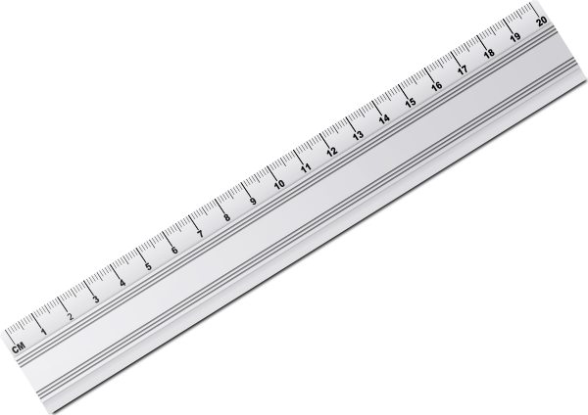
Stakeholder mapping – what you need

Slide 15
Stakeholder mapping – step 1
Identify the stakeholders of the business, these should be internal and external
Supplier – external stakeholder

Slide 16
Stakeholder mapping – step 2
Rank the stakeholder’s power either low, medium or high
Employee power over Tesco’s corporate decision making is medium

Slide 17
Stakeholder mapping – step 3
Rank the stakeholder’s level of interest in the business; low medium or high
Tesco’s supplier of Rainbow chard; level of interest is high

Slide 18
Stakeholder mapping – step 4
Rank the stakeholders value to the business; low, medium or high
Customers of Tesco; stakeholder value is high

Slide 19
Stakeholder mapping – step 5
Place all this information into a matrix (table):
Stakeholder | Power over decisions | Level of interest in the business
Customers | High | Medium
Unions | High | High
Suppliers | Low | High
Employees | Medium | High
Competitors | Low | Low
Notes:
These are just some examples; add in some other stakeholders

Slide 20
Stakeholder mapping – step 6
Draw a quadrant diagram:
Level of interest in the business
Low
High
Low
A
B
Power over decisions
C
D
High

Slide 21
Stakeholder mapping – step 7
Place this information into a quadrant diagram:
Level of interest in the business
Low
High
Low
A
B
Competitors
Power over decisions
C
D
Customers
High
Notes:
Get the students to put the rest of the information in - they can add in other stakeholders too.

Slide 22
Stakeholder mapping – step 8
The tactics of how the business engages with the stakeholder will depend on the quadrant that you put them into:
A: Stakeholders in this quadrant require minimal effort, and can be contacted using newsletters, mail shots and information on the company website
B: Stakeholders should be kept informed of corporate decisions and could be a potential supporter of the business in the future
C: Stakeholders should be kept satisfied, any communication should try to increase the level of interest in the business
D: Stakeholders in this quadrant are key players in the business and should be very involved in the governance and decision making and should be engaged with regularly

Slide 23
The potential for conflict

Slide 24
Stakeholder objectives – possible conflict
Stakeholder | Objectives | Conflict with Board of Director’s or owners objectives?
Customers | Low prices | Conflict – high profits, therefore keep prices high where possible
Suppliers | High prices for their supplies | Conflict – high profits, therefore low prices paid for supplies
Government | Tax, CMA | Conflict tax erodes profit, conflict Directors want to open lots of stores for market dominance
Unions | Working conditions and pay | Conflict, high profits means cost cutting and paying as low wages as possible
Employees | Pay and job security | Conflict, profit may be driven by zero hours contracts
Managers | Budgets, promotion | Conflict, Directors may want to appoint from outside to get fresh ideas
Competitors | Small local independents see Tesco’s as a threat | Conflict, Board want to continue opening stores

Slide 25
Sample Edexcel A2 questions

Slide 26
Case study for question 1

Slide 27
Sample question 1
[9]
Knowledge 2
Application 2
Analysis
2
Evaluation
3
Notes:
This is 9 marks, there are no 9 mark questions in the exam paper as this example is taken from the old Ec / bus spec

Slide 28
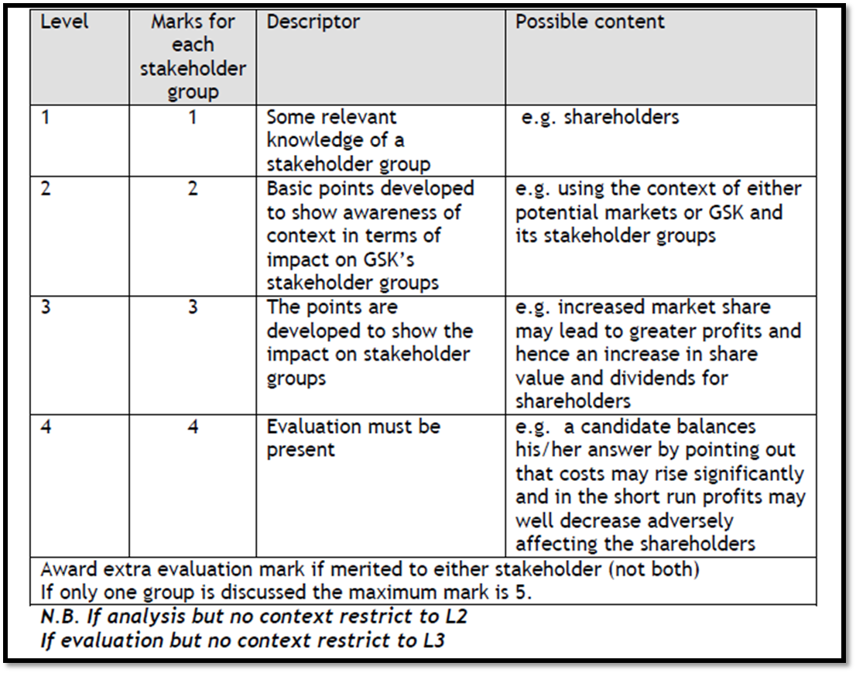
Answer sample question 1

Slide 29
Case study for question 2

Slide 30
Sample question 2
[9]
Knowledge 2
Application 2
Analysis
2
Evaluation
3
Notes:
This is 9 marks, there are no 9 mark questions in the exam paper as this example is taken from the old Ec / bus spec

Slide 31
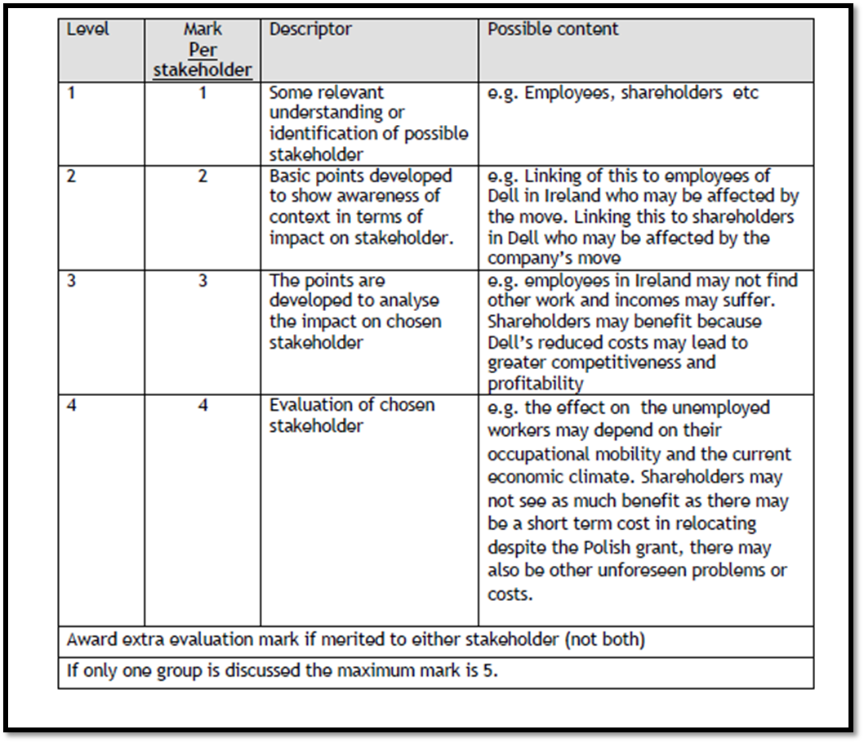
Answer sample question 2

Slide 32
Glossary
Stakeholder; a person or group who have an interest in or may be affected by the actions of a business
Shareholder; a person or group that owns a share of a business either an ltd or a plc
Shareholder objectives; profit maximisation to give dividends

