Slide 1
A-Level Economics

Slide 2
A-Level Economics
Four ‘themes’ (units)
Two in Year 12 and two in Year 13.
The new specification was first examined in June 2017.
The new specification means that A-Levels are linear.
Therefore, your exams at the end of Year 13 will consist topics from both Year 12 and Year 13 – the results of which decide your entire A-Level grade.

Slide 3
CHANGES TO BE AWARE OF…
This means that you do not take an AS-Level at the end of Year 12 if you plan on taking the A-Level in Year 13.
Only take an AS-Level if you want to drop the subject.
Your university applications rely upon predicted grades from your teachers.
…because you have not had any actual exams (old specification used to use AS-Level results in Year 12)

Slide 4
THE PLAN
Finish Theme 1 (microeconomics) by the end of December.
Theme 1 mock – Parents Evening in January.
Theme 2 (macroeconomics) starts in January.
Theme 2 finished in time for the Easter Holiday.
Summer Term left for revision… ‘End of Year 12 Exam’ which is an important element in determining your grade.
Microeconomics focusses on markets and firms, whereas macroeconomics considers the wider economy as a whole.

Slide 5
ECONOMICS QUIZ!
GENERAL KNOWLEDGE AND LOGIC…
Notes:
Get students to write onto pieces of paper, screw up and pick at random. Encourages students to be open, honest.

Slide 6
30 QUESTIONS…
SOME HAVE BONUS POINTS
PRIZE FOR THE WINNING PAIR!

Slide 7
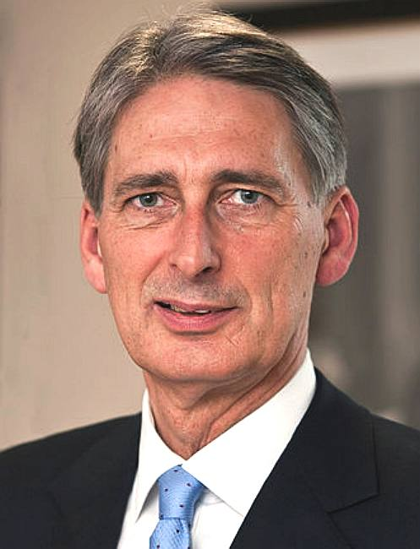
1. Who is this person? Bonus mark for their job title.

Slide 8
1. Who is this person? Bonus for job title
2. How many countries are in the EU?
3. What is the total GDP of the United Kingdom (ie. add up all of the goods and services produced in a year)
4. How much is the total debt of the UK government?
5. Which footballer recently broke the world record transfer fee? Bonus point for fee in pounds

Slide 9
6. Who is the UK’s chief negotiator with the EU regarding Brexit?
7. The UK is currently in the Eurozone – true or false?
8. How many euros would £1 get you? (point for 5 cents above or below)
9. How many dollars would £1 get you? (point for 5 cents above or below)
10. If the pound is strong, exports are… what?

Slide 10
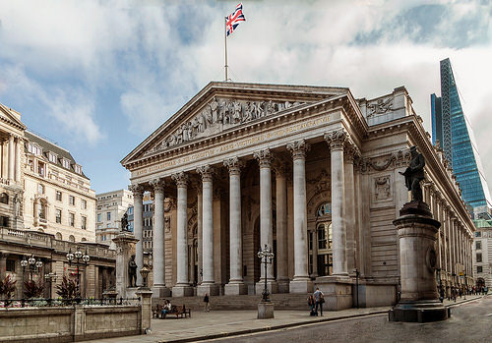
11. What is the minimum age to purchase cigarettes in the UK?
12. Where is this? (Bonus mark for giving the nearest tube station)
13. Place the top 6 supermarkets in order of market share (1 mark for each).
14. Name one person to appear on any banknote in the UK (other than The Queen!)
15. What is the current level of UK CPI inflation?

Slide 11
16. What is the current level of unemployment? Give you answer as a percentage.
17. In terms of GDP, place these economies in order: UK, Germany, US, India, Japan, China, France
18. If a country was experiencing shrinkflation, describe what would be happening. For a bonus mark, give an example.
19. Every month the Monetary Policy Committee sets the UK base interest rate. What is it currently?
20. What percentage of jobs have been taken by automation (replaced by machinery)? Within 5% each way.

Slide 12
21. What is special about the current level of interest rate?
22. Who is the Governor of the Bank of England? Bonus point for correct nationality.
23. What is the current level of minimum wage for somebody: Under 18? 25 and over? (1 mark for each correct answer with 10p above or below)
24. Name any one of North Korea’s top 3 imports
25. Name any one of North Korea’s top 3 exports

Slide 13
26. Which country purchases 83% of North Korea’s exports?
27. Which two of these economic facts is true about Reading? A The economy has not grown in three years B has a higher GDP growth rate than anywhere else in the UK C Unemployment in Reading is above the national average D The Oracle is in the top 10 UK retail centres by sales E Reading was home to the UK’s first Little Chef A
28. In metres, how tall is The Blade? Point for within 5m each way
29. What is the current price of a litre of unleaded petrol? (1 point for above or below by 5p)
30. Which category does the government spend the most on?

Slide 15
ANSWERS

Slide 16
1. Who is this and what is their job?
Philip Hammond, the current Chancellor of the Exchequer
2. How many countries are in the EU?
28
3. What is the total GDP of the United Kingdom (ie. add up all of the goods and services produced in a year)
£1.95 trillion
4. How much is the total debt of the UK government?
£1.75trn
5. Which footballer was recently broke the world record transfer fee? Bonus point for fee in pounds
Neymar £198M

Slide 17
6.Who is the UK’s chief negotiator with the EU regarding Brexit?
David Davies
7. The UK is currently in the Eurozone – true or false?
False
8. How many euros would £1 get you? (point for 5 cents above or below)
1.09 (1.04-1.14)
9. How many dollars would £1 get you? (point for 5 cents above or below)
$1.30 – (1.25-1.35)
10. If the pound is strong, exports are… what?
More expensive

Slide 18
11. What is the minimum age to purchase cigarettes in the UK?
18
12. Where is this?
Photo of Bank of England
13. Place the top 6 supermarkets in order of market share (1 mark for each)
Tesco 27.8%
Sainsbury 15.8%
ASDA 15.3%
Morrisons 10.4%
Aldi 7.0%
Co-Op 6.3%
Lidl 5.1%
14. Name one person to appear on money British banknote.
Adam Smith, Winston Churchill, Charles Darwin, Matthew Boulton, James Watt, Jane Austen
15. What is the current level of UK CPI inflation?
2.6%

Slide 19
16. What is the current level of unemployment? Give you answer as a percentage.
4.6% (lowest since 1975)
17. In terms of GDP, place these economies in order: UK, Germany, US, India, Japan, China, France
US, China, Japan, Germany, UK, France, India
18. If a country was experiencing shrinkflation, describe what would be happening. For a bonus mark, give an example.
Products are getting smaller (Toblerone, fewer Maltesers etc.)
19. Every month the Monetary Policy Committee sets the UK base interest rate. What is it currently?
0.25%
20. What percentage of jobs have been lost due to automation (replaced by machinery)?
0.5% (award a mark for anything under 5%)

Slide 20
21. What is special about the current level of interest rate?
Lowest ever.
22. Who is the Governor of the Bank of England? Bonus mark for nationality.
Mark Carney - Canadian
23. What is the current level of minimum wage for somebody: Under 18? 25 and over? (1 mark for each correct answer with 10p above or below)
£4.05
£7.50
24. Name any one of North Korea’s top 3 imports
Petrol, delivery trucks, computers
25. Name any one of North Korea’s top 3 exports
Coal, non-knit men’s coats, non-knit men’s suits, non-knit women’s coats

Slide 21
26. Which country purchases 83% of North Korea’s exports?
China
27. Which two of these economic facts is true about Reading? A The economy has not grown in three years B has a higher GDP growth rate than anywhere else in the UK C Unemployment in Reading is above the national average D The Oracle is in the top 10 UK retail centres by sales E Reading was home to the UK’s first Little Chef A
B and E
28. In metres, how tall is The Blade? Point for within 5m each way
128m
29. What is the current price of a litre of unleaded petrol? (1 point for above or below by 5p)
116p
30. Which category does the government spending the most on?
Pensions

Slide 22
Marked out of 40

