Slide 1
1.4.1 Approaches to staffing
a) Staff as an asset; staff as a cost
b) Flexible workforce:
multi-skilling
part-time and temporary
flexible hours and home working
outsourcing
c) Distinction between dismissal and redundancy
d) Employer/employee relationships
individual approach
collective bargaining

Slide 2
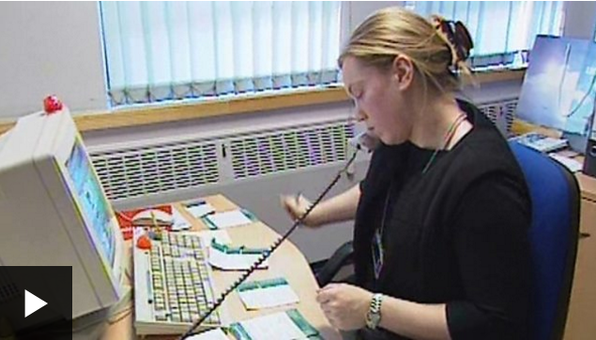
Starter
Watch the video and then discuss what you think a work-life balance means…
Video here

Slide 3
Definition: staff
Staff are the employees in a business
Staffing is the process of hiring, training and supervising employees in an business.
Notes:
Staff is an old fashioned word for employees – but is still used with some enthusiasm by all exam boards for business

Slide 4
Staff as an asset; staff as a cost

Slide 5
What is the dilemma?

Slide 6
How will each approach differ from each other?

Slide 7
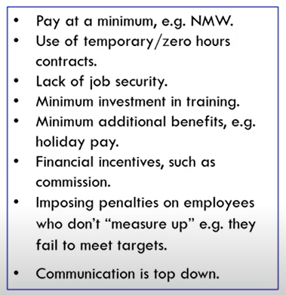
Hard approach – staff as a cost

Slide 8
McDonalds – soft approach

Slide 9
Soft approach – staff as an asset

Slide 12
Amazon working conditions
https://www.youtube.com/watch?v=HTOxxCRqpLM
https://www.youtube.com/watch?v=PhHwLRoGTpI
https://youtu.be/tlUj2F26XSg
Summarise the evidence of the hard approach to HRM at Amazon and Sports Direct.
Why would an employer adopt a hard approach to HRM?
How could the `great resignation` and Brexit impact on this hard approach to HRM?

Slide 13
A Better Way of Working
https://www.youtube.com/watch?v=S2f40q3LFTg
https://www.youtube.com/watch?v=jwcNW8niFwE
Summarise the evidence of the `soft` approach to HRM at John Lewis.
Why would an employer adopt a `soft` approach to HRM?
How could the `great resignation` and Brexit impact on this `soft` approach to HRM?

Slide 14
Douglas McGregor's Theory X and Theory Y
https://youtu.be/CXAzZRnJo2o
Summarise Theory X and Theory Y and the approach to staff

Slide 15
Staff as an asset or a cost
https://youtu.be/ScNCc0iGop4
Assess the benefits of considering staff as a cost for a manufacturing company like Foxconn? (extension: assess the benefits of Apple outsourcing to Foxconn?)
https://youtu.be/5ItLIywwepY
Assess the benefits of Zappos approach to staff as an asset? (10/12 marks) What type of firms and industries are more likely to use this approach?
https://youtu.be/5mknIg_Abfw

Slide 16
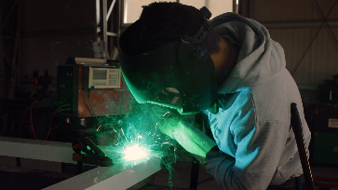
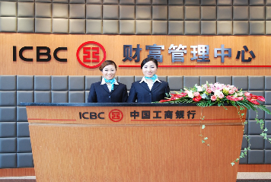
Staff as an asset - value
Staff can be viewed by the business as an asset
An asset is: a useful or valuable thing or person
Staff which support the manufacturing process (1) or who give great customer service (2) can both contribute to the value of the output – add value to the product

Slide 17
Staff as an asset – developing staff
Treating staff as an asset means that they are developed with training and seen as a benefit to the business
A member of staff will have been recruited, trained and developed and as such has unique skills relevant to the business
Some staff are very highly skilled – could you operate a high crane?

Slide 18
Staff as an asset – participation in decision making
Advantages to the business of treating staff as an asset is:
Staff are allowed to participate more in decision making
The business is more able to respond quickly to market changes
Staff have more autonomy over their work, which is more motivating for the staff and will increase retention rates and reduce absenteeism
An amazing chef can be a real asset to a business and add value to the meal with flavour, dishes and showmanship

Slide 19
Staff as a cost
Staff may also be considered to be a cost of the business, if they are to be productive they need to be invested in. There are lots of costs to be aware of, but these are the six main ones that your exam board is keen for you to be able to discuss and apply to a given case study. Get ready to make some notes on these from the next few slides,
Cost of recruitment
Cost of training
Cost of paying minimum wages
Cost of paying staff salaries and wages
Cost of staff welfare
Cost of redundancy

Slide 20
#1 Cost of recruitment
The costs of recruitment can be high.
A business may carry out the recruitment themselves, costs add up, from the advert for the job to the employee time away from their job to carry out interview
If a business decides to use an agency to hire their staff this can mean a payment of up to £2,000 per employee that they take on

Slide 21
#2 Cost of training
Staff training is often viewed as a cost rather than adding value, however companies with innovative learning and development programmes are increasing sales revenue and retaining their staff for longer
Training is an ideal way to close the skills gap in a business
What are the costs of NOT training an employee?
Notes:
Unhappy employees who leave affecting staff retention rates
Unhappy customers – poor customer service

Slide 22
#3 Cost of minimum wage
A business in the UK is bound by employment laws
One of these laws is the minimum wage law, businesses must pay these rates or higher to their workers - if the don’t they face high fines and “naming and shaming”
Notes:
Correct as Aug 2018

Slide 23
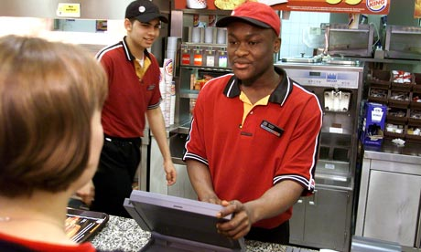
#4 Cost of salaries and wages
A salary is paid to permanent staff and is usually a year’s salary divided into 12 equal monthly amounts e.g. £1,200 a month
Wages are paid to staff on an hourly basis e.g. £7.83 an hour

Slide 24
#5 Cost of staff welfare
Staff welfare is an umbrella term that can mean anything and everything from facilities and benefits, to working conditions and retirement pension rates.
An employee who is well cared for will be more fulfilled and satisfied in their job so are less likely to leave
For example staff who work off site need to be provided with suitable toilet facilities , which is why you may see a port-a-loo on a building site! HSE guide here

Slide 25
#6 Cost of redundancy
Employees are made redundant when the job no longer exists. In comparison being fired is when an employee does not do their job correctly.
Employees may be entitled to redundancy pay and this depends on how long they have been employed
Look at the rates here

Slide 26
1.4.1 Approaches to staffing
a) Staff as an asset; staff as a cost
b) Flexible workforce:
multi-skilling
part-time and temporary
flexible hours and home working
outsourcing
c) Distinction between dismissal and redundancy
d) Employer/employee relationships
individual approach
collective bargaining

Slide 27
Flexible workforce

Slide 28
Flexible working. Sounds great, but is it actually working?
https://youtu.be/T-yXbROOABc
What is the 'gig' economy?
https://www.youtube.com/watch?v=gKtuBedlMG0
The Gig Economy: flexible freedom or wage slavery?
https://www.youtube.com/watch?v=1yH96FO0ZUM

Slide 29
Multi-skilling
This means having a workforce that can be moved around from one job to another.
For example a history teacher than can also teach English or Geography is really useful to a school
Another example would be a builder that can plaster, plumb or do electrics

Slide 30
Multiskilling
Disadvantages
Workers become a “Jack of all trades master of none”
Businesses lose the benefits of having specialist staff
Advantages
Less staff are needed, those that are employed are used to capacity not standing around
More interesting jobs for the workers as there are a variety of tasks
This can increase efficiency, quality and productivity while reducing costs

Slide 31
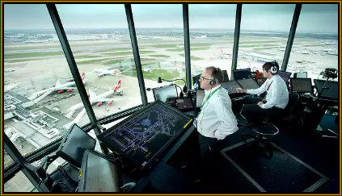
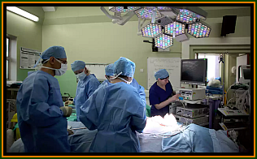
Full time work
There is no specific number of hours that makes someone full or part-time, but a full-time worker will usually work 35 hours or more a week
The maximum you can work a week is 48 hours (by law)
Average pay before tax: £77,220
Average pay before tax: £80,628.

Slide 32
Full time work
Disadvantages
Employees standing idle if there is a business downturn
Less flexible than part-timers, no-one to cover late nights and weekends
Advantages
May be more highly paid per hour than part-time
Access to more holiday entitlement
Employees are committed to the business and may be more productive
Loyalty to the business

Slide 33
Part-time work
A part-time worker is someone who works fewer hours than a full-time worker.
So this is someone who works less than 35 hours a week
Part time workers should get the same benefits as a full-time worker on a “pro rata” basis
Example part-time jobs; delivery driver, accountant, graphic designer, shop worker

Slide 34
Part time work
Disadvantages
Employees might not give the business the commitment and loyalty that a full-time worker would
Employee may work more than one job which would make them inflexible
Employee might leave if they find a full-time job
Advantages
Good way to keep costs down while a business is growing
Part-time jobs attract a wide pool of applicants with experience and skills who might not want a full-time job
Flexible to respond to seasonal changes in demand
Part-time employees have the same employment rights as full-time employees
The availability of part-time work can attract skilled workers who are unable to work full-time

Slide 35
Temporary work
A temporary (temp) job is one where the employer only needs extra staff to cover a seasonal period
If you ever had a supply teacher – this was a temporary job
Other examples are Christmas staff in retail stores and holiday reps in resorts
The business can cover staff shortages and keep their costs low
Temporary staff can be employed directly by the business or can be employed from an agency

Slide 36
Temporary work
Disadvantages
Agency staff may be expensive but it may be cheaper than hiring permanent staff
Injury rates are higher in temp workers
All staff will need some kind of training to get them started, this costs time and money
Advantages
Ideal for a business that needs extra workers for a special project
Useful to meet seasonal demands, and work fluctuations
Useful to meet employee shortages
Agencies may complete all the paperwork

Slide 37
Permanent work
A permanent contract is the most common type of employment, an indefinite contract whereby you are employed by the company until either the employee leaves is fired or made redundant

Slide 38
Permanent work
Disadvantages
Permanent staff can develop negative attitudes to work, or get involved in office politics and so may become lazy, uncooperative or disinterested in the business
Advantages
Staff will be very focussed on the business, they will look to the long-term to build up their professional development profile with the business.
Higher staff morale as they know they have a secure job
Employees have loyalty to the business which reduces absenteeism and increases produtivity

Slide 39
Flexible hours
Flexible working is a way of working that suits an employee’s needs, e.g. having flexible start and finish times, or working from home
All UK employees have the legal right to request flexible working - not just parents and carers
Work is divided up into “core” and “flexi time”

Slide 40
Flexible hours
Disadvantages
Can sometimes confuse suppliers or customers who may want to speak to the same member of staff
The business may need extra staff to cover unmanned periods
Advantages
From a business perspective flexible working can keep valuable staff from leaving and can also cover busy periods
Can accommodate the work life balance needs of employees with busy lives and families

Slide 41
Zero hours contracts
Zeros hours contracts means that employees are “on call” to work when you need them, but they have no fixed hours of employment
The employer does not have to provide the employees with work
The employees can say no if the employer calls and offers them work that day
910,000 employees in the UK are on zero hours contracts; hotels, fast food, Sports Direct etc.*
Zero hour contracts are banned in New Zealand (fact)
Notes:
* source: https://www.theguardian.com/business/2017/mar/03/zero-hours-contracts-uk-record-high

Slide 42
Zero hours contracts
Disadvantages
Employees might not give the business the commitment and loyalty that a full-time worker would
Employees may become unhappy with the zero hours and leave to find more permanent work
Advantages
Great for a business where work can be unpredictable
Ideal where staff are needed at short notice
Gives the employer great flexibility, no staff standing around with nothing to do

Slide 43
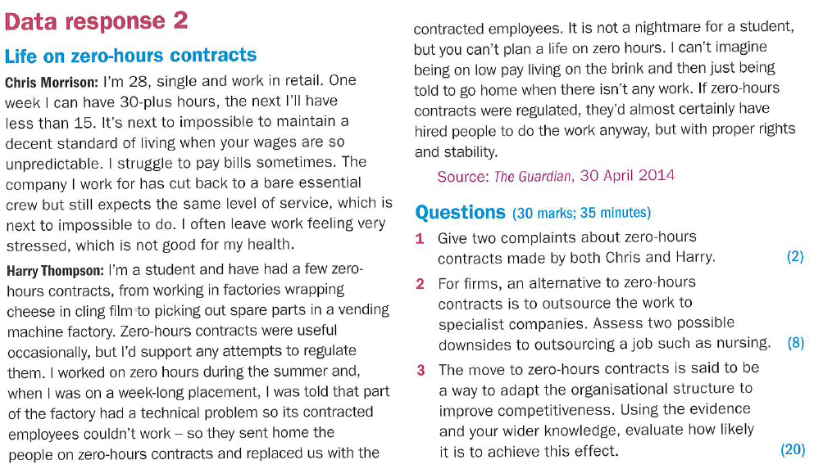

Slide 44
Home working
Over the last decade in the UK home working has gone from unusual to quite normal for a number of industries
The employer lowers their overhead costs by not having to provide offices and supervision
The employee cuts out the cost and stress of a commute and can set their own work hours

Slide 45
Suggested activity
Draw up a list of 5 advantages and 5 disadvantages you think that there are to working from home
Then write a conclusion, looking at your lists, explain if you think that working from home is a good idea or a bad idea and justify your answer.

Slide 46
Advantages of working from home
Fit a business round a family, gives a good work-life balance
The owner can work hours that suit their lifestyle
No commute, so reduction in costs of travelling
No expensive premises to pay for, so a reduction in fixed costs
Less stress from travelling and tension with colleagues

Slide 47
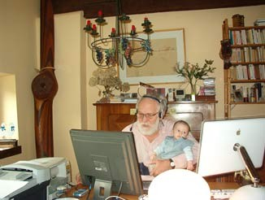
Disadvantages of working from home
No socialisation with other workers, so business owner may not have anyone to bounce ideas off
Work is all around the business person so they may find it hard to switch off
The business owner may find that they work more hours than a regular job as they don’t keep track of the time that they work
Needs lots of self discipline to avoid distractions
Too easy to be lazy and not work

Slide 48
As a company grows it cannot afford to be an expert in lots of areas and job roles.
It may not want to take on staff on a full time permanent basis. The outsourcing of non-core activities to the business is important way for them to achieve greater efficiency and productivity.
Think of it as “plug and play” solutions.
This is a third party company that specialises in the role and can be hired on a contract (rather than permanent basis).
See next slides for examples of functions and roles that can be outsourced

Slide 49
Outsourcing examples
Production
Payroll
Purchasing
Delivery

Slide 50
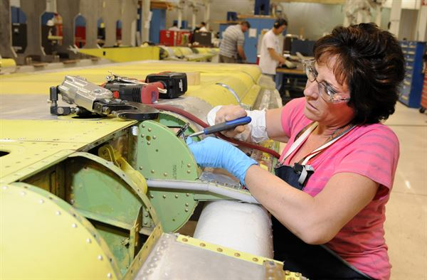
Outsourcing - production
Production; Some motor manufacturers now outsource not only parts but complete assemblies – steering, transmissions, engines, interior assemblies
Can you research to find production outsourcing companies in your country?

Slide 51
Outsourcing - payroll
Payroll is the function of the finance department that makes sure that all the staff get paid the right amount, on time
Payroll; is the one of the most common task that companies outsource. Services include weekly/monthly/quarterly payroll and normally attending to the completion of the (many) Government returns

Slide 52
Outsourcing - IT
Purchasing and maintaining information systems; hiring and evaluating IT staff and training users can all be very difficult. By outsourcing the information systems function, the business can obtain the latest technology and suitably skilled personnel
An IT helpdesk could be anywhere in the world

Slide 53
Outsourcing - delivery
Delivery; Larger businesses might prefer to contract a major delivery firm rather than maintain their own fleet.
Either way, the business can hire the expertise to keep delivery problems and decisions off their desk
For delivery a business could use Eddie Stobart, can you name 3 more delivery companies?
Notes:
UPS, DHL, yodel, Hermes and so on…

Slide 54
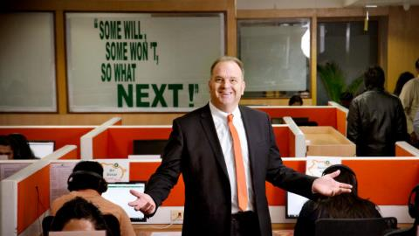
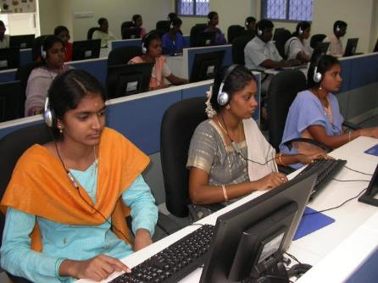
Keep a call centre in the UK or move it to India?
This is a cracking opportunity to work on your counter balance
Can you argue both ways, to move it and to keep it in the UK?

Slide 55
Advantages of moving a call centre to India slide 1/2
India is a hub of talent. It has skilled call centre professionals who can provide businesses with efficient services at fraction of the UK cost.
Indian call centres utilise the best of technology, software and infrastructure.
The time zone difference between western countries and India makes it possible for companies to offer customers quality services on a 24x7 basis.
A vast majority of the Indian population speaks English. They also have workers who can speak other foreign languages like French, German, Spanish.
Language warning!

Slide 56
Advantages of moving a call centre to India slide 2/2
India also has a growing pool of technical talent, making it an ideal location to outsource call centre services to.
India's highly advanced satellite-based telecommunication network helps in high-speed transfer of voice and data from all over the world.
The Indian government is very supportive of the IT industry and does all it can to nurture it.

Slide 57
Disadvantages of moving the call centre to India slide 1/2
One of the biggest disadvantages of outsourcing is the risk of losing sensitive data and the loss of confidentiality.
Losing management control of business functions mean that businesses may no longer be able to control operations as well as if the were in domestic markets.
Problems with quality can arise if the outsourcing provider doesn't have proper processes and/ or is inexperienced in working in an outsourcing relationship.
Language warning!

Slide 58
Disadvantages of moving the call centre to India slide 2/2
Since the outsourcing provider may work with other customers, they might not give 100% time and attention to a single company. This may result in delays and inaccuracies in the work output.
Hidden costs and legal problems may arise if the outsourcing terms and conditions are not clearly defined.
Not understanding the culture of the outsourcing provider and the location where the business outsources to may lead to poor communication and lower productivity.

Slide 59
1.4.1 Approaches to staffing
a) Staff as an asset; staff as a cost
b) Flexible workforce:
multi-skilling
part-time and temporary
flexible hours and home working
outsourcing
c) Distinction between dismissal and redundancy
d) Employer/employee relationships
individual approach
collective bargaining

Slide 60
Distinction between dismissal and redundancy

Slide 61
Dismissal - fired
Worker may be dismissed or fired from a job for:
Absenteeism
Gross misconduct (showing up drunk)
Theft of company money or property
Worker is not entitled to a pay-out from the business if dismissed
This may also be called being “fired” or “sacked”

Slide 62
Redundant / redundancy
Worker’s job no longer exists possibly due to lack of business or restructuring
Redundancy is sometimes: voluntary – where some staff close to retirement take voluntary redundancy to gain a pay-out
Compulsory redundancy is where a member of staff must leave a job

Slide 63
Employer/employee relationships

Slide 64
Problems at work
If there are problems at work employees can be represented by a member of their trade union. Rather than 300 employees all complaining to the boss about the same thing the trade union rep will argue on their behalf
This is called collective bargaining (the union rep bargains on behalf of the collective)

Slide 65
British Airways Employee Sacked for Having a Man Bun | Good Morning Britain
https://www.youtube.com/watch?v=A6hUuImuX5E

Slide 66
A Short History of Trade Unions
https://youtu.be/gPPeDO4dMRA

Slide 67
Trade unions
A trade union is an organisation with members who are usually workers or employees. It looks after their interests at work by doing things like:
negotiating agreements with employers on pay and conditions
discussing big changes like large scale redundancy
discussing members’ concerns with employers
going with members to disciplinary and grievance meetings
Name me three Trades Unions
Notes:
https://www.gov.uk/join-trade-union/joining-a-trade-union

Slide 69
What are the differences between craft/occupational union, Industrial union and General union.

Slide 71
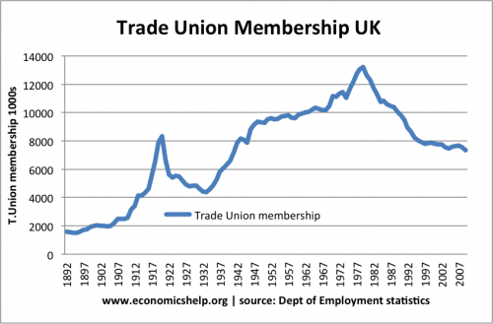
Account for the decline in TU membership since 1980

Slide 73
Trade Unions in the UK I A Level
https://www.youtube.com/watch?v=g_xQKO8cBCE

Slide 74
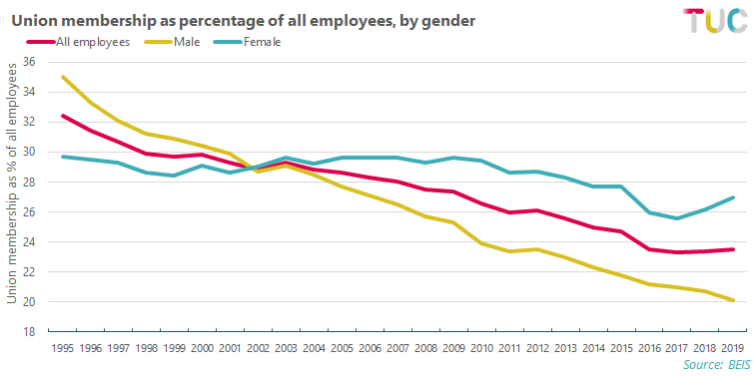
Explain why TU membership is now higher amongst female workers.

Slide 75
Real wages have stagnated since the Great Recession.

Slide 76
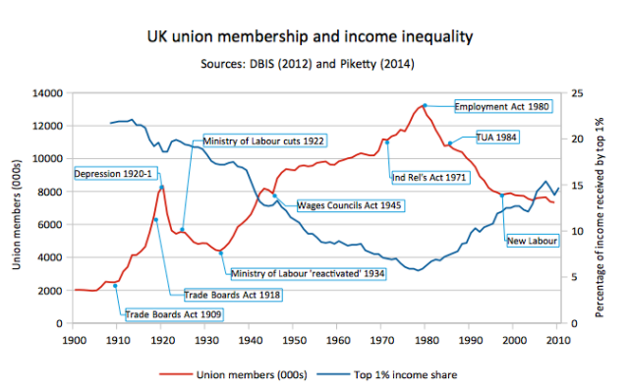
Explain the relationship between TU membership and income inequality.

Slide 77
Sample Edexcel A2 questions

Slide 78
Case study for question 1
Notes:
No suitable A2 questions so I have borrowed this from Edexcel AS sample paper

Slide 79
Sample question 1
Knowledge 2
Application 2
Analysis
3
Evaluation
3

Slide 80
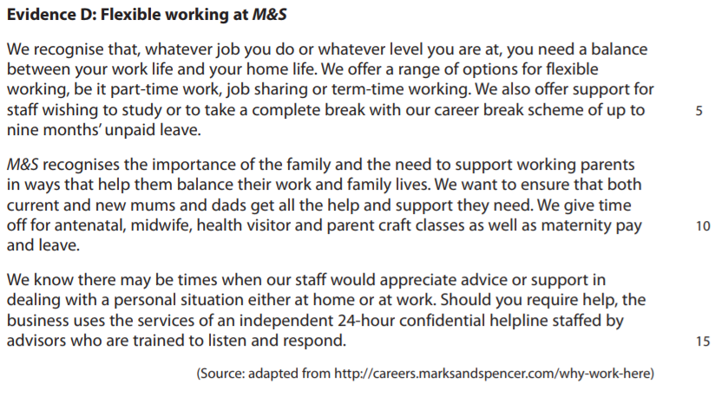
Case study for question 2

Slide 81
Sample question 2
Level 1
1-2
Level 2
3-4
Level 3
5-8
Level 4
9-14

Slide 82
Glossary
Collective bargaining; A union representative will speak to the management on behalf of all the workers in a business, usually about working conditions or pay
Multi-skilling; An employee is trained to do more than one job, for example an electrician is trained to plaster walls
Homeworking; Employees work from home to save commuting time and give them work life balance
Part-time; Employees work less than 35 hours a week but still get sick pay and work benefits
Temporary; Employees are hired on a fixed term contract, to finish building a housing estate for example
Zero hours; Employees are called into work only when they are needed, they get no work benefits and cannot be guaranteed work
Flexitime; Employees can start and finish when they need to as long as their work their 35 hours and the job gets done

Slide 84
https://www.gov.uk/redundancy-your-rights/redundancy-pay
https://www.theguardian.com/uk-news/2018/may/30/strikes-in-uk-fall-to-lowest-level-since-records-began-in-1893
https://www.theguardian.com/business/2022/jan/18/uk-workers-pay-rises-inflation-unemployment-covid
https://www.tuc.org.uk/sites/default/files/long-run.png
https://www.ibisworld.com/uk/bed/average-real-wage/44028/

