Slide 1
Business
2021

Slide 2
FAQ’s
Can you choose both Business and Economics?
Do you need to have studied Business at GCSE?
How is work divided between BGS and BHS?
BHS (Theme 1 and 3) BGS (Theme 2 and 4)
YES
NO

Slide 3
What do we study?
Functional areas of a Business
Accounting and finance
Human resources
Operations management
Marketing
External environment

Slide 5
Business decisions and strategy
Detailed research and planning:
Are important when undertaking an event
Reduces the risk of things going wrong

Slide 6
Making strategic decisions
This topic covers the various techniques that may be used by the business to inform their strategic decision making.
Students should consider non-financial information as well information generated by the techniques to aid decision making

Slide 7
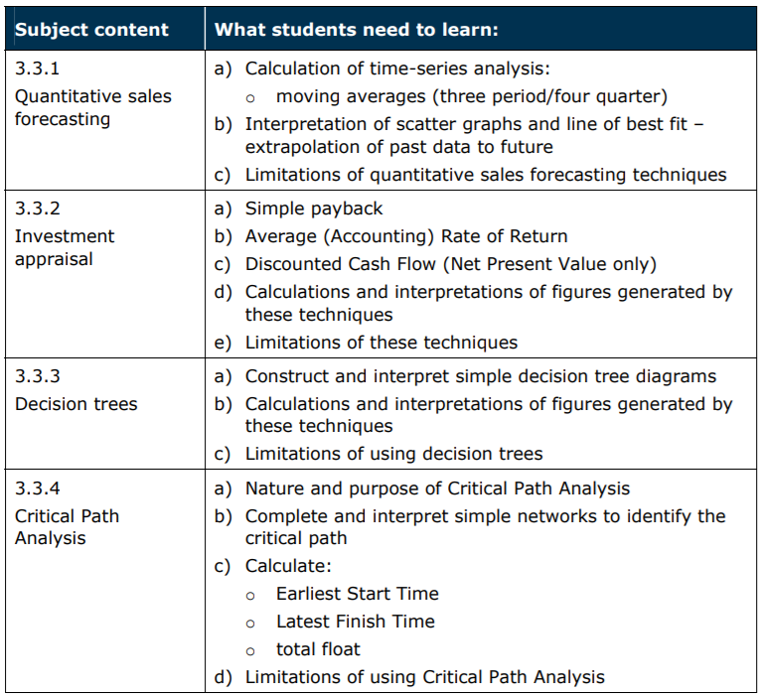

Slide 8
Critical Path Analysis

Slide 9
Get a pencil and paper
Write down all of the steps involved in order to brew a pot of tea and serve one cup of tea!
Estimate the duration of each task!
How long will it take for you to make one cup of tea?
Am I missing something?
Does it really take this long?
Open up record sheet

Slide 10
Activity | Description | Seconds
A | Fill kettle, connect to mains
B | Boil kettle
C | Put tea in pot
D | Pour boiling water in to pot and brew
E | Prepare cups and saucers
F | Pour milk in to cup
G | Put sugar in to cup
H | Pour brewed tea in to cup
I | serve
 | Total time taken

Slide 11
Timings
Activity | Description | Seconds
A | Fill kettle, connect to mains | 15
B | Boil kettle | 90
C | Put tea in pot | 10
D | Pour boiling water in to pot and brew | 130
E | Prepare cups and saucers | 20
F | Pour milk in to cup | 10
G | Put sugar in to cup | 10
H | Pour brewed tea in to cup | 10
I | serve | 5
 |  | 300
 |  | 5 minutes

Slide 12
Construct your networks!
Identify the order of each activity.
Now determine which activities follow on from a previous activity (Boil kettle follows on after filling kettle with water)

Slide 13
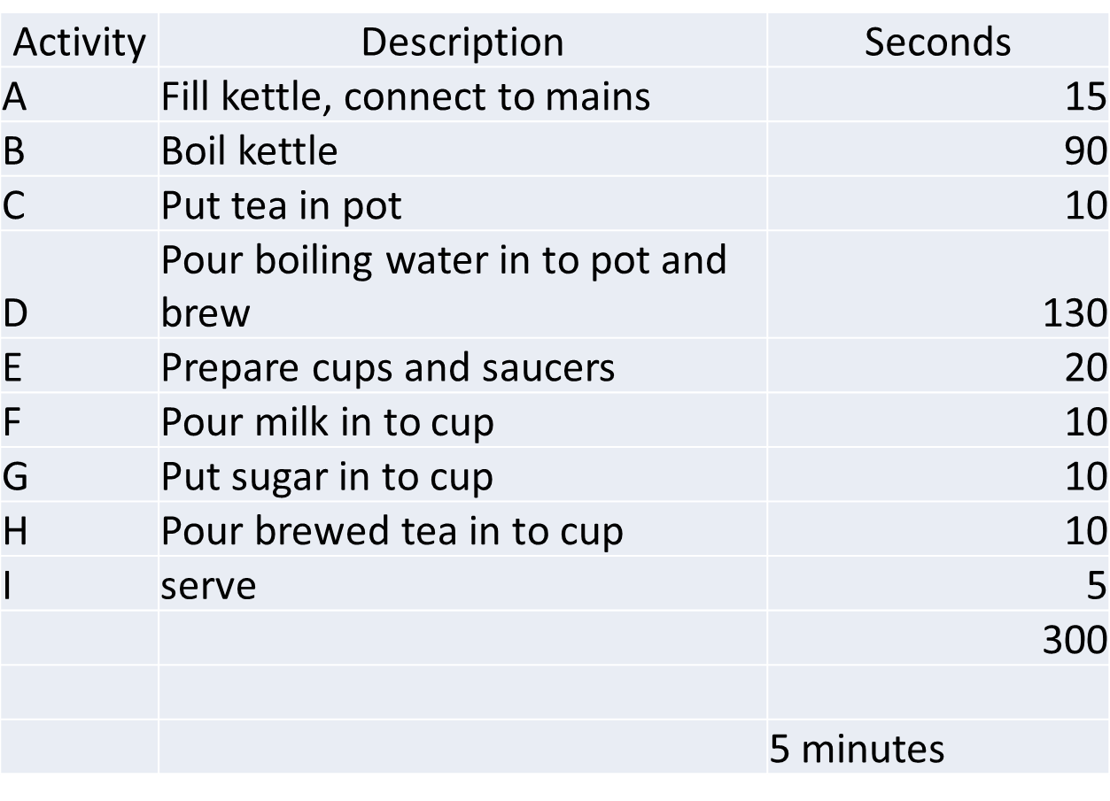
Label each activity correctly

Slide 14
Critical Path
How long will it take?
250 seconds
Why have I highlighted A,B,D.H.I in red?
A
B
D
15
90
130
C
H
10
10
F
E
10
I
20
G
5
10
Which activities must be closely supervised?

Slide 15
Boston Matrix

