Slide 1
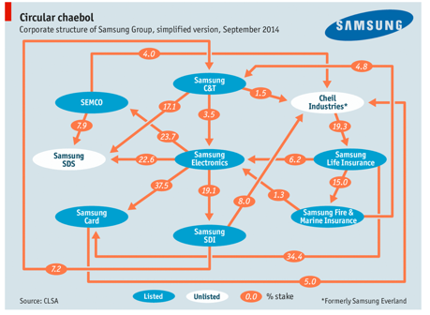
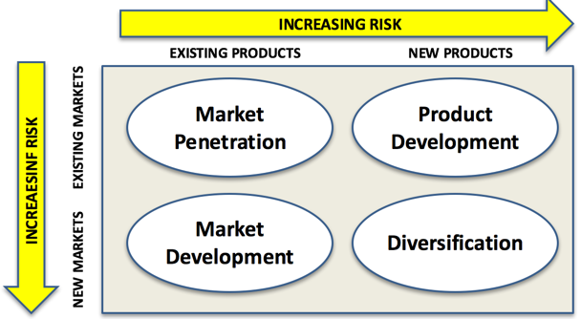
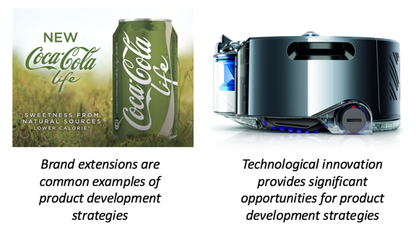
Ansoff’s Matrix
3.1 Business objectives and strategy

Slide 2
What you need to know
Theories of corporate strategy
a) Development of corporate strategy:
Ansoff’s Matrix

Slide 3
Concept links
Ansoff Matrix
Organic growth
External growth
Diversification
International expansion
Corporate objectives

Slide 4
What is the Ansoff Matrix?
A marketing planning model that helps a business determine its product and market strategy

Slide 5
Ansoff Matrix – the Grid
INCREASING RISK
EXISTING PRODUCTS
NEW PRODUCTS
INCREAESINF RISK
Market Penetration
Product Development
EXISTING MARKETS
Market Development
Diversification
NEW MARKETS

Slide 6
Market Penetration
A growth strategy where a business aims to sell existing products into existing markets

Slide 7
Market Penetration
Aim: to increase market share
By selling more existing products to the same target customers
Get existing customers to buy more
Widen the range of existing products

Slide 8
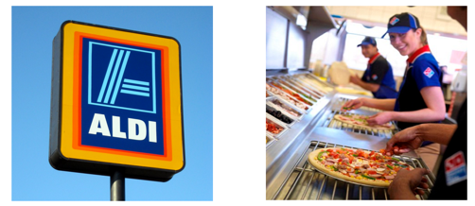
Examples of Market Penetration Strategies
Rapid organic growth in the UK targeting the same customer base with new stores
Effective use of e-commerce to encourage existing customers to buy more pizza!

Slide 9
Evaluating Market Penetration
Business focuses on markets and products it knows well
Can exploit insights on what customers want (and competitors)
Unlikely to need significant new market research
But will the strategy allow the business to achieve its growth objectives?

Slide 10
Product Development
A growth strategy where a business aims to introduce new products into existing markets

Slide 11
Examples of Product Development Strategies
Brand extensions are common examples of product development strategies
Technological innovation provides significant opportunities for product development strategies

Slide 12
Evaluating Product Development
A strategy that often plays to the strengths of an established business
Strong emphasis on effective market research (insights into customer needs) and successful innovation
A great way of exploiting the existing customer base
Being first to market is usually important

Slide 13
Market Development
A growth strategy where the business seeks to sell its existing products into new markets

Slide 14
Approaches to Market Development
New geographical markets; e.g. exporting to emerging markets
New distribution channels (e.g. using e-commerce and mail order)
Different pricing policies to attract new customers in different segments

Slide 15
Examples of Market Development Strategies
Starbucks expansion into China is a classic example of a successful market development strategy
Tesco’s market development strategy to enter the US grocery supermarket sector was a disaster for shareholders

Slide 16
Evaluating Market Development
A logical strategy where existing markets are saturated or in decline
Often more risky than product development – particularly expansion into international markets
Existing products may not suite new markets: depends on customer needs

Slide 17
Diversification
The growth strategy where a business markets new products in new markets

Slide 18
Examples of Diversification: Alphabet

Slide 19
Examples of Diversification: Samsung

Slide 20
Examples of Failed Diversification
Great example of a failed takeover and diversification: bought by ITV for £175m; sold fold £25m and then closed
Retailer HMV diversified into the live entertainment market with the £40m purchase of several live music venues. Exited the market soon after

Slide 21
Evaluating Diversification
Inherently risky strategy
No direct experience of the product or market
Few economies of scale (initially)
However, if successful, overall risk of the business is spread
Approaches to diversification
Innovation & R&D: develop new solutions
Acquire an existing business in the market
Extend an existing brand into the new market

Slide 22
Ansoff Matrix
INCREASING RISK
EXISTING PRODUCTS
NEW PRODUCTS
INCREAESINF RISK
Market Penetration
Product Development
EXISTING MARKETS
Market Development
Diversification
NEW MARKETS

