Slide 1
Edexcel A2 Business
2.5.3 The Competitive Environment
Revisionstation

Slide 2
Worksheet

Slide 3
From Edexcel
a) Competition and market size

Slide 4
Starter
How often do you shop at independent shops? Do you stick to chain stores? Can you recommend a good independent shop? What do the independents offer the shopper?

Slide 5
Definition: Competition
Competition in business is where more than one seller seeks to sell goods or services to a customer
In other words “competition” is rivalry amongst sellers
A highly competitive market has lots of rivalry and many sellers

Slide 6
Competition and market size

Slide 7
What is a competitive market?
There is a presumption that a competitive market:
- is good for consumers, innovation and the economy
will be more intense with more competitors
However, a market with 50 businesses may not be very competitive if one of them has 60% market share
Businesses do not like fierce competition and may use predatory pricing, USP and entry barriers to entry keep competition to a minimum

Slide 8
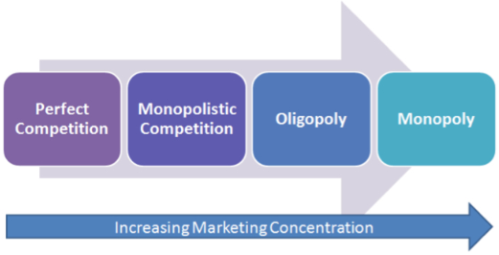
The degree of competition
Very few, if any, businesses operate without facing competition. It is not enough to understand what customers value. A business has to be able to deliver customer value better than the competition.
The ability to do this is heavily influenced by the structure of the market in which a business operates. The more competitive a market is – the harder the task becomes.
In economics, there are four main categories of market structure:

Slide 9
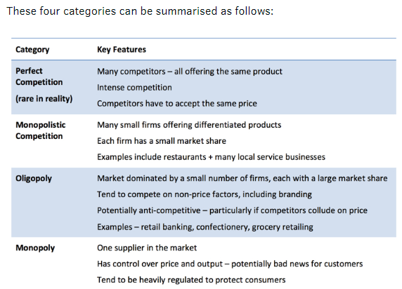

Slide 10
A monopoly in its purest form is when one business dominates the whole market – it has 100% concentration. In reality, the CMA describe a monopoly as any firm with more than 25% of the industry's sales.
Oligopoly collusion - When a few large firms dominate a market there is always the potential for businesses to seek to reduce uncertainty and engage in some form of collusive behaviour

Slide 11
Responses of businesses to a changing competitive environment
Price cutting - may help to maintain market share but at potentially lower profit margins. Refer to PED as well.
Increase product differentiation – Increase the extent to which customers perceive your product to be different and insulate the business from having to compete head on with its rivals
Design – eye catching design can add value to a product
Unique product features – MPG, distance travelled on one charge
Collusion – work together in order to avoid damaging consequences of fierce competition. This is common, but can lead to significant legal penalties.

Slide 12
What is Competitiveness?
Competitiveness is the ability of a business to deliver better value to customers than competitors.
If a business is able to be more competitive than the rest of the market or industry over a sustained period, it is said to have competitive advantage:
The ability of a business to add more value for its customers than its rivals and attain a position of relative advantage
A situation where a business has an advantage over its competitors by being able to offer better value, quality and/or service

Slide 13
Competition and Market Structure
The nature of competition in a market is determined by a variety of factors, including:
• The extent of current competition
• The potential for new businesses to enter the market
• The extent to which a business produces a similar product (indistinct from rivals) or a differentiated product (distinct from rivals)

Slide 14
Threat of new entrants
The threat of new businesses entering a market is a particularly important factor influencing the extent of competitive rivalry:
High profits will tempt newcomers to enter a market and this will drive down prices and profits
Therefore the maintenance of market power depends upon erecting and maintaining barriers to market entry

Slide 15
Competition
Competition from other businesses will impact on business decisions, your exam board would like you to know about these in particular:
Nature of business ownership
Nature of product or services produced
Nature of the product range
Pricing strategies used
Marketing methods used
Competition
Nature of business ownership
Nature of product or services produced
Nature of the product range
Marketing methods used
Pricing strategies used

Slide 16
#1 nature of business ownership
Competition from other businesses will have an impact on the decision to become a Private Limited Company (Ltd) or a Public Limited Company (PLC)
A business may wish to grow and to expand and to do this it will need a significant injection of finance and may need to become a Ltd or PLC to sell shares to raise to fund the expansion cash
Have a look at the PLCs, listed to sell shares on the London stock exchange, that are today’s risers and fallers. How many have you heard of? LINK HERE

Slide 17
#2 nature of product or services provided
Competition from other businesses may change the nature of the product or the services provided
Competition from Starbucks and Costa has meant that many smaller cafes and coffee shops now serve lattes and cappuccinos rather than just basic tea and coffee

Slide 18
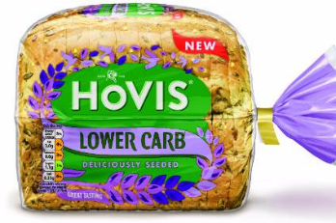
#3 nature of the product range
Competition from other businesses means that in some industries that whole nature of the product range has had to change
In response to consumer demand and competition from independent bakeries, the larger bread manufacturers have had to produce a whole “free from” range of new types of bread e.g. sourdough

Slide 19
#4 pricing strategies used
Competition from other businesses means that different pricing strategies have to be used to attract customers and remain competitive
Instead of skimming a business in a very competitive market would use competitive pricing to make sure that customers have to differentiate on non-price factors e.g. Airlines, differentiate on routes and customer service rather than enter a price war
Watch the video – how many “real” non-price factors was it showing?

Slide 20
#5 marketing methods used
Competition from other businesses means that marketing campaigns need to be exciting, up to date and eye catching
This is going to have a cost implication, but important where there are many sellers with the same product e.g. car insurance
Can you name 5 car insurance companies and their adverts?
Notes:
Admiral multicar etc

Slide 21
Independent vs Chain store: Tony and Guy
TONI & GUY has over 420 salons in 42 countries worldwide, employing over 5000 people in the UK and a further 2000+ employees across the world!
2013 marked fifty years of this iconic British hairdressing Superbrand, which is now the largest independent salon chain worldwide
Can independents survive along side this huge chain? How do independent hairdressers compete?

Slide 22
The impact on business of being in a competitive market
Competition forces prices down resulting in falling profit margins
In a highly competitive market businesses may needs to design new products to match what rivals are doing
The business may need to increase spending on advertising an branding to retain their competitive advantage
Competitive markets encourage innovation

Slide 23
Sample Edexcel A2 questions

Slide 24
Case study for question 1

Slide 25
Sample question 1
Knowledge 2
Application 2
Analysis
2
Evaluation
2

Slide 26
Case study for question 2

Slide 27
Case study for question 2

Slide 28
Sample question 2
Knowledge 2
Application 2
Analysis
3
Evaluation
3

Slide 29
Glossary
Competitive market; A competitive market is one where there are lots of rival retailers selling similar products
Independent trader; An independent trader is not part of a national chain

