Slide 1
Buddhist Beliefs - Revision
Focus;
How do we answer exam questions on Buddhism?
To begin… Recap quiz!
Introduction… W?

Slide 2
Buddhist Beliefs - Revision
4 mark ‘explain two…’ questions;
Think of these questions as 2 + 2 = 4 (for all papers and topics).
Explain two ways in which learning about the four sights influences Buddhists today.
One way in which the four sights influence Buddhists today is that
witnessing things like sickness, old age and death, helps them understand
compassion, just like it did for Buddha. This may encourage Buddhists to
help others.
Another way would be that it may encourage them to lead a spiritual life,
trying to understand how to end suffering. Much like Buddha did when he
saw the holy man.

Slide 3
Buddhist Beliefs - Revision
4 mark ‘explain two…’ questions;
Think of these questions as 2 + 2 = 4 (for all papers and topics).
Explain two differences between an Arhat and a Boddhisattva. (4 marks).
This is a Theravadan Buddhist belief and refers to a ‘perfected person’. An
Arhat is someone who has become enlightened and has overcome the causes
of suffering.
Whereas a Bodhisattva is a Mahayanan Buddhist belief that an enlightened
being remains in the cycle of samsara out of compassion for others in order
to help others to achieve enlightenment.

Slide 4
Buddhist Beliefs - Revision
5 mark ‘explain two…’ questions;
Think of these questions as 2 + 2 + 1= 5 (for all papers and topics).
Explain two Buddhist beliefs about dependent arising. (5)
Dependent arising is the belief that everything that
happens, happens as a result of something before it.
This is illustrated in the 12 nidanas such as the 12th
link, death, leading to the 1st link which is rebirth.
Dependent arising also links to the ideas of karma and
samsara because your actions have an affect which will
determine which realm you will be reborn in the wheel
of life. This is illustrated in the teaching, ‘If one acts or
speaks with an evil mind, from that sorrow follow him as the wheel follows the foot of the ox…’

Slide 5
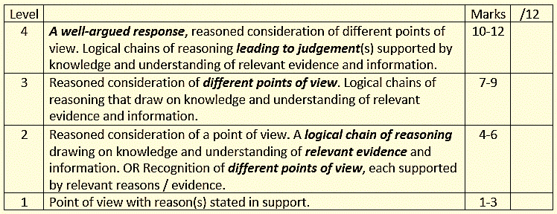
Buddhist Beliefs - Revision
12 mark ‘evaluate’ questions;
Make sure you fully focus on the statement and follow the instructions in the question.
In your answer you should:
• refer to Buddhist teaching
• give reasoned arguments to
support this statement
• give reasoned arguments to
support a different point of view
• reach a justified conclusion.

Slide 6
Buddhist Beliefs - Revision
‘Achieving Enlightenment is not that difficult’. Evaluate this statement. (12)
Some people might agree with this statement because Buddha was a human being, just like the rest of us and if he could achieve enlightenment, so can we. Also during his enlightenment Buddha discovered the Four Noble Truths, the second of which tells us why we suffer (tanha) and the fourth tells us how to end suffering by achieving enlightenment and being released from the cycle of samsara. The fourth noble truth is also known as the Eightfold Path, if we follow this we can achieve enlightenment as this is the ‘cure’ to end suffering by becoming enlightened. For example part of the Eightfold Path is meditation, this is how Buddha attained enlightenment, suggesting enlightenment can’t be that difficult if all we have to do is meditate and follow the rest of the Eightfold Path.
However, it took Buddha many years to achieve enlightenment. When he witnessed the four sights Siddhartha (Buddha) needed to find out why we suffer, he gave up his rich lifestyle and spent six years as an ascetic. Neither of these two life styles led him to the ‘truth’, suggesting that achieving enlightenment if very difficult. Whilst meditating, Siddhartha was distracted by Mara, he managed to overcome the distractions, but for most people, overcoming distractions whilst meditating is very difficult, therefore achieving enlightenment is very difficult.
Overall I disagree with the statement as achieving enlightenment is very rare and requires a lot of focus on spiritual practice.

Slide 7
Buddhist Beliefs - Revision
Buddhism (pa
1. Which

