Slide 1
3.1.1 Corporate objectives
a) Development of corporate objectives from mission statement/corporate aims
b) Critical appraisal of mission statements/corporate aims

Slide 2
Starter
This is a mission statement:
To inspire and nurture the human spirit – one person, one cup and one neighbourhood at a time.
Which business do you think this might be from?

Slide 3
Mission statement defined
A mission statement is a qualitative statement of an organisations aims

Slide 4
Development of corporate objectives from mission statement/corporate aims

Slide 5
Hierarchy of business objectives
Mission statement and general aims
Corporate Objectives
Department Objectives

Slide 6
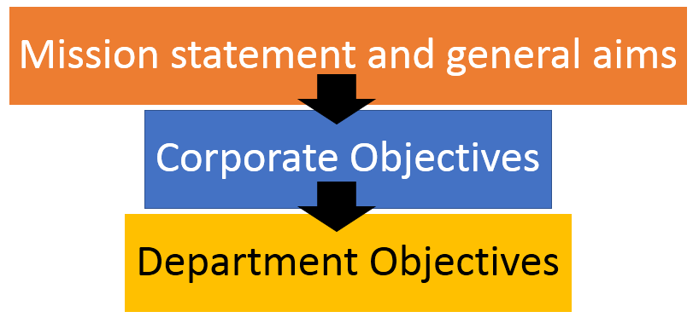
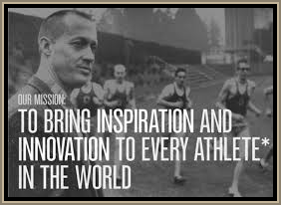
Mission statements
A mission statement is a short way of a business expressing their main intent
Nike’s mission statement is "To bring inspiration and innovation to every athlete* in the world.“
The legendary University of Oregon track and field coach, and Nike co-founder, Bill Bowerman said, "If you have a body, you are an athlete."

Slide 7
Mission statement - criticism
A mission statement is a document written by a business which should provide general aims for all the employees to work towards
Critics say that mission statements are just a public relations tool
"Our vision is to be earth's most customer-centric company; to build a place where people can come to find and discover anything they might want to buy online."

Slide 8
Mission statement – coca cola
The Coca Cola Company Mission
Our mission is:
To refresh the world in mind, body and spirit
To inspire moments of optimism and happiness through our brands and actions
To create value and make a difference.

Slide 9
Mission statement - Google
“Google’s mission is to organize the world’s information and make it universally accessible and useful”
Google Inc. is a multinational corporation that provides Internet-related products and services, including internet search, cloud computing, software and advertising technologies.
Advertising revenues from Ad Words generate almost all of the company's profits.”

Slide 10
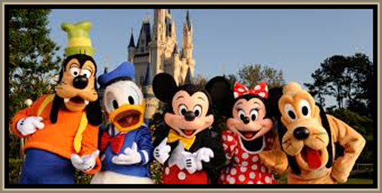
Mission statements
"The mission of The Walt Disney Company is to be one of the world's leading producers and providers of entertainment and information. Using our portfolio of brands to differentiate our content, services and consumer products, we seek to develop the most creative, innovative and profitable entertainment experiences and related products in the world."
A mission statement sets out the purpose and primary objectives of a business in the present.
A mission statement should be memorable
A mission statement should be inspiring
A corporate vision looks towards the future and where the business would like to be

Slide 11
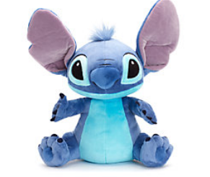
Corporate objectives
Corporate objectives should flow from the mission statement and corporate vision
Usually set by senior management for the whole company
Aimed at satisfying the shareholders so may be related to profit or dividends:
Increase operating profit 4% over the next 24 months
Increase dividends by 2% over the next three years
Objectives need to be SMART (see next slide)

Slide 12
SMART objectives
Specific; This means there must be a clear definition, often including a number
Measurable; This means the achievement can be checked
Achievable; This means you can achieve your target but you may need to stretch yourself
Realistic; This means that the target should sensible so that you can achieve it
Time-related; this means setting a date for achievement or review
Example: To achieve a 30% share of the total sales in the children’s clothing market within five years

Slide 13
Department objectives
In most businesses they divide up the work into departments or functions; sales, marketing, human resources, operations and finance
Each department will set their own objectives which should flow from the corporate objectives
For example, the marketing department may aim to increase sales 3% each quarter, or increase sales revenue 2% each year
This will help the business to achieve its corporate objectives of more dividends for the shareholders
What do you think the department objectives of Bape might be?
Notes:
This is Bape the latest must have brand for teenagers – its in here to make you look cool and so you can discuss what the department objectives of Bape might be

Slide 14
Critical appraisal of mission statements/corporate aims

Slide 15
What is the purpose of mission statements?
A mission statement can define the essence or purpose of the business in just a few sentences
It is the purpose of the business that is key in the statement
Notes:
https://www.adidas-group.com/media/filer_public/2013/07/31/adidas_gb_2012_en_booklet_en.pdf

Slide 16
Who is the intended audience for a mission statement?
EA games mentions the audience in their mission statement:

Slide 17
Notes:
https://www.inc.com/minda-zetlin/9-worst-mission-statements-all-time.html

Slide 18
How does the corporate strategy followed by the business compare to the mission in reality?
Old mission statement:
“To give people the power to build community and bring the world closer together.” WEBSITE HERE

Slide 19
Uses of mission statements
Focus; helps to focus and involve all employees in the business
Profitability; helps to motivate employees to become more efficient which could have an impact on profitability
Identity; helps to create an identity in a competitive marketplace
Apple designs Macs, the best personal computers in the world, along with OS X, iLife, iWork and professional software. Apple leads the digital music revolution with its iPods and iTunes online store.

Slide 20
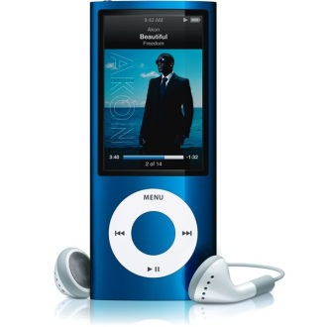
Limitations of mission statements
Can be unrealistic and over optimistic
Can be a waste of management time and resources
Can lead to conflicts and inconsistencies when not properly written
Can be ambiguous
Can become obsolete as the business develops but the mission statement remains the same (perhaps due to a merger or change of product, iPod to iPhone for example)

Slide 21
Stakeholder perspectives on mission statements
Owners
Managers
Employees
Pressure groups
Customers
Competitors

Slide 22
Stakeholder perspectives on mission statements
Owners | Owners will want to maximise shareholder value of the business
Managers | Manager will look for core aims and objectives of the business to lead their staff / teams with
Employees | Employees will look for motivational statements that make them feel proud to work for that company
Pressure groups | Pressure groups will look for a clear environmental or ethical message in the mission statement
Customers | Customers will look to see core business principals that are ethical
Competitors | Competitors will look to see if the business is visionary, competitive, innovative and organised

Slide 23
Try this mission statement generator

Slide 24
Sample Edexcel A2 questions

Slide 25
Case study for question 1

Slide 26
Sample question 1
Knowledge 1
Application 2
Analysis
1

Slide 27
Glossary
Mission statement; Defines the fundamental purpose of an organisation or enterprise, briefly describing why it exists and what it does to achieve its vision.
Corporate vision; outlines what the organisation wants to be, or how it wants the world in which it operates to be.*
Functional objective; a departmental objective which helps the business to achieve its mission
Notes:
Taken from : http://steinvox.com/blog/tip-for-2013-time-to-review-vision-and-mission-statements/

