Slide 1
Edexcel A2 Business
3.3.3 Decision trees
Revisionstation

Slide 2
Worksheet

Slide 3
From Edexcel
a) Construct and interpret simple decision tree diagrams
b) Calculations and interpretations of figures generated by these techniques
c) Limitations of using decision trees

Slide 4
Starter
You are a business that has a marketing budget of £1 million.
You can either launch a new product or re-market an old product. You cannot afford to do both.
How do you decide which option to take?
Notes:
This should lead to a discussion about weighing up the pros and cons of a decision and then to tools that can help a business to make decisions.

Slide 5
Decision Trees Defined
Example of a Decision
Tree
A business can’t afford to follow every option so it may use a decision tree to analyse the probability of a success in a choice of strategies;
A new product launch
A new marketing campaign on the current product
Relocation to a new building

Slide 6
Construct and interpret diagrams

Slide 7
You will need a ruler and selection of colours

Slide 8
How the decision tree works
A decision tree traces an alternative outcome of a decision, the results can be compared and the business can decide which option would be the most profitable
This is a quantitative approach (means it uses numbers) it is pictorial as it’s in the shape of a tree and it predicts the best bet outcome so a business knows what to spend its money on
The data is usually based on historical data from the business, for example they would know the probability of success of launching a new product would be 20% based on previous product launches and how well they had turned out

Slide 9
Step by step how to draw a decision tree

Slide 10
Start with a decision point
It all starts with a decision point which is a square, this may be empty, say “A” or “1” and it appears at the start
A decision needs to be made by the business at this point, there may be more decision points in the diagram and they are always a square

Slide 11
Add in two decisions to make
Now the business has to decide between courses of action, there will (obviously) be more than one
Launch a new product
Start a marketing campaign on the old product

Slide 12
Add chance nodes to the decisions
Each decision that the business makes may result in a number of outcomes. This is shown using a chance node which is always round
Launch a new product
A
B
Start a marketing campaign on the old product

Slide 13
Add probability data
Now the success or failure probability data can be added to the diagram (you will be given this data in a question)
Success
The more eagle eyed amongst you will have noticed that the probabilities from each chance node must add up to one e.g. 0.8+0.2 = 1
0.2
Failure
Launch a new product
A
0.8
So if some probability data is missing in a question you CAN fill it in
B
Success
Start a marketing campaign on the old product
0.4
Failure
0.6

Slide 14
Fill in the probability data example exercise
Success
0.6
Failure
A
Whiteboard exercise:
Fill in the two failure probability values (orange squares), press the Esc key for the answers
B
Failure
Success
0.5
Notes:
Failure of A is 0.4
Failure of B is 0.5
They add up to 1

Slide 15
Example 1

Slide 16
Start here again…
Success
0.2
Failure
Launch a new product
A
0.8
B
Success
Start a marketing campaign on the old product
0.4
Failure
0.6

Slide 17
Add the expected profit or loss from each decision
Now the profit or loss expected from each outcome is added to the diagram
Success
£15 million profit
0.2
Failure
Launch a new product
(£-2 million) Loss
A
0.8
B
Success
Start a marketing campaign on the old product
£7 million profit
0.4
Failure
(£-1 million) Loss
0.6

Slide 18
Calculate expected outcome node A
Now the expected value of each outcome is calculated,
where 0.2 x 15m + 0.8 x (-2m) = 1.4m
Success
£15 million
0.2
£1.4 million
Failure
Launch a new product
(£-2 million) Loss
A
0.8
B
Success
Start a marketing campaign on the old product
£7 million
0.4
Failure
(£-1 million) Loss
0.6

Slide 19
Calculate expected outcome node B
Now the expected value of each outcome is calculated, where 0.4 x 7m + 0.6 x (-1m) = 2.2m
Success
£15 million
0.2
£1.4 million
Failure
Launch a new product
(£-2 million) Loss
A
0.8
B
Success
Start a marketing campaign on the old product
£7 million
0.4
£2.2 million
Failure
(£-1 million) Loss
0.6

Slide 20
Choose the higher yield option
Now the final values are analysed. In this example option B should be followed as the expected value is higher
Success
£15 million
0.2
£1.4 million
Failure
Launch a new product
(£-2 million) Loss
A
0.8
B
Success
Start a marketing campaign on the old product
£7 million
0.4
£2.2 million
Failure
(£-1 million) Loss
0.6

Slide 21
Example 2

Slide 22
Positive numbers AND cost of project is known
If the costs of the two projects are given you approach the question in a different way:
Success
Launch a new product £1 million
£20 million
0.2
Failure
£1 million
A
0.8
B
Success
Start a marketing campaign on the old product
£0.7 million
£7 million
0.4
Failure
£1 million
0.6

Slide 23
Positive numbers AND cost of project is known
This time add together the outcomes and then minus the cost of the project (in red) to find how much profit will be made from each decision
Success
0.2 x 20 = £4 million
Launch a new product £1 million
£20 million
0.2
£4.8m – cost of £1m = £3.8m
Failure
£1 million
0.8 x 1 = £0.8 million
A
0.8
B
Success
Start a marketing campaign on the old product
£0.7 million
£7 million
0.4 x 7 = £2.8million
£3.4m – cost of £0.7m = £2.7m
0.4
Failure
£1 million
0.6 x 1 = £0.6 million
0.6

Slide 24
Alternative method if cost of projects is known
Now look at the project which is most likely to yield the highest amount. This is the project that you should choose.
Success
0.2 x 20 = £4 million
Launch a new product £1 million
£20 million
0.2
£4.8 million - £1 million = £3.8 million
Failure
£1 million
0.8 x 1 = £0.8 million
A
0.8
B
Success
Start a marketing campaign on the old product
£0.7 million
£7 million
0.4 x 7 = £2.8million
£3.4 million - £0.7 million = £2.7 million
0.4
Failure
£1 million
0.6 x 1 = £0.6 million
0.6

Slide 25
Example 3 – question with text

Slide 26
Bob’s farm example decision tree Read the text below then complete the tree on the next slide
Bob decides to grow some fruit and veg in a field on his farm. He can’t make up his mind so he is using a decision tree.
He could plant lettuce 0.6 chance of a good crop netting a £50,000 profit and 0.4 chance of a bad crop but still getting a £10,000 profit. This option will cost him £10,000 to plant, tend and harvest.
Or he could plant strawberries, with a 0.5 chance of a £40,000 good season’s profit and a 0.5 chance of a bad season making just £5,000. This option is less expensive at just £5,000.
Draw a decision tree – which option should Bob pick?

Slide 27
Answer to Bob’s problem
Good crop
£50,000
£50,000 x 0.6 = £30,000
0.6
£30,000+£4,000 - £10,000 (cost) = £24,000
Grow Lettuce
Bad crop
Cost £10,000
£10,000
£10,000 x 0.4 = £4,000
A
0.4
B
Cost £5,000
Good crop
£40,000
£40,000 x 0.5 = £20,000
Grow Strawberries
0.5
£20,000+£2,500 - £5,000 (cost) = £17,500
Bad crop
£5,000
£5,000 x 0.5 = £2,500
0.5

Slide 28
Limitations

Slide 29
Limitations
Decision trees are based on predicted data of the potential impact of a decision
Decision tree does not take into account unforeseen costs and circumstances
Probabilities and net outcomes are all estimates
Using decision trees might fit with the culture exhibited by the business but this is likely to be overridden by the need to act quickly, which would suggest the decision trees are not that useful in some situations
Large degree of uncertainty about any situation that a decision tree might be used for, so the benefits of adding numbers to uncertainty e.g. 58% might not be correct

Slide 30
Revision Video

Slide 31
Sample Edexcel A2 questions

Slide 32
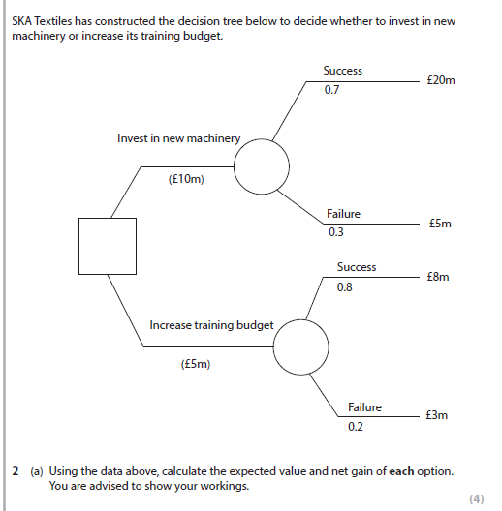
Case study and sample question 1

Slide 33
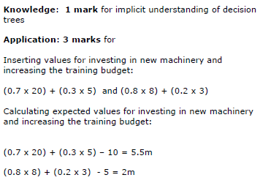
Answer sample question 1

Slide 34
Sample question 2
[20]

Slide 35
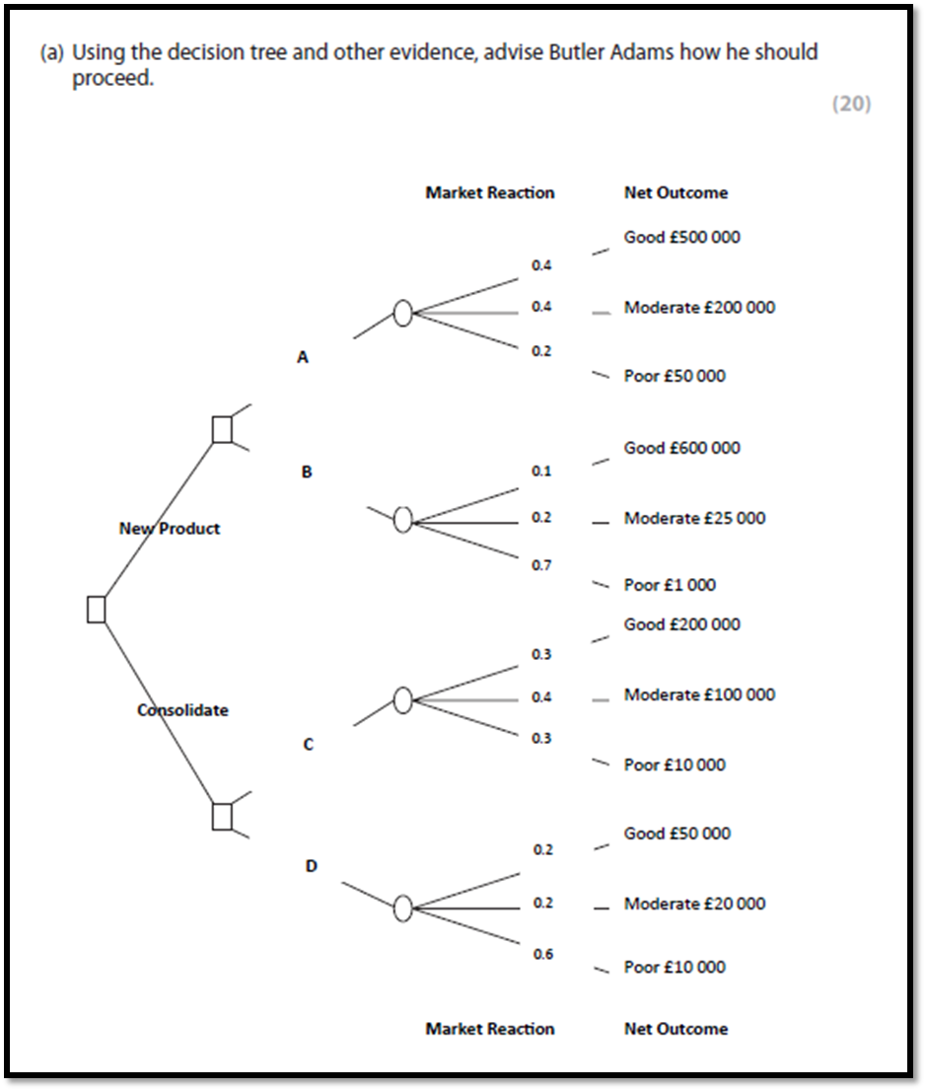
Case study for question 2

Slide 36
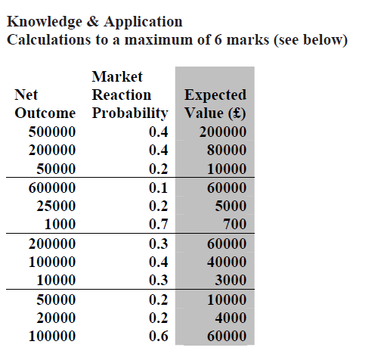
Answer sample question 2
This is all the exam board give you as an answer – can you draw the correct tree using this table?

Slide 37
How to level sample question 2
1 | 1-3 | Knowledge of probability; decision-points; expected outcomes etc.
2 | 4-6 | See results in table • At the lower end of the range answers may describe the business implications of different probabilities and net outcome mentioned in decision tree diagram
3 | 7-12 | • Launching a new product after thorough testing and development has the highest Expected Value (£200000). However, there is only a 0.4 probability attached to this choice which is risky • Importantly though a ‘moderate’ market reaction to a new product is the next highest EV – add these together and there is a 0.8 chance of a ‘positive’ response to a new product launch • Brompton customers are used to high levels of design and engineering quality; they are therefore more likely to buy and thoroughly tested new product at launch
4 | 13-20 | • Launching a new product and thoroughly developing the product is the best option in both quantitative and qualitative terms • This decision fits with the corporate culture and values of the business and also allows them to respond to a rapidly changing market for folding bikes • Consideration though must be given to the weaknesses and assumptions underlying the Decision Tree method (probabilities and Net Outcomes being estimates)

Slide 38
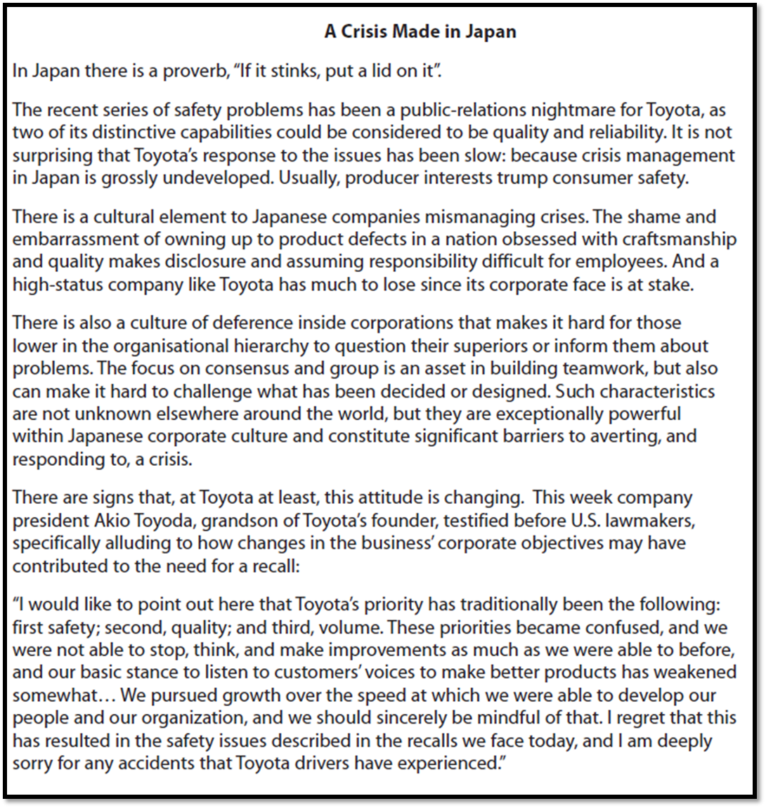
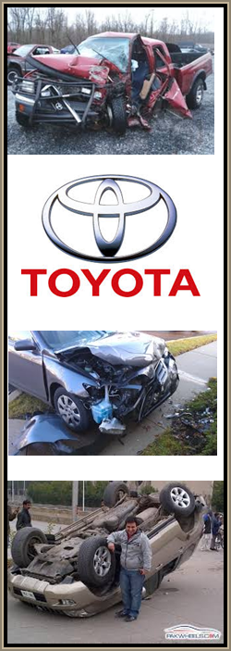
Case study for question 3

Slide 39
Sample question 3
[10]
Knowledge 2
Application 2
Analysis
3
Evaluation
3

Slide 40
Answer sample question 3
1 | 1-2 | e.g. Decision trees help businesses to attach probabilities to the outcomes of decisions e.g. Expected outcomes/values give a financial value to the results of decisions which account for different probabilities
2 | 3-4 | e.g. Toyota could estimate the financial cost of recalls in different markets e.g. Toyota is an established business and will have lots of previous sales data to help construct probabilities and expected outcomes
3 | 5-6 | e.g. Decision tree analysis will help Toyota to quantify their recall decision as this can be more easily communicated to key stakeholders such as managers e.g. If the full financial implications of the recall decision can be estimated accurately this means decision trees may be a rational basis for making decisions e.g. Decision trees take time to construct accurately and customers need immediate feedback on the status of their vehicle
4 | 7-10 | e.g. Decision trees are based on predicted data of the potential impact of a decision such as a recall e.g. Decision tree does not take into account unforeseen costs and circumstances such as a delay in shipping. e.g. Using decision trees might fit with the cautious culture exhibited by the business but this is likely to be overridden by the need to act quickly, which would suggest the decision trees are not that useful in this instance

Slide 41
Glossary
Decision tree; A pictorial decision making tool that shows all possible outcomes from a decision
Chance nodes; these are always round and show the probabilities of the success or failure of a decision
Probabilities; the chance that an outcome will happen, for example 0.5 is 50% chance
Expected monetary values; the financial outcome from each decision
Decision point; this is a square and indicates where a business must make a decision

Slide 42
Revisionstation also produces a pack called “Tricky Topics” with lots more decision tree worksheet examples!

