Slide 1
Edexcel A2 Business
1.5.6 Moving from entrepreneur to leader
Revisionstation

Slide 2
Worksheet

Slide 3
From Edexcel
The difficulties in developing from an entrepreneur to a leader
The extra guidance (getting started guide) from the exam board explains that the difficulties in moving from entrepreneur to leader may include:
The need to delegate
Trust and verify
Learning to listen
Having an open mind
Being less reactive
Developing emotional intelligence

Slide 4
Starter
Imagine you started a market stall selling photos that you have had made into greetings cards.
The business has been so successful you need to take on extra staff. What are your first 3 decisions?
Notes:
You may start by asking family who you can trust with the added bonus of they may not draw a wage, you may get help cheap or for free. Then you need to issue commands and that is not so easy to do, so maybe you look at taking staff on – job centre? How can you trust these will have the right skills? How about a local college or university leaver? These are all dilemmas that face the entrepreneur when they start to expand.

Slide 5
The difficulties in developing from an entrepreneur to a leader

Slide 6
Definition: Entrepreneur
An entrepreneur is a person who sets up a business and takes risks in the hope of a profit or reward

Slide 7
Definition: Leader
The action of leading a group of people or an organisation, or the ability to do this.
To lead: to be in charge of, to show direction, to be superior to others.

Slide 8
Learning to delegate
When a business owner starts out as a sole trader they may be working on their own.
When the business grows an entrepreneur will need to learn to delegate tasks out to others so that they can focus on the more strategic areas of the business, such as developing a new product
Delegation means giving authority to others to carry out tasks (like permission)
Can you delegate? Have you ever delegated a task to someone else?

Slide 9
Trusting others
When hiring employees or taking a business partner an entrepreneur will have to learn to trust others
Often this will mean letting go of an idea that they have been nurturing or delegating tasks out to new employees
Trust is important in relationships with customers.
Can you explain this in the context of an independent café and of Heinz?

Slide 10
Listen to others
A good entrepreneur when moving to leader will need to discuss bigger decisions with other stakeholders in the business
For example the entrepreneur may need to listen to; a joint owner, a manager, an employee who may have good ideas, a customer with a complaint or an investor
Good leaders take the opinions of others into account and allow them to help with the business
What would the opposite of this mean?
Watch the video – how did “listening to others” help him in setting up his business?
Notes:
If the manager was very closed off and didn’t listen to others they may make poor decisions e.g. a restaurant owner who doesn’t listen to regular customers on ideas for the menu

Slide 11
Suggested activity – have an open mind
A manager is open-minded if they:
Accept new suggestions, comments and questions
Are always in search of new ideas and innovation
Are familiar with their market and potential competitors
Are motivated and flexible
Are open to learning new skills
Have a broad looking perspective
Have a flexible mind adaptable to various situations
Can make decisions based on sufficient knowledge
Are ready to consider and receive new ideas
Have a look at the list on the left
Tick all those that apply to you
How open minded are you?
How did you score?
1-4 Very closed to new ideas, stuck in old ways, likes routine, unlikely to innovate, slow to make decisions
4-7 Somewhat open minded, may try a few new ideas but may need more information before jumping in
8-9 Very open to new ideas, very innovative and creative and keen to try new things

Slide 12
Be less reactive
A true business leader will be less reactive to dynamic markets and more proactive
This means setting trends, being able to see a gap in the market, moving forward with a business idea ahead of the competition
First to market always has competitive advantage
Read this article and find out how Rachel Riley was proactive in her business

Slide 13
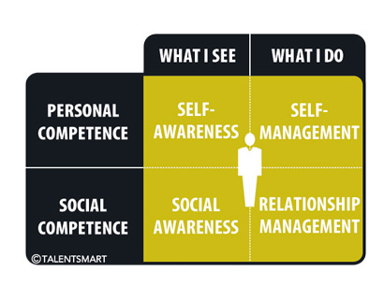
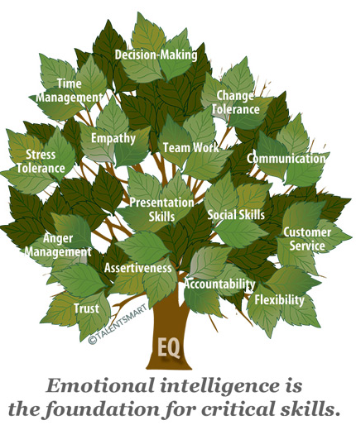
Develop emotional intelligence
Self-Awareness is your ability to accurately perceive your emotions and stay aware of them as they happen.
Self-Management is your ability to use awareness of your emotions to stay flexible and positively direct your behaviour.
Social Awareness is your ability to accurately pick up on emotions in other people and understand what is really going on.
Relationship Management is your ability to use awareness of your emotions and the others’ emotions to manage interactions successfully.
Notes:
Extract taken from: http://www.entrepreneur.com/article/241998

Slide 14
Discussion
There are no sample questions for this topic. Instead read the case study and discuss how Lord Somerleyton may have difficulties in moving from entrepreneur to leader

Slide 15
Glossary
Entrepreneur; a person who sets up a business, taking financial risks in the hope of making a profit
Leader; a person who has vision and followers
Emotional intelligence; to be able to recognise, use, understand and manage emotions in a positive way to reduce stress

