Slide 1
Edexcel A2 Business
1.2.5 Income Elasticity of Demand (YED)
Revisionstation

Slide 2
YED
This is YED it stands for Income Elasticity of Demand
We can’t use the letter “I” as that is reserved for the word Investment
So we use “Y” instead. The cartoon is here to help you remember it.

Slide 3
Worksheet

Slide 4
From Edexcel
a) Calculation of income elasticity of demand
b) Interpretation of numerical values of income elasticity of demand
c) The factors influencing income elasticity of demand
d) The significance of income elasticity of demand to businesses

Slide 5
Starter
Here are three statements:
We know that an inferior good is a good whose demand decreases when consumer income increases
We also know that a normal good (necessity good) is any good for which demand increases when income increases
We also know that a luxury good is a good for which demand increases more than proportionally as income rises
Now try the question on the next slide

Slide 6
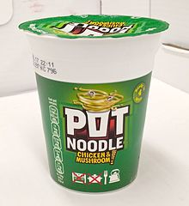
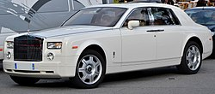
Starter – which product is inferior?
Notes:
Pot noodle – as your income rises you choose to buy a better quality dinner

Slide 7
Definition: Income Elasticity of Demand
Income Elasticity of Demand is also known as YED for short
It is a calculation used, by business, to estimate how demand will change given changes in income
As consumer incomes change (up or down) so do demands
So a business can measure how much demand for a product or service will be affected by a change in consumers income

Slide 8
YED in a nutshell
A
B
C
You have a part-time job which gives you a steady income. What do you have for lunch?
You are broke, what do you have for lunch?
You have a successful online business, what do you have for lunch?
Notes:
A – pot noodle
B – Mc Ds
C – meal out, steak anything posh nosh

Slide 9
Calculation of income elasticity of demand

Slide 10
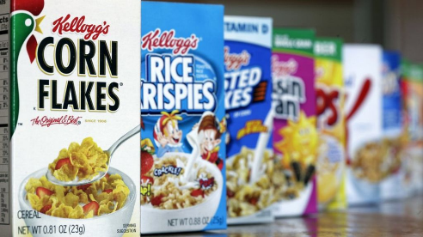
Normal (necessity) goods
Normal goods are those for which consumer demand increases when income increases
A good is normal when consumers demand more as their incomes increase
YED value would be >0 (a positive value)
For example the YED value for Kellogg’s cornflakes might be 0.4

Slide 11
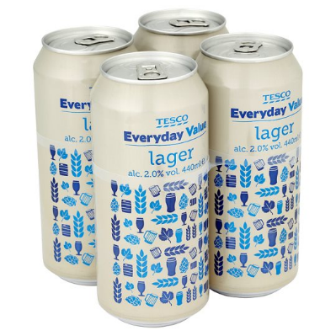
Inferior goods
Inferior goods are products where demand decreases as income increases
YED value for an inferior good will be <0 ( a negative value)
For example charity shop clothes might have a YED of -1.5
Leo is earning more money now he has been promoted, so he wants to buy less inferior goods. This means that he can now afford Champagne and doesn’t have to drink Tesco Value larger

Slide 12
Luxury goods
A luxury good is when an increase in income causes a larger increase in demand (it’s all about proportion)
Yed value for luxury goods will be >1 positive
For example you buy an game with extra online downloadable content levels e.g. Far Cry. You have had a 10% increase income but your demand increases 25%. This gives a YED value of 2.5

Slide 13
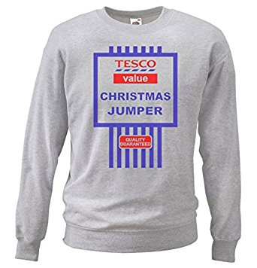
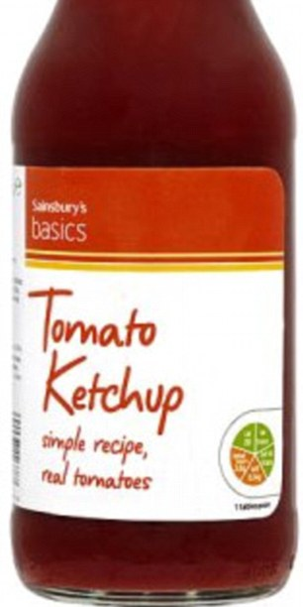
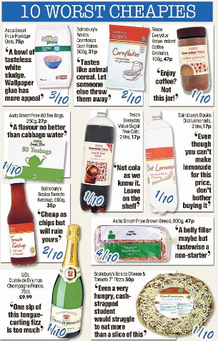
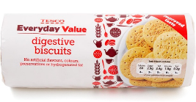
Suggested activity - Can you create your own collages of inferior / normal and luxury goods?

Slide 14
Interpretation of numerical values of income elasticity of demand

Slide 15
YED formula
This is the main formula

Slide 16
% change in price or quantity demanded formula
Price new – Price old
Price old x 100
If this looks familiar we used it in PED calcs, it’s a very useful formula for calculating percentage change, you will also need this one for YED. You will need to learn both formulas. You may know this formula as change over original.

Slide 17
Interpretation of numerical values
YED measures the responsiveness of demand to a change in income
Inferior | Normal | Luxury
YED value is <0 negative | YED value is between 0 and 1 positive | YED value is >1 positive
Ian increase in income means a decrease in demand | An increase in income means a small increase in demand | An increase in income means a higher increase in demand

Slide 18
Example YED Calculations
Question 1: Calculate YED if demand has increased from 20,000 units to 25,000 units following an average income increase of 15%.
Question 2: Calculate YED if demand has increased from 52,476 units to 702,003 units following an average income increase of 4%.
Question 3: Calculate YED if demand has increased from 6,438 units to 6,489 units following an average income increase of 12%.
Use both formulas!
Round up and down and show results to 2 decimal places

Slide 19
Answers to example YED calculations
Question 1: 25,000 – 20,000 / 20,000 x 100 / 15% = 1.67
Question 2: 702,003 – 52,476 / 52,476 x 100 / 4% = 309.44
Question 3: 6,489 – 6,438/ 6, 438 x 100 / 12% = -0.07
Wrong result? Check you are rounding down (1-4) and up (5+)

Slide 20
Comment on your results
Look at your answers from questions 1, 2 and 3
Comment if the YED value is negative or positive
Comment if the YED value is for an inferior or normal good
 | Question 1 | Question 2 | Question 3
Your answers
YED negative or positive?
Inferior or normal good?

Slide 21
Comment on your results - answers
 | Question 1 | Question 2 | Question 3
Your answers | 1.67 | 309.44 | -0.07
YED negative or positive? | positive | positive | negative
Inferior or normal good? | Luxury | Luxury | inferior

Slide 22
The factors influencing income elasticity of demand

Slide 23
Factors influencing YED = luxury goods
An increase in income will mean an increase in the demand for luxury goods
Scott has had a pay rise and now he is considering purchasing a luxury watch

Slide 24
Factors influencing YED = normal goods
An increase in income will lead to an increase in demand
Kathryn is earning more because the minimum wage has increased this year, so she will buy more of the products that she needs

Slide 25
Factors influencing YED = Inferior goods
An increase in income will lead to a fall in demand for inferior goods
Chazz earns more money, he no longer wants to buy ASDA Smartprice food and is treating himself to a tin on Heinz branded beans

Slide 26
Expectations of changes income – why incomes change
Incomes will fall if employees lose their job and end up claiming jobseekers – see website
Incomes will rise if an employee is promoted within a business

Slide 27
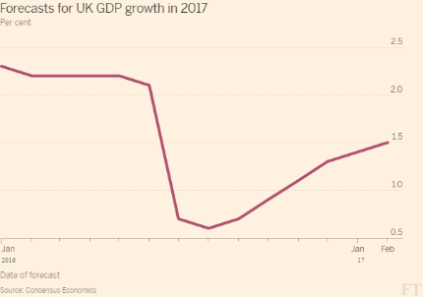
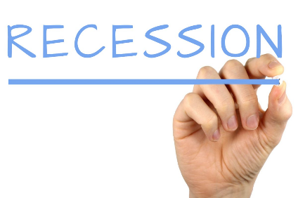
Expectations of changes income
Incomes may fall in times of recession – businesses may need to cut costs (staff wages)
Incomes may rise in times of economic growth – businesses may want to keep key staff with a pay rise

Slide 28
The significance of income elasticity of demand to businesses

Slide 29
Uses of YED
YED is used by business to help them decide what products and services they should offer in order to increase sales

Slide 30
YED example - Poundland
Poundland specialises in inferior goods
Poundland specialises in negative YED products
Poundland will thrive and have more sales when incomes are falling in a recession
What will happen in economic growth when incomes start to rise?
What is the current state of the economy and is there any news about Poundland which would back up this idea?

Slide 31
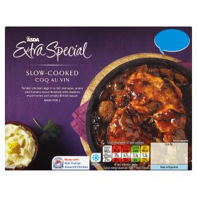
YED example ASDA
When incomes start to rise, in a period of economic growth, ASDA may need to diversify into premium products and extra special ranges

Slide 32
Revision Video

Slide 33
Another revision video

Slide 34
Sample Edexcel A2 questions
Notes:
No suitable A2 question for this topic so I have borrowed an Edexcel sample AS question for practice

Slide 35
Case study for question 1

Slide 36
Sample question 1
Knowledge 1
Application 3

Slide 37
Answer sample question 1

Slide 38
Sample question 2
Knowledge 1
Application 2
Analysis
1

Slide 39
Answer sample question 2

Slide 40
Case study for question 3

Slide 41
Sample question 3
Knowledge 1
Application 3

Slide 42
Answer sample question 3

Slide 43
Glossary
Income elastic demand; how much demand changes when the consumer has a change in income
YED; income elastic demand (we use Y because the letter I is reserved for the word investment)

