Slide 1
The BIG Idea
Kay’s distinctive capabilities
Think about…
Achieving competitive advantage through distinctive capabilities
Notes:
Students identify key words to underline

Slide 2
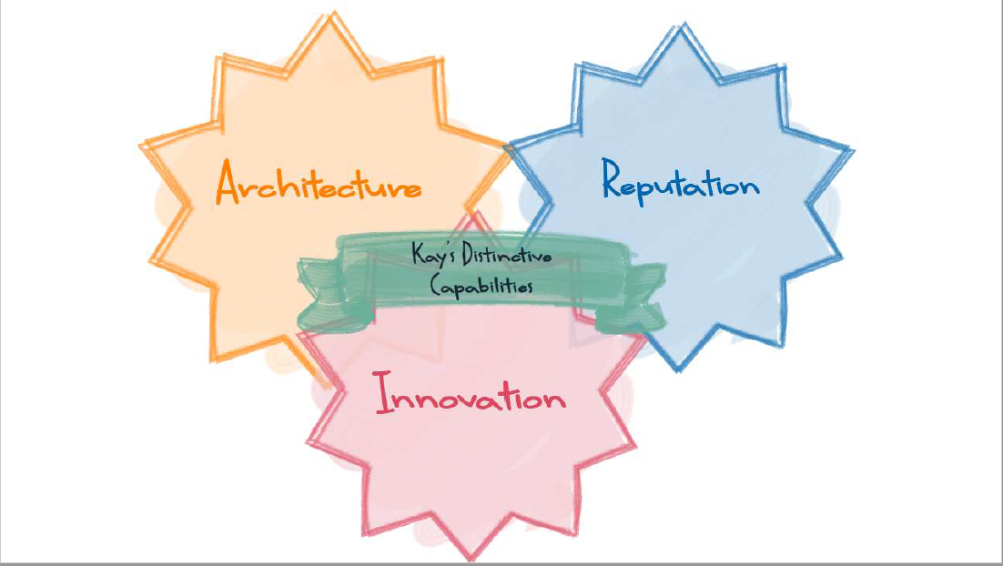

Slide 4
Lush link
First Direct link
Sony link

