Slide 1
Edexcel A2 Business
2.4.3 Stock Control
Revisionstation

Slide 2
You will need a ruler and selection of colours

Slide 3
Calculators will be needed for this topic

Slide 4
Worksheet

Slide 5
From Edexcel
a) Interpretation of stock control diagram
b) Buffer stocks
c) Implications of poor stock control
d) Just in time (JIT) management of stock
e) Waste minimisation
f) Competitive advantage from lean production

Slide 6
Starter
You have two cats.
Each cat eats 2 pouches of wet food a day (one at 6 am one at 2pm)
Each cat also eats 25g of dry food a day
You shop once a week and only have limited money
Questions:
How many wet cat food pouches would you buy for one 7 day week?
What size bag of dry cat food would you buy for 7 days?
Is there an efficient way to ensure that you never run out of cat food?
What if you don’t have the storage space?
What if you have a tight weekly budget?
On which day would you go shopping (assume your week starts on Sunday) to ensure a constant supply?

Slide 7
Answers to starter
1) 28 pouches of wet food a week
2) 350g bag of dry food
3) Buy lots and lots and lots of cat food and have it in the cupboard
4) Having cat food delivered just before you run out, you won’t need storage space
5) Make sure you only buy exactly what is needed
6) Go shopping on Friday to ensure there is a small buffer stock, incase the shops have run out

Slide 8
Definition: Stock control
Stock control is the control of the flow of stock in a business, it concerns the ordering and management of:
Raw materials
Components
Work-in-progress
Finished goods

Slide 9
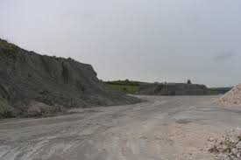
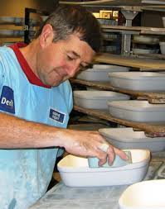
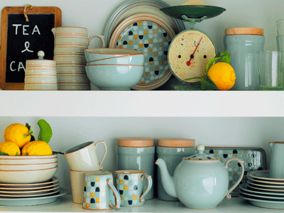
Stock explained
Stock is also known as inventory. It can mean any of these; raw materials, work-in-progress, components or even finished goods. So stock does not have to be complete products it can be part made items. This is an example of the stocks held by Denby pottery. What would a component be in Denby pottery?
Raw materials - clay
Work-in-progress
Finished goods
Notes:
This might be an item that is already part assembled like a mug with a handle.

Slide 10
Interpretation of stock control diagram

Slide 11
Stock management diagram
Stock management can be carried out by using a diagram such as the one on the right
This diagram is also known as a bar gate if you are looking for examples online or in text books
You do not have to draw one in an exam but you will need to be able to make calculations from one

Slide 12
Step 1: Know the diagram
In a business they may need to order more stock when they run out
For example in a pet shop they may need to order cat food
The goods will come from the supplier but may not turn up for a few weeks
Business needs to PLAN to make sure that they don’t run out of cat food to sell

Slide 13
Step 2: Understand about holding stock
High stock holding is expensive and adds to the cost of a business which will reduce profits e.g. extra storage, insurance, etc.
A business can be left with lots of unwanted stock e.g. cat food that is out-of-date
Makes it more difficult to compete on price due to stock holding costs
Can you explain how this would have an impact on profitability?
Urgh this cat food it out-of-date
Notes:
Higher costs means lower profitability.

Slide 14
Step 3: Have a go at drawing a diagram
20
Stock Level – boxes of cat food
15
10
5
2
4
6
8
Time in weeks

Slide 15
Step 3: Have a go at drawing a diagram
20
Maximum Stock Level
Stock Level – boxes of cat food
15
10
Re-order Level
5
Minimum Stock Level
Lead Time
Buffer stock
2
4
6
8
Time in weeks

Slide 16
Step 4 read your diagram
The stock arrives when your stock level is at maximum – think about a box of cat food arriving and filling the shelves
What is the max stock level that the business can hold?
What is the minimum stock level that the business can hold?
What is the re-order level?
What is the buffer stock level?
How long does it take for stock to arrive after it has been ordered? (this is the lead time)

Slide 17
Step 5 check your answers
What is the max stock level that the business can hold? | 20
What is the minimum stock level that the business can hold? | 5
What is the re-order level? | 10
What is the buffer stock level? | 5
How long does it take for stock to arrive after it has been ordered? (this is the lead time) | 4-5 days

Slide 18
Try another example
What is the max stock level that the business can hold?
What is the minimum stock level that the business can hold?
What is the re-order level?
What is the buffer stock level?
How long does it take for stock to arrive after it has been ordered? (this is the lead time)

Slide 19
Answers
What is the max stock level that the business can hold? | 95
What is the minimum stock level that the business can hold? | 25
What is the re-order level? | 60
What is the buffer stock level? | 25
How long does it take for stock to arrive after it has been ordered? (this is the lead time) | 5 weeks

Slide 20
Try this question (not an exam question)
What is the max stock level that the business can hold?
What is the minimum stock level that the business can hold?
What is the re-order level?
What is the buffer stock level?
How long does it take for stock to arrive after it has been ordered? (this is the lead time)

Slide 21
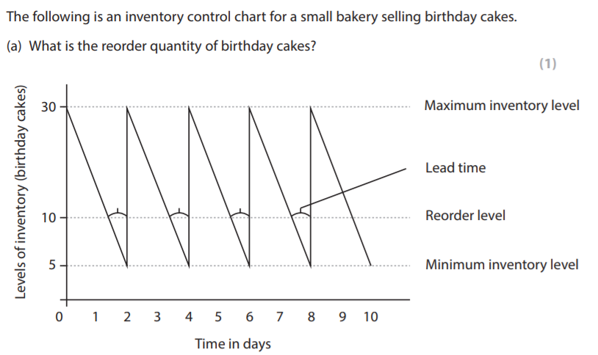
Try this question (not an exam question)
Notes:
Taken from an old spec Edexcel International business paper, only 1 mark.

Slide 22
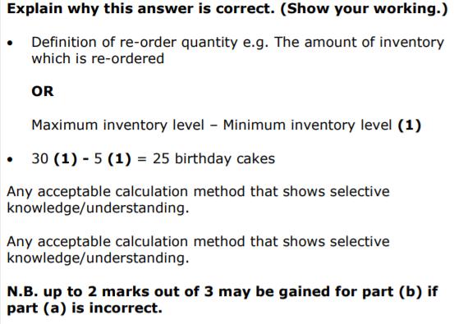
Answer

Slide 23
Buffer stocks

Slide 24
Buffer stocks
Buffer stocks are stocks which are held in case there is unforeseen rise in demand or a problem with supply
A business will keep buffer stocks to make sure that production is not stopped and that customers are kept happy with supply dates being met
Some goods cannot hold buffer stocks – due to perishability (it goes off like milk) or due to obsolescence (it goes out of date like technology)

Slide 25
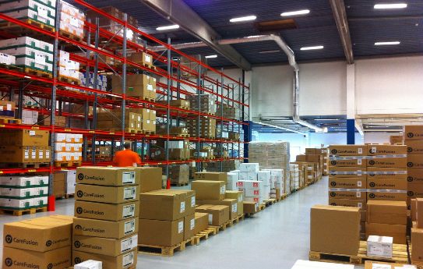
Buffer stocks
Disadvantages
The cost of storage is high, a business will need to pay for premises, staff and security of the stock
This can tie up the working capital of a business
Advantages
Holding buffer stocks means that a business can easily respond to changes in consumer demands
Holding buffer stocks means that if the suppliers cannot deliver on time that production will not be affected

Slide 26
Implications of poor stock control

Slide 27
Stock out costs
Stock out costs are the costs of not having stock when it is needed:
Loss of customer goodwill
Loss of sales revenue
Damage to reputation
Disruption to production

Slide 28
Just in time (JIT) management of stock

Slide 29
Just-in-time delivery
Just-in-time means that a business does not keep stocks of parts in a warehouse
Instead they order the parts and get them delivered same day from the supplier
This means very close links with suppliers
Watch the video: can you now explain JIT to someone else?

Slide 30
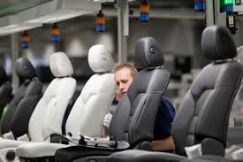
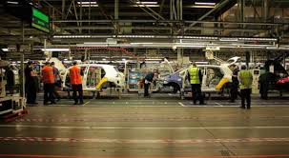
JIT and suppliers
To make JIT work the manufacturer needs to have excellent working relationships with their smaller parts suppliers
JIT does not work when there are delivery or quality issues
No buffer stocks are held in a JIT system so if delivery does not arrive the product cannot be made

Slide 31
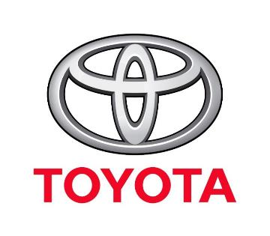
Where JIT is most suitable
Just in Time Manufacturing (JIT) - also known as "lean manufacturing" refers to a system of manufacturing in which products are not built until the product is ordered and paid for
Some companies that have successfully implemented JIT include Toyota, Dell and Harley-Davidson. Can you find other examples?

Slide 32
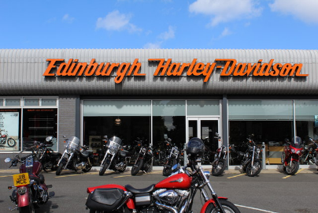
JIT + Waste + Lean Management
JIT's main philosophy is to eliminate waste - wasted inventory, wasted stock and wasted time
By creating and delivering products quickly when consumers request them excess inventory is eliminated, customers receive their orders quicker and the manufacturer doesn't need to keep a large inventory of stock parts

Slide 33
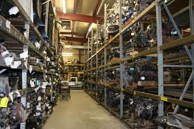
JIT
Disadvantages
The business won’t be able to meet unpredicted surges in demand
The business won’t be able to quickly replace damaged parts
If the delivery does not turn up in time this can stop the whole production line, which is costly
Advantages
As parts are ordered as they are needed there is no wastage
Parts are not warehoused which is a massive cost saving in terms of premises and staff
Stock is less likely to go out of date
The business will improve their cash flow, as their money is not tied up in stock

Slide 34
Waste minimisation

Slide 35
Definition: Waste
Any activity or result that the customer doesn’t value and is not willing to pay for. These activities that don’t add value for the customer between the inputs and the outputs must be removed or minimised.

Slide 36
Waste minimisation
Waste minimisation can help improve efficiency and reduce the unit costs of production
Waste minimisation can also improve the public image of the business – if they are seen to be more eco friendly
Waste minimisation can carry heavy legal fines for non-compliance

Slide 37
7 Deadly wastes
Lean production aims to eliminate the 7 deadly wastes:
Over production
Waiting time
Transportation time
Excess processing
Excess stock
Excess motion
Product quality

Slide 38
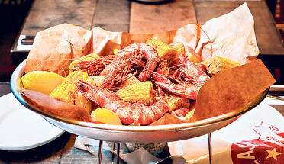
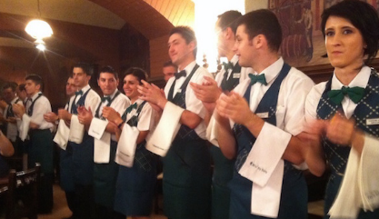
7 Deadly wastes: #1 Over production
Over production means that the business is making more than required and maybe running at over capacity (Just-in-case)
Over production can stop the smooth flow of materials round the factory and reduces quality of finished goods
Overproduction is number 1 because it triggers all the other types of waste, can you explain why this is true?
Over production could be a huge meal in a restaurant or over-staffing an event

Slide 39
7 Deadly wastes: #2 Waiting time
The waste of waiting can take two forms;
Waiting because the next step in the process is not ready
Waiting because there are not enough inputs necessary to complete the next process
E.g. garden company waiting for delivery of trees and grass
What is the waiting time in the airline industry?
Notes:
Time waiting for a gate to open up or to take off or for a flight to arrive

Slide 40
7 Deadly wastes: #3 Transportation time
There can be significant costs spent on transporting parts, components and stock to each workstation or between sites
It wastes energy and resources of an employee that could be better used
It wastes fuel for forklifts and lorries
Anytime that materials have to be moved from one place to another is an opportunity to reduce wasteful transportation

Slide 41
7 Deadly wastes: #4 Excess processing
Excess processing can mean any extra processes which take the original raw material further and further from its natural state
This is fine if it meets customer needs, but if the customer doesn’t want these extra processes then this is wasteful
If the customer just wants to buy a garden shed and we paint it before delivery, and the customer wasn’t really expecting it to be painted, just plain wood, then this is wasteful unnecessary process

Slide 42
7 Deadly wastes: #5 Excess stock
If a product is over produced then it must be stored somewhere until it is needed. This means warehousing, tracking and monitoring.
It risks the products becoming obsolete, going off or going out of style (depending on hat it is) and it is incurring costs
Can you link this to profitability of a business?
Clothes, if stored too long, risk going out of fashion
Notes:
Higher costs leads to lower profitability.

Slide 43
7 Deadly wastes: #6 Excess motion
Excess motion can mean unnecessary activities within the workspace
Too much bending, lifting stretching can be tiring and case accidents
Examples might be printers or photocopies that are not in a convenient location and require staff to have to walk to them
Can you think of an example at your school or college of where excess motion may be a problem?
In this work area tools and components are stored right where they are needed. This is called point of Use Storage or POUS)

Slide 44
7 Deadly wastes: #7 Product quality
If product quality is inferior then this will cause scrap and rework, these defects all add costs to the manufacturing process
Mistakes can cause waste, for example when you order a chicken legend meal with no lettuce and no mayo from the drive through and it arrives wrong, this may have to be thrown away – causing waste
Can you explain how a glitching game may be relevant here?
Notes:
Game might have to be recoded (reworked) if it is not working correctly.

Slide 45
Suggested activity – 7 wastes video project
Watch the video – these students made a video to illustrate the 7 deadly wastes, it’s had 55,000 views!
Could you write a script for your own version?
Could you make your own film?

Slide 46
Competitive advantage from lean production

Slide 47
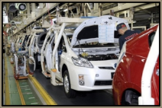
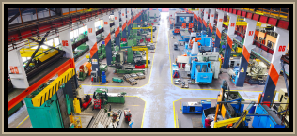
Lean production
Lean production is a Japanese approach top production first adopted by Toyota.
The aim is to reduce resources used in production, to use less of everything;
Time
Labour
Capital
Space in the factory
Raw materials

Slide 48
Lean production cost savings
Toyota can develop a car in 18 months, it takes general Motors (who make Ford) three years.
It takes GM 50% longer to assemble their cars than Toyota do.
So there are impressive cost savings to be made from introducing lean production

Slide 49
Benefits of lean production
Improved customer service through delivering exactly what is required when they want it (think cars)
Improved productivity in terms of output per worker per time period
Quality improvements through reduction in defects and reworking faulty goods

Slide 50
More benefits of lean production
Shorter lead times – which can become a competitive advantage for the business – who wants to wait six months for a sofa?
Reduced waste in terms of the 7 types of waste
Safer work environment, with a more organised leaner organisation comes higher levels of safety

Slide 51
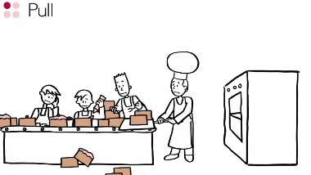
Revision videos

Slide 52
Case study for question 1 – from 2017 paper

Slide 53
Sample question 1
Knowledge 1
Application 2
Analysis
1

Slide 54
Answer sample question 1

Slide 55
Glossary
Stock control; the control of the flow of stock within a business
Buffer stock; stock held in case there is an unforeseen demand
Lead time; the time it takes from ordering the product to delivery to customer
Work-in-progress; goods which are still being made
'Just-in-time': System of delivering parts to the assembly line in a continuous flow, rather than stockpiling large volumes at the plant

