Slide 1
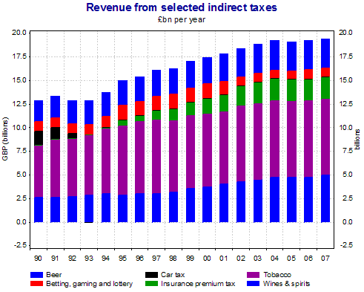
RECAP: What is PED?

Slide 2
QUESTION
Why do the government receive large amounts of revenue from these goods?
Why does the government choose these goods in which to impose an indirect tax?

Slide 3
TASK – 5 MINUTES
In pairs, list as many UK taxes that you can think of!
Then rank them in order of how much revenue they contribute to the government.

Slide 4
Specification
1.2.9 Indirect taxes and subsidies
a) Supply and demand analysis, elasticities, and:
the impact of indirect taxes on consumers, producers and government
the incidence of indirect taxes on consumers and producers
the impact of subsidies on consumers, producers and government
the area that represents the producer subsidy and consumer subsidy
1.4.1 Government intervention in markets
a) Purpose of intervention with reference to market failure and using diagrams in various contexts:
indirect taxation (ad valorem and specific)
subsidies
1.2.3 Price, income and cross elasticities of demand
e) The significance of elasticities of demand to firms and government in terms of:
the imposition of indirect taxes and subsidies

Slide 5
ICT TASK…
Have your worksheet from the ICT task ready to share with the class.
We are going to reflect upon these answers.
Make sure your answers are correct.

Slide 6
TAX DEFINITION
The definition of a tax is tricky, as we all know what a tax is… but it is difficult to put into words.
Golden rule: never used the word you are trying to define in the definition.
This is an accurate definition of a tax:
“…a compulsory contribution to state revenue, levied by the government.”

Slide 7
TYPES OF TAXES
There are two categories of taxation:
Indirect Tax
Specific Tax
Ad Valorem Tax
Direct Tax
The tax diagram that we learn demonstrates indirect taxes

Slide 8
DIRECT TAX
These are taxes that go straight to the government from whoever is paying the tax.
The easiest example of a direct tax would be income tax and national insurance, which goes straight to the government from worker’s pay packets.
Businesses pay corporation tax straight to the government, so this is another example of a direct tax.
http://www.youtube.com/watch?v=t9N4La0-k9c

Slide 9
INDIRECT TAX
Tax that involves an intermediary (retailer) to collect the tax, before the government receives.
For example, if we purchased a chocolate bar from Tesco, we would pay VAT. However, the tax revenue from the VAT will not go straight to the government from our pockets. It is collected by the retailer (Tesco) first and then passed onto the government.
This indirect tax effectively adds to the costs of production, as producer has the responsibility to ensure it gets paid.
Supply shifts to the left (reduction)
http://www.youtube.com/watch?v=t9N4La0-k9c

Slide 10
INDIRECT TAX – Specific or Ad Valorem?
Two types of indirect taxation: specific tax and ad valorem tax.
Specific tax: When the amount of tax placed on each item, regardless of the price of the item, is exactly the same.
For example, if the government decided to place a tax of £2 on all food items – this is specific amount of tax placed on each unit of food, regardless of their original price.
Ad valorem: Where as with a tax like VAT, the tax is a percentage and so the tax placed upon goods becomes larger, the more expensive the good. For example if VAT is 20%, the tax on a £50 item would be £10 – where as the tax on a £200 good would be £40.

Slide 11
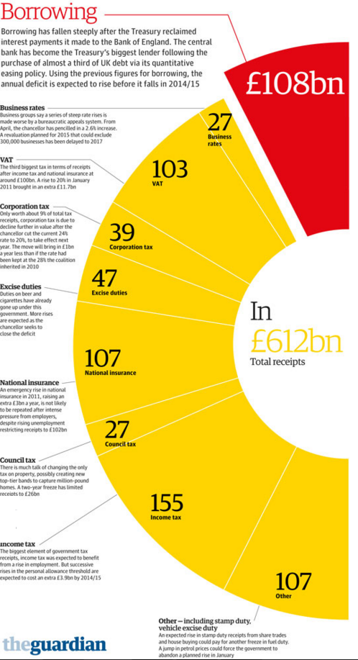
UK TAX REVENUE
UK government received circa. £600-£750bn last year in tax revenue.
The top three sources of tax revenue were Income Tax, National Insurance and VAT.
This can be used as effective evaluation when assessing impacts.
https://www.ukpublicrevenue.co.uk/breakdown

Slide 12
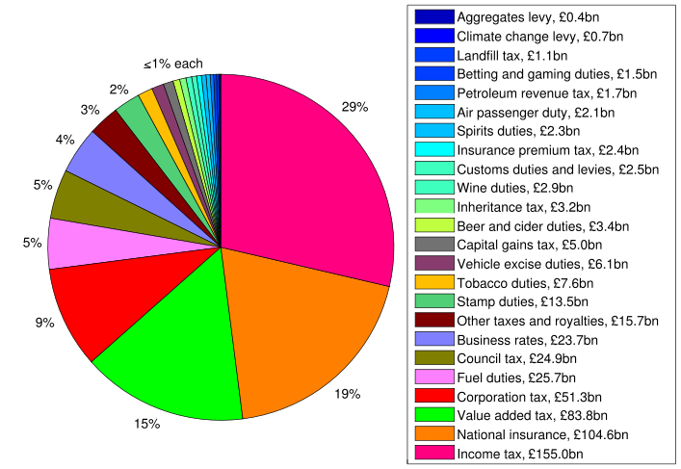
UK TAX REVENUE
Don’t need to memorise specifics, but knowing the top ones is great evaluation e.g. ones most impactful upon gov. revenue
https://www.ukpublicrevenue.co.uk/breakdown
Notes:
Business Rates: Occupation of non-domestic property.

Slide 13
Band | Taxable income | Tax %
Personal Allowance | Up to £11,500 | 0%
Basic rate | £11,501 to £45,000 | 20%
Higher rate | £45,001 to £150,000 | 40%
Additional rate | Over £150,000 | 45%
Income Tax
 | 2017 | 2016 | 2015
Main rate | 19% | 20% | 20%
Corporation Tax
(There are no longer different rates for different sized companies)
Notes:
Corporation tax: https://www.gov.uk/government/publications/rates-and-allowances-corporation-tax/rates-and-allowances-corporation-tax
Income Tax: https://www.gov.uk/income-tax-rates

Slide 14
Band | Taxable Income | Tax Rate
Personal Allowance
Basic Rate
Higher Rate
Additional Rate
Up to £11,500
0%
£11,501 to £45,000
20%
£45,001 to £150,000
40%
Over £150,000
45%

Slide 15
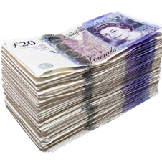
Average UK full-time salary £26,700
INCOME TAX - Example
0-£11,500 = 0% (no tax due)
£11,501-£45,000 = 20%
So… 20% of £33,499 = £6,699.80
£45,001-£150,000 = 40%
So… 40% of £104,999 = 41,999.60
Over £150,000 = 45%
So… 45% of £0 = £0
Total tax bill due = £48,699.40
£120,000 per year
+
+
+
Take home £71,300.60 (before pension, student loan and NICs of £6,500 circa.)

Slide 16
Year | VAT %
2011-Present | 20%
2011 | 15%
Pre-2011 | 17.5%
VAT (Value Added Tax)
Employees start paying NI after they earn £8,000 a year at a rate of 12% and an additional 2% when earning over £45,000 a year.
Importantly though, employers have to pay NI for each worker they employ – roughly 13.8% of the worker’s earnings.
National Insurance Tax
https://www.gov.uk/government/publications/rates-and-allowances-national-insurance-contributions/rates-and-allowances-national-insurance-contributions
Notes:
Corporation tax: https://www.gov.uk/government/publications/rates-and-allowances-corporation-tax/rates-and-allowances-corporation-tax
Income Tax: https://www.gov.uk/income-tax-rates

Slide 18
LEARNING OBJECTIVES
Lo1: Define what is meant by ad valorem, specific, indirect and direct taxation.
Lo2: Evaluate the impact of PED upon the incidence of taxation.
Lo3: Analyse the impact of tax and subsidies upon consumers, producers and the government.

Slide 19
Diagram Stages - TASK
Starting with the basic D&S curves at equilibrium (1)
Draw the indirect taxation diagram in 3 stages - labelling/explaining what is happening
Finishing with the total revenue gained by the Government – and consumer/producer portion. (3)

Slide 20
HOW INDIRECT (Specific) TAXATION WORKS
Equilibrium before taxation
Supply decreases because their costs of production have effectively increased.
Price
S2
Government introduces an indirect (specific) tax to producers – supply curve shifts to the left
S1
Consumer + Producer = Government Revenue
P2
Consumer
Quantity supplied decreases and demand contracts from Q – Q1
P1
Producer
Notice that the price rise is not equal to the tax, therefore the producer does not pass all of the burden onto the consumer, the producer pays some themselves.
D1
0
Q2
Q1
Quantity
The consumer/producer shares are known as the incidence of tax.
Notes:
Demerit good: Consumption is consider unhealthy and a damage to society.
Negative externality: are third party effects arising from production and consumption of goods and services for which no appropriate compensation is paid.

Slide 22
TAXATION, PED AND CALCULATIONS
Answer the questions relating to taxation, PED and calculations.
Calculating the tax is new to the spec, so the examiner will be keen to include it in an exam!

Slide 23
What is the initial equilibrium price and quantity?
£6, Q400
The government imposes a tax of £3 per unit. The new supply schedule is shown in the right hand column of the table – less is now supplied at each and every market price. Find the new equilibrium price after the tax has been imposed
£8 where QD and QS are both 150.
Explain why the new equilibrium price is not simply £3 more than the old equilibrium price (before the tax was introduced).
Because the consumer does not take on all of the incidence of tax, some of it is absorbed by the producer.
Calculate the total tax revenue going to the government
£450, the new equilibrium is Q150 – therefore £3 per unit x 150 = £450 revenue.
How much of the total tax revenue is being paid by the consumer?
Consumer pays £2, so 2x150 = £300
How much of the total tax revenue is being paid by the producer?
Producer pays £1, so 1x150 = £150
How have consumers been affected by this tax? Refer to consumer surplus and welfare in your answer.
There has been a fall in quantity traded and a rise in the price paid by consumers – this leads to a fall in economic welfare as measured by consumer surplus

Slide 24
Answers - INDIRECT (Specific) TAXATION
D=S where the price is £6 and Qd is 400.
Supply decreases because their costs of production have effectively increased
Price
S2
After supply shifts, the new equilibrium is at £800 and Qd of 150.
S1
A = Consumers share (£2x150 = £300)
B = Producers share (£1x150 = £150)
A+B = Government Revenue (£300+£150 = £450)
£8
A - Consumer
The tax is given as £3, but the market price has only risen by £2 (6-8) and so we know that the ‘missing’ £1 is being absorbed by the producer.
£6
B - Producer
£5
D1
0
150
400
Quantity
Notes:
Demerit good: Consumption is consider unhealthy and a damage to society.
Negative externality: are third party effects arising from production and consumption of goods and services for which no appropriate compensation is paid.

Slide 25
PED and INDIRECT TAX
The following is A* evaluation and analysis…
Products that have a PED inelastic demand curve, will alter the incidence of tax.
Price
S2
S1
When the demand curve is relatively inelastic, the incidence of tax will be placed mostly upon the consumer.
P2
CONSUMER
P1
Remember, the producer is the one who has to pay the tax to the government. Therefore when the PED of the product is inelastic, they choose to pass most of the tax burden onto the consumer.
PRODUCER
Because the inelastic PED means that the tax causes only a small reduction in demand.
0
D1 (PED inelastic)
Q2
Q1
Quantity
Notes:
Demerit good: Consumption is consider unhealthy and a damage to society.
Negative externality: are third party effects arising from production and consumption of goods and services for which no appropriate compensation is paid.

Slide 26
PED and INDIRECT TAX
The opposite happens when the demand for the produce being taxed is relatively elastic.
Price
When the demand curve is relatively elastic, the incidence of tax will be placed mostly upon the producer.
S2
S1
P2
Because the product has an elastic PED, the producer chooses to have the highest tax burden.
P1
CONSUMER
PRODUCER
D1 (PED elastic)
Because if the producer placed the burden upon the consumer, then the elastic nature of demand means that it would take only a small price increase to cause a large fall in quantity demanded.
0
If demand fell too much, then the producer is in danger of going out of business – therefore takes the highest burden of tax.
Q2
Q1
Quantity
Notes:
Demerit good: Consumption is consider unhealthy and a damage to society.
Negative externality: are third party effects arising from production and consumption of goods and services for which no appropriate compensation is paid.

Slide 27
REVENUE/INCIDENCE CALCULATIONS
The new specification requires you to be able to calculate the incidence of tax for consumers and producers.
As well as the total tax revenue for the government.

Slide 28
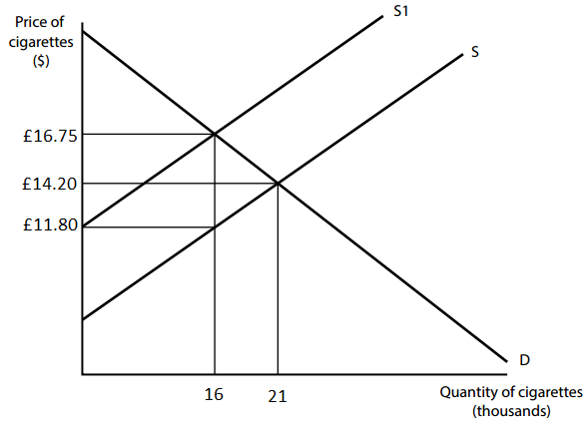
REVENUE/INCIDENCE CALCULATIONS
Calculate the total incidence of tax on consumers. You are advised to show your working. (2)
(16.75-14.20) x 16,000 = £40,800
Calculate the total tax revenue. You are advised to show your working. (2)
(16.75-11.80) x 16,000 = £79,200
Calculate total revenue before and after the tax. What does your answer suggest about this section of the demand curve, in terms of elasticity?
14.20 x 21,000 = £298,200 total revenue before the tax.
16.75 x 16,000 = £268,000 total revenue after tax.
Price increases and revenue falls, therefore this is the elastic section of the demand curve.
Actual A-Level exam question.

Slide 30
So, how will this alter the diagram? Draw how you think this might look!
AD VALOREM TAX
The indirect tax we discussed last lesson was a ‘specific tax’ example.
Ad valorem is Latin for…
…according to the value.

Slide 31
VAT ARTICLE
Read the article about the VAT increase in January 2011.
Answer the questions on the back.
What do you think an ad valorem tax will look like?
BBC News - http://www.bbc.co.uk/news/business-12106663

Slide 32
AD VALOREM TAX
Non-parallel shift in supply, where the higher the price – the bigger the shift.
Because the tax is a percentage, goods with higher prices will have higher taxes.
£100 camera (£20 tax attached) £1000 TV (£200 tax)
The amount of shift is always the same percentage as the price (20% for VAT). So if the price is higher, the shift is higher.

Slide 33
INDIRECT (AD VALOREM) TAX
S2
The concept is exactly the same as a ‘specific’ indirect tax – only the supply curve experiences a non-parallel shift.
Because the higher the price, the higher the tax (Ad Valorem is a % tax like VAT)
Price
S1
P2
A Consumer
A = Consumers share
B = Producers share
A+B = Government Revenue
P1
B Producer
D1
0
Q2
Q1
Quantity
Notes:
Demerit good: Consumption is consider unhealthy and a damage to society.
Negative externality: are third party effects arising from production and consumption of goods and services for which no appropriate compensation is paid.

Slide 34
TASKS – LESSON 2
Finish the VAT activity, copy the diagram and answer the questions.
Complete the ‘Taxation, PED and Calculations’ activity which you started last lesson.
Carry out a detailed plan of the taxation question on petrol.
15 marks – 2KAA, 2EV
Start with definition, diagram and data.
Integrate (use labels) your diagram and use to answer the question.
EV idea – PED is a good starting point (different groups impacted differently)

Slide 35
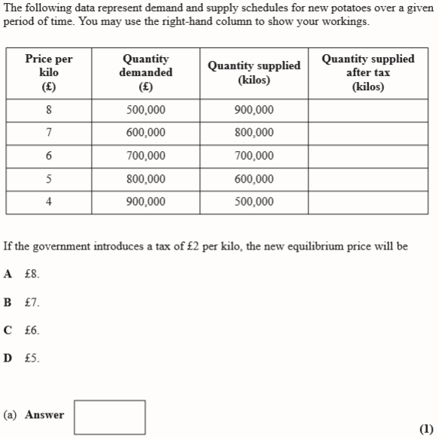
1. If the government imposes a tax of £2 per kilo, what would the new equilibrium price be?
2. What proportion of the tax is paid by the producer?
3. Calculate the total revenue received by the government.
Thinking further… Draw the scenario above on a demand and supply diagram, replacing Q/P with values from the table.

Slide 36
700
600
500
400
300
Supply will decrease and the original QS illustrates that when price rises by £2 (e.g. £4 to £6), supply changes by 200,000 (500,000 to 700,000).
You therefore need to reduce the original QS by 200,000.
The new equilibrium is where QD=QS at £7.

Slide 37
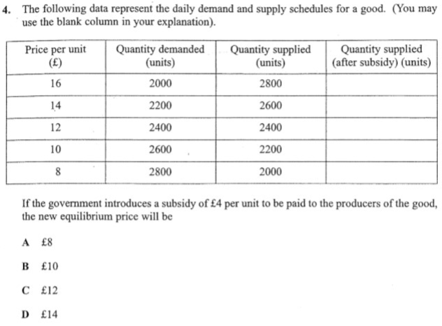
2400
2200
2000
1800
1600

