Slide 1
Edexcel A2 Business
2.1.2 External Finance
Revisionstation

Slide 2
Worksheet

Slide 3
From Edexcel
a) Sources of finance:
family and friends
banks
peer-to-peer funding
business angels
crowd funding
other businesses
b) Methods of finance:
loans
share capital
venture capital
overdrafts
leasing
trade credit
grants

Slide 4
Starter
Where do you think a business gets its money from?
(BTW)This is the last day you will ever use the word money from now on you must be more specific....
Instead of money, why not use; finance, capital, loan, investment, cash, currency, wealth, profit, income, asset, resource, venture, security, venture capital, etc.

Slide 5
Definition: External finance
External finance is investment for the business that is obtained from; banks, investors and lenders outside of the business

Slide 6
The difference between a source of finance and a method of finance
Source of finance: This is where the finance has come from e.g. a bank
Method of finance: This is the use of a finance – or what use it would be suitable for e.g. loan to buy computer equipment for the business
Source of finance
Source of finance
Method of finance

Slide 7
Sources of finance

Slide 8
Sources of finance
There are many external sources of finance available to a business, these are the ones that Edexcel would like you to know the advantages and disadvantages for:
family and friends
banks
peer-to-peer funding
business angels
crowd funding
other businesses
Get ready to make some notes about these on the next few slides.
Source of finance

Slide 9
#1 Family and friends
Private limited companies are able to raise finance by selling shares to friends and family.
A sole trader or partnership may also find that their family may want to contribute to the business. This may be for interest, a share of the profits or maybe even an interest free loan amongst family.

Slide 10
Friends and family
Disadvantages
Downside is that it may cause tension and problems if the finance is not repaid or the business does not flourish.
They may also demand their money back at short notice
Advantages
Loans from friends and family will probably be offered without the need for security and at lower rates and over longer terms than traditional lenders
They are also unlikely to need a business plan which means the owner may not need to write one

Slide 11
#2 Banks
Banks may lend a loan to a business to start-up or when a business wants to grow and expand
Banks may also provide a business with an overdraft to help when they have cash flow problems
All the high street banks have business departments that will deal with commercial loans

Slide 12
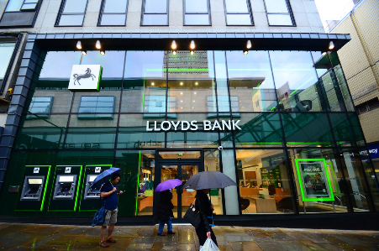
Banks
Disadvantages
Bank loans can be expensive compared to other sources of finance and interest must be paid back on time
It may be hard for a new business owner to obtain a loan as they have no historical sales data to show the bank
The owner may need to use their own assets as security for the loan e.g. their own house
Advantages
Banks will lend to businesses without asking for a % of the ownership
Banks will allow the business owner to continue running the business their own way, and not interfere, so the owner retains control of the business (unlike business angels)

Slide 13
#3 Peer to peer funding
Lending marketplaces such as Funding Circle have gained the trust of consumers by offering lower rates than banks to business owners who want to borrow money
Peer-to-peer funding matches businesses that need finance with investors who are looking for a good return on their investment

Slide 14
Peer to peer funding
Disadvantages
Peer to peer loans are classified as private business loans, so the money for the loan comes from several investors or small businesses.
If there are not enough individuals interested or willing to invest in your loan, you may not be able to acquire the entire amount that the business needs
Advantages
Businesses can get access to funding within a week once approved
Business owners can apply online
Investors can expect returns of 6-7% whereas a savings account might only give them 3%
Lender
Borrower

Slide 15
#4 Business angels
An angel investor offers to lend their personal disposable finance
The angel would normally take shares in the business in return for providing finance
Angels normally seek to not only provide the business with money to grow, but also bring their experience and knowledge to help the company achieve success
Angel Investors seek to have a return on their investment over a period of 3-8 years
Usually smaller loan amounts than a venture capitalist

Slide 16
Business angels
Disadvantages
Not suitable for investments below £10,000 or more than £500,000
Owner needs to give up a share of the business
Advantages
Angels are free to make investment decisions quickly
The owner gets access to your investor's sector knowledge and contacts
The owner gets access to angels mentoring or management skills
The owner will have no repayments or interest on the money lent

Slide 17
#5 Crowd funding
Crowd funding is where a large number of people fund a project over the internet making small investments each, 3 ways to fund:
Donate: no money back, but rewards like tickets or a newsletter
Lend: get money back with interest and satisfaction of contributing to success of a small business
Invest: Invest in a business in exchange for equity or shares which may increase in value

Slide 18
Crowd funding
Disadvantages
The business will need to show case their idea to investors and may need to put together a video and other promotional material to attract investors
Advantages
Good alternative to loans for small business owners
Finance can be obtained without paying upfront fees
The business can generate funds and also promote the business at the same time

Slide 19
#6 Other businesses
Other businesses may wish to invest in start-ups
A business may have surplus profit and view this as a way to get a good return on their investment
Usually IT or disruptive technology businesses will attract funding as they are likely to offer a larger % return on investment

Slide 20
Methods of finance

Slide 21
Methods of finance
There are many external methods of finance available to a business, these are the ones that Edexcel would like you to know the advantages and disadvantages for:
loans
share capital
venture capital
overdrafts
leasing
trade credit
grants
Method of finance

Slide 22
#1 Loans
Loaning money from a bank is like “renting” the money
Banks will lend to small business but may not lend when they first start-up as there is no track record or history of them making money.
Loans are quick to set up
Loans are affected by interest rates – if they go up the cost of borrowing will go up too and the business may have to pay more interest back to the bank

Slide 23
#1 Loans
Disadvantages
A bank will charge interest on the loan
Not very flexible, the business may incur a penalty if they decide to settle the loan early
A bank will ask for security or collateral on a loan this may be a house or another asset that can be seized if the loan is not paid back
Advantages
As the loan is fixed for a certain length of time the business owner can plan ahead and knows exactly what the repayments will be and when they will leave the bank account
Banks will not ask for a % of the business or get involved in the running of the business
Getting into a high street bank to apply for a business loan is a straightforward process

Slide 24
#2 Share capital
In a public limited company – plc - one that has been floated on the stock market - they can raise more finance to expand by having an ordinary share issue
This is an external and long term method of finance but would only apply to a large business with a plc after its name

Slide 25
#2 Share capital
Disadvantages
Potential investors may require a great deal of background information before they buy the shares
The more shares that are sold, the more the profits have to be divided up and paid out to investors as dividends
Can be expensive and slow process to organise
Advantages
Investors are often prepared to provide extra funding as the business grows
More cost effective way to raise finance than a loan – no interest to pay back
Finance is based on acquiring more equity rather getting further into debt

Slide 26
#3 venture capital
Venture capitalists (VCs) will invest large sums of other people’s money in a business in return for shares in the company.
Typically, VCs will invest at least £50 000 in a small regional business although this can rise into millions of pounds.
The VC will look for a high rate of return in a specific time period e.g. 5 years

Slide 27
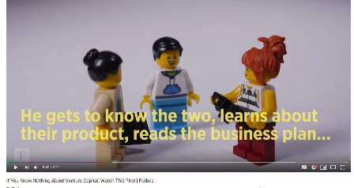
#3 Venture capital
Disadvantages
Venture capital firms look for a strong business plan, sound management and a proven track record, making it difficult for start-up firms
Venture capital firms typically want 20-30% stake in the business
Advantages
Useful if the business is looking to raise a large amount of money in a short space of time e.g. £1 million
The business gets all the skills of the venture capital business, their network and links may increase revenue streams
Great for owners who have been refused a loan from a bank

Slide 28
Suggested activity
YouTube is full of videos about venture capital and angel investors.
Watch a few, including the one on the right, then make some notes, write a script and create your own 2 minute video to explain what these terms means
Make sure you clearly explain what the differences are

Slide 29
#4 overdrafts
Some months a business may need extra cash to tide it over until a better month. A loan is over many years so is not suitable.
An overdraft may be organised by the bank which is short term lending of smaller amounts of money
Once its arranged (say £2,000) on an account a business can dip into it or pay it back as they see fit

Slide 30
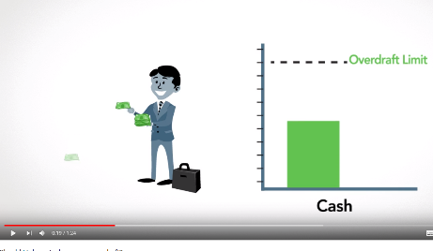
#4 Overdrafts
Disadvantages
If the business goes over this amount the overdraft will be “unauthorised” and the business will be charged heavily
Very expensive source of finance, very high charges and interest rates
Not suitable for large amounts over a long period of time
Advantages
For a business owner this would idea as a quick fix method to tide the business over a difficult month of trading
An overdraft can be arranged on the phone
or online with an instant decision from the bank
The business will only pay interest on the amount of money that they are overdrawn
As soon as the business improves trading they can easily pay back the overdraft to the bank and the interest charges will stop

Slide 31
#5 leasing
As a business grows it may decide that it needs some more vehicles or equipment
They may decide to lease so that the equipment can be updated regularly and spread the cost
They will never own the equipment but will get the option to change it when it wears out
Examples are photocopiers and vans

Slide 32
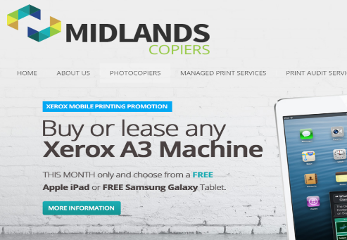
#5 Leasing
Disadvantages
Leasing is often over a fixed term, if the business changes its mind and wants to lease from a different company, contracts may be difficult to get out of
Advantages
This is a lower monthly costs for a business owner than a loan
Often business leases can be arranged without any advanced fees being paid
The leasing firm maintain the equipment, vans, cars etc. so the business will always have reliable working equipment

Slide 33
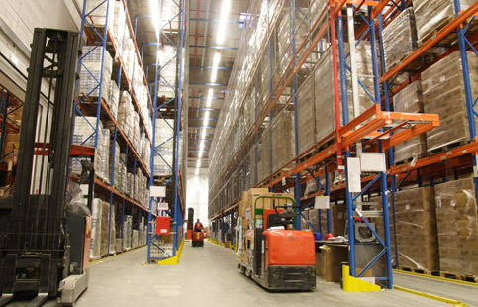
#6 trade credit
When one business trades with another they will sometimes need to “buy” goods with trade credit
The seller gives the buyer 30, 60, 90 days to pay
The buyer then has time to sell the goods in their own shop before they have to pay for them
The wholesaler may give the buyer a discount when they use cash instead

Slide 34
#6 Trade credit
Disadvantages
Not all stock is available to buy using the trade credit method, so only applies to certain industries
If the business does not pay in time they risk being refused further credit by the supplier in the future
Advantages
Business can sell the goods before the stock needs to be paid for, so can make a profit before the costs have to be paid
No interest has to be paid on trade credit
Businesses that pay regularly on time can build relationships with their suppliers and secure better deals

Slide 35
#7 Grants
The UK government provides financial help to businesses in some areas of the country, in an effort to overcome problems of unemployment.
Government grants do not normally have to be repaid and owners keep full control of their business.
More information on government grants here

Slide 36
#7 Grants
Disadvantages
A business will have to find a grant that suits their specific project, which can be difficult
There’s a lot of competition for grants
The business may be expected to match the funds they are awarded, eg a grant might cover part of the cost of a project
Grants are usually awarded for proposed projects, not ones that have already started
The application process can be very complex and time-consuming
Advantages
The business usually will not have to pay the grant back
Unlike a loan there will be no interest to pay
The business owner will get funds without any loss of control of the business

Slide 37
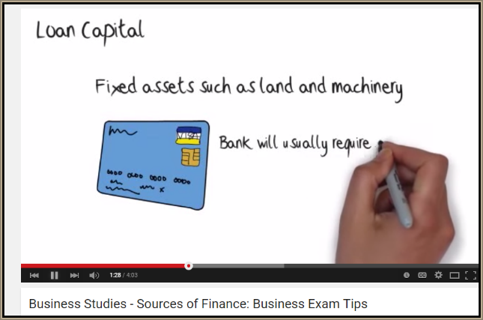
Revision Video

Slide 38
Sample Edexcel A2 questions

Slide 39
Case study for question 1

Slide 40
Sample question 1
Knowledge 2
Application 2
Analysis
3
Evaluation
3

Slide 41
Answer sample question 1

Slide 42
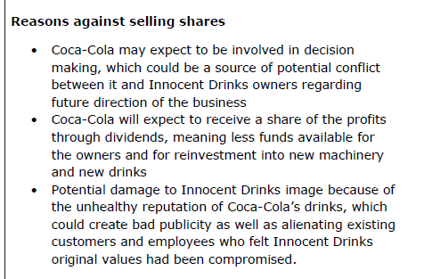
Answer sample question 1

Slide 43
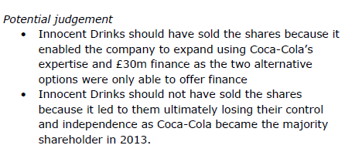
Answer sample question 1

Slide 44
How to level sample question 1

Slide 45
Case study for question 2

Slide 46
Sample question 2
Knowledge 1
Application 2
Analysis
1

Slide 47
Answer sample question 2

Slide 48
Case study for question 3

Slide 49
Sample question 3
Knowledge 2
Application 2
Analysis
4
Evaluation
4

Slide 50
Answer sample question 3

Slide 51
Answer sample question 3

Slide 52
Answer sample question 3

Slide 53
How to level sample question 3

Slide 54
Glossary
Loan collateral; The loan will need to be secured on something worth equivalent value such as premises or a building.
Limited liability; If the business goes bust and cannot replay its debts the owners will only lose their initial investment, the bank will not be able to chase the owners for any more (such as equity in a house or a car). It is therefore likely that the bank may have to write off the debt.
Venture capital; Large amounts of capital invested by private investors usually in return for a proportion of equity or shares in the business.
Liquidity; The ability of the company to pay their debts when they are due
Gearing; The amount of funding in a business which is leant from a bank, versus funding which has been acquired from shareholders.
Current ratio; (current assets / current liabilities) Shows investors how many times the company can pay its current liabilities (short term debts) out of its current assets.
Interest repayments; On a loan the amount of interest that will need to be paid on top of payment of the original loan amount back to the bank.

