Slide 1
Edexcel A2 Business
3.5.3. Human resources
Revisionstation

Slide 2
Worksheet

Slide 3
Calculators will be needed for this topic

Slide 4
From Edexcel
a) Calculate and interpret the following to help make
business decisions:
labour productivity
labour turnover and retention
absenteeism
b) Human resource strategies to increase productivity and
retention and to reduce turnover and absenteeism:
financial rewards
employee share ownership
consultation strategies
empowerment strategies

Slide 5
Starter
Did you ever get a certificate for 100% attendance at primary or secondary school?
Why do you think your school had this scheme?
Notes:
This shoud start a discussion about why this is encouraged in schools and how that translates in the world of work.

Slide 6
Absenteeism defined
The habitual non-presence of an employee at his or her job. Possible causes of absenteeism include job dissatisfaction, ongoing personal issues and medical problems. Regardless of cause, a worker with a pattern of being absent may put their reputation at risk, and may lose their job.

Slide 7
Calculations and interpretations

Slide 8
Labour productivity
Labour Productivity
Productivity is the output per worker in a time period
For example in a car garage we could measure the number of faults fixed by each mechanic in a day

Slide 9
Labour Productivity Calculation
Total Output
_____________________________
Number of Workers
Notes
Productivity is an indicator (measure) of efficiency
Example: if 50 workers produce 10,000 items a day then daily
productivity = 10,000/50 = 200 items

Slide 10
Labour Productivity Interpretation
Productivity is output per worker and it measures the efficiency of the workforce
A business will seek to increase productivity to reduce the average cost per unit to produce
Labour productivity can be improved through kaizen, TQM, lean production

Slide 11
Labour Turnover Calculation
Labour turnover measures the rate at which employees leave the business in a 1 year period
A high rate of labour turnover would be bad for business, it means that staff are so unhappy they don’t stay in the business and they leave. The business then has all the costs of recruiting and training another member of staff
55% staff turnover

Slide 12
Labour Turnover Calculation
Number of Employees Leaving
__________________________________________
X 100
Average Number of Employees
Notes
Number of staff leaving a business in a year compared to the total number of staff who work there
Example: if 12 staff leave a business employing 200 the labour turnover = 12/200 x 100 = 6%

Slide 13
Labour Turnover Interpretation
This is a measure of performance
Some industries may naturally have a high turnover so context is important e.g. retail and catering
Turnover should be measured against historical figures in the business
High labour turnover may be due to poor recruitment, weak induction, lack of challenge in the job and low pay rates
If this figure is rising year on year management should see this as a red flag and investigate it

Slide 14
Absenteeism Calculations
Number of work days lost through absence
__________________________________________
X 100
Total possible days worked
Notes

Slide 15
Absenteeism Interpretation
The results of absenteeism calculations can show if there is low staff morale or job satisfaction
This can be caused by; poor management, stress at work through role overload or under load, lack of recognition or poor working conditions
Some absenteeism is natural as staff retire or move on to new challenges but too much and it could cost the business in terms of lost orders and poor customer relations
Absenteeism can be improved through job enlargement, job rotation, incentive schemes etc.

Slide 16
Human resource strategies

Slide 17
Ways to reduce absenteeism
introducing more flexible working practices
ensuring that jobs are interesting and challenging
improving working conditions and thus reducing dissatisfaction
improving relations between employers and employees
introducing attendance bonuses as an incentive to attend regularly
Notes:
Adapted from: http://www.revisionworld.com/a2-level-level-revision/business-studies-level-revision/people-operations-management/employer-employee-relations

Slide 18
Financial rewards
To motivate staff so that they will turn up for work and work harder - is sometimes possible to do through financial rewards. For example depending on the business context some of the following may be suitable;
Commission – sales jobs e.g. car sales
Overtime on a weekly wage
Bonus on a salaried wage
Piece rate – paid by results e.g. per garment knitted
Fees – one off payment for work completed, for example editing a book

Slide 19
Employee share ownership
Shared ownership can also bring a say in who runs the company. On major issues it can be a powerful reason for employees to focus on business improvement.
However, employee share ownership never means employees taking over business management. This continues to be the directors' job
Article from the Guardian here

Slide 20
Consultation strategies
Employees are motivated by being consulted (asked for their opinion) on matters relating to work by managers
This can reduce absenteeism and labour turnover as it involves the employee in a discussion on; pay, conditions and work matters
Employees are less likely to be frustrated and leave the business if they feel that they have a valid influence on management decisions

Slide 21
Empowerment strategies
Empowerment means giving employees the authority to make decisions. This shows recognition of an employees abilities and trustworthiness, and will boost their self confidence and motivate them hopefully reducing absenteeism and raising productivity
Criticism of this method is that it may be an excuse to cost cut, delayer and make managers redundant. Also that employees being empowered is a smoke screen for more work on the same pay.

Slide 22
Revision Video

Slide 23
Sample Edexcel A2 questions

Slide 24
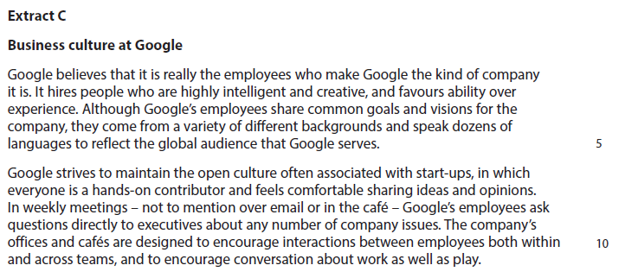
Case study for question 1

Slide 25
Sample question 1
Knowledge 4
Application 4
Analysis
6
Evaluation
6

Slide 26
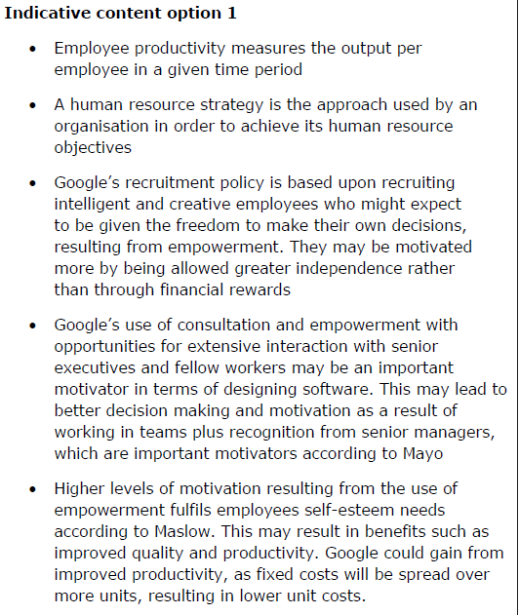
Answer sample question 1

Slide 27
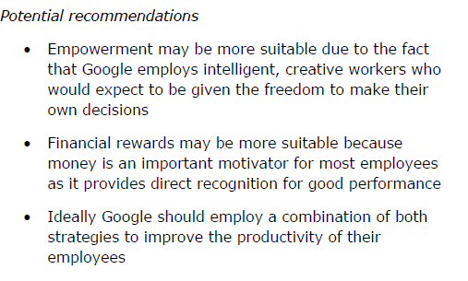
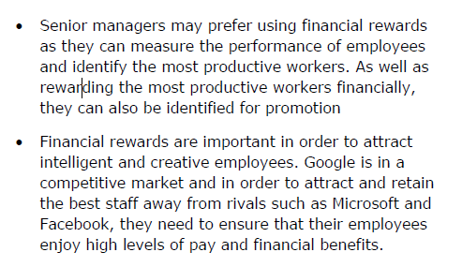

Slide 28
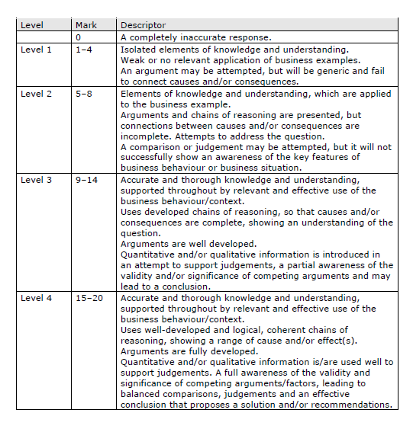
How to level sample question 1

Slide 29
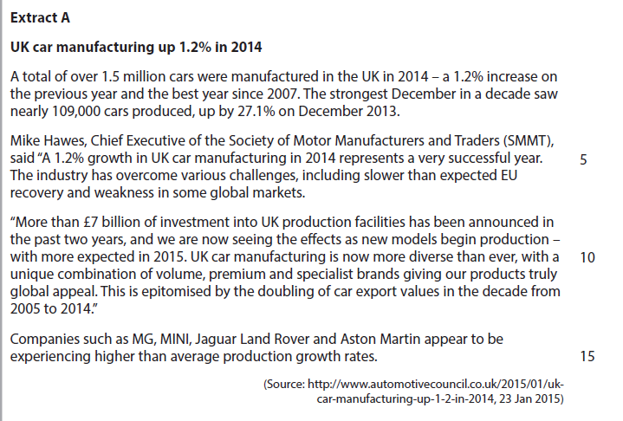
Case study for question 2

Slide 30
Sample question 2
Knowledge 2
Application 2
Analysis
3
Evaluation
3

Slide 31
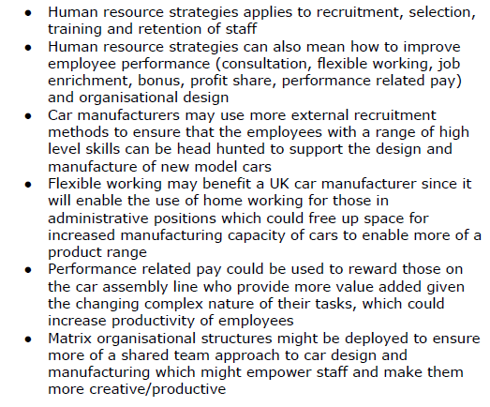
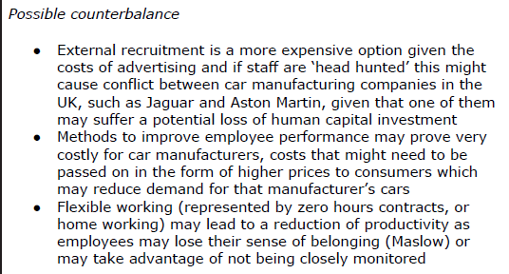
Answer sample question 2

Slide 32
Case study for question 3

Slide 33
Sample question 3
Knowledge 4
Application 4
Analysis
6
Evaluation
6

Slide 34
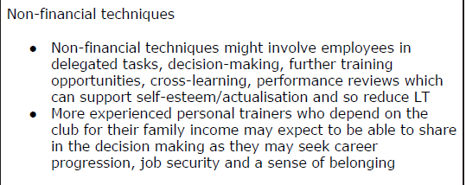
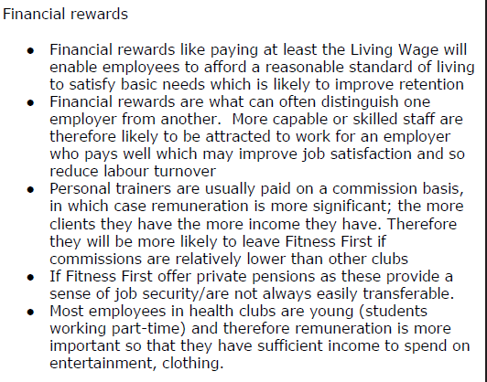
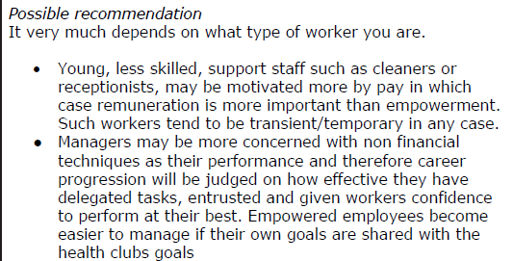
Answer sample question 3

Slide 35
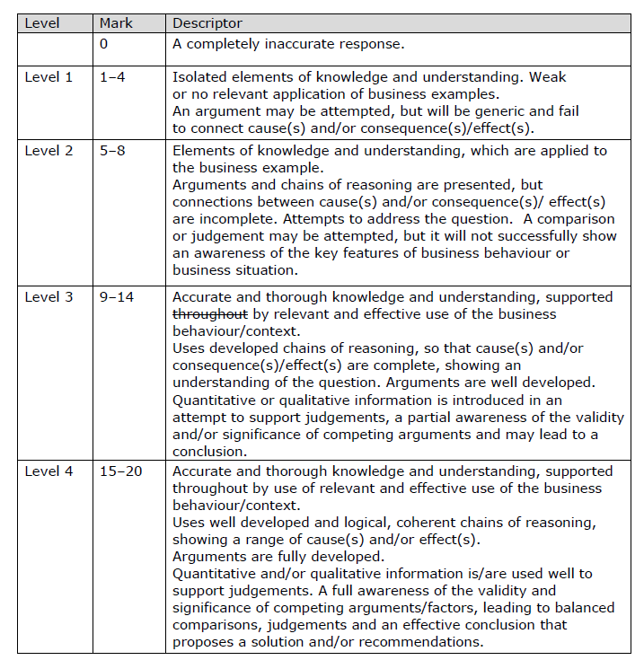
How to level sample question 3

Slide 36
Case study for question 4

Slide 37
Sample question 4
[4]
Knowledge 1
Application 1
Analysis
2

Slide 38
Answer sample question 4

Slide 39
Glossary
Labour productivity; rate of output per person in a time period e.g. Knitting one jumper per day
Labour turnover; the rate at which employees leave their jobs and need to be replaced in a year e.g. 27%
Labour retention; the amount of employees who stay in a business e.g. 98%
Absenteeism; Absence from work on a regular basis

