Slide 1
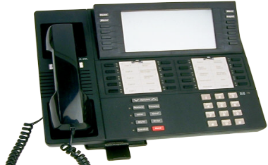
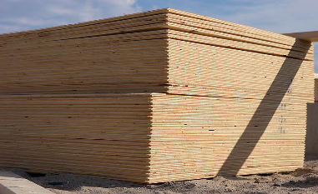
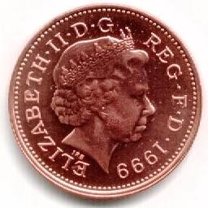
Business Costs
There are three main types of costs:
Fixed Costs
Sometimes called Indirect Costs or Overheads
They are not affected by output levels
They must be paid even if nothing is produced
Examples include:
Salaries
Rent
Semi-Fixed Costs
Sometimes called Semi-Variable Costs
These are costs that are a mixture of both fixed and variable
For example a telephone bill will be made up of:
Line rental
Cost of calls
Variable Costs
Sometimes called Direct Costs
They change directly with production
If production increases, so will these costs
Examples include:
Hourly Wages
Raw Materials

Slide 2
Calculating Total Costs
Once a firm knows their fixed and variable costs they can calculate their total costs
Total cost is the cost of producing any given level of output
As such total costs are calculated as:
Total Costs = Fixed Costs + Variable Costs
OR
TC = FC + VC

