Slide 1
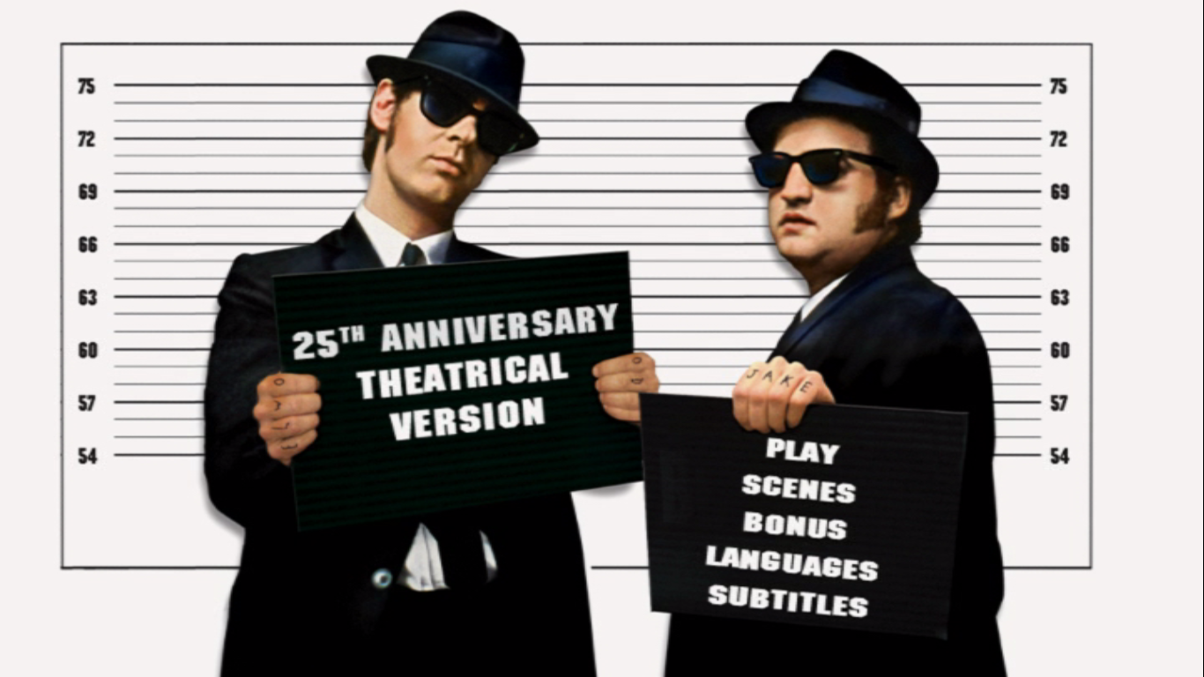
Y10 Exam Feedback
ON A MISSION FROM GOD
to take exam performance to new heights.

Slide 2
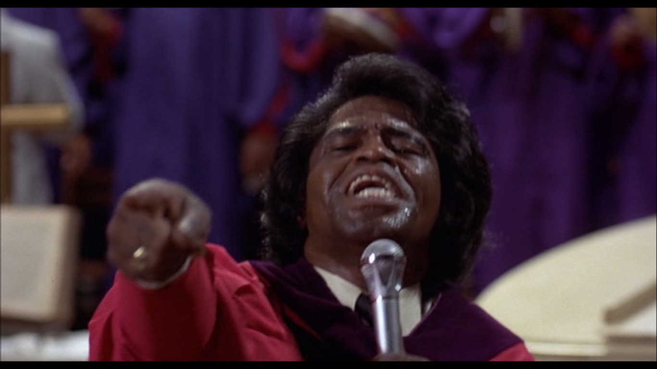
Key Question:
(about exam progress)
Y10 Exam Feedback
HAVE YOU SEEN THE LIGHT?

Slide 3
Y10 Exam Feedback
Key Question:
HAVE YOU SEEN THE LIGHT on exam progress?
Learning objectives:
To REPENT OF YOUR SINS of losing cheap marks.
To SEE THE LIGHT on how the exam system works.
To aim for a HOLY REFORMATION of how you do your 12 mark questions.
To receive SACRED INSTRUCTION on your personal goals for EXAMINATION SALVATION.

Slide 4
Y10 Exam Feedback
Key Question:
HAVE YOU SEEN THE LIGHT on exam progress?
Mock Paper
Mark/77 % Grade
73 95% 9
67 87% 8
62 81% 7
56 73% 6
51 66% 5
46 60% 4
36 47% 3
26 34% 2
16 21% 1
Starter Tasks;
Look at the purple feedback sheet.
Write ‘10X1’ next to ‘Teaching group’.
Correct ‘Mark:/72’ to ‘Mark:/77’.
Write your own spag.
2a. Extension
Read up on parts where you
did not know the information.

Slide 5
Y10 Exam Feedback
Key Question:
HAVE YOU SEEN THE LIGHT on exam progress?
Starter Tasks;
Look through your exam paper.
Write on your purple feedback sheet in green
how many marks you were off a grade 5
OR how many marks off your target
OR how many marks off a grade 9;
whichever is the next one up from your result.
2a. Extension
Read up on parts where you
did not know the information.
Mock Paper
Mark/77 % Grade
73 95% 9
66 86% 8
60 78% 7
54 70% 6
46 60% 5
42 55% 4
33 43% 3
23 30% 2
16 21% 1

Slide 6
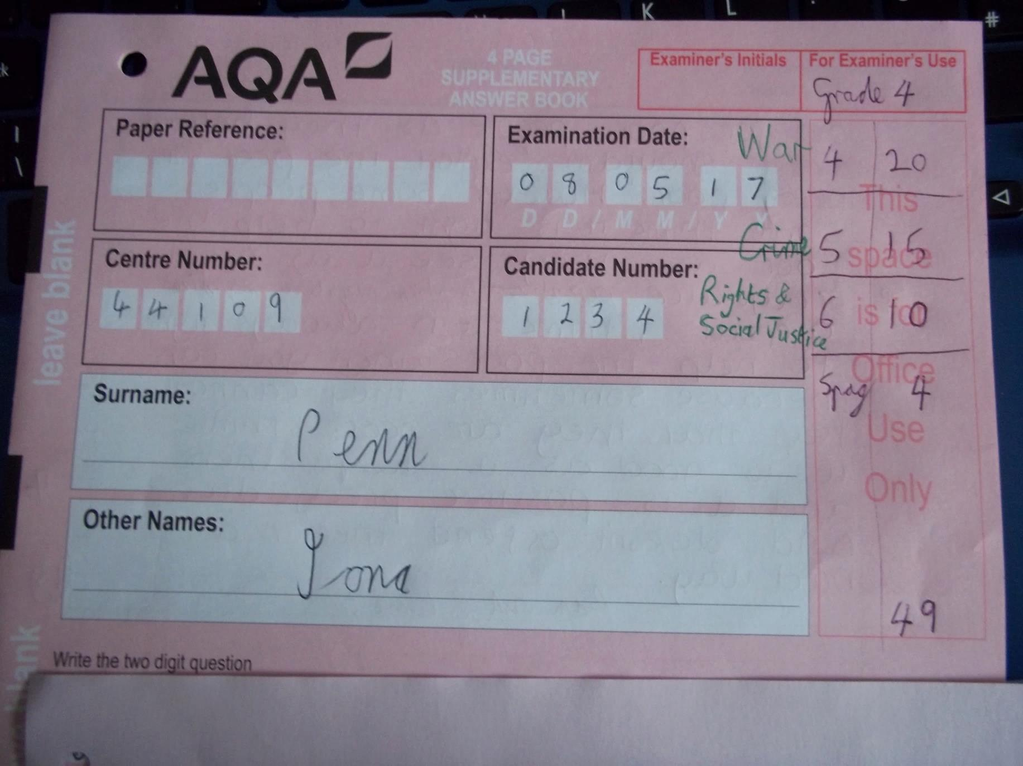
Y10 Exam Feedback
Key Question:
HAVE YOU SEEN THE LIGHT on exam progress?
GCSE Religious Studies Paper 2A
Thematic Studies (Individual Sections)
War
Crime
Rights & Social Justice
Look at the front cover of your exam script. Work out and write in green the name of each section (‘Rights & Social Justice’, etc.), next to the number using the table on the left of this screen to help you.
3a. Extension Read up on two questions that you did not answer successfully.

Slide 7
Y10 Exam Feedback
Thematic Studies sections
Section Mark/24 Grade
23-24 9
21-22 8
19-20 7
17-18 6
15-16 5
13-14 4
11-12 3
8-10 2
5-7 1
0-4 U
Look at the front cover of your exam script. Work out and write in green what grade you got for each section using the table on this screen to help you.
Make a note either on the paper or elsewhere of your weakest topic as a target for future revision.
4a.Extension Read up on two questions that you did not answer successfully.

Slide 8
Y10 Exam Feedback
Look at how many marks each question is worth and note in green how many marks you dropped with a minus sign, e.g. ‘-2’. If you dropped no marks, put ‘-0’ next to the number.
In your exercise books you have an A5 handout called ‘RE Marking Abbreviations’. These abbreviations have been used in the marking of your exam. Using green, go through the whole paper and write out in full the meaning of any abbreviations that you don’t know. Do this on the exam paper itself.
6a. Extension Read up on a question that you did not answer successfully.

Slide 9
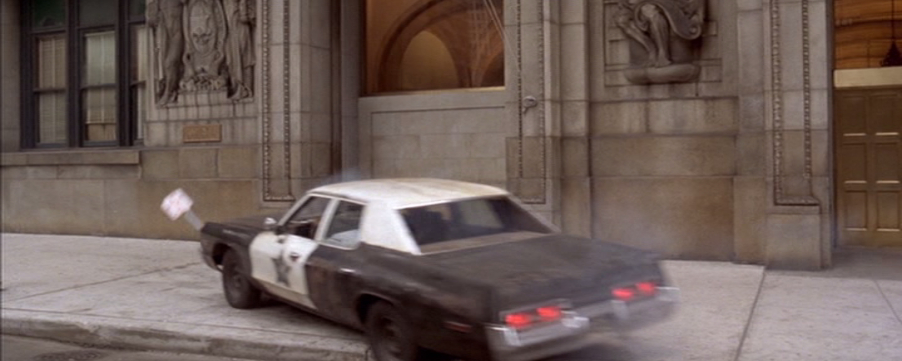
Y10 Exam Feedback
Key Question:
HAVE YOU SEEN THE LIGHT on exam progress?
In green, note down your targets using the corresponding numbers on the next slide.
Extension
9a. Make some targets of your own and write them.

Slide 10
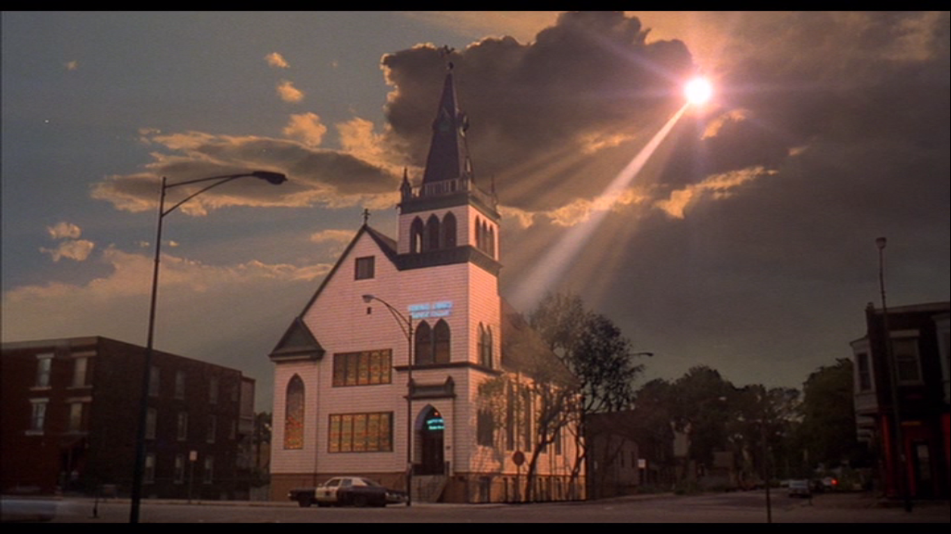
Assessment Targets
In 12 mark questions, to give at least 2 reasons for the statement and at least 2 against with examples to explain each reason.
To show clearly in your answer that you understand the question e.g. that ‘corporal punishment’ ≠ ‘capital punishment’.
To spend the same amount of time on each section.
To include more religious teachings in my answers (where appropriate).
To make sure I include the most relevant religious teachings.
To avoid contradicting myself in 12 mark answers.
To develop a clearer understanding of Buddhism.
To make sure I read questions carefully and my answers clearly link to the requirements of the question.
To make sure reasons given in an answer are different, not just the same idea repeated in different words.
In 4 and 5 mark questions, to take two points and develop them by explaining them in detail.
To give top priority to memorising scriptural teachings.
To memorise key terms like ‘pacifism’.
To answer the right questions only!
In 4 mark questions give two contrasting religious views.

Slide 11
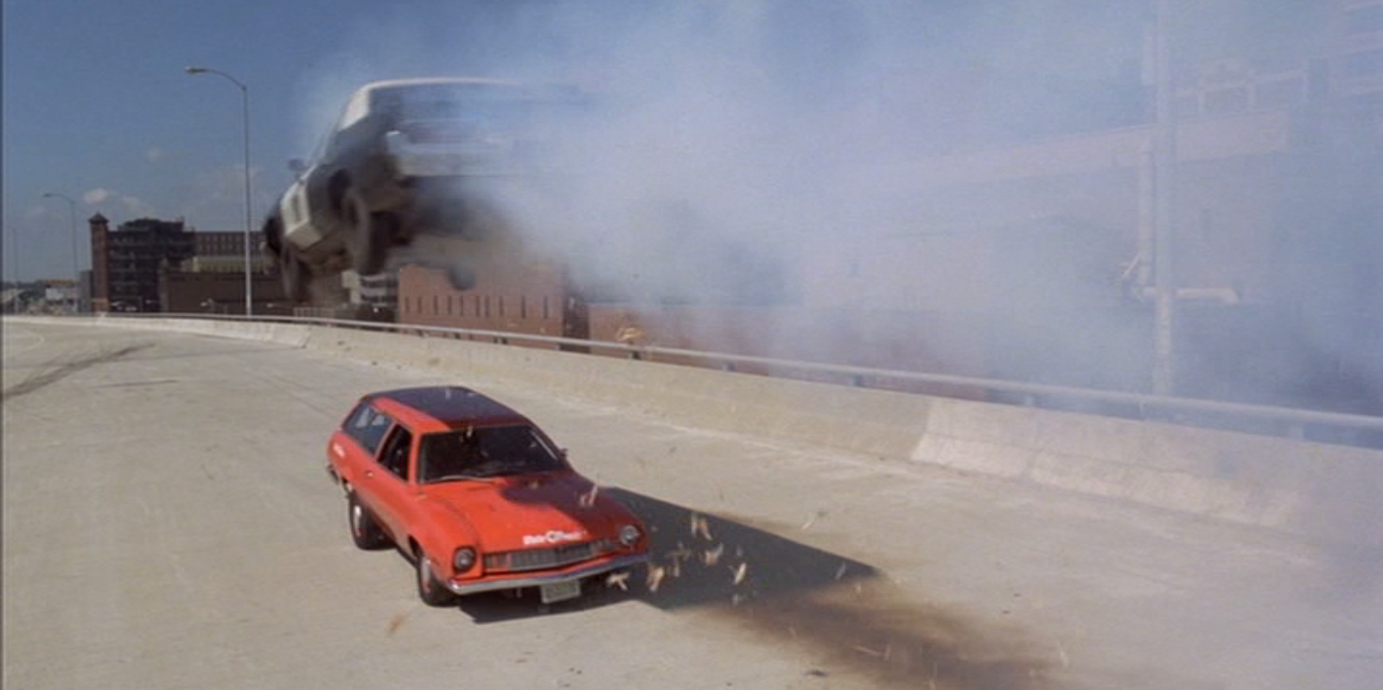
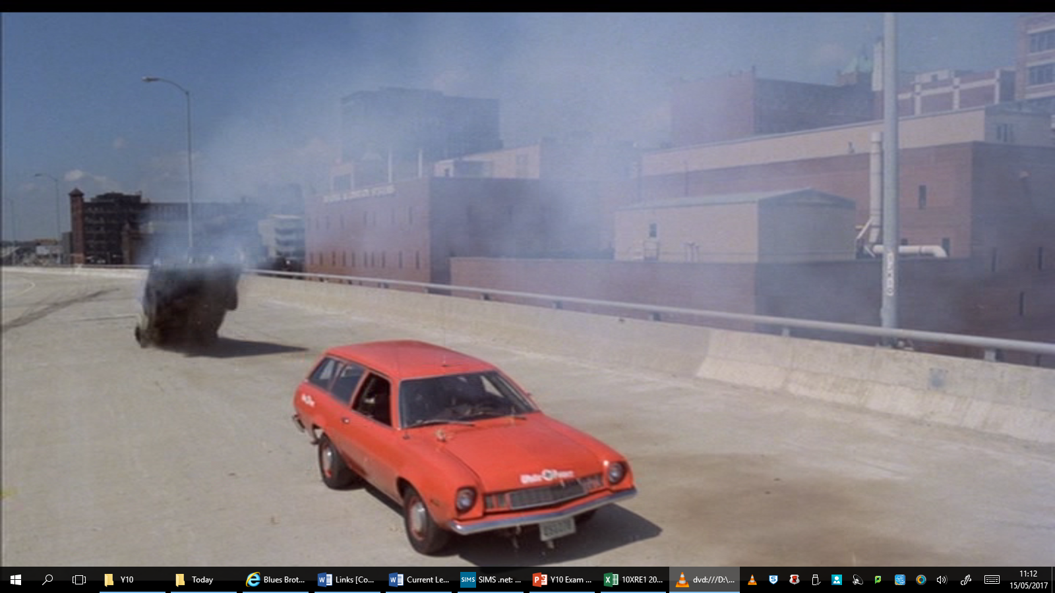
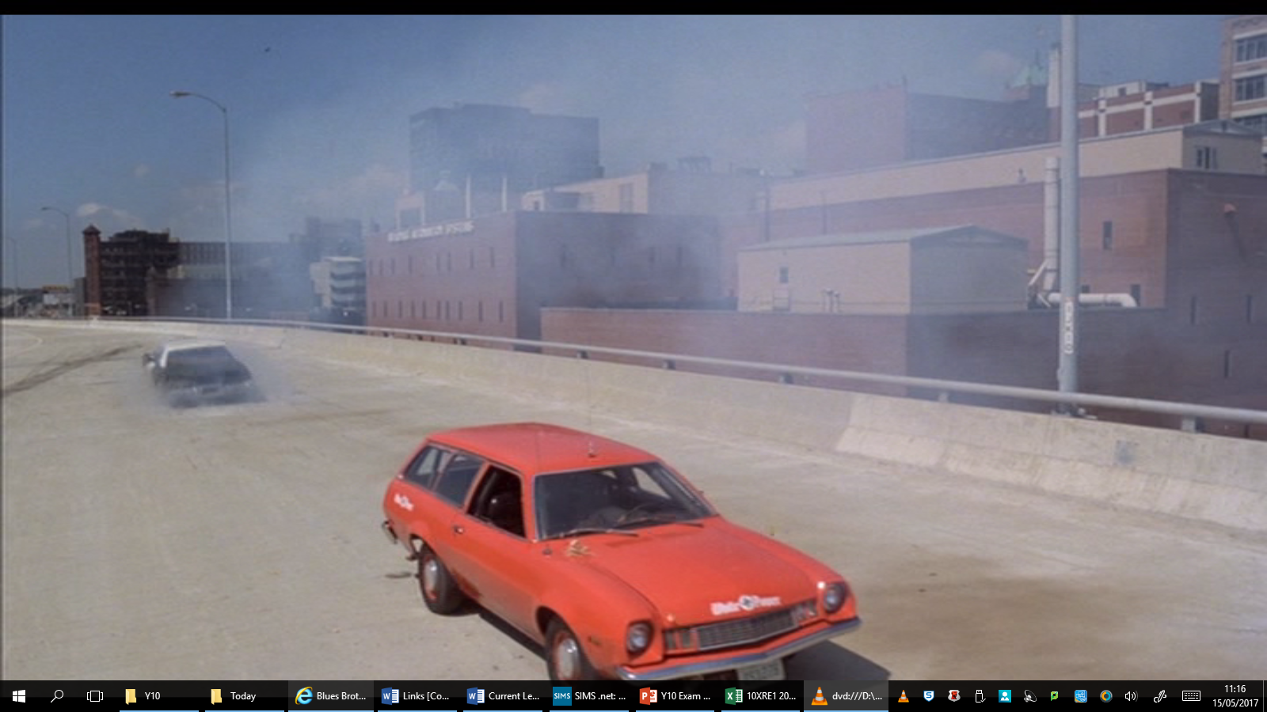
Y10 Exam Feedback
The rubber hits the road:
Re-do the questions where you dropped the most marks.
Don’t include anything in your re-do answer that you previously got wrong or was irrelevant.

Slide 12
Plenary
HAVE YOU SEEN THE LIGHT?

Slide 13
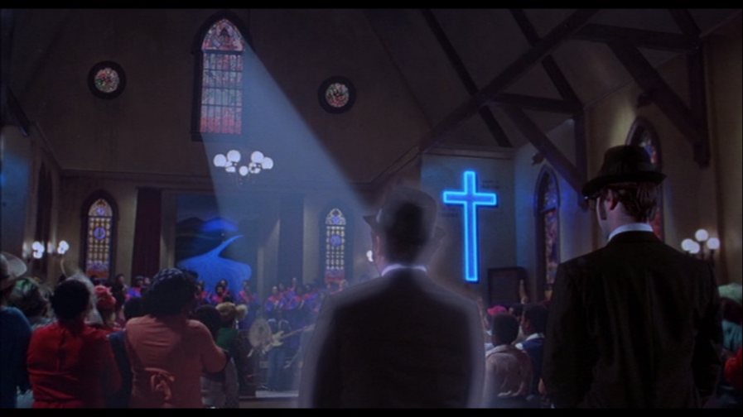
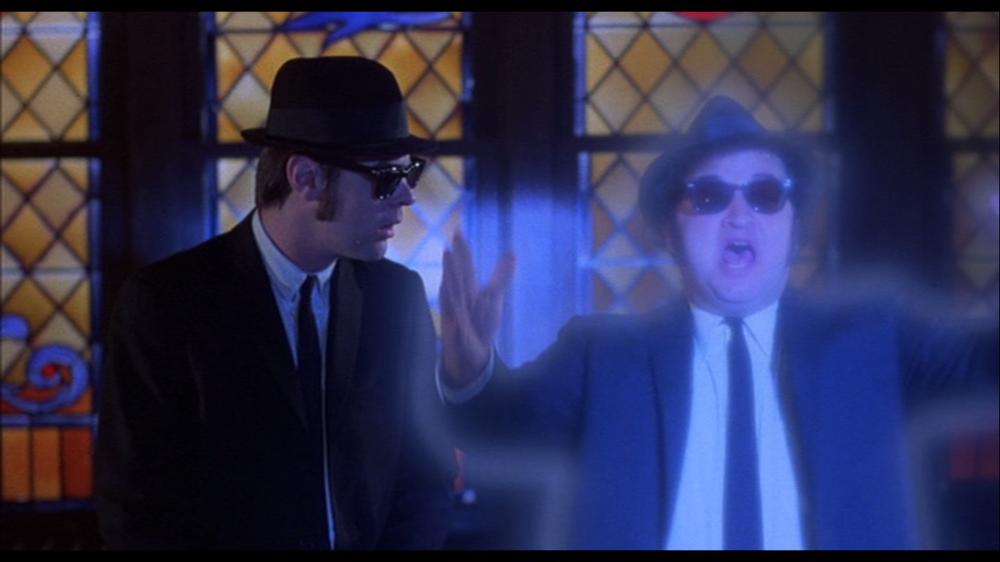
YES! Jesus is the blessèd Christ!
RE is the greatest subject!
I have SEEN THE LIGHT!

Slide 14
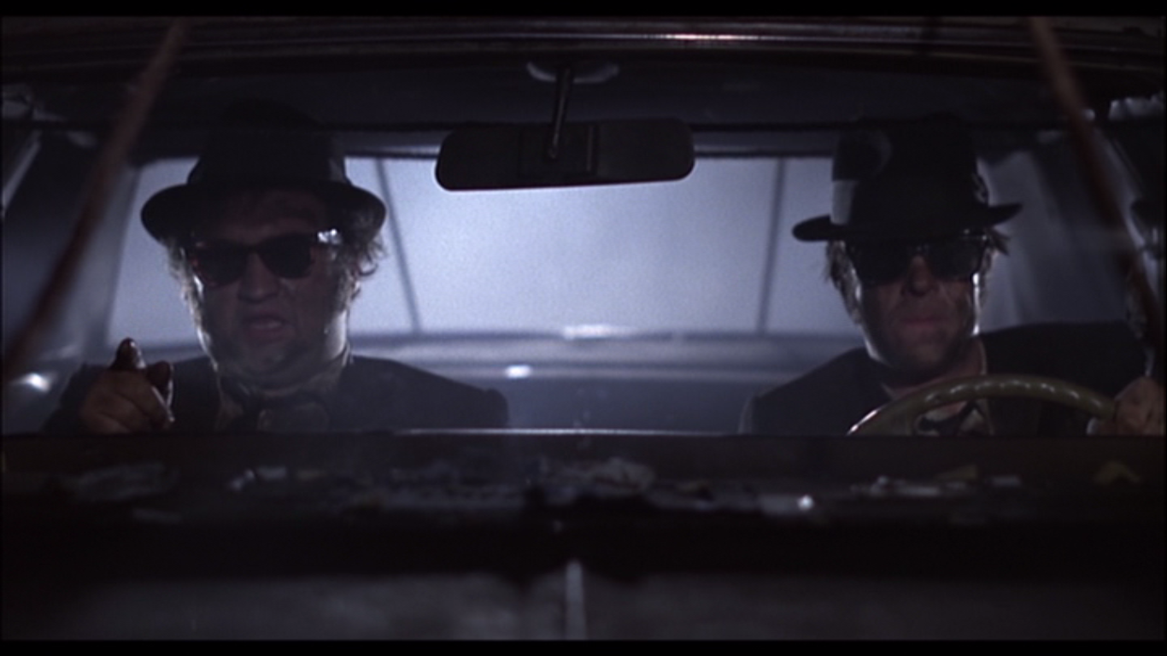
It’s 106 miles to Chicago, we’ve got a full tank of gas, half a pack of cigarettes, it’s dark and we’re wearing sunglasses.
Hit it!

