Slide 1
The BIG Idea
3.2.2 Mergers and takeovers
Think about…
Reasons for mergers and takeovers
Distinction between mergers and takeovers
Horizontal and vertical integration
Financial risks and rewards
Problems of rapid growth
Notes:
Students identify key words to underline

Slide 2
Definition
Mergers are where two firms of similar size agree to join forces permanently, creating a new company that is twice the size of each predecessor.
Takeovers occur when one firm buys the majority of the shares in another and therefore achieves full management control.

Slide 3
Reasons for mergers and takeovers
Growth - the fastest way to get big is by, taking over or, merging with another business.
Cost synergies - Cost savings are often claimed to be available – arising from economies of scale. The proposed merger between Asda and Sainsburys claimed that synergies would be achieved. One head office and rationalisation of supply and distribution channels would be achieved i.e. 2 + 2 = 5
Diversification - This means entering different markets in order to reduce the dependence upon current products and customers. Don't have all your eggs in one basket
Market power – When two competitors in the same market merge, the combined business will have more power within the market. (See Porter’s Five Forces Model)

Slide 4
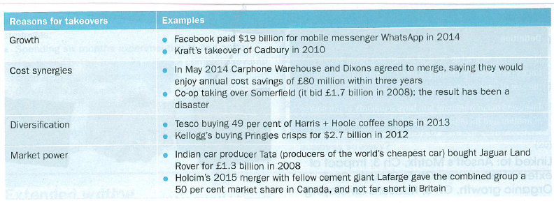

Slide 5
Distinction between takeovers and mergers
Merger - joining of equals in order to create a new and larger company. This is likely to be agreed in advance and on cordial terms.
Takeover – may be `friendly` (agreed between both boards) or `hostile` (the target company’s board may not welcome the bid)
Xerox hostile takeover of HP
What is the motivation for this hostile takeover?
What is surprising about this particular hostile takeover?
Evidence suggest that hostile takeovers tend to be more successful than `friendly mergers`. Can you explain why this might be the case?

Slide 6
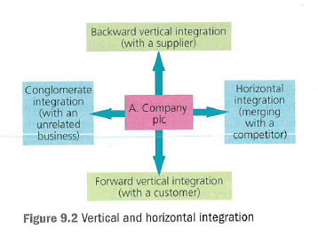
Types of integration
Vertical – integration between businesses in the same industry, but at different stages of production
backwards – integrate with a supplier
forwards - integrate with a customer
Horizontal – integration occurs when one firm buys another firm in the same industry and at the same stage of production.
Conglomerate - integration occurs when one firm buys another firm in an unrelated industry. The desire to diversify is often the main motivation.

Slide 7
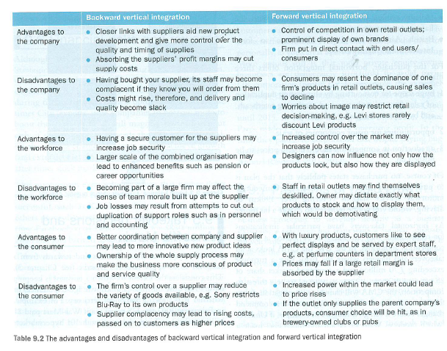
Vertical integration
What would backwards and forwards vertical integration look like in the alcoholic drinks industry? Provide a motivation for each!

Slide 8
Horizontal integration
This is the most common form of integration – buying out a competitor.
It is likely to result in a CMA investigation if the proposed merger results in the combined business holding > 25% of the UK market and a market capitalisation of £75m.
Motivations include:
Economies of scale
Exploitation of synergies
Reduction in competition

Slide 9
Conglomerate integration
Motivations include:
Asset strip a business and sell it on
Spread the risk of being dependent on one marketplace
These are not always successful – primarily because the management team do not know much about the marketplace of the company that has been bought.

Slide 10
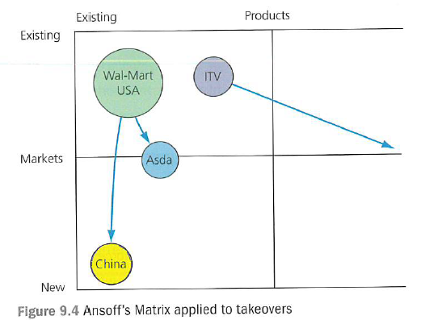
Takeover decisions and Ansoff’s Matrix
The Ansoff’s Matrix model can be used to analyse the level of risk associated with each type of merger and takeover.

Slide 12
Key terms

