Slide 1
Blood Brothers.
LO: To use characterisation to show social class.

Slide 2
Learning Outcomes.
By the end of the lesson you should be able to…
Recall what the main themes of the play are.
Describe the differences between working and middle class.
Explain how you would create contrasting characters.

Slide 3
Discussion.
What did we find out about the play?
What are the main themes of the play?
What do we now know about the play?

Slide 4
Themes
The main themes in Blood Brothers are connected with differences in social class, and the effects these have on the lives of the main characters.
Although superstition and fate are presented as themes, the political message of the play seems to be saying that it is real-world social forces that shape people's lives.

Slide 5
Social Class
Family and friendship for characters from two different social classes form the heart of the play. Russell shows how wealth brings privilege, even down to the way the Johnstone's and the Lyons are treated differently by the law.
The four main characters can be seen to be social stereotypes, presented dramatically in order to emphasise certain important differences in social class. Russell does this to show the unfairness that it results in.

Slide 6
Class Task
One group create a still image of working class people.
One group create a still image of middle class people.

Slide 7
Progress Check
What is the difference between the two?
How does class dictate the way we stand?
How does class dictate the way we talk?
What is a sterotype?

Slide 8
Mickey and Eddie
Language? Accents?
How do you show the difference between the two? PPPPP
How do you show the differences between the two and show that you are a 7 year old.

Slide 9
Pair Work.
In pairs create the scene between Micky and Eddie from where they fist meet until Sammy walks in.
Think Voice… Movement… facial expressions.

Slide 10
Perform and Evaluate

Slide 11
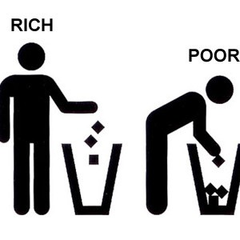
Theory Stuff…
Explorative Strategies.
Role Play
Drama Medium.
Use of Voice
Use of spoken language
Use of movement and gesture
Elements of Drama.
Contrasts
Characterisations

Slide 12
Independent Learning
Drama diaries up to date.
Create a labelled costume design for either Mrs Johnstone or Mrs Lyons.

