Slide 1
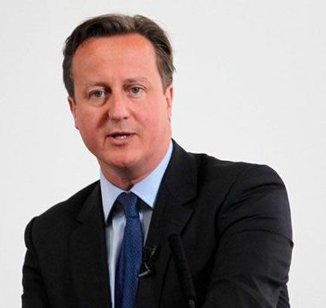
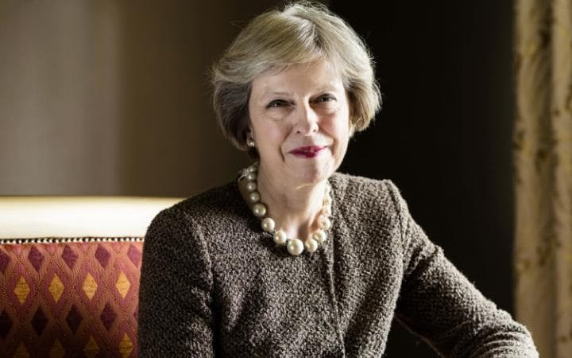
What do you think is meant by the phrase ‘government failure’?
Can you provide any examples?

Slide 2
LEARNING OBJECTIVES
Lo1: Explain the term ‘government failure’
Lo2: Explain how government failure can occur.
Lo3: Analyse various instances and real examples of where government failure has occurred.

Slide 3
Specification
1.4.2 Government failure
a) Understand of government failure as intervention that results in a net welfare loss
b) Causes of government failure:
Distortion of price signals
Unintended consequences
Excessive administration costs
Information gaps
c) Government failure in various markets

Slide 4
GOVERNMENT FAILURE
“Situation where government intervention in the economy, to correct a market failure, creates inefficiency and leads to a misallocation of resources.”
Be careful with this definition, as it is tempting to write an overly simplistic definition… e.g. “When the government makes things worse.”

Slide 5
GOVERNMENT FAILURE
The main causes of government failure are:
Information gaps
Distortion of price signals
Unintended consequences
Excessive administrative costs

Slide 6
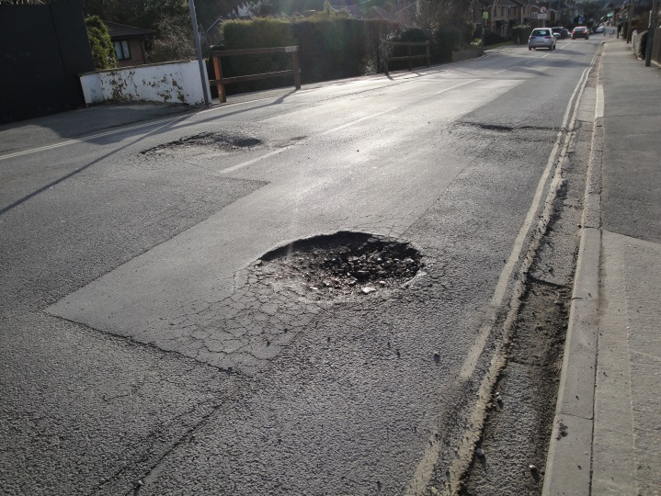
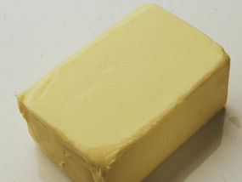
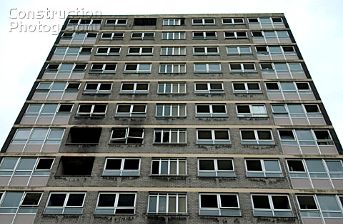
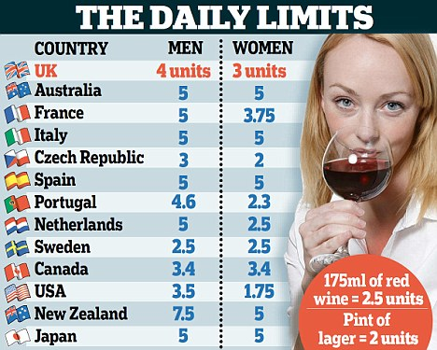
GOVERNMENT FAILURE
Government failure has a wide variety of associations.
Information failure is one of them (Hayek) – how can a government intervene if they do not understand the full scale or complexity of the issues? Such as not knowing the socially optimum level (bottom right photo).
It can even be used in the context of pot holes – roads are provided by the government (state provision) but the failure to know about and fix pot-holes (information failure) is government failure too.
Anything where the government intervenes and makes the situation worse or creates different problems.
Impoverished Council Estates
CAP Butter mountains

Slide 7
GOVERNMENT FAILURE
Most governments see it as their responsibility to correct market failure.
However, some policies have unintended effects that may not culminate in successful elimination of market failure – sometimes even leading to new market distortions. Known as government failure.
For example, with externalities, the government may choose to tackle pollution with a tax or regulation.
However, it may not be possible to identify the appropriate amount of tax to correct the market failure or how many pollution permits need to be issued to reach the socially optimum level.
Furthermore, if Q* is not accurate – then it will not be possible to get the policy exactly right.
Government failure is not just restricted to externalities – government failure may rise in many other ways. As we shall see…

Slide 8
TUITION FEES £9,000 A YEAR

Slide 9
INCREASED TUITION FEES
Despite being a flagship policy of the Liberal Democrats, in 2011 the Coalition increased the maximum level of tuition fees from £3,000 to £9,000.
This piece of regulation intended to bring more funding to universities, so that the quality of labour and further education would increase.
However, how could it be argued that government failure has occurred and that the situation is worse?
Draw a positive externality diagram and illustrate the problem getting worse.

Slide 10
Q* = Socially optimal level of output. Best level for society. MC = MSB
Cost/Benefit
MSC = MPC
Qe = Free market. MSB > MPB
MSB > MPB = Positive externality
If output was at Q*, extra welfare could be gained.
Therefore there is a welfare loss between the two quantities
MSB
Arguably, the tuition fee rise would put people off from going to university.
MPB
MPB + Intervention
Quantity has moved even further away from the socially optimum level
This would result in a reduced quantity (Q2) and the welfare loss triangle would increase
Qe2
Qe
Q*
Quantity
Notes:
Things like healthcare and education provide positive externalities to third parties.
However, when left to the market, we won’t get enough of these goods (market failure). As market forces will only generate so much, as a larger level of output would be good for society.
Private benefits = those enjoyed by the buyers and sellers.
Marginal private benefit = the extra benefit enjoyed by having one more. MPC = cost of one more.
MSB = The private benefit + the externality which, in this case, is positive.
Education: If you’re in education, you’re earning more and pay more tax – which is then spent on society and benefits them.
Healthcare: Vaccination for the private benefits of avoiding flu. Benefits society as they’re now less likely to get sick.

Slide 11
https://www.youtube.com/watch?v=KUDjRZ30SNo
Nick Clegg Apology Song

Slide 13
HOUSING MARKET
RENT CONTROLS

Slide 14
HOUSING MARKET – RENT CONTROLS
Read the information about rent controls and government failure in the housing market.
Demonstrate the affect of such an intervention using a demand and supply diagram.
What government failure has occurred?

Slide 15
Price
Supply
With rent capped, there is a lack of incentive for landlords to supply more. Therefore a disequilibrium occurs and the demand is higher than supply.
Rent Control (Price Ceiling)
Demand
0.
QS
QD
Quantity

Slide 16
HOUSING MARKET
PLANNING PERMISSION

Slide 17
HOUSING MARKET – PLANNING PERMISSION
Localism Act 2011 has increased NIMBYism (Not In My Back Yard). This adds to already strict planning laws, which make it difficult for developers to build houses.
Green Belts restrict what can be built on land around urban areas, this is to prevent urban sprawl and towns merging into one another
All of which has made the supply of housing even more inelastic.
Increasing house prices and age of first time buyers is 36 and rising.
Generation of people renting and living with parents.

Slide 18
LABOUR MARKET

Slide 19
LABOUR MARKET
How has the government intervened in the labour market?
Where has the government failure occurred?

Slide 20
Wages
Supply of Workers (Labour)
(QD-QS) Unemployment
Minimum Wage (Price Floor)
The government’s intervention has reduced inequality amongst other benefits, but the unintended consequence was unemployment (arguably) – government failure.
Demand for Workers (Jobs)
0.
QD
QS
Quantity

Slide 21
Minimum Wage
Disequilibrium in the mark may theoretically create unemployment.
Firms will also seek to reduce costs in other ways, by reducing overtime and paid breaks.
They may also pass on the additional labour costs in the form of higher prices (cost-push inflation).
Ultimately, fewer may be left with a job and those that do will have worse conditions.

Slide 22
https://www.gov.uk/national-minimum-wage-rates
NMW and NLW current figures

Slide 23
National Living Wage
On April 1st 2016 the government introduced the National Living Wage.
Increasing the minimum amount that an over 25 can earn to £7.20 per hour.
Read the article and watch the clips to assess the impacts upon employers, employees and consumers.
https://www.youtube.com/watch?v=DyyJuOJVYC8
https://www.youtube.com/watch?v=Gq7T3_M_Zn4
https://www.youtube.com/watch?v=etZvDNANf2g
Notes:
https://www.youtube.com/watch?v=DyyJuOJVYC8
https://www.youtube.com/watch?v=Gq7T3_M_Zn4

Slide 24
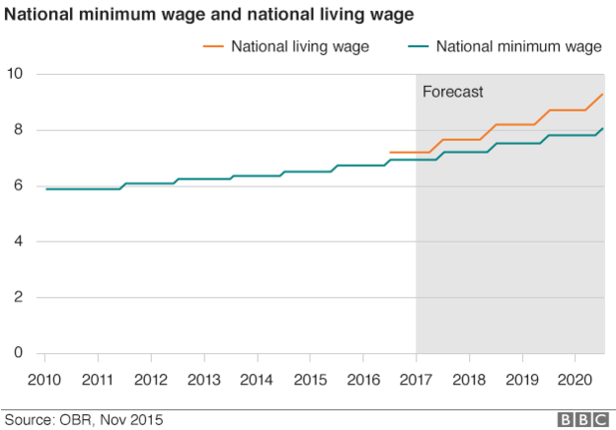

Slide 26
TAXATION LAFFER CURVE

Slide 27
WHAT WOULD THE CURVE LOOK LIKE..?
Tax rate and revenue.
Demonstrates that setting a tax at 100% does not result in maximum revenue for the government.
Too high = less revenue.

Slide 28
TAX EVALUATION – LAFFER CURVE
In order to reduce the externalities associated with smoking, the government taxes cigarettes. But what if the tax is set too high?
Arthur Laffer’s theory suggests that if taxes on the likes of tobacco are set too high, then government failure will occur.
Whereby taxes are set to high, consumers will smuggle tobacco in from other countries where they are cheaper e.g. Belgium.
Could also apply to income tax/corporation tax – companies and people leave/tax avoidance if set too high.
These unintended consequences are government failure.
As a result, the government’s tax becomes less effective and they are losing out on tax revenue.

Slide 29
Anything beyond a tax rate of T* and consumers begin to smuggle the good in from other countries.
Thus, the government loses revenue and people are still consuming the
good (and the negative externality continues).
Tax Revenue
T* Optimum Tax Level
Tax Rate %

Slide 30
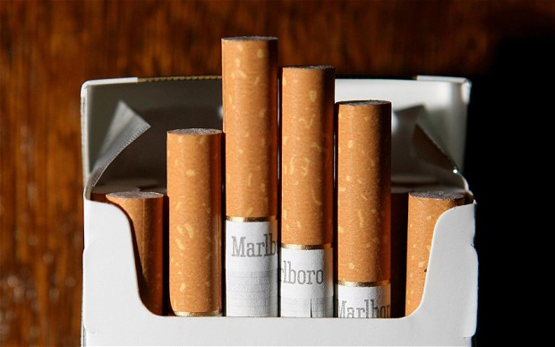
LAFFER CURVE…
Read the article:
One in five cigarettes smoked in Britain avoids UK tax as holidaymakers stock up abroad.
This illustrates an A* piece of evaluation for taxation and also government failure.

Slide 32
LAFFER CURVE…
Top 1% of earners (£126,000+) contribute 27% of all income tax revenue.
If taxes for top earners was reduced, how might this actually increase government revenue overall?
Notes:
SETS UP THE NEXT VIDEO… TRICKLE DOWN

Slide 33
https://clickv.ie/w/yqci
Super-Rich and Us - TRICKLE DOWN
24:00 – 35:00

Slide 34
NHS

Slide 35
NHS – Government Failure
Healthcare in the UK is publicly funded and this state provision brings about enormous positive externalities.
However, it is not without criticism and there are examples of where government failure occurs.
Because the NHS is free at the point of consumption, the result can be very long waiting times.
Further NHS concerns include the performances of some hospitals, including higher than average ‘death rates’.
http://www.bbc.co.uk/news/health-22758157

Slide 37
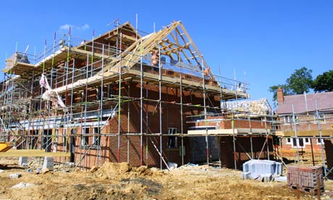
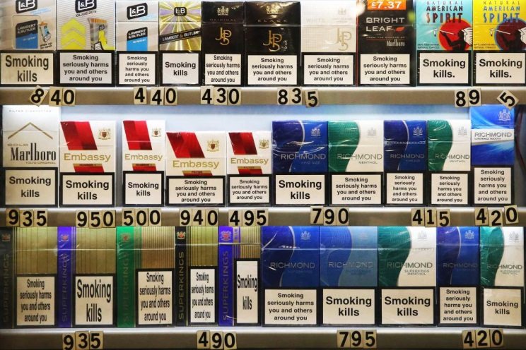
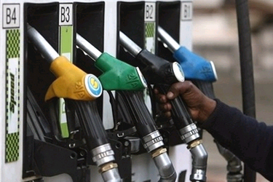
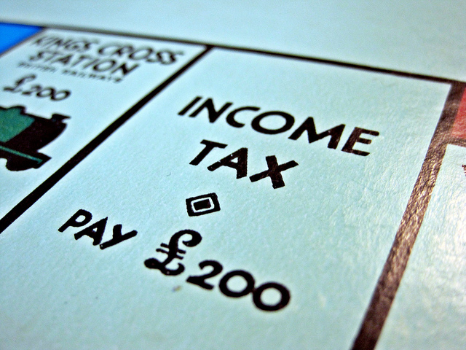
ANSWERING ANY GOV. FAILURE Q.
Mind map KAA/EV points for the following questions:
To what extent has government intervention within (insert industry) resulted in government failure?
KAA – Government failure because….
EV – Not gov. failure because (successes of intervention) / critique of KAA

Slide 38
GOVERNMENT FAILURE Q…
“With reference to the information provided and your own knowledge, to what extent might regulations on the sale of cigarettes and high taxes on tobacco result in government failure?” (15)
Notes:
http://qualifications.pearson.com/content/dam/pdf/A%20Level/Economics/2013/Exam%20materials/Question-paper-Unit-1-(6EC01)-June-2014.pdf
QUESTION PAPER
http://qualifications.pearson.com/content/dam/pdf/A%20Level/Economics/2013/Exam%20materials/Mark-scheme-Unit-1-(6EC01)-June-2014.pdf
Mark Scheme p26-27

Slide 39
LEARNING OBJECTIVES
Lo1: Explain the term ‘government failure’
Lo2: Explain how government failure can occur.
Lo3: Analyse various instances and real examples of where government failure has occurred.

