Slide 1
Stakeholders and Corporate Social Responsibility
Starter

Slide 2
Learning Objectives
Understand how stakeholders affect corporations
Be able to identify conflicting and common objectives of stakeholder groups

Slide 3
Who Are The Stakeholders?
Stakeholders are people or groups who have an interest - or “stake” - in the activities of a business
YOU are a stakeholder in a number of businesses
E.g. Stoke City fans are stakeholders in the football club
Stakeholders may be able to influence the behaviour of a business
Fans protesting can get a football manager sacked
Some stakeholders have more influence than others!
E.g. Peter Coates has more influence on Stoke City than any of the fans

Slide 4
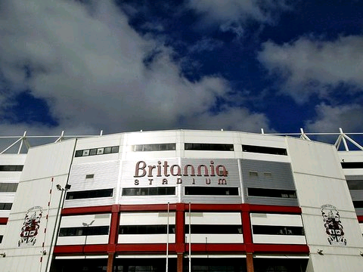
An Example of Stakeholders
The Stakeholders of Stoke City FC
INTERNAL STAKEHOLDERS
Owners
Employees (E.g. Players)
Managers
Financiers (E.g. Banks)
Customers (E.g. Fans)
Suppliers
Central Government
Local Government
Pressure Groups
Local Community (E.g. Residents)

Slide 5
Objectives & Stakeholders
Stakeholder | Possible Objectives | How Much Influence?
Owners | Survival, profit, independence | Major decision maker
Shareholders | High dividends, growth | Limited unless holding many shares
Managers | Career progression, good salary | Some input into decisions
Employees | Job security, job satisfaction, good pay | Limited; may have influence through trade unions
Customers | Good quality, value for money | Varies – can take their trade elsewhere
Suppliers | Regular orders | Varies according to market
Financiers | Prompt repayments | Varies – but may have great influence
Government | Job creation, good economic conditions | Can be very influential
Local Community | Good quality of life | Limited
Pressure Groups | Business meets their demands | Limited, unless large

Slide 6
Conflicts Of Objectives
Conflicts can occur in 2 ways:
Conflicts can be overcome if the business is adaptable
Objectives may have to be changed if circumstances change
The objectives of stakeholders can conflict
Shareholders want good dividends which requires high profits
Workers want high wages, increasing costs and lower profits
The objectives of the business can conflict
Short-term objectives may conflict with long-term objectives, E.g.
If the short-term objective is survival risks may be avoided
BUT if the long-term objective is growth risks must be taken!

Slide 7
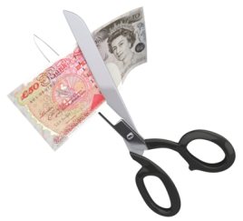
Possible Conflicts
Consider the two scenarios below:
What are the conflicts and how could they be overcome?
Case 1
Managers decide to automate, and invest in new machinery
They believe this will help them to reduce the workforce by 20% over the next three years
Case 2
The marketing team decide to increase prices to consumers by 5% and re-negotiate contracts with suppliers to reduce raw material costs by 10%.
They believe that this combination will enable profits to increase by 8%

Slide 8
Overcoming Conflicts
Many conflicts occur because:
Firms will try to overcome this problem by:
Writing policies that outline their social and ethical stances
Promoting themselves as being ethical and socially responsible
The owners and managers will focus on profit-related objectives
Other stakeholders will be interested in the social and ethical behaviour of the firm

Slide 9
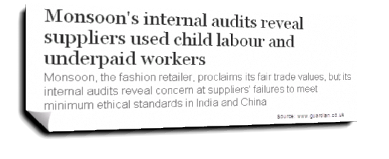
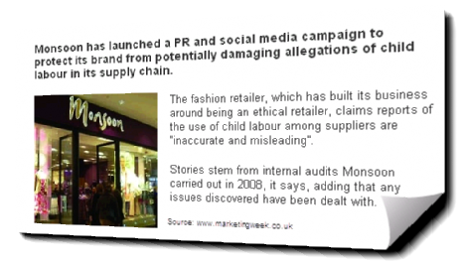
Profits or Ethics?
Firms must be careful when tackling ethics and social responsibility:
It’s easy to write a policy – but usually much more difficult to implement it
It can be a PR disaster if a company making itself out as being ethical is found out not to be
As the retailer Monsoon found out:

Slide 10
Corporate Social Responsibility (CSR)
Corporate Social Responsibility can mean different things to different people
Generally CSR involves:
This means that CSR is about:
Conducting business in an ethical and moral way
Balancing the interests of different stakeholders
Acting upon issues before legally required to do so
The business as a good citizen
“Managing a business so that it exceeds minimum legal requirements, and has a positive impact upon society”

Slide 11
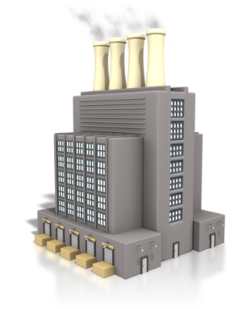
What Does CSR Mean For A Business?
CSR should permeate everything a business does since:
Customers
Society
Will be concerned with:
Product sourcing
Value for money
Informed choices
After sales service
Will be concerned with:
Waste
Carbon emissions
Biodiversity
Energy efficiency
The Local Community
Employees
Will be concerned with:
Pollution
Job creation
Consultation
Health & Safety
Will be concerned with:
Health & Safety
Equality
Work-life balance
Training

Slide 12
The Arguments For & Against CSR
Some people believe that CSR is a marketing ploy
There are a number of arguments for and against CSR:
CSR could…
However CSR could also…
Help to attract and retain staff
Reduce the risks of gaining a poor reputation
Create a USP that helps a company stand out
Reduce the chances of government intervention
Be seen as being hypocritical – given that most businesses focus on profits
Distract a business from their core activities
Be seen as trying to avoid government intervention

