Slide 1
Edexcel A2 Business
2.5.1 Economic Influences
Revisionstation

Slide 2
From Edexcel
a) The effect on businesses of changes in:
inflation (the rate of inflation, the Consumer Prices Index)
exchange rates (appreciation, depreciation)
interest rates
taxation and government spending
the business cycle
b) The effect of economic uncertainty on the business environment

Slide 3
You will need a ruler and selection of colours

Slide 4
Worksheet

Slide 5
Starter – match the words
rising unemployment, rising inflation, reduction in demand, rising costs, rising unemployment, rising inflation, higher prices, greater availability of workers
Notes:
Rising unemployment = reduction in demand, greater availability of workers
Rising inflation = higher prices, rising costs

Slide 6
Definition: Economic influence
Economic influence is when a business is affected in any way by economic factors e.g. inflation, exchange rates etc.

Slide 7
The effect on businesses of changes

Slide 8
What is inflation?
Ever noticed that goods now are more expensive than when you were younger? This is inflation at work.
The annual rate of inflation shows how much higher or lower prices are compared with the same month a year earlier. It indicates changes to our cost of living
The inflation rate is the rise in the price of goods in the UK economy
What do you think deflation means?
Notes:
Deflation: Reduction of general prices in an economy

Slide 9
CPI is the Consumer Price Index
CPI looks at the prices of hundreds of things we commonly spend money on, including bread, cinema tickets and pints of beer - and tracks how these prices have changed over time.
The inflation rates are expressed as percentages. If CPI is 3%, this means that on average, the price of products and services we buy is 3% higher than a year earlier.
What is the rate of UK inflation today?

Slide 10
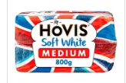
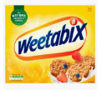
Inflation measured by Consumer Price Index
Consumer price inflation is the rate at which the prices of goods and services bought by households rise or fall
Imagine a very large ‘shopping basket’ containing those goods and services bought by households, as the prices of the various items in the basket change over time, so does the total cost of the basket
Movements in consumer price inflation (CPI) indices represent the changing cost of the shopping basket, this is how inflation is measured

Slide 11
Suggested activity – basket discussion
Each year the items in the basket changes to reflect consumer trends
Use your skill and judgement to work out which of these products is new for 2019 and which items have been removed?
Full answers can be downloaded in an Excel file here or press esc
Popcorn
Hi Fi
Peanut butter
Herbal tea
Bluetooth speaker
Envelopes
Dog treats
Crockery set
Electric toothbrush
Notes:
NEW:
Popcorn
Peanut butter
Herbal tea
Bluetooth speaker
Dog treats
Electric toothbrush
Out:
Envelopes
Crockery set (we just buy single plates now)
Hi-Fi

Slide 12
How is business affected by changes in inflation?
As inflation rises so does the cost of products and services
Cost of supplies, ingredients and raw materials will go up
As costs go up due to inflation, business owners may need to increase their prices to maintain profitability
Profit margins will be squeezed
Watch the video, can you now explain how inflation might impact a business?
Notes:
Costs rise then profitability falls

Slide 13
What are exchange rates?
The exchange rate is the price of one currency in exchange for another
You may have “changed” your money up for a holiday abroad, and you will have been charged commission to do so
Currencies can change in value and this is due to the demand and supply of a currency
Watch the video, how have exchange rates impacted the case business?

Slide 14
Exchange rates - appreciation
Appreciation means that there is a rise in the £pound against other currencies means the £pound can buy MORE foreign currency
This may also be called a high value or strong value of the pound
Strong pound means that imports will be cheaper and exports will be dearer

Slide 15
Exchange rates - depreciation
A fall in £pound is called depreciation
UK decision to leave the EU meant that the £pound fell sharply against other currencies
This is bad news for UK tourists as their money will be worth less abroad
Why will this have a negative impact on UK businesses that import goods and services?

Slide 16
SPICED
When the pound is strong UK businesses that import from abroad will have cheaper costs e.g. a restaurant that imports Italian wine will have lower import costs
When the pound is strong businesses will find it harder to export UK made goods abroad as they will appear more expensive to other countries e.g. Raleigh bikes made in UK
Strong
Pound
Imports
Cheaper
Exports
Dearer
What is the opposite of SPICED?

Slide 17
How is business affected by changes in exchange rates?
First you need to find out in the question if the pound is stronger (appreciated) or weaker (depreciated) against other currencies
Then find out if the business imports or exports, use SPICED to work out if the business costs will rise or fall
Appreciation of the £pound
Strong
Pound
Imports
Cheaper
Exports
Dearer
Depreciation of the £pound
Weak
Pound
Imports
Dearer
Exports
Cheaper

Slide 18
Interest rates and the Bank of England
Interest rates means the cost of borrowing money
The Bank of England is now responsible for deciding what the interest rate should be in the UK
If the bank of England pushes up interest rates consumer and business spending will fall
The bank of England will raise interest rates if inflation is high and lower them if inflation is not a problem within the economy
Lower interest rates encourage economic growth and a fall in unemployment

Slide 19
Interest rates – cost of borrowing
If interest rates on a loan are low then consumers may borrow money to buy; a car, sofa, holiday etc. This will stimulate demand for these products and services
If interest rates go up then consumers will not borrow and so will save instead of spending, this is bad news for UK businesses that sell products and services that are heavily financed e.g. cars

Slide 20
How is business affected by changes in interest rates?
If interest rates rise then the cost of borrowing will rise and this will mean that the cost of supplies for a business may increase
A fall in interest rates means that the cost of lending falls which may lead to an increase in profits (costs less to borrow so less to pay back)
What is the current UK interest rate?

Slide 21
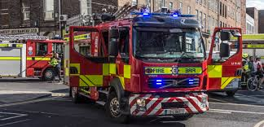
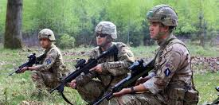
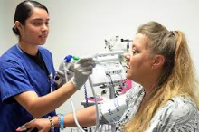
What is taxation?
The UK government requires its citizens and businesses to pay a variety of taxes
These taxes are used to pay for; education in state schools, the armed forces, the 999 emergency services, the NHS and local councils to name a few
If taxation increases then the costs of a business will also increase, which will reduce profitability

Slide 22
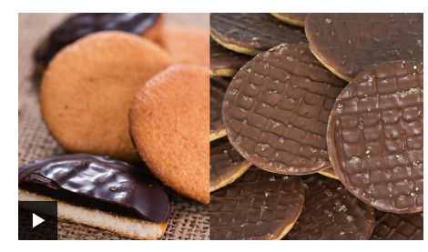
How is business affected by changes in taxation?
Lower taxes can result in more demand in the economy and lead to higher output and employment
If taxes are high then UK businesses will have higher costs
This makes them less competitive in a global marketplace
It may also mean unemployment rates may rise as businesses have to lay off extra staff due to the reduction in demand
Can you guess which items we pay VAT on – pay the BBC game above

Slide 23
Taxation and VAT
If the % of VAT goes up a business could pass this cost on to the consumer so if makes goods more expensive to buy, or absorb the cost which will have an impact on their profit margin
In 2011 the rate of VAT was 17.5% and it is now 20%
Reducing VAT on some items can stimulate demand
Find out what products VAT is paid on HERE

Slide 24
UK taxation for small businesses
UK taxes that sole traders must pay:
Income tax: taken off an employee's or business owners’ salary.
VAT (only if they earn above £82,000) added to goods and services. A rise in VAT increases prices.
Business rates (but not if they work from home)
National insurance: contributions are payments made by both the employee and the employer. They pay for the cost of a state pension and the National Health Service. An increase in this tax raises a company's costs and could result in inflation.
Notes:
2017 figures from ONS

Slide 25
UK taxation for larger businesses
UK taxes for private limited companies (Ltds) and public limited companies (PLCs):
Corporation tax at 20%
VAT at 20%
Business rates on business premises
National Insurance contributions to employees
These are all costs to a business and will have an impact on profitability

Slide 26
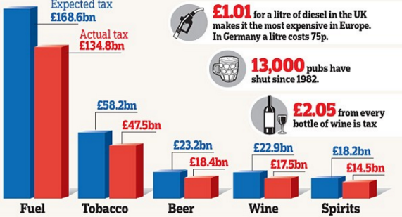
UK taxation- excise duties
Excise duty has to be paid by customers on products which are considered to have negative effects on society, in essence a sin tax e.g. fuel, tobacco, beer, wine and spirits
If a UK business produces these goods they may see a reduction in demand

Slide 27
What is government spending?
Taxes that the government collects goes into a central pot – this is then spent on various things for the benefit of the UK society
The person who makes the decisions about tax and how t spend it is the Chancellor of the Exchequer also known as the treasurer
The budget, taxation and public spending is extremely complex but you only need to know how changes might affect UK business
Notes:
2017 figures from ONS

Slide 28
How is business affected by changes in government spending?
If the government decides to cut government spending to reduce the deficit (amount it owes) this can have an impact on businesses which supply goods or services to public organisations e.g. the NHS
Businesses affected for example in spending cuts may be care home providers, school builders

Slide 29
Draw a diagram – The Business Cycle
Boom
Economic activity
Recovery
General trend over time
Boom
Recession
Slump
Slump
Time

Slide 30
The business cycle
As time has passed over the last 150 years economists have noticed that demand and output in the UK changes, it goes up and down in a cycle pattern
This is called the business cycle. Some text books call it the trade cycle, some the economic cycle and others call it the boom bust cycle.
Is this pattern the same in other countries?

Slide 31
Boom
In boom times a country may enjoy a period of high consumer spending
As consumers are spending there is an increased demand for goods and services
This increase in demand means an increase in work, lower unemployment and higher wages
This leads to more people in work able to buy more goods and services

Slide 32
Recession
In times of recession countries experience falling levels of demand
This means that consumers will demand less goods and services as they seek to save their money rather than spend – they worry about borrowing in case the interest rates go up
Businesses will typically have to make redundancies to lower costs and will have lower profits as demand falls

Slide 33
Slump
A slump is the bottom of the business cycle where consumer confidence and spending is at its lowest
There is usually very little investment in businesses and high levels of unemployment as demand for goods and services falls to its lowest level

Slide 34
Recovery
In the recovery phase of the cycle, demand levels for goods and services start to improve
Unemployment will start to fall as businesses start to take on workers to meet new improving levels of demand
Consumer confidence starts to return and consumers start to buy larger items again

Slide 35
The effect of economic uncertainty on the business environment

Slide 36
Economic uncertainty
A series of financial shocks since the recession in the UK in 2008 has meant that there has been macroeconomic uncertainly
This means that with a risk of unemployment that consumers are delaying the purchase of goods
This means that demand falls for goods and services
As a result of uncertainty manufacturers are reluctant to expand and to grow which affects and reduces supply of goods and services
Notes:
Authors note: The guidance wants you to discuss micro and macro and the impact but I think they have stepped a toe outside of the “business” spec so I have made it shorter, easier and relevant to business. They are not going to get a micro / macro question but you can cover it if you wish and you have time.

Slide 37
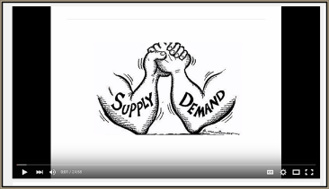
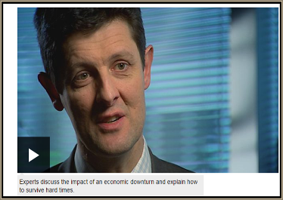
Revision Videos

Slide 38
Sample Edexcel A2 questions

Slide 39
Case study for question 1

Slide 40
Sample question 1
Knowledge 1
Application 2
Analysis
1

Slide 41
Answer sample question 1

Slide 42
Case study for question 2

Slide 43
Sample question 2
Knowledge 2
Application 2
Analysis
4
Evaluation
4

Slide 44
Answer sample question 2

Slide 45
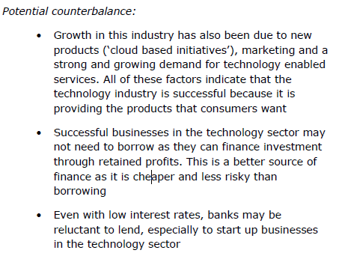
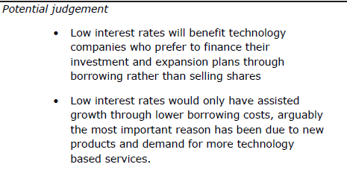
Answer sample question 2

Slide 46
How to level sample question 2

Slide 47
Case study for question 3

Slide 48
Case study for question 3

Slide 49
Case study for question 3

Slide 50
Sample question 3
Knowledge 2
Application 2
Analysis
4
Evaluation
4

Slide 51
Answer sample question 3

Slide 52
Answer sample question 3

Slide 53
Answer sample question 3
Potential judgement:
The unemployment rate is forecasted to increase from 4.8% to 6.5%, which may have a negative impact on the restaurant business because it is a luxury good and people may need to make economies.
Rising unemployment may have a positive impact because of the greater availability of workers especially for Mumtaz’s new factory in Bradford
The impact may be negative for the restaurants because demand is likely to be more income elastic but positive for ready meals. Overall impact on Mumtaz may depend upon which part of the business is bigger

Slide 54
Glossary
Interest rates; cost of borrowing, the price of money
Inflation rates; rise in cost of goods and services to buy (persistent increase in costs)
Unemployment rates; rise in numbers of people not in employment
Tax; monies demanded from the government so they have money to spend elsewhere like the NHS and on roads and education
Exchange rate; the rate at which one currency can buy another £1 = $1.67
Boom; period when an economy is growing strongly
Recession; a period when growth or output become negative (for two successive quarters 6 months)
Recovery; when demand for goods and services starts to improve
Slump; a period where there is a particularly deep and long fall in output

