Slide 1
Edexcel A2 Business
1.1.2 Market Research
Revisionstation

Slide 2
Worksheet

Slide 3
From Edexcel
a) Product and market orientation
b) Primary and secondary market research data
(quantitative and qualitative) used to:
identify and anticipate customer needs and wants
quantify likely demand
gain insight into consumer behaviour
c) Limitations of market research, sample size and bias
d) Use of ICT to support market research:
websites
social networking
databases
e) Market segmentation

Slide 4
Starter
When you buy your first car – what colour will it be?
What if you could only have one colour, what if there was no choice?

Slide 5
Answer to starter
In 1918 in the USA almost half of all cars were a Model T Ford.
Ford wrote in his autobiography that in 1909 he told his management team that in the future “Any customer can have a car painted any colour that he wants so long as it is black”*
Notes:
From wiki: http://en.wikipedia.org/wiki/Ford_Model_T

Slide 6
Product and market orientation

Slide 7
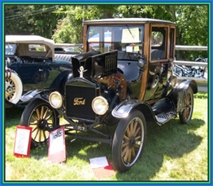
Definition: Product Orientation
A business is product orientated when it only looks at the product or the production process when deciding what to make next
This means the business is inward looking – sounds familiar?
Product orientation is appropriate when;
There is little competition in the market, the business can make what suits its production capacity
When there is limited consumer knowledge e.g. dental fixtures, braces etc.
When there is low disposable income of consumers, when funds are limited customers will buy what is available

Slide 8
More product orientation examples
Apple create iPhones and iPads and create innovative products, but they create and make what they can, not what consumers want
This is because consumers may not know what they want from technology that has not yet been invented!
Also consumers may want what is not yet possible e.g. a battery which charges to 100% in 5 minutes
iPad Pro

Slide 9
Product orientation - Gillette
Gillette makes a range of razors that they are able to make, not that are specific to customer needs
Customers have limited knowledge of razors and razor technology
Do you demand a pivot head or that your razor will shield your skin from irritation?

Slide 10
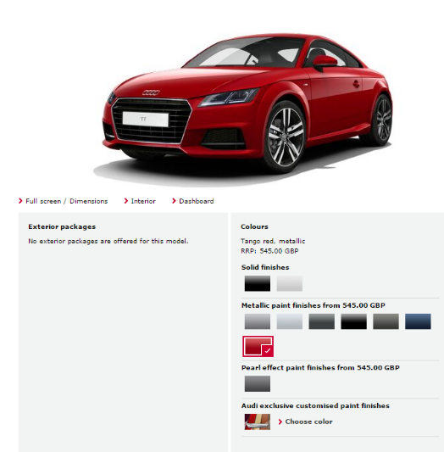
Market orientation - defined
The consumer is the most important factor when providing products for the market, the business has a sensitivity to customers requirements
A market orientated business will focus on the needs of the consumer e.g. the customer can choose the colour of their new car, it doesn’t have to be black anymore
Customise your Audi car, any engine, any colour, any trim

Slide 11
Market orientation example
ASDA – Chosen by you range
Each Chosen By You product was tested by a minimum of 50 consumers in a single location
The Chosen By You range is made up of more than 3,500 own brand food products, 500 of which are entirely new and another 1,000 of which have been reformulated.
Together they account for between £8-9bn worth of annual sales – so not only is this the most significant food development at Asda – it is the single largest own label re-launch ever in UK retailing history.
Notes:
April 2016 “Chosen by you” began to be phased out

Slide 12
Suggested activity - market or product orientated you decide

Slide 13
Primary and secondary market research data

Slide 14
Effective market research will help a business to:
Reduce risk
Understand consumer behaviour e.g. Dominos Pizza found that they sell more products when its raining
Quantify potential consumer demand for a product (forecast sales)
Understand how much consumers will pay for a product (pricing)
Identify potential competitors (strategy)

Slide 15
Benefits to a business of researching their market
For business decision making, carrying out market research reduces risks and costs of making poor decisions
To develop a marketing plan based on data gathered about the marketing mix – the 4Ps (e.g. where the best place to sell is to reach the target audience)
To help the business to react to and prepare for changes in the market
To help the business to become market orientated
Have a look at the 26 must wanted products HERE

Slide 16
Definition: Primary market research
Primary research is collecting data first hand
This means NEW data is gathered for the benefit of the business
This data will be specific to the needs of the business

Slide 17
What is a primary research?
Primary research is new / original data gathered by the researcher
The information does not yet exist, so it could not be found on the Internet, the business website or anywhere else
This is brand new data which the business will gather about their product or service
They will use this data to make specific decisions about the business; perhaps a new product or a new market
Primary research – asking a customer’s opinion, have you ever participated in a survey or questionnaire?

Slide 18
Primary research methods
Questionnaires (surveys)
Observation
Customer interviews
Test Marketing
Focus groups
Notes:
Can include amongst this list feedback from websites. For example when taking out car insurance after you have spoken to an operative they will text you a short survey on how you rated the service. The operative if they get 10/10 receives a scratch card where they can win prizes so its worth them being extra nice to customers on the phone.

Slide 19
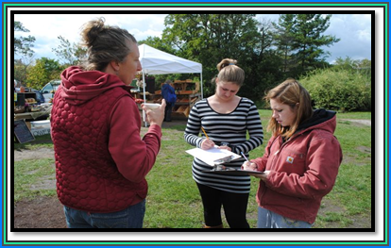
Primary research - Survey
Primary research may also include a survey of customers who use the business. Work out what questions you want to ask first
A business can gather quantitative (numbers) and qualitative data in this method
It can also be used to measure customer satisfaction – giving the business a clear idea of where to improve

Slide 20
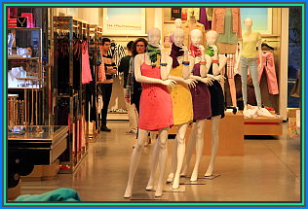
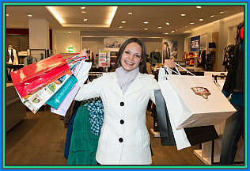
Primary research - Observation
A business may choose to gather data from observation of buyer behaviour
Do customers shop alone or in groups?
Do customers notice carefully placed promotions?
What route do customers take when they walk round a store?
How many items do customers try on?

Slide 21
Primary research – interview
A primary research team may carry out interviews, these can be face-to-face or on the telephone:
This will measure reactions to new tastes or ideas that the business is having
This is a good way to gather qualitative data
As it is primary research this will be very specific to the needs of the company

Slide 22
Primary research - test marketing
A business may invent or produce a new product or service
All staff in the business may agree that these are good products or services, but they need to know if the wider public will buy them in the quantity they need to break even and make a profit.
Therefore the product is offered to a carefully chosen sample, and based on the sample’s reactions the product will either be launched full scale or scrapped.*
Carry out some research and find out what the AB split test is, can you explain it to the rest of the group
Notes:
Adapted from http://www.businessdictionary.com/definition/test-marketing.html
Often one location will be given product version A
And another location will get product version B
Comparisons and conclusions can then be made as to which version should be launched across the UK

Slide 23
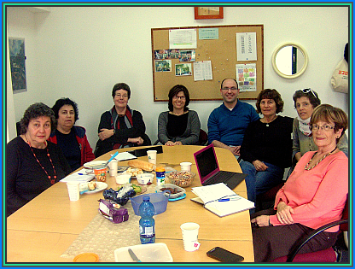
Primary research – focus group
A group of target market demographic respondents are chosen to take part in a product trial
They may use the product over time and then get together in a group to discuss their thoughts about the product
This gives the business very specific qualitative information about how customers relate and “feel” about the product

Slide 24
Definition of secondary research
Secondary research is gathering data which already exists
It is also known as desk research

Slide 25
Secondary research methods
Government Sources
Trade Publications
Market reports
Internet sources
Newspapers / Magazines / TV / Radio

Slide 26
Secondary research – government sources
Office of national statistics (ONS) is very useful demographic information and data on the market or industry that the business is in
Information can be used to make decisions about expanding overseas for example
Department for Business, Energy & Industrial Strategy is also a good source of information

Slide 27
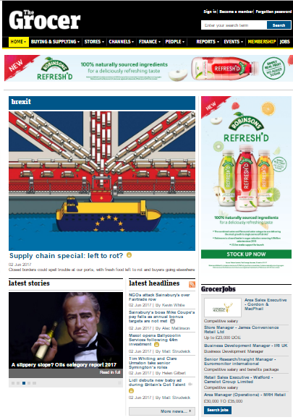
Secondary research - trade publications
Trade journals cater to a very specialist market
Information on competitor activity such as promotions
News specific to the industry
Helps small businesses stay in touch with trends in the market
Can you research trade publications? Try an industry that you are interested in e.g. accountancy or architecture

Slide 28
Secondary research – Reports
Marketing departments of smaller companies may have smaller budgets
Buying a report about an industry may be the most cost effective way for them to achieve their marketing objectives
Mintel trends and reports – Mintel has a global team of trend analysts constantly assessing change in culture, economy and society.
Reports cost £1,000 - £3,000
Have a look through their site at the samples
Notes:
Link takes you to sample reports which are free to download, but you will need to invent an e-mail to get to them.

Slide 29
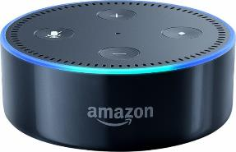
Secondary research – internet sources
The Internet is an ideal way to research competitor websites, articles, publications, annual accounts etc.
The Internet is a useful method of quickly gaining industry information
Social networks, blogs, and other forms of social media have emerged as forums where consumers discuss their likes and dislikes, and customers can be particularly vocal about companies and products

Slide 30
Secondary research – Newspapers / Magazines / TV / Radio
Local newspapers, journals, magazines, and radio and TV stations are some of the most useful commercial information outlets
They are useful because they contain demographic profiles of their audiences (their income, age, gender, amount of disposable income, and types of products and services purchased, what they read, and so on)
They can also have information about economic trends in their local areas that could be significant to the business

Slide 31
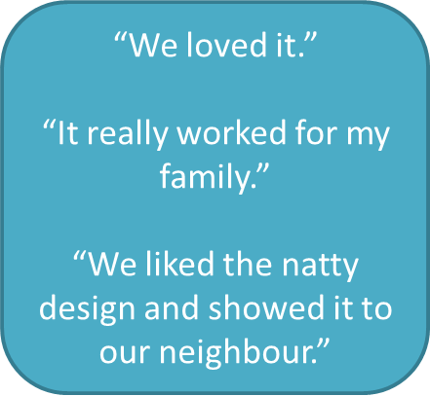
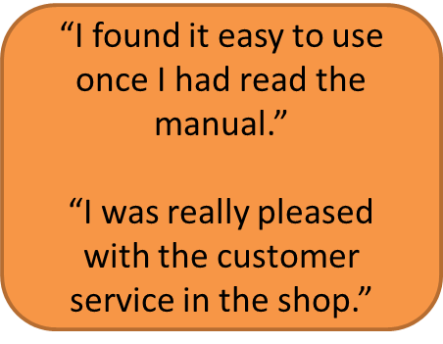
Qualitative research
Seeks to gather and explore feelings and thoughts about a product from consumers
Information gathered by;
Focus group discussions
Interview with consumers on what they “think” about the product or service
Observations of buyer behaviour (e.g. only family groups bought the squash)
This can help a business to identify; buyers moods, the decisions behind a purchase and other invaluable data

Slide 32
Quantitative research
Involves gathering data and measuring responses
Data displayed in charts, graphs, as statistics and percentages
Questionnaires written to gather numerical data – e.g. number of respondents who bought 4 pints of milk twice a week
Quantitative research asks questions to a large sample – to provide valid useful data for the business

Slide 33
Limitations of market research, sample size and bias

Slide 34
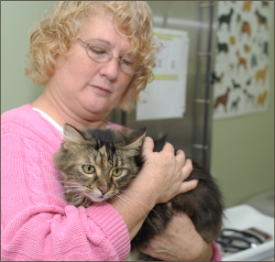
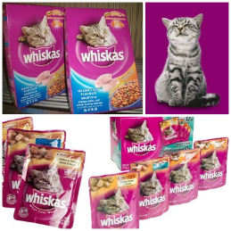
Sampling
Sampling is the process of choosing the right people to be part of the research
For example: Whiskers is a pet food manufacturer, they would only want to sample pet owners in their research

Slide 35
Sample size
A sample size is the number of people who are interviewed during the research
The sample size needs to be large enough that the data has statistical validity and can be useful to the business for decision making

Slide 36
Bias
Bias is when research findings cannot be trusted because of the way the research has been carried out
This can be through;
Interviewer bias e.g. see video
Biased questions e.g. “You really like shopping at the co-op don’t you?”
Respondent bias e.g. They already use a different product or work for a marketing company

Slide 37
Use of ICT to support market research

Slide 38
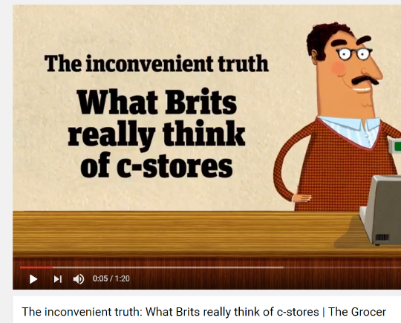
Websites
Pop-ups on websites can be used to ask customers about products they have bought or may buy
These may also be used to gather e-mail addresses so that targeted customers can be surveyed later via e-mail
Some sites (Like the Grocer, see video) have lots of useful quantitative data about the industry

Slide 39
Social Networks - Twitter
Twitter can be used to support marketing research – by searching for trending hashtags to see emerging trends
It can also search a business name or a brand name to find out quantitative information about customer perceptions
See twitter cloud here

Slide 40
Social networks – it doesn’t always work!

Slide 41
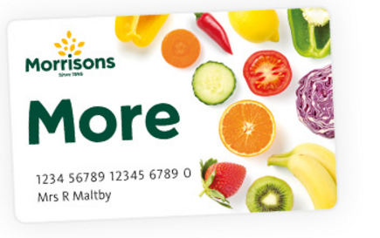
Business Databases
Large supermarkets use all the data from their loyalty schemes to build huge customer databases
This information can be used to target customers likely to buy at the store e.g. customer satisfaction with bakery products at Morrison's
Other databases such as Experian can also be a valuable source of customer information e.g. credit scores, incomes

Slide 42
Market segmentation

Slide 43
Definition of market segments
A market segment is an identifiable group of individuals or part of a market where consumers share one or more characteristics or needs
Harley Davidson bikers club

Slide 44
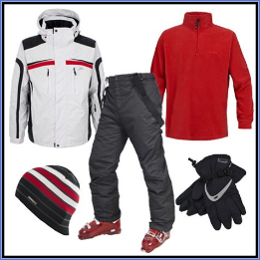
Segmentation by location
A business may decide to sell its product in just one country, one region (like the Midlands), or in an even smaller area
A business may target its product at rural rather than urban areas
A business may target its products depending if the market area is hot or cold
What countries could you sell the snow gear in?
Notes:
USA, Germany, Italy, UK (Scotland), Austria, Switzerland, Russia, Finland, Iceland and so on..

Slide 45
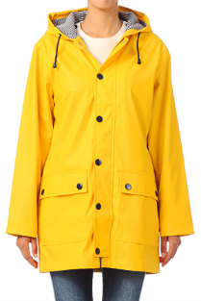
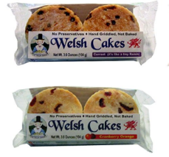
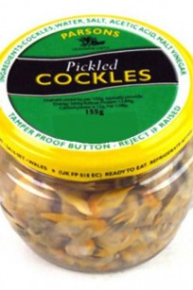
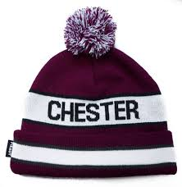
Segmentation by location
Which location segment are these products aimed at?

Slide 46
Market segment - demographics
Statistical data relating to the population and particular groups within it
For example market segmentation helps book publishers target customers as we won’t all read the same books (not everyone wants to read Harry Potter)

Slide 47
Segmentation by lifestyle
Customers can be grouped according to the way they lead their lives and the attitudes they share
For example, young professionals may drive a sports car because of the image they want to project
Parents might want the same things, but have to provide for their children, which is a large extra cost. They will need a family car to suit their lifestyle

Slide 48
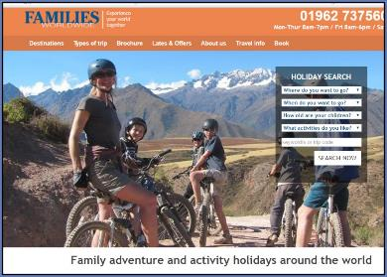
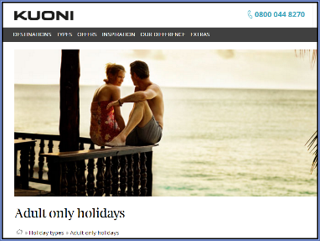
Segmentation by lifestyle
A business may decide to segment the market according to lifestyle
This may be a combination of; values attitudes, perceptions, beliefs
This may also include hobbies and interests
This may also include family situation (living on own or living with five kids)
For example the two different type of holidays in the pictures

Slide 49
Segmentation by lifestyle - discussion
Look at these 4 holidays – can you describe the type of lifestyle segment that they are aimed at?

Slide 50
Segmentation by Income
The population can be segmented according to annual salary (e.g. £15,000, £30,000 etc.) or type of job and social class
The population can also be divided into; low income, middle income and high income
Establishing a group's disposable income is important so that products can be targeted to the relevant income group
What is disposable income, can you explain the term?
Notes:
Disposable income is what is left after all the bills have been paid

Slide 51
Segmentation by income - discussion
Can you explain which income group these products are aimed at?

Slide 52
Segmentation by Age
Market segmentation could be on age groups;
0-10
11-16
17-19
20-25
26-35
36-50
51+
Each age group will have different needs and wants in terms of products and services and the business can develop a targeted marketing strategy to appeal to that age group

Slide 53
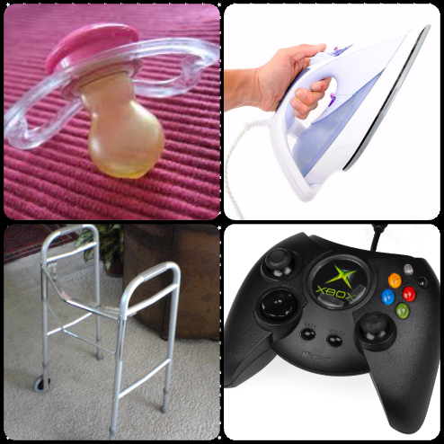
Segmentation by age - discussion
Can you explain which age group segment are these four products are aimed at?

Slide 54
Segmentation by age - discussion
Can you explain? Kellogg’s product portfolio of cereals, why does the business produce so many?
Notes:
Answer because at different ages you want different cereals, to satisfy the needs of customers in different segments

Slide 55
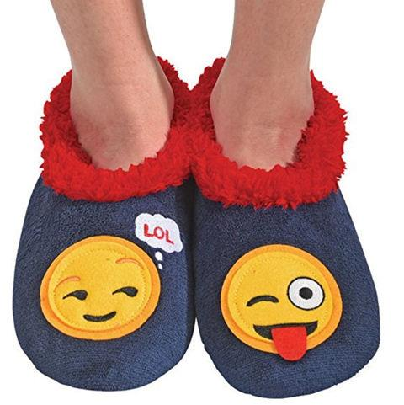
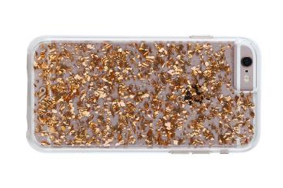
Can you explain which age group segment are these products aimed at?

Slide 56
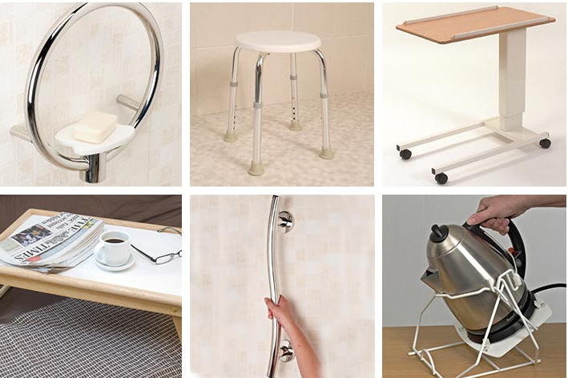
Can you explain which age group segments these products are aimed at?

Slide 57
Segmentation by gender
Many products are aimed at either men or women
A business may produce or adapt its products to ensure they can be marketed effectively
For example these razors made originally for men now adapted for women
Notice the use of blue and pink in packaging so customers know which one to choose!

Slide 58
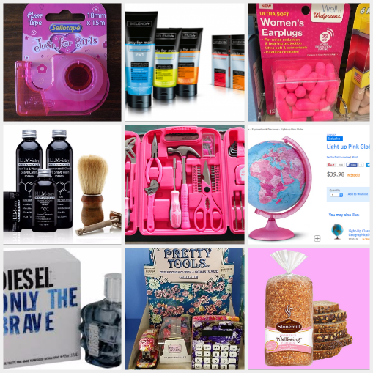
Segmentation by gender - discussion
Can you explain which gender segment these products are aimed at?

Slide 59
Sample Edexcel A2 questions

Slide 60
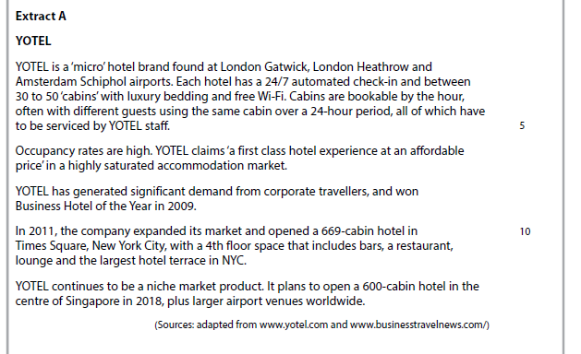
Case study for question 1 – from 2017 paper

Slide 61
Sample question 1
Knowledge 1
Application 2
Analysis
1
Notes:
There was no suitable A2 question on this topic so I have borrowed an Edexcel AS question

Slide 62
Answer sample question 1

Slide 63
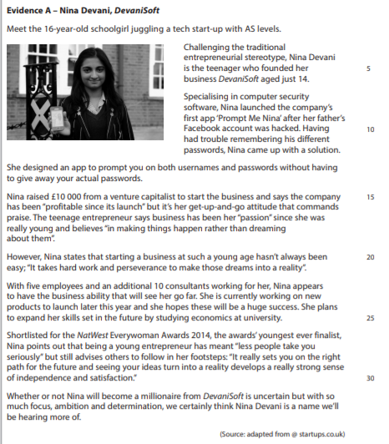
Case study for question 2

Slide 64
Sample question 2
Evaluate the extent to which Devanisoft is a product orientated business [12]
Level 1
1-2
Level 2
3-4
Level 3
5-7
Level 4
8-12

Slide 65
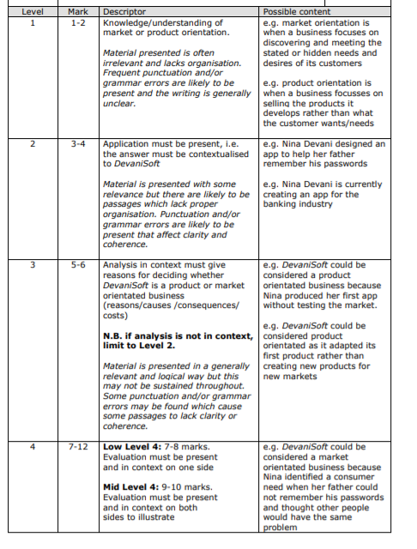
Answer sample question 2

Slide 66
Glossary
Quantitative data; data gathered that is numerical such as % of customers who buy more than once a week
Qualitative data; non numerical data such as how customers use the product
Product orientation; to sell products and services that the business wants to produce
Market orientation; to sell products or services based on customer needs and wants
Primary market research; data which is collected first hand
Secondary market research; data which already exists
Market segmentation; a whole market can be divided into sections called segments

