Slide 1
STARTER ACTIVTIY
Sustainable Resources
Positive Statement
Opportunity Cost
Factors of Production
Scarcity
Economic Problem
Renewable Resources
Non-Renewable Resources
Normative Statement
Define the following key terms that we have covered so far.
Notes:
Definitions from previous lessons thus far.

Slide 2
Impact upon society?
Notes:
Impact upon society? Good and bad stuff – like pensioners, healthy workforce.

Slide 3
LEARNING OBJECTIVES
Lo1: Understand what is meant by a social science.
Lo2: Explain the inability in economics to make scientific experiments
Lo3: Analyse the process of developing economic theories, including the need to make assumptions.

Slide 4
READ THIS STATEMENT…
Brainstorm the assumptions which might underlie this economic argument….
“Free school meals for children at infant school will reduce the cost burden in the future for the NHS’.”
In a different colour, now brainstorms limitations and problems with this economic argument.
Example: other factors that might impact the cost?

Slide 5
READ THIS STATEMENT…
“Free school meals for children at infant school will reduce the cost burden in the future for the NHS’.”
Now imagine you were going to set up a study/experiment to test this statement. How would you do it? What problems might occur?

Slide 6
SOCIAL SCIENCE
As you can see by this example, economics is a social science and therefore quite complex.
It is difficult for economists to analyse all possible variables and their influences.
Therefore economists create models, which are simplified representations of real-life.
But in order to do this, economists will focus upon a few variables and assume that all other influences stay the same. Known as ceteris paribus.

Slide 7
Ceteris Paribus
Latin phrase meaning other things being equal.
It is used in Economics when we focus on changes in one variable, whilst holding other influences constant.
Economic experiments are often extremely difficult, therefore theorised models are more practical.

Slide 8
ECONOMIC MODELS
These justifiable criticisms and limitations are evaluation!
Economic models are not flawless and are not the undisputed answer to everything.
They were merely created by economists to try and explain the real world.
The real-world came first, which was followed by models to try and explain it.
So if you feel that a model is inaccurate or not always true, you’re probably right!

Slide 9
https://www.youtube.com/watch?v=BiLj35g_cAU

Slide 10
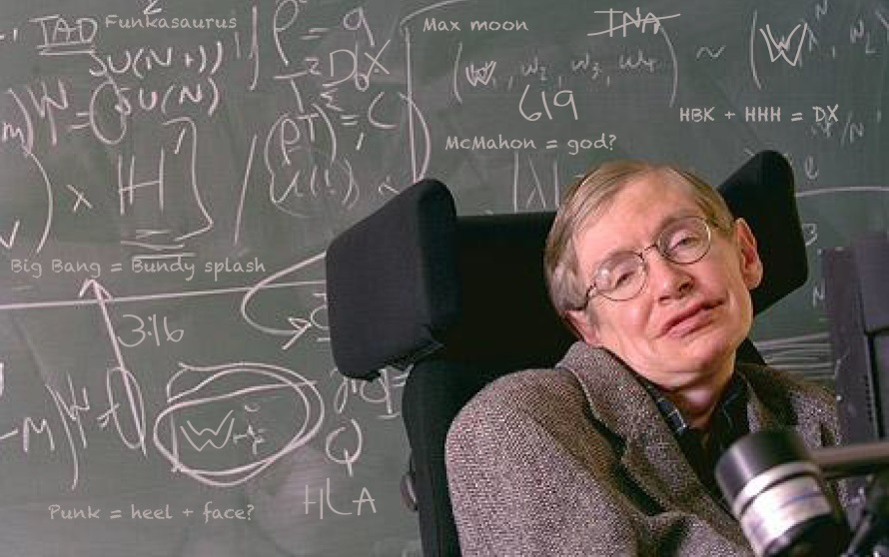
SOCIAL SCIENCE.
“Whilst physicists and mathematicians may be able to tell us how the universe began, they are not much use in predicting human behaviour because there are far too many equations to solve.”
- Stephen Hawking
Notes:
Part 1 - https://www.youtube.com/watch?v=kUApnFN2vGk
Part 2 - https://www.youtube.com/watch?v=1DTRjAqC61s

Slide 11
ECONOMIC AGENTS
More commonly known as stakeholders at GCSE.
When answering extended questions, you need to consider the three main economic agents impacted and analysed by models:
Households/Individuals
Firms
Government
Notes:
Part 1 - https://www.youtube.com/watch?v=kUApnFN2vGk
Part 2 - https://www.youtube.com/watch?v=1DTRjAqC61s

Slide 12
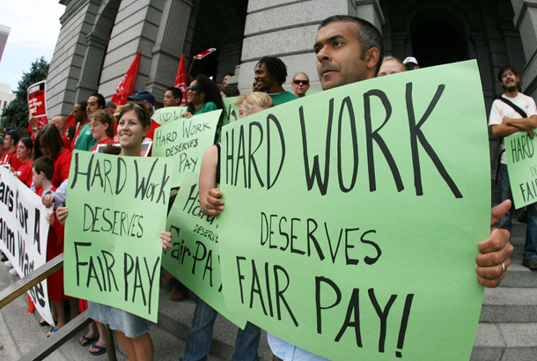
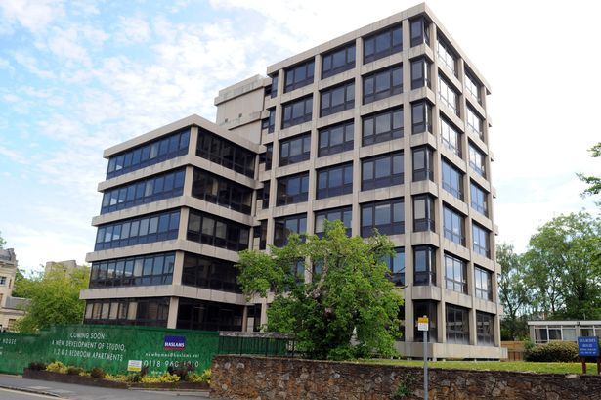
SCENARIOS WORKSHEET.
Look at the economic statements regarding a variety of issues.
Do not worry about precise knowledge, simply consider assumptions that might support it and those that might question it.
Notes:
Part 1 - https://www.youtube.com/watch?v=kUApnFN2vGk
Part 2 - https://www.youtube.com/watch?v=1DTRjAqC61s

Slide 13
