Slide 1
Edexcel A2 Business
3.2.2 Mergers and takeovers
Revisionstation

Slide 2
From Edexcel
a) Reasons for mergers and takeovers
b) Distinction between mergers and takeovers
c) Horizontal and vertical integration
d) Financial risks and rewards
e) Problems of rapid growth

Slide 3
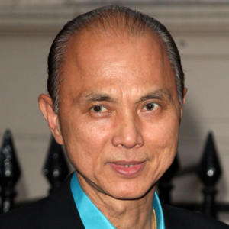
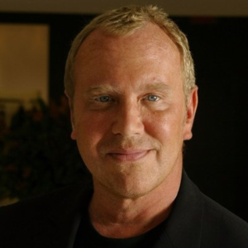
Starter
What links Jimmy Choo with Michael Kors?
Notes:
Answer on next slide

Slide 4
Luxury shoemaker Jimmy Choo has been bought by Michael Kors Holdings in a deal which values the firm at £896m
Recent years have been a struggle for the British business, its most recent sales figures were down 14%.
Michael Kors said the acquisition was expected to deliver a number of benefits, including "the opportunity to grow Jimmy Choo sales to one billion dollars" and "a more balanced portfolio with greater product diversification".
It said Jimmy Choo would also have the opportunity to grow in the men's luxury footwear category, as well as greater exposure to global markets, "particularly the fast-growing market in Asia".

Slide 5
Definition of a merger
A merger is a legal deal to bring two businesses together under one board of directors
The businesses are usually the same size and the name is normally changed (although not always)
E.g. Orange + T Mobile = EE
E.g. Dixons + Carphone Warehouse = Dixons Carphone
E.g. Lloyds + TSB = Lloyds TSB

Slide 6
Definition of a take-over
Take-over is also known as an acquisition
This is a legal deal where one larger business purchases a smaller one
If the deal is unwanted by the management or board of directors then this is a “hostile take-over”
E.g. Michael Kors takes over Jimmy Choo

Slide 7
a) Reasons for mergers and takeovers

Slide 8
Reasons for mergers and takeovers
Merger - joining of equals in order to create a new and larger company. This is likely to be agreed in advance and on cordial terms.
Takeover – may be `friendly` (agreed between both boards) or `hostile` (the target company’s board may not welcome the bid)
Xerox hostile takeover of HP
What is the motivation for this hostile takeover?
What is surprising about this particular hostile takeover?
Evidence suggest that hostile takeovers tend to be more successful than `friendly mergers`. Can you explain why this might be the case?

Slide 9
Reasons for mergers and takeovers
There are lots of industry specific reasons that one business will merger or takeover another, the ones that your exam board would like you to know about are:
TACTICAL STRATEGIC
Attempt to ensure increased market share
Access to technology, staff or intellectual property
Access to new markets
Improved distribution networks
Improved brand awareness

Slide 10
#1 Tactical Attempt to ensure increased market share
US payment processing giant Vantiv has agreed to merge with Worldpay in a deal which values its UK rival at £9.3bn ($12.1bn; 10.3bn euros).
"The combination of scale and presence the merger will bring is an exciting step in the creation of a truly global leader in payments," said Worldpay.

Slide 11
#2 Access to technology, staff or intellectual property
US drugs giant Pfizer has sealed a deal to buy Botox-maker Allergan for $160bn (£106bn) in what is the biggest pharmaceuticals deal in history.
The takeover could allow Pfizer to escape relatively high US corporate tax rates by moving its headquarters to Allergan's Dublin base.
November 2015

Slide 12
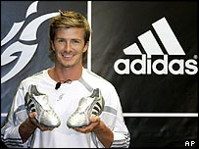
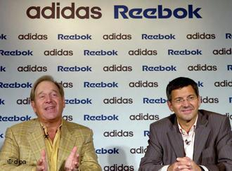
#1 Strategic Access to new markets
Adidas the German company bought Reebok in 2005 to help them take on Nike:
The merger gained the business new markets in Asia
The merger made Adidas the second largest sportswear manufacturer after Nike in the US
2005 article HERE

Slide 13
#2 Improved distribution networks
The world's biggest producer of canned tuna, Thai Union Frozen Products, is buying Norwegian seafood firm King Oscar, for an undisclosed sum.
Thai Union, which owns the 'John West' and 'Chicken of the Sea' brands, is looking to increase earnings overseas to offset slowing sales at home.
September 2014

Slide 14
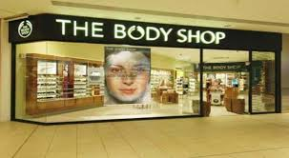
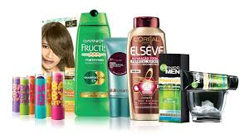
#3 Improved brand awareness
On Friday 17th March 2006 L'Oreal bought the Body shop Brand for £652 million
The French firm L’Oreal said Body Shop would enhance its business because of its "sizeable and complimentary brand" across 54 countries, which delivered revenues of £419m last year
L’Oreal is a manufacturer and Body Shop is a franchised retailer.

Slide 15
b) Distinction between mergers and takeovers

Slide 16
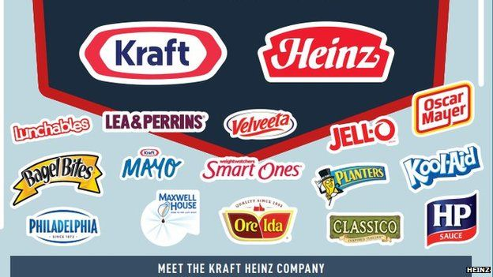
Merger defined
A merger is when two businesses have agreed to join forces to make a third company
2015 Kraft merged with Heinz to become:
See article here

Slide 17
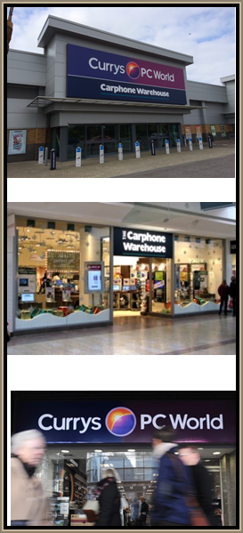
Dixons and Carphone Warehouse merge to become
2014: Carphone Warehouse and Dixons have agreed a £3.8bn "merger of equals" to create an electricals retailer selling phones to fridges, and offering service and support alongside a multitude of gadgets.
With 3,000 stores and sales of almost £11bn, the new company, called Dixons Carphone, will bring the household names Currys, PC World and Carphone Warehouse under one umbrella.
Why?
Carphone and Dixons said the merged company would benefit from greater buying power, extra growth options and annual savings of at least £80m within three years.
Full article here and website here

Slide 18
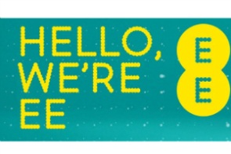
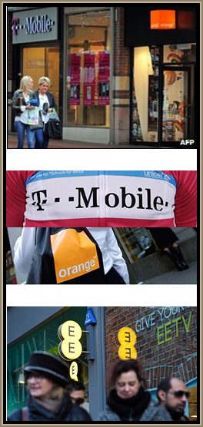
Orange and T-Mobile merge to become
2009 T-Mobile and Orange merged their UK businesses, creating a mobile phone giant with 28.4 million customers.
This was re-branded as everything everywhere or EE as we know it
Why?
It would be the UK's largest provider, overtaking Telefonica's O2, with about 37% of the mobile market.
BBC article and video here
Guardian article here

Slide 19
Takeover - friendly
Friendly; A business may be struggling with cash flow problems and invite a takeover from a stronger business – known as a “white knight” as they come in to rescue the struggling business
Morrisons took over a struggling Safeway read the story here

Slide 20
Takeover - hostile
Hostile; The board of directors will try an resist the takeover, but if another business gets 51% shares they can takeover management and control

Slide 21
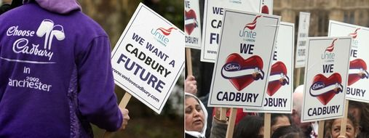
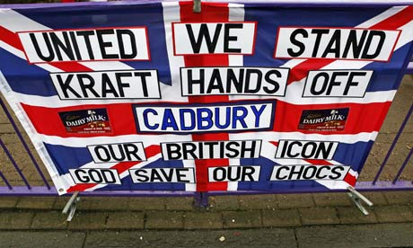
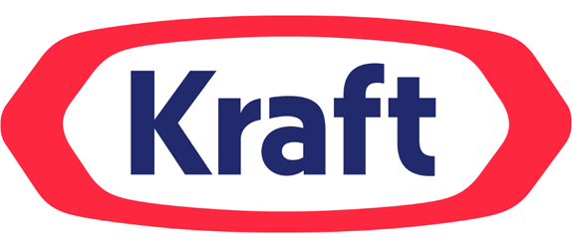
Takeover example Kraft and Cadbury
Jan 2010 Kraft the MNE food giant bought 71.7% of Cadbury’s shares
The takeover was part of Kraft’s long-term strategy to drive profitable growth in emerging markets, and Cadbury’s had well established brands in Brazil and India
Cadbury was not for sale, the MD of Cadbury Sir Roger Carr tried to fend off the deal but eventually accepted £11.7 billion for the company
Despite assurance prior to the deal that staff would not be affected, within a week Kraft had closed the Bristol Cadbury factory making 400 workers redundant at a moments notice, video here
How this takeover changed the way takeovers happen in the UK, BBC article here
Article on ways that Cadbury has been changed since the takeover, telegraph here

Slide 22
Takeover example Kraft and Cadbury (Mondelez)
https://youtu.be/2suHFP20Pm4
https://youtu.be/zJp-iDnwCdU
Assess the benefits of Kraft's decision to acquire Cadbury’s?
(10/12 marks)

Slide 23
Mergers and Takeover
https://youtu.be/Za5tUjesRxc
https://youtu.be/sgAplQu_UFw
Assess how Google's strategy to acquire other companies impacts its profits? (10/12 marks)

Slide 24
c) Horizontal and vertical integration

Slide 25
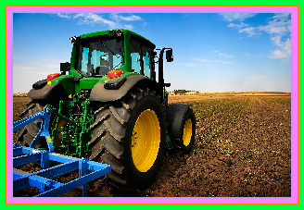
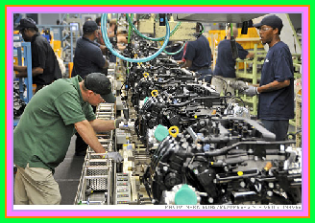
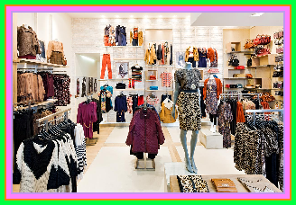
Horizontal and vertical integration
To be able to understand vertical and horizontal integration in mergers and takeovers, you need to first understand the three sectors in business (geography has four but we ignore that):
Primary Sector
businesses that are involved in digging, fishing, mining to remove products from the planet at source E.g. a Farm or quarry
Secondary sector business that are involved in manufacturing raw materials into other products e.g. Clothes factory, cheese maker
Tertiary sector are businesses that sell goods to the customers e.g. Shops, Banks, insurance companies

Slide 26
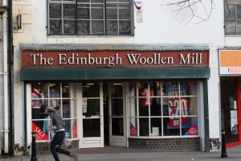
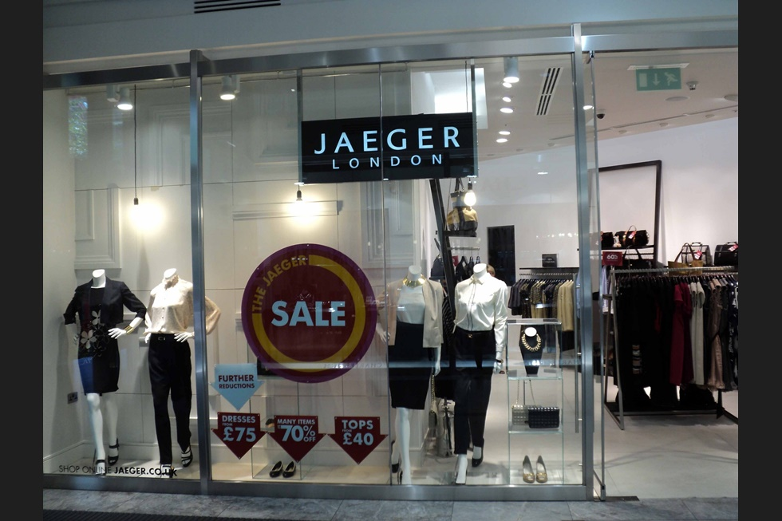
Horizontal integration
Businesses operating in the same sector (e.g. tertiary) merge or takeover another business in the same sector

Slide 27
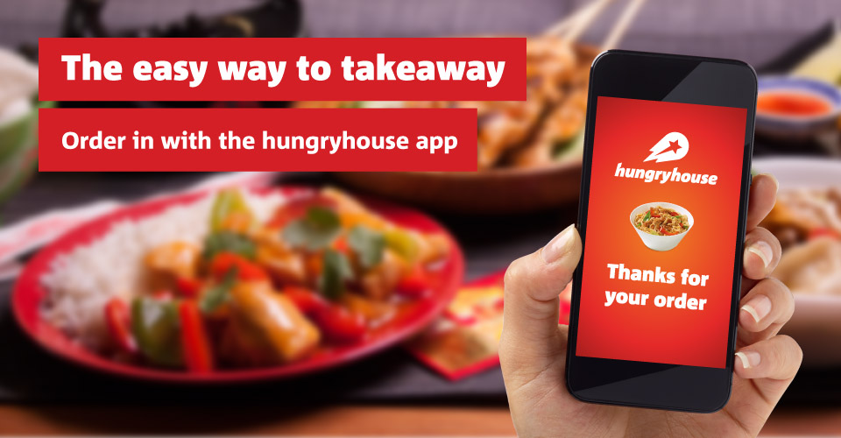
Horizontal integration example
Just Eat and Hungryhouse allow customers to order food from local takeaways but orders are delivered by staff from the individual restaurants – CMA are currently investigating this merger
Notes:
The CMA had also been concerned that the two companies, once merged, would not be as competitive as they might be now in terms of the amount they charge restaurants for being on their respective websites.

Slide 28
Vertical integration
Vertical integration is when one business in one sector takes over or mergers with a business in another sector or part of the supply chain

Slide 29
Vertical Integration
Vertical integration can also be a different part of the supply chain e.g. British broadcaster Sky has agreed an £11.2bn takeover by Rupert Murdoch’s US media group 21st Century Fox

Slide 30
d) Financial risks and rewards

Slide 31
Financial risks of mergers and takeovers
Original purchase cost
Cost of change into a new business
Redundancies of duplicate staff e.g. two marketing managers, two finance managers etc.
Cost if it all goes wrong:
In 2005 ITV bought Friends Reunited website for a total of £175 million, see article here
In 2006 ITV sold Friends reunited for £25 million a loss of £150 million, see article here

Slide 32
Financial rewards of mergers and takeovers
Increased revenue (see example below)
Economies of scale
2006 Disney bought Pixar for US$7.4 billion, see article here
Disney-Pixar revenue for 2014 was: US$ 48.813 billion, see here

Slide 33
Reducing risks
Questions: > Consider the following acquisition in the video. Why would Disney pay $4 billion to buy Marvel? > What risks were attached to the purchase? > How did they seek to eliminate those risks? Consider the 2 financial risks below: > Purchase cost > Costs of adjustments (redundancies)
https://youtu.be/jOcs9il6oWQ

Slide 34
e) Problems of rapid growth

Slide 35
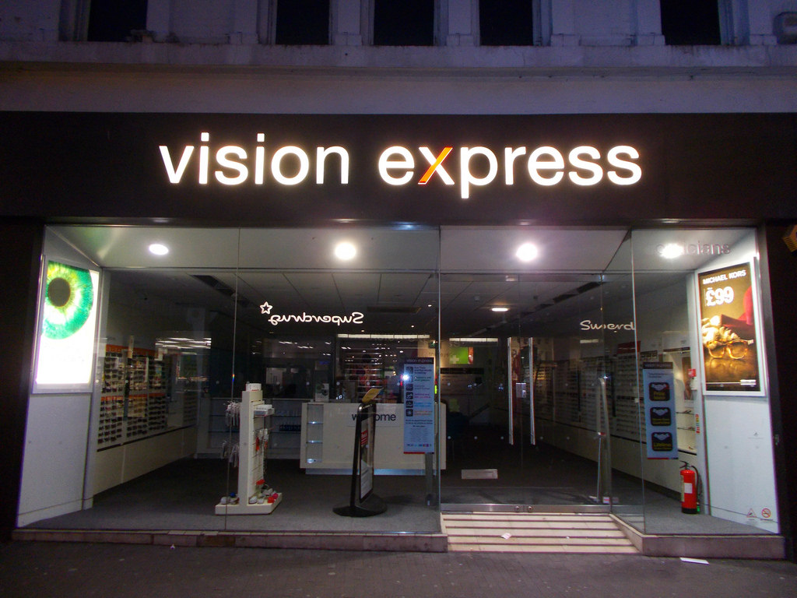
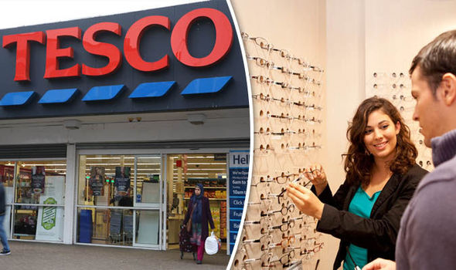
Problems of rapid growth – short-term
The businesses that have merged may outgrow their premises in the short-term. There may not be enough space for everyone to work efficiently.
Morale may drop if staff cannot cope with the extra work so productivity can decrease.
There may be a shortage of cash to meet expansion costs.
Taking on more and more work to generate more income places additional pressure on the premises and staff.
CMA investigating Vision Express and Tesco opticians

Slide 36
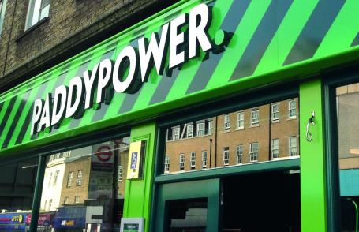
Problems of rapid growth – management pressure
Management may be under pressure, operating reactively rather than proactively.
The quality of the products and services could drop, causing an increase in customer complaints.
The business may even lose customers to their competitors.
Staff turnover may increase due to heavy workloads. Vital knowledge could be lost as staff leave. Hiring and training new staff takes time and money.

Slide 37
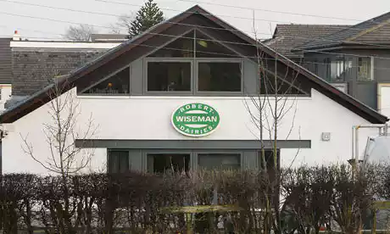
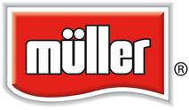
Problems with mergers and acquisitions
Clash of cultures
Possible communication problems
Possible move away from core competencies of original business may cause issues of control
Unreliable merger partners
Diseconomies of scale
Lack of understanding of local markets leading to wrong promotional message
75% of all mergers fail
The founding family of Britain's biggest milk producer stands to pocket nearly £100m after agreeing to sell the firm to the German dairy company Müller.

Slide 38
Merger fail – Daimler Chrysler
Daimler and Chrysler
When German Daimler (the makers of Mercedes-Benz) merged with American company Chrysler in the late 1990s, it was called a “merger of equals.” A few years later it was being called a “fiasco.”
The two company cultures had the two divisions at war as soon as they merged.
Differences between the companies included their level of formality, philosophy on issues such as pay and expenses, and operating styles.
The German culture became dominant and employee satisfaction levels at Chrysler dropped off.
By 2000, major losses were projected and, a year later, layoffs began. In 2007, Daimler sold Chrysler to Cerberus Capital Management for $6 billion.

Slide 39
Merger fail – Daimler Chrysler
What problems are more likely when growth occurs via M&A?
https://www.youtube.com/watch?v=9oCQ2mM8jlU

Slide 40
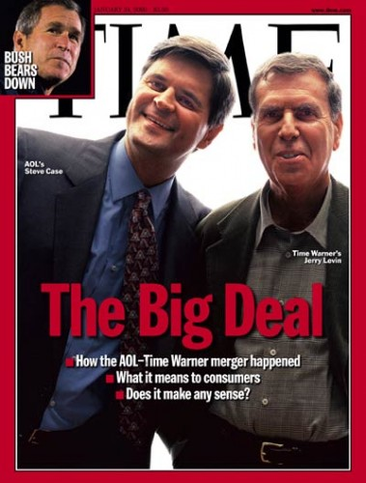
Merger Fail- AOL Time Warner
AOL/Time Warner
In January of 2000, Time Warner stock sold for $71.88. By 2008 you could buy a share of Time Warner for less than $15.
A failed $350 billion merger with AOL. Culture clash was widely blamed for the failure of the joint venture.
Richard Parsons, president of Time Warner said: “I remember saying at a vital board meeting where we approved this, that life was going to be different going forward because they’re very different cultures, but I have to tell you, I underestimated how different… It was beyond certainly my abilities to figure out how to blend the old media and the new media culture.”

Slide 41
Why would a business look to demerge?
https://youtu.be/be-M5ZsBtgQ

Slide 42
Revision Video

Slide 43
Sample Edexcel A2 questions

Slide 44
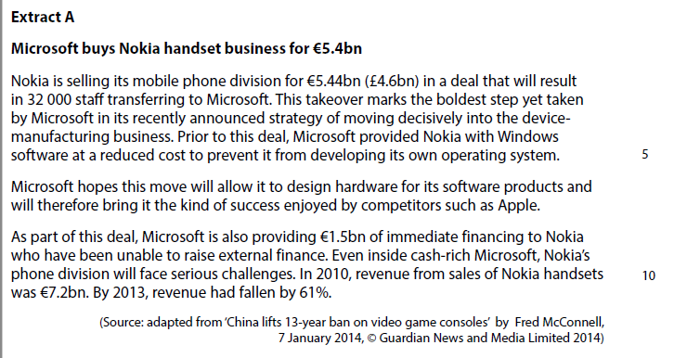
Case study for question 1

Slide 45
Sample question 1
Level 1
1-2
Level 2
3-4
Level 3
5-8
Level 4
9-12

Slide 46
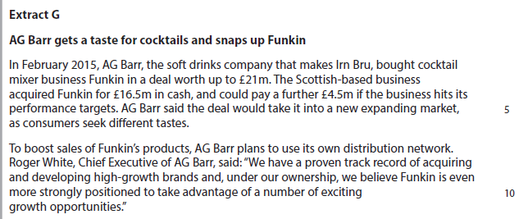
Case study for question 2

Slide 47
Sample question 2
Knowledge 2
Application 2
Analysis
4
Evaluation
4

Slide 48
Case study for question 3

Slide 49
Sample question 3
[8]
Knowledge 2
Application 2
Analysis
2
Evaluation
2

Slide 50
Glossary
Mergers; when two businesses mutually agree to join forces. Sometimes you may see M&A which means mergers and acquisitions.
Takeovers (acquisition); when one business is taken over by another by buying the majority share. If the owners do not want to be taken over by that company it is called a “hostile takeover”
Organic growth; when a business grown internally through buying another factory or increasing premises and staff
Inorganic growth; when a business grows externally through a merger or acquisition

