Slide 1
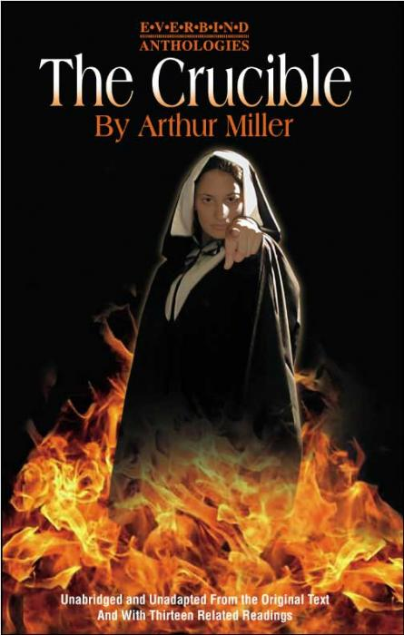
The Crucible by Arthur Miller
Leaning Objective: To explore the themes within Act 1 of ‘The Crucible’.

Slide 2
Learning Outcomes
By the end of the lesson you should be able to…
Recall the characters motives and relate them to the themes of the play.
Describe how you would perform the role of Abigail Williams.
Explain how the characters should react to each other on the stage.

Slide 3
Our Understanding so far…
Split into two groups…
Write down who the main characters are within act 1….names and who they are…
3 minutes

Slide 4
The Themes

Slide 5
The Themes
Fear: Parris is worried about his reputation.
‘evidently’ praying-obvious- appearances are important.
‘my ministry's at stake & perhaps your cousins life.
Denies witchcraft: reputation/Minister.
Scared he will loose authority if he doesn’t do something.

Slide 6
The Themes
Envy & Revenge: 1st scene gives us clues…
Ann Putnam is jealous of Rebecca nurse: all her babies survived.
Parris think he should be paid more.
Giles Corey is unpopular as he is a lawyer.
Big disagreements over land (Proctor and Putnam)

Slide 7
Abigail Williams
Soiled: suggests she is not a virgin/ She beaks the rules.
Denies everything: She is a liar/ ruthless and vindictive/ wants to kill Elizabeth to get John.
Voice and movements: lowers her eyes/talks innocent to Parris/ talks tauntingly to Proctor: A good actress.
ENVY AND REVENGE: DRIVING FORCES BEHING ACTIONS

Slide 8
Group A
10 minutes in pairs… A & B: A= Abi B=Proctor
Create the scene between Abi and Proctor.
Pages 17: Gah!
19: The words going up to Jesus.

Slide 9
Group B
10 minutes in pairs… A & B: B= Abi A=Parris
Create the scene between Abi and Parris.
Pages 7: Uncle the rumour of witchcraft…
9: enter Mrs Putnam

Slide 10
Evaluation…
Recall the characters motives and relate them to the themes of the play.
Describe how you would perform the role of Abigail Williams.
Explain how the characters should react to each other on the stage.

Slide 11
Independent Learning
For next lesson…
Make a poster about The Crucible… This could be about…
Witchcraft, the puritan life, the characters, the themes, the witch hunts, the 1950 witch hunts, Salem, Arthur Miller ….
These will be on display

