Slide 1
3.6.2 Key factors in change
Key factors in change:
a) Organisational culture
b) Size of organisation
c) Time/speed of change
d) Managing resistance to change

Slide 2
Starter
So your school decides that they are going to make some drastic changes to your school day – you will work 9-2 but you will have to go in on a Saturday and one twilight session during the week – that means your week will look like this:
Mon 9-2
Tues 9-2
Weds 9-2 and 4-8
Thurs 9-2
Fri 9-2
Sat 9-12
Sun off
What is your next move? Are you in favour of these changes or against them? How will you react?
Notes:
Leads nicely into a discussion about resistance to change. You can fiddle with these settings to make then the worst possible for your set of kids to really provoke strong reactions and then say (with a flourish) that a business could make you work these hours or impose these changes – will you resist and lose your job or comply?

Slide 3
Change Management defined
Change management means planning and implementation of change in a way that is mindful of those who will be affected by the changes. If a business attempts to force changes on the workforce – problems will arise. Changes must be; realistic, achievable and measureable (RAM)

Slide 4
Two types of change
Planned change
Emergent change
Refers to change which is planned by the top management of a business
This could be:
Board of Directors
The Owners
Senior leadership team
This is change that happens at any level in the organisation and is the result of an event or need
E.g. Computer back-up system has failed so a new IT system must be installed which will require training for all staff

Slide 5
Organisational culture – factor in change

Slide 6
Key factor in change: organisational culture
People are social beings who will adhere to cultural norms and values (would you come to school naked?)
Successful change is based on redefining those existing norms and values and getting commitment from workers towards new ones
E.g. introducing a uniform

Slide 7
Size of organisation – factor in change

Slide 8
Key factor in change: Size of organisation
As a business grows there will be inevitable changes within the organisation
For example as a business grows from ltd to plc so that they can raise more finance by floating share on the stock market this will mean huge changes for the business

Slide 9
Time / speed of change – factor in change

Slide 10
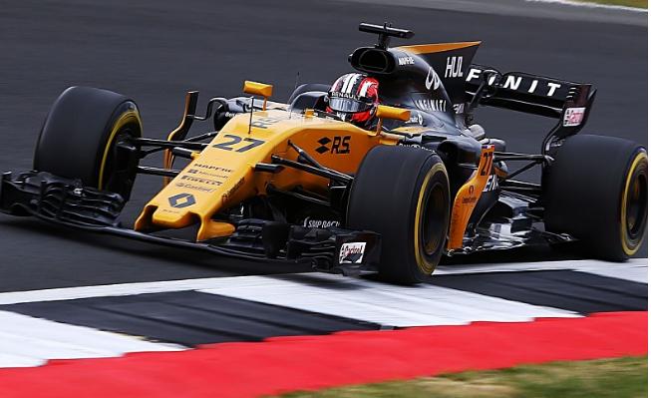
Key factor in change: Time/speed of change
One of the main problems with change is to align expectations with reality
Changes that happen too quickly will mean that employees may experience stress
“I didn’t know it would happen so fast”
“I can’t keep up with the all the changes”
“ I haven’t had time to adjust to all the improvements the business has made”
The Renault Formula 1 team had to effectively pause development for a spell this season because of the scale of change that its Silverstone upgrade required.

Slide 11
Change – continuous improvement
A business may decide to become a kaizen organisation – adopting the ideal of continuous improvement
This will mean small incremental improvements possibly every day
The management also need a commitment to kaizen and make sure they are using good quality data to make decisions from
Traditional | Kaizen
Self | Team
Own department | Whole business
Fire fighting | Continuous improvement
Short term | Long term
Results driven | Process driven
Them and us | Harmony
Who is to blame | Ownership

Slide 12
Dr Kotter’s 8 steps
Dr Kotter suggests there are 8 steps to effective change management and that a business should not rush or skip steps – see the diagram
Video here
Notes:
This is not specific on the syllabus – but interesting theory none the less.

Slide 13
Change - Cadbury
Businesses operate in dynamic markets and must deal with change – positive and negative on a daily basis
Some change is good for a business, keeps it fresh and moving forwards, e.g. Cadbury no longer produces cocoa essence but has developed new and delicious alternatives
A business will need to adapt to internal changes e.g. the Kraft takeover of Cadbury
A business will need to adapt to external changes e.g. due to a change in tax or interest rates or a recession

Slide 14
Managing resistance to change– factor in change

Slide 15
Resistance to change defined
This is defined as:
“….behaviour which is intended to protect an individual from the affects real or imagined of change”*
Where employees try to block the intended change is called resistance to change
Notes:
Alvin Sander 1950

Slide 16
Resistance to change – the employee perspective
Resistance by employees may just be a defence mechanism caused by frustration and anxiety about the changes
Many employees fear that they will be unable to acquire the new skills (older staff on IT equipment) that will be required after the change

Slide 17
Managing resistance to change
Resistance to change in a business is to be expected
Resistance can be managed by working with employees, listening to their concerns and trying to understand them
Employees worry about; loss of status or power as a result of the change, fear of personal failure, resentment, or perception that change is not necessary

Slide 18
Ways to reduce resistance to change
The business will need to:
Deliver training programs
Focus on the positive aspects
Design flexibility into the change – this will give employees time to adapt
Involve employees effected in the planning of change, adding their ideas

Slide 19
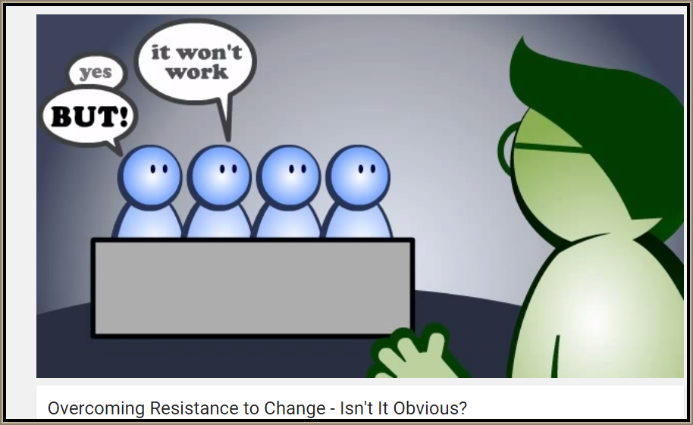
Revision Video

Slide 20
Sample Edexcel A2 questions

Slide 21
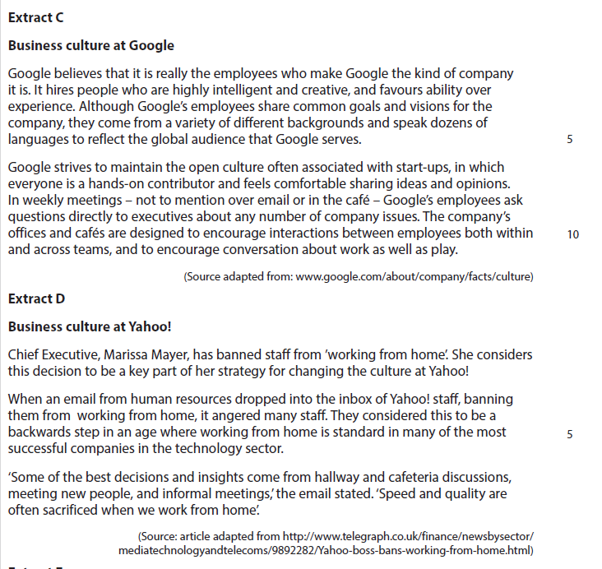
Case studies for question 1

Slide 22
Sample question 1
Knowledge 2
Application 2
Analysis
3
Evaluation
3

Slide 23
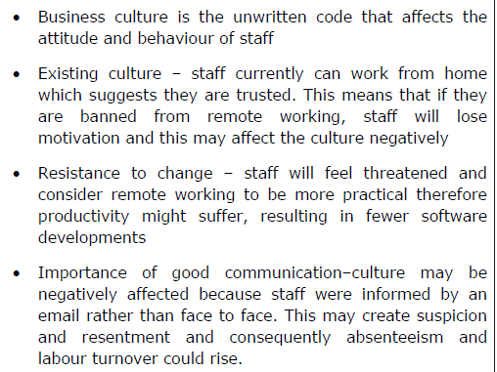
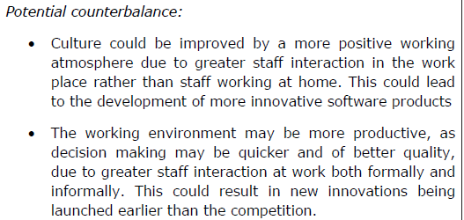
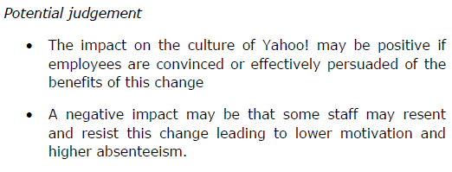
Answer sample question 1

Slide 24
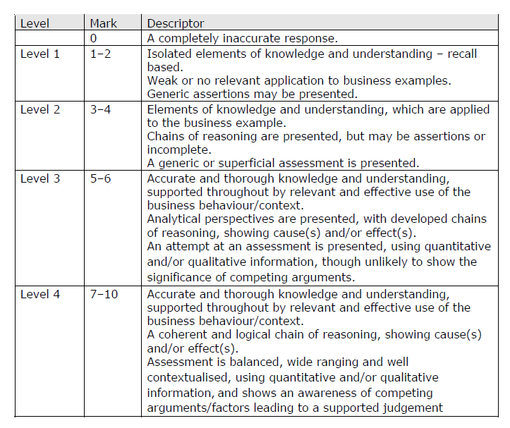
How to level sample question 1

Slide 25
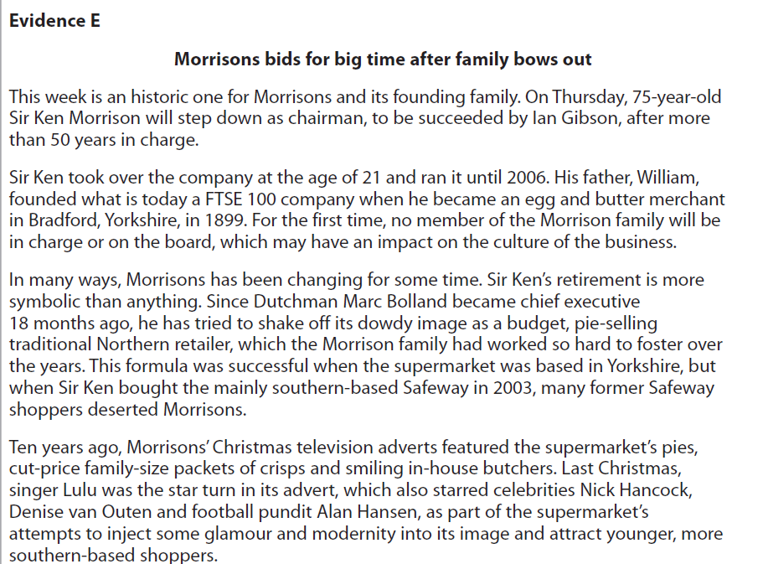
Case study for question 2

Slide 26
Sample question 2
[8]
Knowledge 2
Application 2
Analysis
2
Evaluation
2

Slide 27
Answer sample question 1
Corporate Culture describes the prevailing attitudes and values in an organisation or business.
• Sir Ken Morrison is the son of the business’ founder, William, so up to this point the business has been a ‘family’ one
• Application of Handy’s categories e.g. Power; Role; Person etc.
• Morrison’s has been a traditional ‘Northern’ business, focussing on cheap, honest values
• The Chairman of a PLC has decision-making power which affects the whole business.
• As son of the founder and Chairman of the company, Sir Ken had powers to make important strategic decisions that could influence culture e.g. store openings
• His historical position in the business is likely to have made him more influential than chairman of similar business organisations, thus affecting culture too.
• Sir Ken may have seen the need for a change of culture, wanting to make this easier by stepping aside for Ian Gibson
• Strategic decisions and changes will affect the day-to-day working conditions and therefore culture, which is more informal than business objectives or missions and can be influenced by a range of factors outside the control of the chairman and the board
• The change in culture may be what is needed as Morrisons tries to expand and become a national force
• Despite this the family nature of the business in the past would have influenced culture to a large extent, particularly in relation to the business’ objectives and geographical location

Slide 28
Glossary
Resistance to change; This is the action taken by employees who regard the change in the business that they work for as a negative thing
Organisational culture; Handy described this as “the way we do things round here”

