Slide 1
Edexcel A2 Business
1.2.2. Supply
Revisionstation

Slide 2
Worksheet

Slide 3
From Edexcel
a) Factors leading to a change in supply:
changes in the costs of production
introduction of new technology
indirect taxes
government subsidies
external shocks

Slide 4
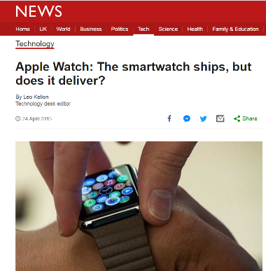
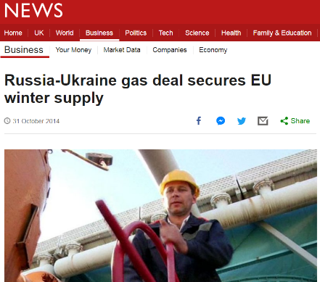
Starter
Read these articles and discuss what it tells us about supply in business
Notes:
Divide the room – one half explains one to the other half or assign volunteers to read the cases or teach as a whole group. Either way you may want to print these out ahead of time.

Slide 5
Definition: Supply
Supply is measured in terms of the quantity of a good or service that a producer is willing and able to make available on the market, at a given price, over a given period of time

Slide 6
What determines supply?

Slide 7
Factors leading to a change in supply - price

Slide 8
Price determines levels of supply
Price and supply are related
As a price paid by customers increases on a product or service, normally, a business will want to supply more, in anticipation of higher profits
As the price paid by customers decreases – what might happen to supply?
Notes:
Supply falls as the price falls

Slide 9
Non-price determinates of supply
Cost of production
Introduction of new technology
Indirect taxes (e.g. VAT)
Government subsidies
External shocks
Get ready to make some notes on these factors on the next few slides
Non-price factors that can affect supply for a product or service, is there anything missing from this list?
Press esc for answer
Notes:
Availability of competitors products

Slide 10
#1 Cost of production
If the costs of production increases e.g. due to a rise in the cost of raw materials or due to a rise in the minimum wage:
The business may decide to produce less
Prices may have to go up
The product will have lower sales and therefore lower revenue

Slide 11
Introduction of new technology
New technology means that more goods can be supplied
Mechanisation and automation of production processes means supply can increase
Mass production methods improved to increase capacity
Using new technology means that costs can be reduced and that means that they can offer lower prices to the customer to drive up demand

Slide 12
Indirect taxes
When the government increases tax on goods such as petrol then supply will decrease
VAT / Customs tax / Excise tax are all indirect taxes and when applied to goods it makes supplying them less attractive. This can lead to a decrease in supply

Slide 13
Government subsidies
This is a payment from the government to encourage more suppliers to enter the market and to supply more. With a subsidy there is an increase in supply because costs have been lowered thanks to the subsidy
For example the Government pays subsidies to wind farm manufacturers to erect turbines offshore in the UK. This adds about £18 a year to a UK householder’s energy bill

Slide 14
External shocks
External shocks may mean that the business may not want to supply at current levels, these shocks may be;
Changes in oil price which can affect transport costs
War, a business may not want to supply goods to a country which is at war
Weather problems – particularly for crops
Changes in labour laws (e.g. length of working week or minimum wage)
For example if the cost of oil increases what impact will this have on a business?
What is the impact on business of 18 years of war in Afghanistan?
Notes:
If the cost of oil increases this increases cost of production, and may lead to job losses or cost cutting, and will result in a decrease in supply

Slide 15
Other non-price factors that can influence levels of supply
Watch the video and read the article

Slide 16
Plenary game: Increase or decrease in supply?
Increase in oil price
Increase in minimum wage
Increase in orders
Increase in productivity
Increase in VAT rate
Decrease in inflation
Introduction of robots
Introduction of new labour laws

Slide 17
Plenary game answers
1 decrease
2 decrease
3 increase
4 increase
5 decrease
6 increase
7 increase
8 decrease

Slide 18
Sample Edexcel A2 questions

Slide 19
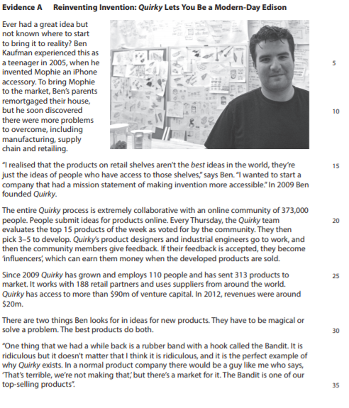
Case study for question 1

Slide 20
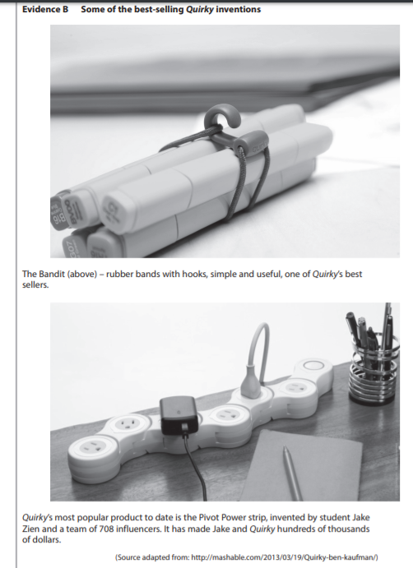
Case study for question 1

Slide 21
Sample question 1
[12]
Level 1
1-2
Level 2
3-4
Level 3
5-7
Level 4
8-12

Slide 22
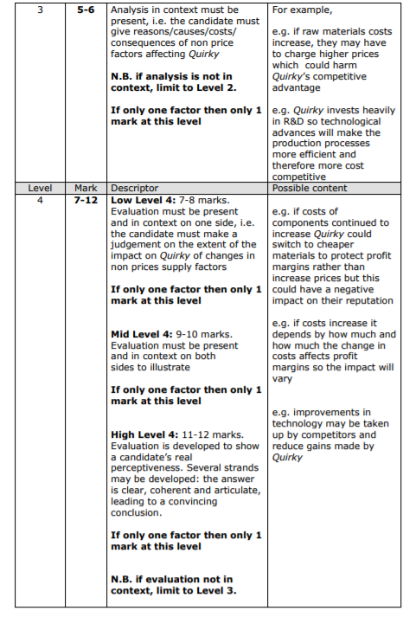
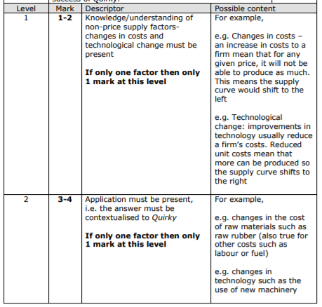
Answer sample question 1

Slide 23
Revision Video

Slide 24
Glossary
Productivity; the rate at which goods or services are produced
Shock; an event which causes a change within an economy which occurs outside of it. Unpredictable and may affect supply.
Automation; method of operating or controlling processes by automatic means using devices. Reduces need for human interaction.
Mechanisation; method of operating or controlling processes using machinery
Indirect tax; taxes put on products or services before they reach the consumer e.g. VAT and excise
Government subsidy; a grant or gift of money from the government to encourage supply of certain goods e.g. milk subsidies

