Slide 1
1.3.4 Distribution
a) Distribution channels
b) Changes in distribution to reflect social trends:
online distribution
changing from product to service

Slide 2
Starter
Match the product to the selling location
Which one is regulated by law? (only one)
clothes
pottery
online
insurance
groceries
Factory outlet
Supermarket
dealership
Small independent shop
Prescription medicines
Retailer website
Mail order
pharmacy
hypermarket
catalogue
Convenience store
shoes
car
Notes:
Pharmacy – prescription medicines is the only one regulated by law

Slide 3
Definition: Distribution
Distribution is the process of getting the right product or service to the consumer in the right place.
Distribution is one of the 4Ps of marketing: “place”

Slide 4
a) Distribution channels

Slide 5
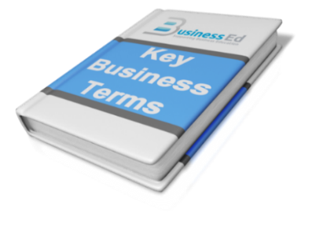
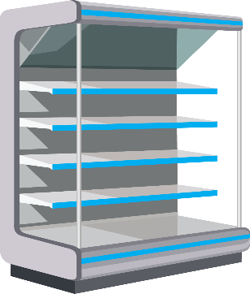
The Importance of Place
Place, as part of the marketing mix, refers to:
“Where a product can be purchased, and how it is moved from the manufacturer to the end consumer”
Place is often overlooked, but it is a vital part of the marketing mix
Failure to get a product to the right place can lead to empty shelves
Empty shelves mean lost sales!

Slide 6
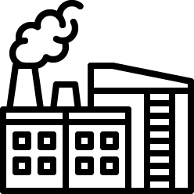
Distribution Channels
A distribution channel refers to how a product is moved from the business that produces it to the consumer that uses it
There are a number of channels available, the most common being:
3 stage
Agent
4 stage
Wholesaler
Retailer/E-tailer
Indirect
Consumer
Manufacturer
3 stage
Retailer/E-tailer
Direct
2 stage
Notes:
Clicking on “Indirect” will take you to slide 4
Clicking on “Direct” will take you to slide 10

Slide 7
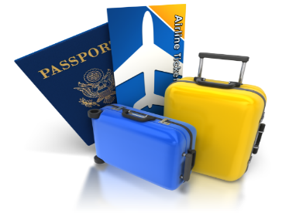
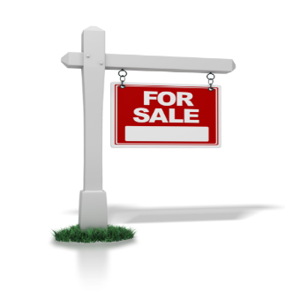
Agents
Agents are involved in negotiating a sale on behalf of the seller
They are usually paid a commission – a percentage of the value of a sale
Agents are common in certain industries, for example:
Travel Agents
Estate Agents
Why do tour operators sell holidays via travel agents as well as selling directly via their own website?
Notes:
Back returns you to slide 4

Slide 8
Wholesalers
Wholesalers sell goods in large quantities to retailers
Using wholesalers can significantly simplify the distribution process:
Manufacturers
Manufacturers
Wholesaler
Retailers
Retailers
Which type of retailers buy direct from the manufacturers and which will buy via Wholesalers? ?
Notes:
Back returns you to slide 4

Slide 9
Distribution Channels
https://youtu.be/G5XTIts7dQk
https://youtu.be/BS1-IkG-cTk

Slide 10
4 stage distribution
Manufacturer
Wholesaler
Retailer
Consumer

Slide 11
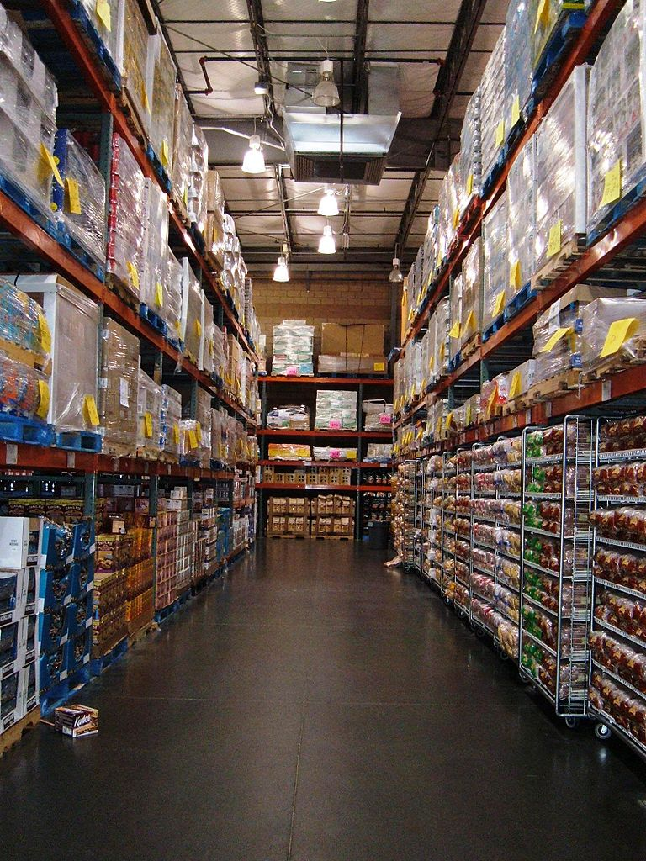
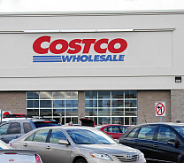
4 stage example
In a 4 stage distribution channel a manufacturer or producer will sell in bulk to the wholesalers
Retailers then buy their stock from the wholesalers to put in their shops
Customers then visit the retailer’s shops to make a purchase

Slide 12
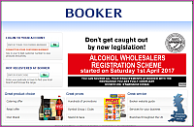
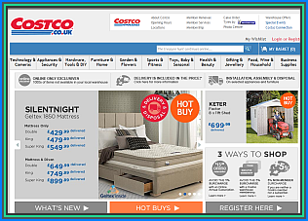
4 stage distribution channels
Four stage e.g. food and sweets
Some manufacturers prefer to deal with just a few wholesalers and sell in larger quantities or they may sell to a wholesaler as well as many retailers.
Wholesalers “break bulk” orders into smaller quantities that independent retailers (Like small local food shops) will buy
The added benefit of a wholesaler is they can offer trade credit terms to the small retailer

Slide 13
3 stage distribution
Manufacturer
Retailer / Agent
Consumer

Slide 14
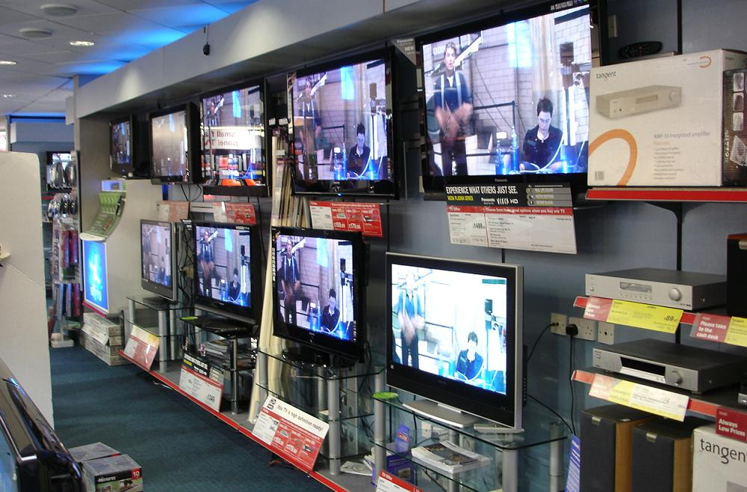
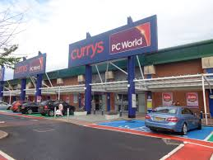
3 stage example
In a three stage distribution channel a manufacturer will sell their products direct to the retailer
The consumer will then buy from the retailer

Slide 15
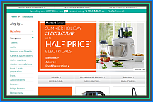
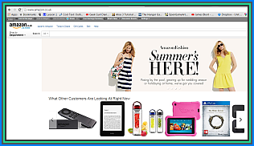
3 stage distribution channels
Three stage e.g. electrical goods such as toasters and kettles
Most manufacturers like to sell into a retailer. As the retailers are spread all over the country it gives the manufacturer the distribution and volume of sales they are looking for
The manufacturer can get the product to where the consumers can buy it by using retailers
Applies to most mass market products such as corn flakes, apple juice, tea bags etc. (FMCG – Fast Moving Consumer Goods)

Slide 16
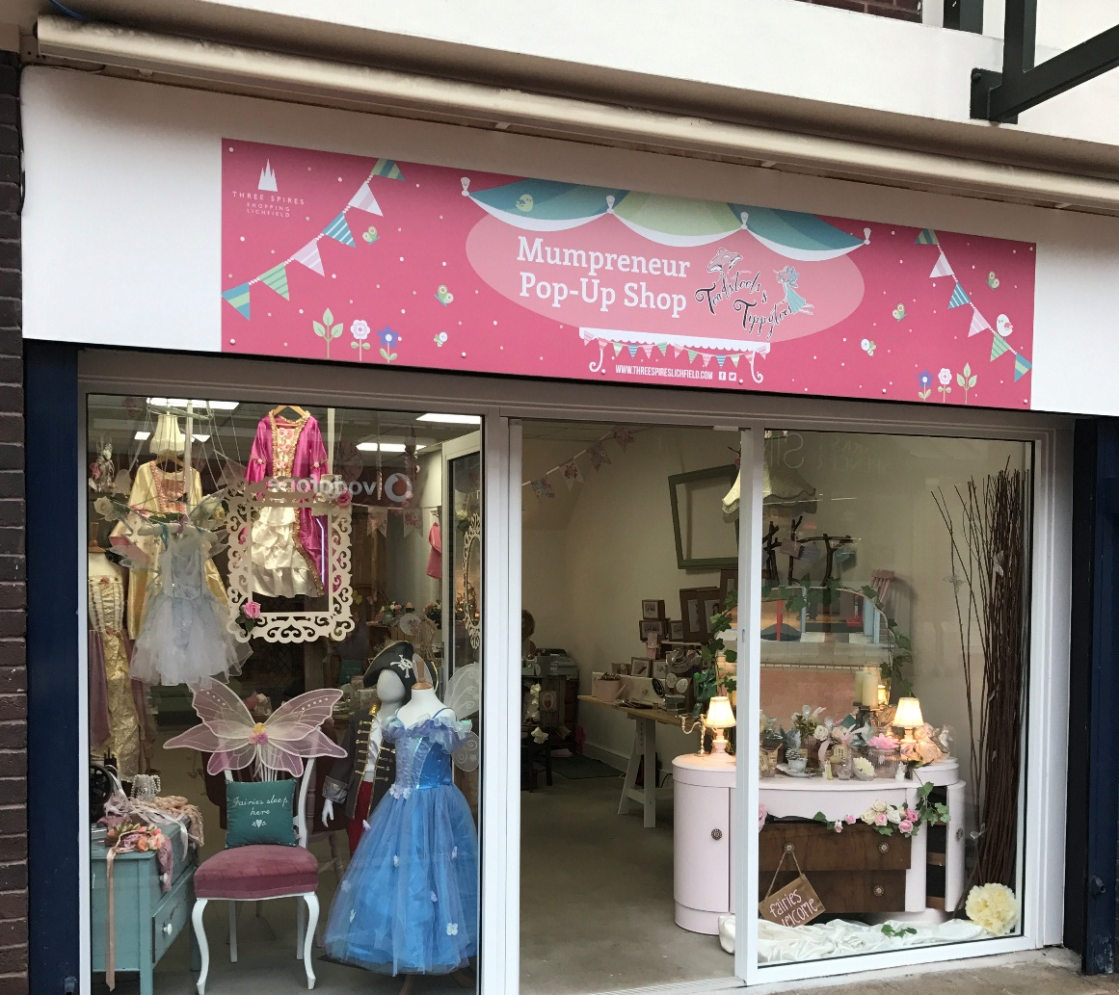
Suggested Activity - retailer list
List all the different types of retailers that you can think of (you may need to research to complete your list) e.g. department store
Can you now explain how the term “retailer” can cover a variety of different types of shops?
Pres esc for a suggested list
8 awesome, 6 great, 4, not bad
Notes:
Retailers could be; shop, department store, supermarket, co-operative, independent or convenience stores and online retailers such as Amazon, pop up shops

Slide 17
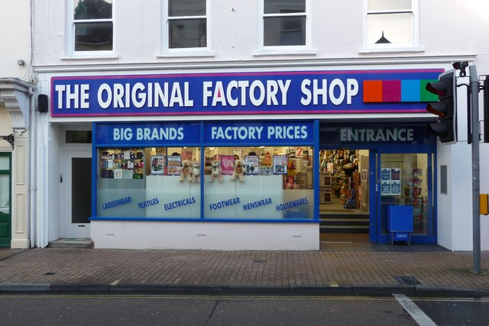
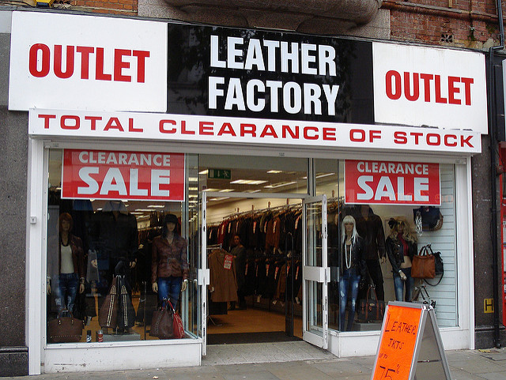
2 stage distribution
Manufacturer
Consumer

Slide 18
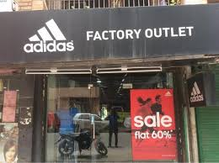
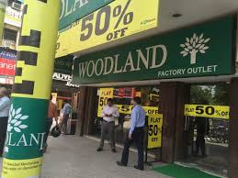
2 stage distribution example
In a two stage distribution channel products are bought by the consumer direct from the manufacturer
There are no intermediaries in a two stage distribution channel

Slide 19
2 stage distribution channels
Two stage e.g. holiday companies that do not use agents and factory outlets
Direct marketing
This means that products are sold directly from the manufacturer to the consumer
For example Mail order catalogues like the Next Directory
Factory shops e.g. Denby pottery shop
Services straight to the consumer e.g. solicitor
Dell computers (online)

Slide 20
What are the large benefits of multichannel distribution and why is it linked to large brands?
https://youtu.be/I1yv_aOyzD4

Slide 21
How has technology, competition and social trends impacted Tesco?
https://youtu.be/vL2ujjLKx2s

Slide 22
b) Changes in distribution to reflect social trends

Slide 23
Online distribution
The main benefit of the Internet is that niche products can reach a wider audience e.g. Low barriers to entry as set up costs are small
Can cater to a far greater geographically dispersed market than traditional local shops
Many transactions happen solely online such as purchasing tickets and software upgrades
Some businesses are clicks and bricks, others are just clicks – in other words just online e.g. Amazon

Slide 24
b) Changes in distribution to reflect social trends
What social trends have affected the way in which companies such as Amazon now distribute their products?
How will this affect the business?
How will this affect the consumer?
https://youtu.be/bfFsqbIn_3E
https://youtu.be/wC4vITSVXoA

Slide 25
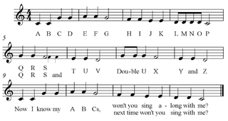
Changing from product to service
This is the concept that you do not have to own something to be able to use it e.g. music – not a physical product like a CD but an experience like a song you sing to yourself
Describe how the consumption of music has changed over time.
Live performances.
Recorded music
Explain how changes in technology and customer lifestyles has resulted in music consumption becoming more of a service than a product.

Slide 26
Choice of distribution channel
The choice of channel of distribution and the method of getting the products to the consumer will depend on:
The nature of the product e.g. medicines need to be sold in a pharmacy under the careful eye of a fully trained pharmacist
The market
The nature of the business
The size of the business e.g. A small fledgling business may start with just an online business

Slide 27
Revision Video

Slide 28
Case study for question 1 – from 2017 paper

Slide 29
Sample question 1
Knowledge 4
Application 4
Analysis
6
Evaluation
6
Notes:
No sample A2 questions for this topic so I have used an AS question from an Edexcel sample paper – with a high tariff

Slide 30
Glossary
Distribution channel; The chain of businesses through which a good or service passes until it reaches the end consumer. A distribution channel can include; manufacturers, wholesalers, retailers, distributors and the internet.
Wholesaler; A business that sells goods to retailers
Retailer; A business that sells goods to consumers
Agent; A foreign sales agent is a business which represents products from another business in a new country

