Slide 1
Edexcel A2 Business
3.6.3 Scenario planning
Revisionstation

Slide 2
Worksheet

Slide 3
From Edexcel
a) Identifying key risks through risk assessment
natural disasters
IT systems failure
loss of key staff
b) Planning for risk mitigation
business continuity
succession planning

Slide 4
Starter
What will you do if you don’t get the A Level grades you need for your first choice at University? What is the probability of this happening? What would be the financial impact of this? What is your back-up plan?
Can you draw a diagram of possible future scenarios for you?
Notes:
You can change this for your context – for example if most of your students are considering going on to an apprenticeship.

Slide 5
Scenario planning defined
Scenario planning is the process of anticipating possible changes in a business’s situation and devising ways of dealing with them. It incorporates the features of contingency planning.

Slide 6
Scenario planning
Critical
Plan
Carry out scenario planning
Predictable
Uncertain
Monitor
Review PESTLE / SWOT
Low importance

Slide 7
Scenario planning process
Scenario planning is the process of looking at potential future situations and planning for those events
The idea is that if we look creatively at what the future could look like (e.g. energy needs), the drivers and the implications that a business can create a series of strategies to handle those situations
Watch the video to find out how Shell uses scenario planning

Slide 8
Risk assessment

Slide 9
Identifying key risks
Identifying key risks through risk assessment, there are lots of key risks for a business, and these are mostly industry specific (think clothes vs energy) but the ones that your exam board would like you to know about are:
natural disasters
IT systems failure
loss of key staff

Slide 10
#1 Natural disasters
A disaster can strike any organisation, large or small. It can arrive in the shape of storm, flood, fire, earthquake and even Tsunami
It may take some time for the business to return to normal operation after an incident.
Climate change means UK businesses must plan for extremes of weather

Slide 11
#2 IT systems failure
IT systems often contain data about: Customers details including; e-mails, phone numbers, addresses, supplier’s details, stock control information, how much stock is in the warehouse, location etc.
Human resources data; sensitive information on contracts, pay rates, health matters and personal circumstances
If this information is lost it could be disastrous for the business (and possibly the customers)
Scenario planning means that adequate firewalls, backups and alternatives are planned for and in place

Slide 12
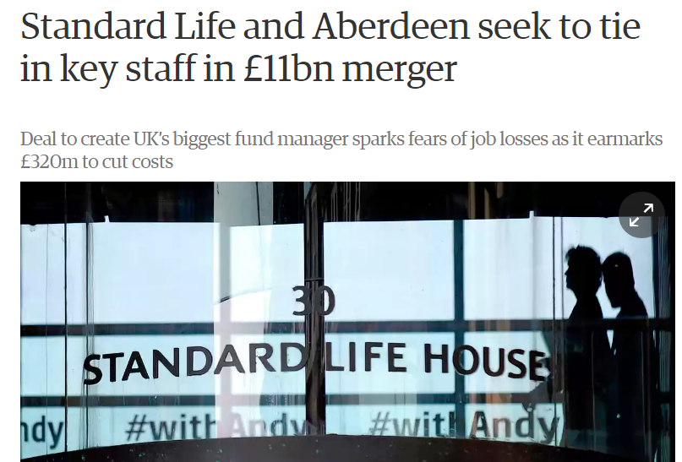
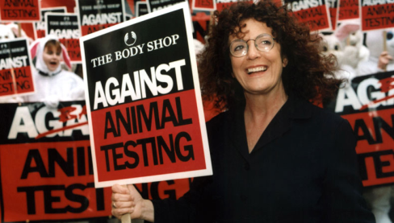
#3 Loss of key staff
When a key figure leaves whether it’s a band or a business, it can have serious repercussions on that organisation’s stakeholders.
It is important to plan for the loss of key staff so that when it happens the business continues as normal

Slide 13
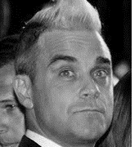
Who am I and what band did I leave?
C
A
B
D
Notes:
A Zayn left one direction
B Geri left the spice girls
C Robby Williams left Take That
D Justin Timberlake left NSYNC

Slide 14
Risk mitigation

Slide 15
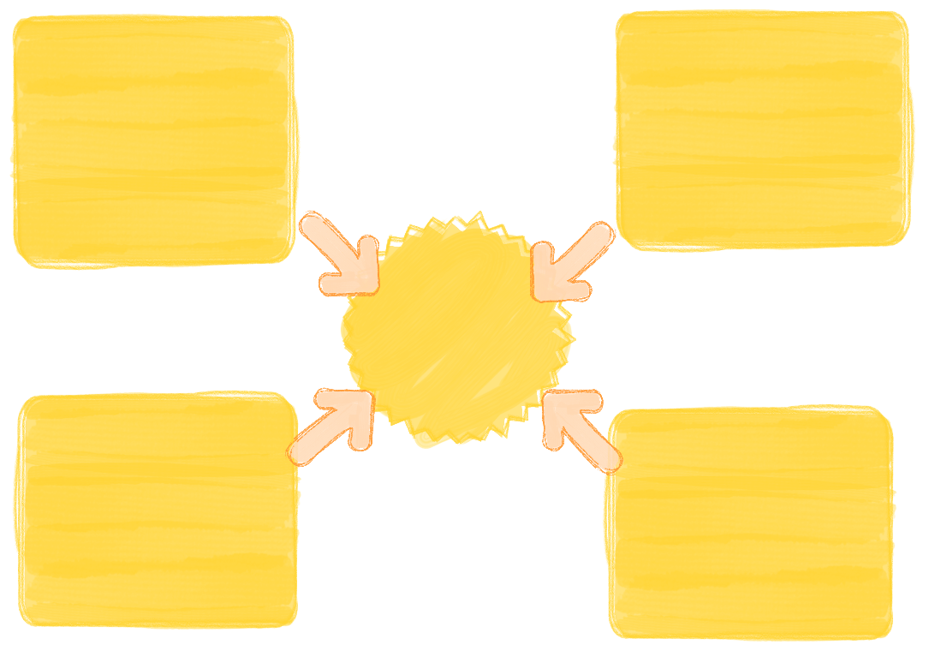
Degrees of risk mitigation
There are degrees of risk mitigation and these depend of specific contextual influences and the overall attitude of the decision-makers in the business. Again there are lots that could be discussed but your exam board would like you to know about just four:
Risk acceptance
Risk avoidance
Risk limitation
Risk transference

Slide 16
Notes:
This slide is here so you can project this on a whiteboard and write in the squares if you want to.

Slide 17
Risk acceptance
The balance between risk and reward is the very essence of business: without taking risks companies cannot generate profits
There is a world of difference between calculated risks, taken with planning and careful judgement, and risks taken carelessly or unwittingly.
An acceptance that there is an element of risk to every business venture is at the heart of successful business and risk management

Slide 18
Risk avoidance
Risk avoidance is the elimination of hazards, activities and exposures that can negatively affect an organisation's assets.
Whereas risk management aims to control the damages and financial consequences of threatening events, risk avoidance seeks to avoid compromising events entirely.
For example a multinational pulling out of an unstable country

Slide 19
Risk limitation
The ‘bottom line’ for businesses is that some risks are both identifiable and manageable.
Risks can be limited by
Watching what is said and done to reduce the possibility of being sued
Managing data carefully
Become a LTD to gain limited liability
Hiring a good solicitor
Having plenty of insurance
This can also be done by investing in security systems such as CCTV for a business, or a dog or fences
In the ICT a business may have a firewall or password protection levels

Slide 20
Risk transference
Buy some insurance!
You buy car insurance in case you have a crash, not after you have a crash. It is protection against the risk (and the law)
A business will buy insurance, for example:
Public liability insurance covers the business for claims made against the business by a client or member of the public for accidental injury.
Employers' liability protects the business if an employee is injured and the business has been negligent.

Slide 21
Planning for risk mitigation
Mitigation means the action of reducing the severity, seriousness, or painfulness of something.
Reducing the impact of a risk can be achieved in many ways, the ones your exam board would like you to know about are:
1. Business continuity
2. Succession planning

Slide 22
#1 Business continuity
Business Continuity (BC) is defined as the capability of the business to continue delivery of products or services at acceptable levels following a disruptive incident
Business Continuity is often described as ‘just common sense’. It is about taking responsibility for the business and enabling it to stay on course whatever storms it is forced to weather. It is about “keeping calm and carrying on”

Slide 23
#1 Business continuity
BC is about building and improving resilience in the business
it’s about identifying the key products and services and the most urgent activities that underpin them and then, once that analysis is complete
it is about devising plans and strategies that will enable the business to continue operations and enable it to recover quickly and effectively from any type disruption whatever its size or cause.

Slide 24
#2 succession planning
Succession planning is a process for identifying and developing internal people with the potential to fill key business leadership positions in the company.
Succession planning increases the availability of experienced and capable employees that are prepared to assume these roles as they become available.

Slide 25
#2 succession planning
Succession planning is defined as a process for identifying and developing potential future leaders or senior managers, as well as individuals to fill other business-critical positions, either in the short- or the long-term
Tim Cook took over from Steve Jobs at Apple

Slide 26
#2 succession planning
In addition to training and development activities, succession planning programmes typically include the provision of practical, tailored work experience that will be relevant for future senior or key roles.
There is a “9 box” theory to succession planning*
high
Wrong workplace or job role | Growth employee | Future leader
Unmotivated employee | Solid performer | High impact performer
Improve or remove | Potential problem | Trusted pro
Potential
low
low
high
Performance
Notes:
This is not a syllabus requirement just quite interesting – I put myself as a “trusted pro” where did you come?

Slide 27
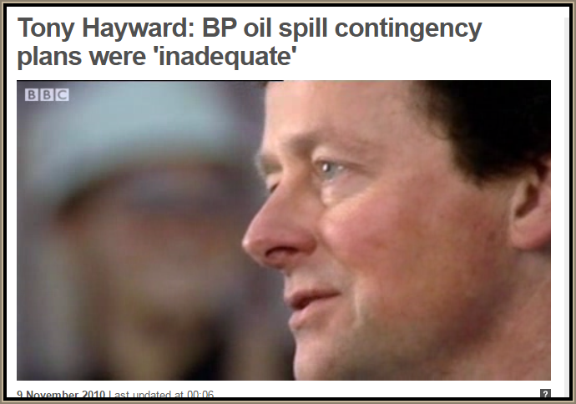
Revision Video

Slide 28
Sample Edexcel A2 questions

Slide 29
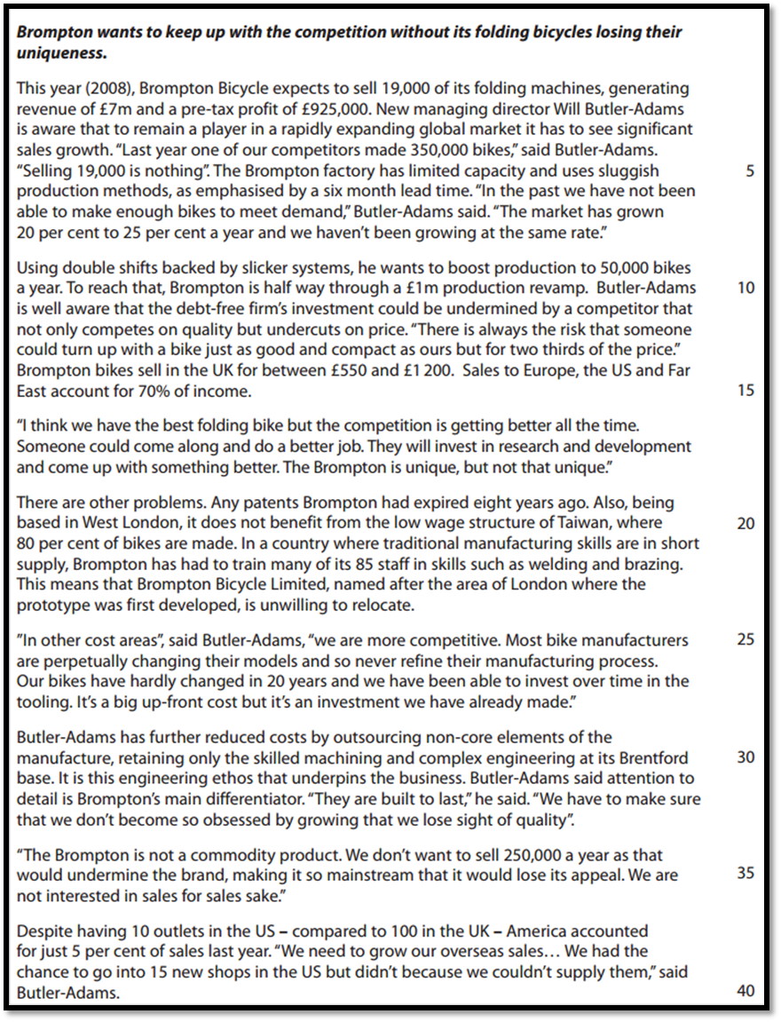
Case study for question 1

Slide 30
Sample question 1
Level 1
1-2
Level 2
3-4
Level 3
5-6
Level 4
7-9
Notes:
This is a legacy question from the ec/bus which is why its 9 marks

Slide 31
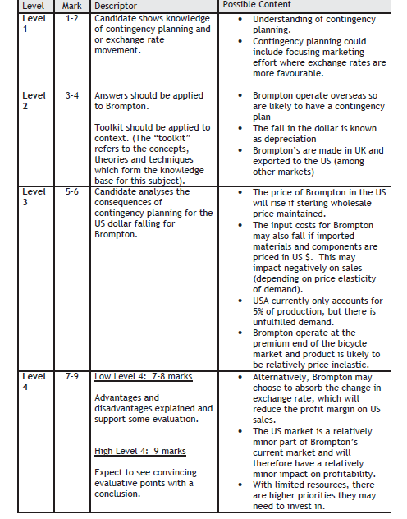
Answer sample question 1

Slide 32
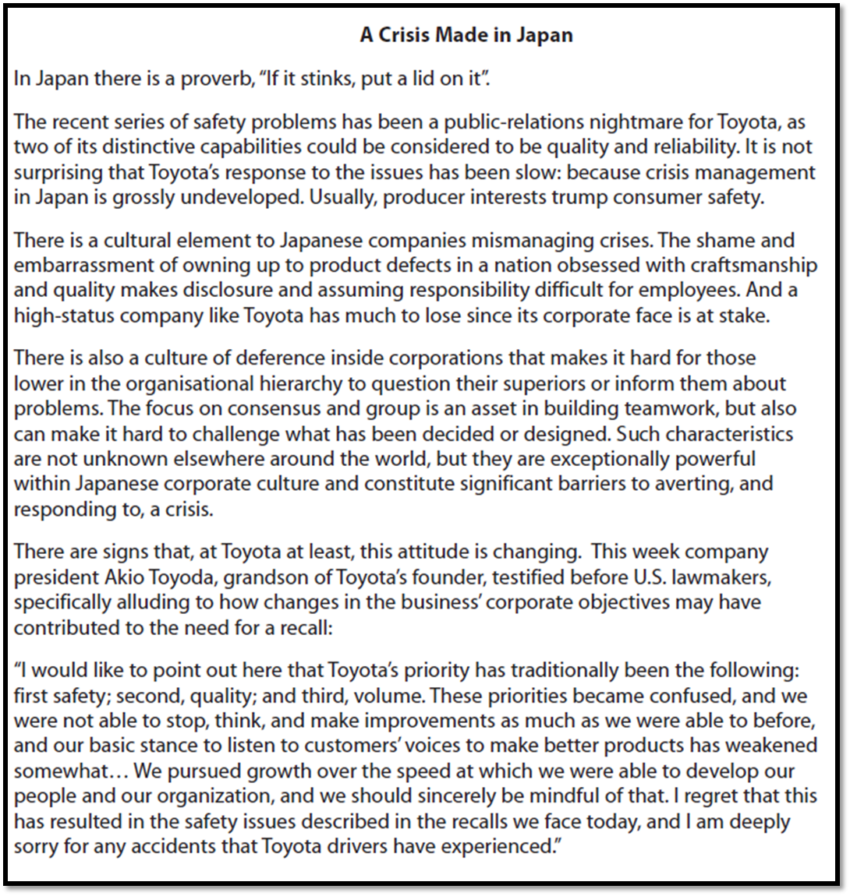
Case study for question 2

Slide 33
Sample question 2
Level 1
1-2
Level 2
3-6
Level 3
7-13
Level 4
14-20
Notes:
Another legacy ec bus question

Slide 34
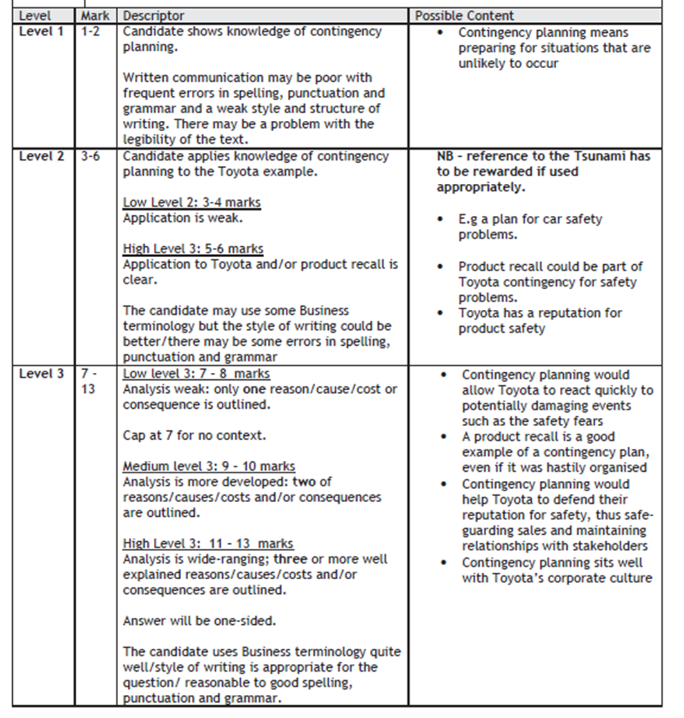
Answer sample question 2

Slide 35
Glossary
Contingency plan; A contingency plan is a plan devised for an outcome other than in the usual (expected) plan. It is often used for risk management when an exceptional risk that, though unlikely, would have catastrophic consequences. Contingency plans are often devised by governments or businesses.
Risk assessment; A risk assessment is a systematic examination of a task, job or process that you carry out at work for the purpose of; Identifying the significant hazards that are present (a hazard is something that has the potential to cause someone harm or ill health)
Business continuity; The Business Continuity Plan (BCP) is an essential part of any organisation's response planning. It sets out how the business will operate following an incident and how it expects to return to 'business as usual' in the quickest possible time afterwards
Succession planning; Succession planning is a process for identifying and developing internal people with the potential to fill key business leadership positions in the company. Succession planning increases the availability of experienced and capable employees that are prepared to assume these roles as they become available

