Slide 1
The Written Paper
Section A: Devised Piece.
‘Life is no Fairy Tale’.

Slide 2
Learning Outcomes.
By the end of the lesson you should be able to…
Recall specific lines from your chosen play.
Describe how you performed those lines in terms of movement, voice and facial expressions.
Explain why you performed the character in the way that you did.

Slide 3
Important Information
You must answer question 1 in section A.
There are four parts to this question.
Answer ALL parts in section A.
Section A should be on a devised piece of work.

Slide 4
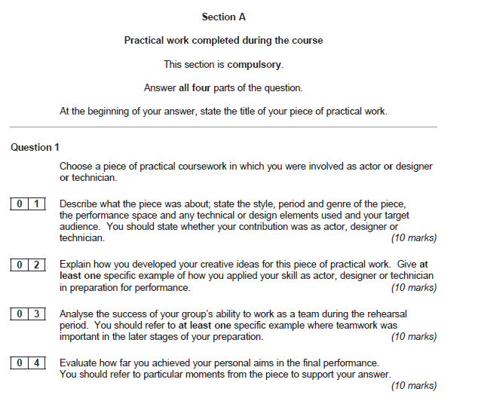
READ THE PAPER!!!

Slide 5
Part 01: Describe
The title.
What the play was about. The context. 4/5 sentences about the play.
The Style
The Genre
Period
Performance Space
Target audience
Tech/Design= Briefly
Own Contribution.

Slide 6
10 marks… Easy!!
The Title: One piece of practical work I completed during the course was a piece of devised thematic work called ‘Life is no fairy tale’ 1 Mark.
Description: The piece was about…. 1 Mark

Slide 7
10 marks… Easy!!
The Style: The style of this piece was non-naturalistic (1 mark) as we used unrealistic techniques such as monologues, flashbacks and freeze frames.
The Genre: The genre of the piece was fantasy (1 mark) as our storylines were based on fairy tales.

Slide 8
10 marks… Easy!!
The Period: We set our piece in…………..(1 mark) because…..
The target audience: Our target audience for the piece was our peers, our teacher and the drama moderator. (1 mark)

Slide 9
10 marks… Easy!!
The Performance space: We performed in the drama studio on the floor using an ‘end on’ stage (1 mark) as we did not want to interact with the audience and we wanted to keep the ‘forth wall’ in place.
Your contribution: My contribution was as an actor/ lighting designer/ set designer. (1 mark)

Slide 10
10 marks… Easy!!
The Tech and design: We used basic lighting such as a general wash and we used a white sheet as a backdrop with ….. pieces of rostra to create varying levels throughout the performance.
(1 mark) ACTORS

Slide 11
10 marks… Easy!!
The Tech and design: . I used rostra to create different levels, a white backdrop to use to create shadow puppets and differing colours to create contrasts between the two worlds. We used basic lighting such as a general wash.
ANA (1 mark)
The Tech and design: We used a back drop for the set. I produced a full lighting set up for the performance. I used set ups such as general washes, red and green spot lights and a dimmer switch to create different effects and atmospheres.
KELLY (1 mark)

Slide 12
The answer
Q1.
01
One piece of practical work I completed during the course was a piece of devised thematic work called ‘Life is no fairy tale’. The piece was about…………………………………………………………………………………………………………………………………………………………………………………………………………………………………………………………………………………………………………………. The style of this piece was non-naturalistic as we used unrealistic techniques such as monologues, flashbacks and freeze frames. The genre of the piece was fantasy as our storylines were based on fairy tales. We set our piece in ………………………………………….because………………………………………..Our target audience for the piece was our peers, our teacher and the drama moderator. We performed in the drama studio on the floor using an ‘end on’ stage as we did not want to interact with the audience and we wanted to keep the ‘forth wall’ in place.. My contribution was as an actor. We used basic lighting such as a general wash and we used a white sheet as a backdrop with ….. pieces of rostra to create varying levels throughout the performance.

Slide 13
Part 02: Explain
Explain the nature of the activity done.
Read the question and relate your answer to the question.

Slide 14
10 marks… explain!!!
What did you do?
What character did you play and what dramatic skills did you bring to the character?
Mention the different aspects of the character. Voice, movement, facial expressions.
E.g. I was unsure of the character I was playing so I used role on the wall, hot seating, I prepared a monologue so that I could develop my character further.
Read the question if it says ‘how did you?’ it means YOU! so use the term I! If it says ‘how did your group?’ it means WE/OUR.
You need to give a specific example in this question so relate it to your piece/ back to your character.

Slide 15
10 marks… explain!!!
Ideas to use
1. Monologues/ Duologues: voice: Pace, pitch, power, pressure, and pause.
2. Interaction with other characters: levels/ status
3. Space on the stage: getting from on scene to the next
4. Multi rolling: changing characters on the stage.
5. Creating of mood/ atmosphere. How did you explore this?
6. How a set design changed.
7. How a lighting design changed.
Remember: HOW AND WHY ARE VERY IMPORTANT!!!

Slide 16
Example question.
Explain how you developed your creative ideas. Give one specific example.
As an actor/ make up designer/ Lighting designer, I developed my creative ideas by using…
How have you got from one stage to the next?
Did you change your voice PPPPP?
Did you change a specific light colour?
Did you change the thickness of a certain colour?

Slide 17
Part 03: Analyse.
Analysis of a process undertaken.
Looking back at a process that you have done. Make sure you relate it to your chosen skill.

Slide 18
10 marks… Analyse.
This is commenting on the later stages of your work.
You need to be specific to the piece that you are doing.
So there needs to be a connection between the question answered and your piece.
This question maybe about team work, but it may be about your own work. READ THE QUESTION.
Make sure you are supporting your answer fully with how and why.
Do not comment on line learning, people being absent, cancelled rehearsals and personality clashes as this is irrelevant. Be productive.

Slide 19
10 marks… Analyse.
So refer to moments such as…
Characterisation/demands of the role.
Vocal skills.
The creation of specific effects for an audience
Sharing decision making
Shaping, refining, discarding or polishing the work in the final stages of preparation.
The team approach to the resolution of problems or the creation and resolution of ideas.

Slide 20
Remember
How and why????
Relate it back to your final piece?
Why are you doing it?
What are you trying to achieve?

Slide 21
Part 04: Evaluate
Evaluate the effectiveness of your contribution.
Looking back on your performance.

Slide 22
10 Marks…Evaluate
Your actual performance that you were marked on/filmed. You are talking as if you are now looking back on it and reflecting on it.
How did you feel you succeeded?
Good or not good. Make it specific. What were your strengths weaknesses? How does your final performance meet your personal aims?
Pick out specific moments and talk about the strengths / weaknesses. In relation to the following aspects……..
Audience reaction
Recognition of the creative journey
Team work
level of commitment
Improvement of identified skills / performance.

Slide 23
Remember
Write clearly and be very specific and…
READ THE QUESTION!!!!!!!!!!

