Slide 1
STARTER ACTIVITY
Read the data for the five economies.
They are a mix of free market, command and mixed economies.
What patterns and conclusions can you draw from the data?

Slide 2
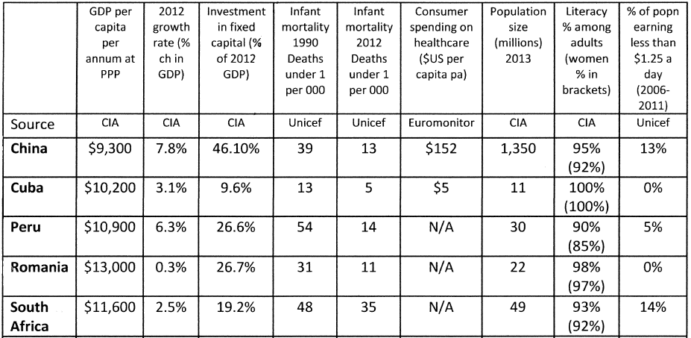

Slide 3
2) Mixed economies have a free-market, with elements of government intervention. Identify three examples of how the government might intervene in an economy.
3) No economy is an entirely free-market, all have some form of intervention by the state. Explain why you think that this is the case and reasons for which intervention is necessary.

Slide 4
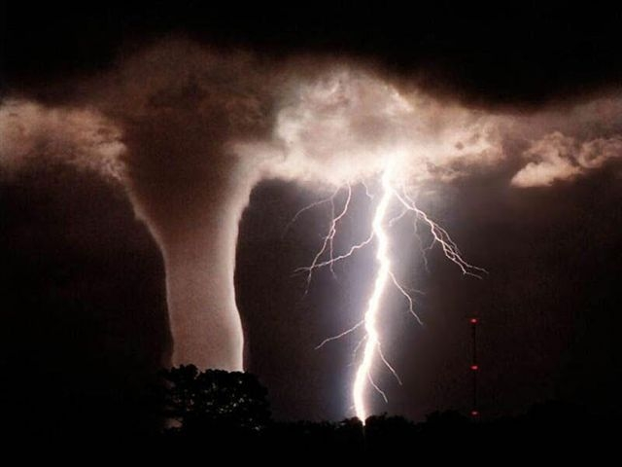
Free-market economies suffer from market failure, therefore the government intervenes in order to correct this. Hence why mixed economies exist.
What is meant by market failure?
This happens when the free market forces, using the price mechanism, fails to produce the demanded products or services at the quantity demanded. Causing an inefficient allocation of resources.

Slide 5
LEARNING OBJECTIVES
Lo1: Define the term market failure.
Lo2: Explain the terms ‘public good’ and ‘information gaps’.
Lo3: Analyse the characteristics and consequences of these upon markets.

Slide 6
What are the CAUSES of market failure?
Under-provision of public goods
Information Gaps
Externalities

Slide 7
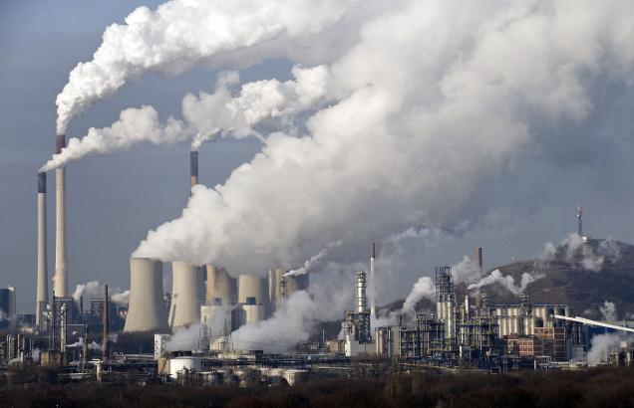
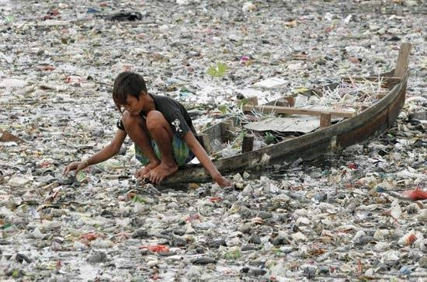
EXTERNALITIES

Slide 8
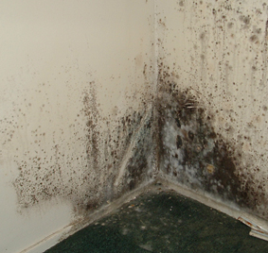
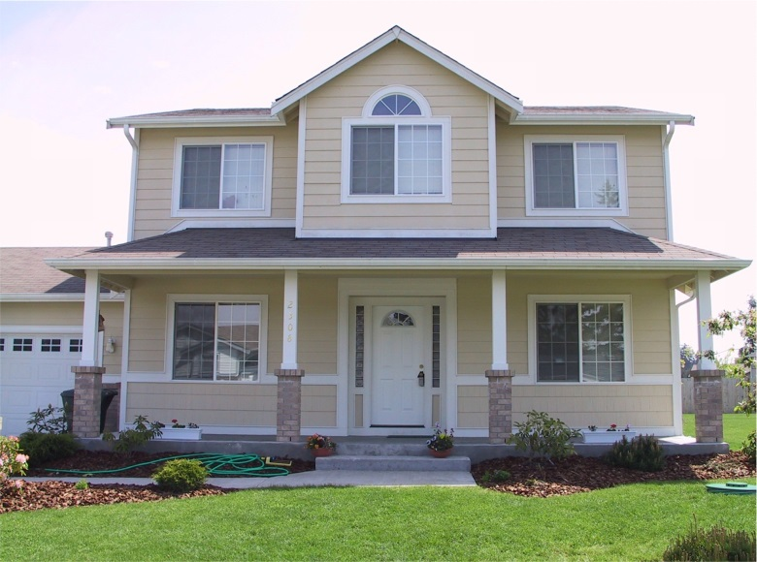
INFORMATION
GAPS

Slide 9
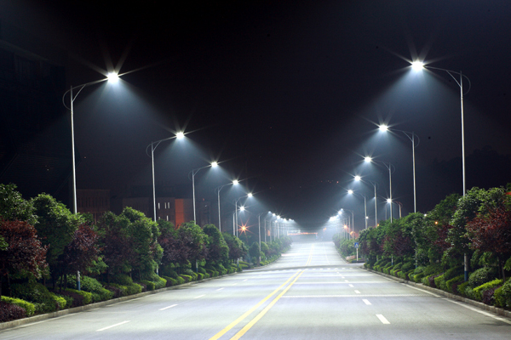
Under-provision of…
PUBLIC GOODS

Slide 10
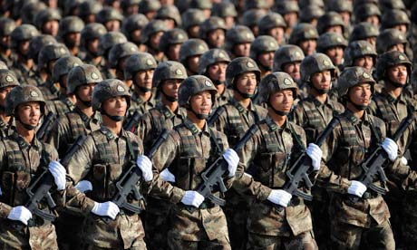
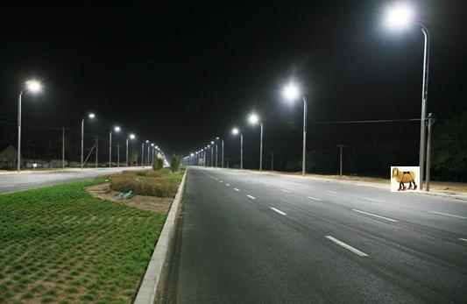
RECAP: What is PED?
What is special about all of these goods/services?

Slide 11
CHARACTERISITICS OF PUBLIC GOODS
The state finances the production of goods, the free market would struggle to produce these for the following reasons:
Non-excludability: ‘free rider problem’ – individuals who do not pay cannot be excluded from usage.
Non-rivalrous: Consumption by one person, does not prevent consumption of another person.
Marginal Production Costs are zero: the cost to benefit 1 more person is zero e.g. military defence is the same cost, even after a baby is born and the population of a protected country increases.
Private goods are the opposite. They display excludability and are rivalrous. Most goods are private goods.
https://www.youtube.com/watch?v=s34Ua_sT60k 3:52 – Portsmouth Professor
Notes:
Examples of goods that the free market would not produce… and why is this the case?

Slide 12
STATE PROVISION – PUBLIC GOODS
http://www.youtube.com/watch?v=mYtW1Ug7L_s&list=PL336C870BEAD3B58B&index=47
Notes:
Examples of goods that the free market would not produce… and why is this the case?

Slide 13
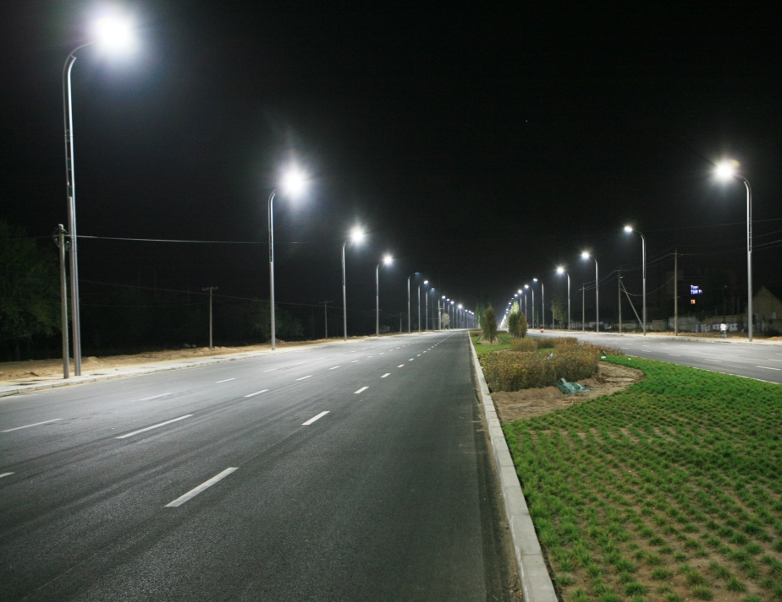
WORKSHEET TASK – 15 minutes
Complete the ‘Public Goods’ worksheet.
Fresh Air
Street Lighting
Knowledge
Flood control systems
Lighthouses
Defence

Slide 14
Public Good
Street Lighting
Knowledge
Fresh Air
Flood control systems
Lighthouses
Defence

Slide 15
FLOOD DEFENCES
“Flood defences provide a collective barrier against the huge damage that flooding can cause. The benefits are largely non-excludable and the costs of not having effective flood defence infrastructure are enormous. It has been found that one home in six in the UK is at risk of flooding in the years ahead as the impact of climate change becomes more apparent.
The Environment Agency will today publish a new study warning £20bn of investment is required over the next 25 years to address rising flood risks and that the annual cost to the UK economy of flooding will rise from £2.5bn to £4bn a year by 2035 unless investment in flood defences is increased.” – BBC News
http://www.tutor2u.net/blog/index.php/economics/comments/one-home-in-six-at-risk-flood-defences-as-a-public-good/#extended

Slide 17
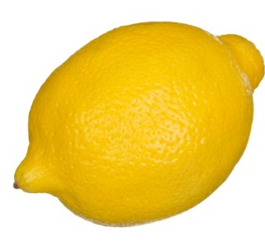
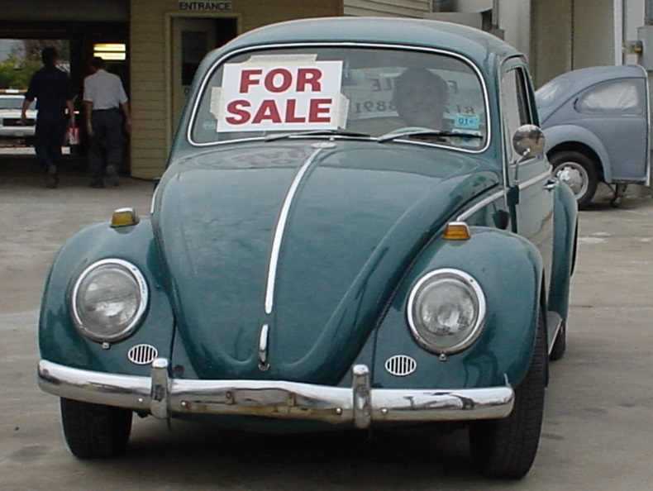
INFORMATION GAPS
In order to make rational decisions regarding prices and quantities, the producer and consumer needs to know all of the information about what they’re consuming/producing.
When there is a difference in knowledge between the buyer and seller, market failure will result. Resulting in an incorrect market price or market quantity – for either the consumer/producer or both.
In America, when you buy a car that turns out to be faulty (information gap) it is known as a lemon. This is a good economic term for any good that is bought with insufficient information.
https://www.youtube.com/watch?v=cYcsFyim_Cs

Slide 18
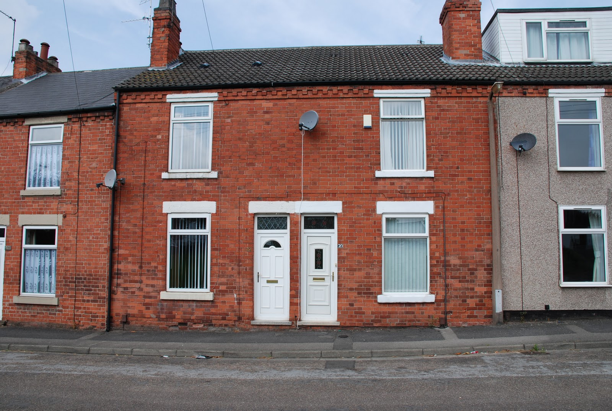
Government intervention? By law, every time you purchase a house – you must also buy a basic surveyors report to flag up issues.
Loose tile causing penetration damp
Improper installation of windows
Wood worm in floor joists.
Built on top of a chalk pit.
Subsidence causing insecure foundations
Traffic is exceptionally busy during weekends.

Slide 19
FOOD, ALCOHOL AND TOBACCO
Lack of information can lead to consumers not being able to make rational choices.
If consumers do not know the true benefit, they will pay and consume too much or too little.
How have the government tried to create symmetric information?

Slide 20
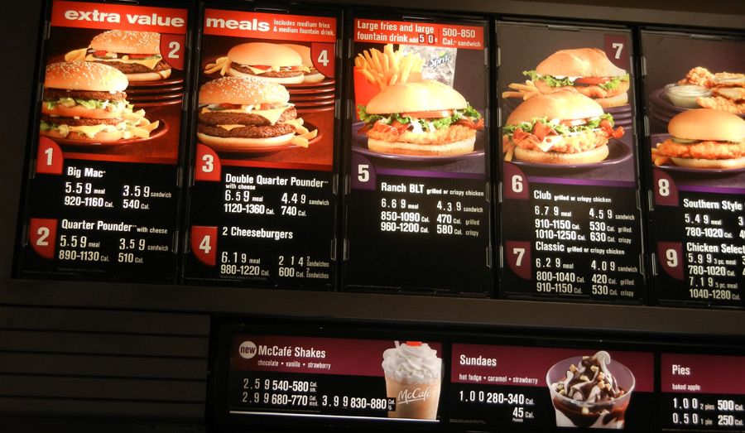
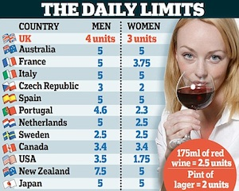
FOOD, ALCOHOL AND TOBACCO

Slide 21
FOOD, ALCOHOL AND TOBACCO
Who knows more and what will the effect be..? How could the information gap be closed?
…at the weekend walking around Reading deciding what to eat.
…a 17-year-old is looking to insure their first car.
…a second-hand care salesman tells me the car is “a good runner”
…the seller of a pension scheme who says the future will be well provided for
…the cigarette manufacturer who does not inform potential consumers of the true health risk from smoking
…a Year 11 choosing their A-Level options and deciding which Sixth Form to attend
Notes:
who knows more and what will be the effect?

Slide 22
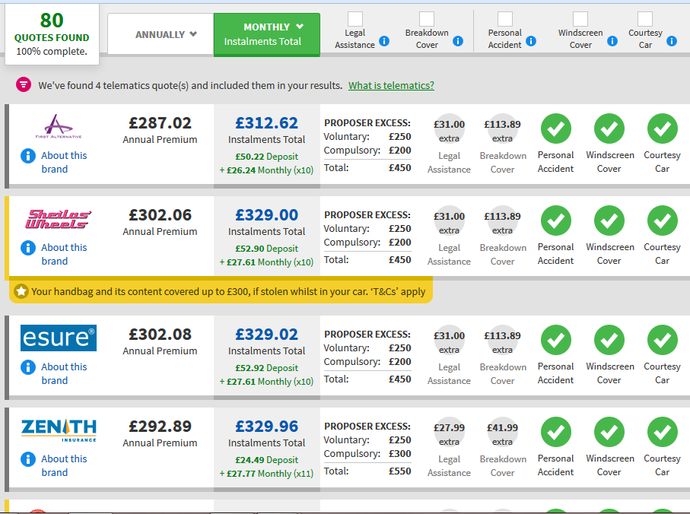
Price comparison sites reduce information gaps between buyers and sellers. Reducing market failure.

