Slide 1
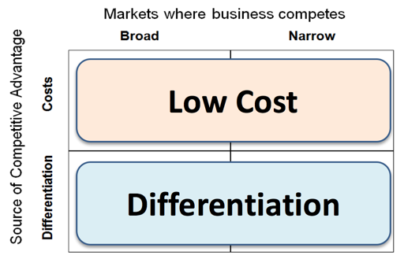
Porter’s Strategy Matrix
3.1 Business objectives and strategy

Slide 2
What you need to know
Theories of corporate strategy
a) Development of corporate strategy:
Porter’s Strategic Matrix

Slide 3
Concept links
Porter’s Strategies
Market positioning
Product differentiation
Mass & niche markets
Competitive advantage
Corporate objectives

Slide 4
The Challenge Facing Business Strategy
To find a way of achieving a sustainable competitive advantage over the other competing products and firms in a market

Slide 5
Porter’s Suggested Approach to Strategic Positioning
Porter suggested two overall business strategies that could be followed in order to gain competitive advantage
Porter argued that differentiation and low cost are effective strategies for firms to gain competitive advantage

Slide 6
What is a Competitive Advantage?
An advantage over competitors gained by offering consumers greater value, either by means of lower prices or by providing greater benefits and service that justifies higher prices

Slide 7
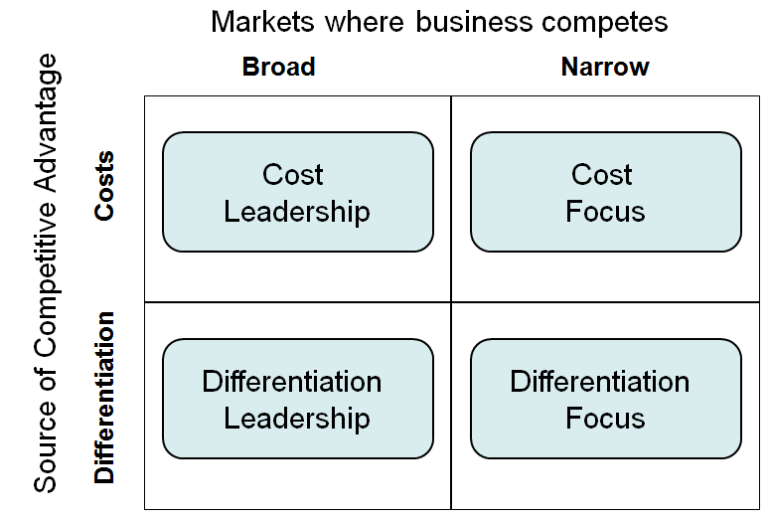
Porter’s Generic Strategies
Low Cost
Differentiation

Slide 8
Low Cost Strategy
With this strategy, the objective is to become the lowest-cost operator. This typically involves production on a large scale which enables the business to exploit economies of scale.

Slide 9
Why Low Cost is a Source of Competitive Advantage
Why is cost leadership important?
If selling prices are broadly similar, the lowest-cost operator will enjoy the highest profits
Lowest-cost operator can also offer the lowest prices (gain market share)
Suitable markets for this strategy?
Standard product
Little product differentiation
Branding relatively unimportant

Slide 10
Likely Features of a Low Cost Operators
High levels of productivity & efficiency
High capacity utilisation
Large scale = economies
Use bargaining power to negotiate lowest prices from suppliers
Lean production methods and culture
Access to the widest and most important distribution channels

Slide 11
Examples of Low Cost Strategies in Action

Slide 12
Strategy of Focus & Differentiation
With a differentiation strategy, aims to offer a product that is distinctively different from the competition, with the customer valuing that differentiation

Slide 13
Ways to for a Business to Achieve Differentiation
Superior product quality (features, benefits, durability, reliability)
Branding (strong customer recognition & desire; brand loyalty)
Wide distribution across all major channels (i.e. the product or brand is an essential item to be stocked by retailers)
Sustained promotion – often dominated by advertising, sponsorship etc

Slide 14
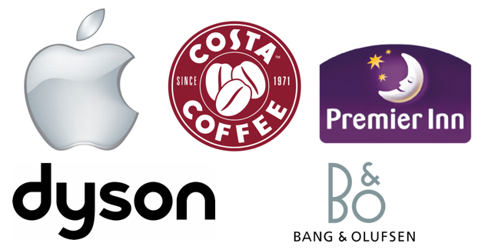
Examples of Successful Differentiation Strategies?

Slide 15
“Stuck in the Middle”
Low Cost
Stuck in the Middle
Differentiation

Slide 16
Examples of Stuck in the Middle?

Slide 17
Hybrid Strategies: Differentiation AND Low Cost
Value proposition = stylish furniture; good quality; low prices
Achieves its low prices via cost leadership:
Furniture is flat packed to reduce storage space
Large out of town retail units spread fixed costs
Products are made in China and Malaysia reducing unit costs
Low margins/ high volume allows economies of scale
Differentiates using:
Unique / unusual design
Localisation of product range
Targeting (mainly) the young global middle class

