Slide 1
TWO QUESTIONS:
WHY DID YOU CHOOSE ECONOMICS
WHAT DO YOU THINK THE SUBJECT IS ABOUT?
Notes:
Get students to write onto pieces of paper, screw up and pick at random. Encourages students to be open, honest.

Slide 2
THE PLAN
Finish Theme 1 (micro economics) by the end of December.
Theme 1 mock – Parents Meeting in January.
Theme 2 (macroeconomics) started in January.
Theme 2 finished in time for the Easter Holiday.
Summer Term left to revision.
Microeconomics focusses on markets and firms, whereas macroeconomics considers the wider economy as a whole.

Slide 3
50% of the AS
NOT of the
full A-Level.

Slide 4
50% of the AS
NOT of the
full A-Level.

Slide 5
CHANGES TO BE AWARE OF…
The new specification means that A-Levels are linear.
This means that your AS results at the end of Year 12 do not count towards your final A-Level result.
Therefore, your exams at the end of Year 13 will consist topics from both Year 12 and Year 13 – the results of which decide your entire A-Level grade.

Slide 6
Theme 1: Introduction to markets and market failure (micro).
Theme 2: The UK economy – performance and policies (macro).

Slide 7
Theme 1 (Micro-economics):
SUBSIDIES
POLLUTION
TAX
GOVERNMENT INTERVENTION
GOODS
EXTERNALITIES
LABOUR
ELASTICITY
DEMAND

Slide 8
LEARNING OBJECTIVES
Lo1: Explain the economic problem
Lo2: Explain and state the ‘factors of production’
Lo3: Analyse how the economic problem creates adverse effects for society

Slide 9
What do you need to produce this sofa?
Now try and categorise them
Notes:
What goes into producing this sofa? Weirder and more obscure the better!

Slide 10
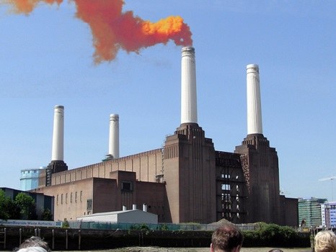
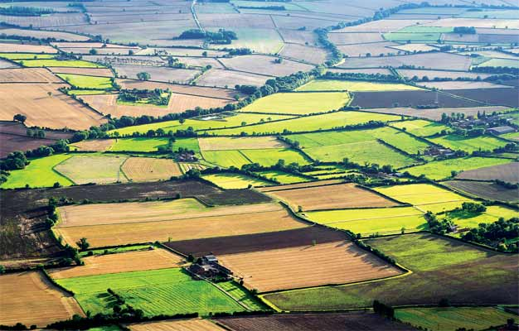
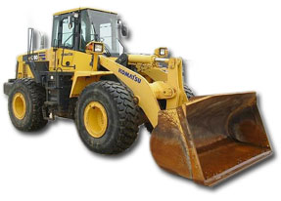
How would you describe society’s wants for goods and services?
How would you describe the availability of these resources?
FACTORS OF PRODUCTION…
LAND
LABOUR
CAPITAL

Slide 11
Resources are SCARCE and our wants often EXCEED them. This CONCEPT is called the ECONOMIC PROBLEM.
‘Infinite wants with finite resources…’ - The Economic Problem
Economic systems exist in order to distribute finite resources amongst people with infinite wants.

Slide 12
https://www.youtube.com/watch?v=IXktCRkgly8
BBC News 3:27

Slide 13
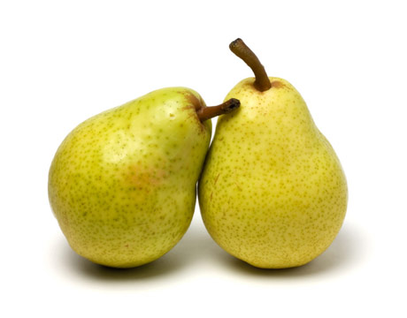
TABLE ACTIVITY – 15 MINS
In you will carry out a small activity...
You will be given a table of different scenarios and various options, you must make a decision.
In pairs discuss the best option, consider the SACRIFICE and JUSTIFY your decision.

Slide 14
Independently write down a situation in which something was limited, and you had to make a choice.
How did you make this choice? Why did you decide to do this?
2 minutes

Slide 15
What are the factors of production?
Provide examples.
Can you also remember what the basic economic problem is?

Slide 16
Impact upon society?
Notes:
Impact upon society? Good and bad stuff – like pensioners, healthy workforce.

Slide 17
In these scenarios you’ve been looking at, who is faced with the economic problem?
The economic problem is faced by consumers, producers and the Government.

Slide 18
LET’S RECAP…
Write down a definition for the ‘economic problem’.

Slide 19
LET’S RECAP…
What are the factors of supply/production?

Slide 20
LET’S RECAP…
Give an example of each.

Slide 21
LET’S RECAP…
How does the economic problem create an adverse effect for society?

