Slide 1
Edexcel A2 Business
4.1.1 Growing economies
Revisionstation

Slide 2
Worksheet

Slide 3
From Edexcel
a) Growth rate of the UK economy compared to emerging economies
b) Growing economic power of countries within Asia, Africa and other parts of the world
c) Implications of economic growth for individuals and businesses:
trade opportunities for businesses
employment patterns
d) Indicators of growth:
Gross Domestic Product (GDP) per capita
literacy
health
Human Development Index (HDI)

Slide 4
Starter
Which countries do you think these acronyms stand for? Take a guess, or maybe you know? 10 points per correct answer
B M
R I
I N
C T
Notes:
Brazil
Russia
India
China
Mexico
Indonesia
Nigeria
Turkey

Slide 5
BRIC economies
Superpowers are countries, or groupings of countries, with global influence and power.
They have economic, cultural and geopolitical influence. Superpowers shift over time, as some powers decline and others emerge.
The BRICs are Brazil, Russia, India and China.

Slide 6
MINT economies
The term was coined by economist Jim O'Neill, who has now identified the "Mint" countries - Mexico, Indonesia, Nigeria and Turkey - as emerging economic giants
Jim O’Neill economist invented the term BRIC and MINT

Slide 7
MINT economies

Slide 8
Economy defined
An economy is the state of a country or region in terms of the production and consumption of goods and services and the supply of money
Economy is the large set of inter-related production and consumption activities that help in deciding how scarce resources are allocated.

Slide 9
Growth rate of the UK economy compared to emerging economies

Slide 10
Comparison of growth rates
Guidance for this topic explains that students will not be expected to be able to state the growth rate of any country but should understand how the growth rate of emerging countries compares with the UK
 | Current GDP growth rate
UK
Brazil
Russia
India
China

Slide 11
UK growth rates
Current UK growth rate = 1.7%
The data here shows % growth rate - click the graphic to fully examine the data and look at forecasts
Notes:
This is very simplified – I have left it to you to judge with your groups just how much detail they can handle. Remember they only need to be able to compare

Slide 12
Brazil growth rates
Infographic HERE
Current Brazil growth rate = 1%

Slide 13
Russia growth rates

Slide 14
India growth rates

Slide 15
China growth rates
Infographic HERE

Slide 16
Implications of economic growth for individuals and businesses

Slide 17
Economic growth
Growing economies start to see changes in employment patterns; working women, migration, the rise of the multi job, home working and the search for a better work-life balance.
The countries that manage to pull themselves out of poverty and get richer are those that are able to diversify away from agriculture and other traditional products.
As labour and other resources move from agriculture into modern economic activities, overall productivity rises and incomes expand.

Slide 18
What does all this growth mean for business?
All these new growing and emerging economies have increasing incomes of their citizens
This means opportunities to increase revenue and profit for MNCs by moving into new markets
Increased incomes combined with low labour costs and proximity to market make these growing economies very attractive

Slide 19
Indicators of growth

Slide 20
Indicators of growth
There are lots of ways to measure the growth rate of a country, the main ones that your exam board would like you to know about are:
Gross Domestic Product (GDP) per capita
literacy
health
Human Development Index (HDI)

Slide 21
Notes:
This is here so you can write on it on the whiteboard if you wish

Slide 22
#1 GDP
GDP stands for Gross Domestic Product
The GDP figure for a country shows the sum total of everything they produce as a nation
Look at the GDP figures and compare to the UK, it may be also be helpful to have a world map so you can compare the size of countries

Slide 23
GDP of nations 2017 data
Rank | Name of country | $trillions
1 | United States | 19,417,144
2 | China | 11,795,297
3 | Japan | 4,841,221
4 | Germany | 3,432,287
5 | UK | 2,496,757
6 | India | 2,454,458
7 | France | 2,420,440
8 | Brazil | 2,140,940
9 | Italy | 1,807,425
10 | Canada | 1,600,265
11 | Russia | 1,560,706
12 | Korea | 1,498,074
13 | Australia | 1,359,729
14 | Spain | 1,232,440
15 | Indonesia | 1,020,515
Source HERE
Notes:
Source: http://statisticstimes.com/economy/countries-by-projected-gdp.php

Slide 24
#2 Literacy
Literacy levels are a key indicator of the economic growth of the world’s countries
The average is 86.3% of a country’s citizens are literate, compare this against Afghanistan for example at 38.2% or Niger at 19.1%
Have a look at the Wiki rates here (no UK or USA data on this table)

Slide 25
#3 Health
World Health Organisation (WHO) keep a record of life expectancy at birth in years
The UK is 81.2 years compare this with the MINT economies
Mexico, Indonesia, Nigeria and Turkey
Link is HERE
Mexico: 76.7
Indonesia: 69.1
Nigeria: 54.5
Turkey: 75.8
Highest data is Japan: 83.7
Lowest expectancy is: Sierra Leone – if you live there you can only expect to live to 50.1

Slide 26
World health league
The world health league is published each year with data comparing countries
The healthiest citizens are in Norway, good news if the business is looking for healthy and strong workers

Slide 27
#4 HDI
HDI is the Human Development Index
This is a statistic which combines; life expectancy, education and income which are used to rank countries into four tiers of human development
UK is 16th

Slide 28
Comparison of all 4 indicators
Country | GDP of nations | Literacy | Health | HDI
UK
Brazil
Russia
India
China
Mexico
Indonesia
Nigeria
Turkey
Notes:
I’m going to leave this blank as ranks may change – it will be on the worksheet for students to complete and draw some conclusions from.

Slide 29
Sample Edexcel A2 questions

Slide 30
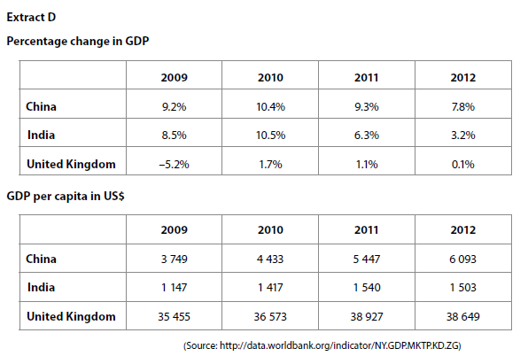
Case study for question 1
Which markets are growing fastest?
Which country has the richest consumers?

Slide 31
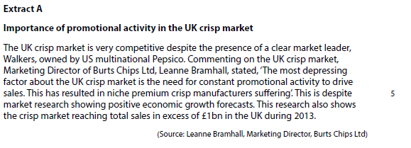
DATA TO USE
Total crisp market sales in UK for 2013 of £1billion

Slide 32
Questions – to help you answer sample question 1
1) The UK market is growing by ______% in 2012
2) Overseas markets are growing / shrinking (select one) faster than the UK
3) China GDP per C growth between 2009 and 2012 is __________%
4) India GDP per C growth between 2009 and 2012 is __________%
5) UK market still has richer consumers than China by _______ times as much (2012)
6) Some foreign markets growing at different speeds and may look more favourable than the UK
China _____________ 2012 and India ________________2012

Slide 33
Answers
1 0.1%
2 Growing
3 62%
4 31%
5 Roughly 6
6 7.8% China and 3.2% India

Slide 34
Sample question 1
Knowledge 4
Application 4
Analysis
6
Evaluation
6

Slide 35
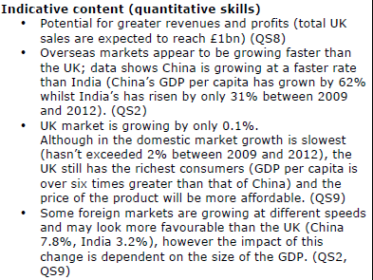
Answer sample question 1

Slide 36
Answer question 1 continued

Slide 37
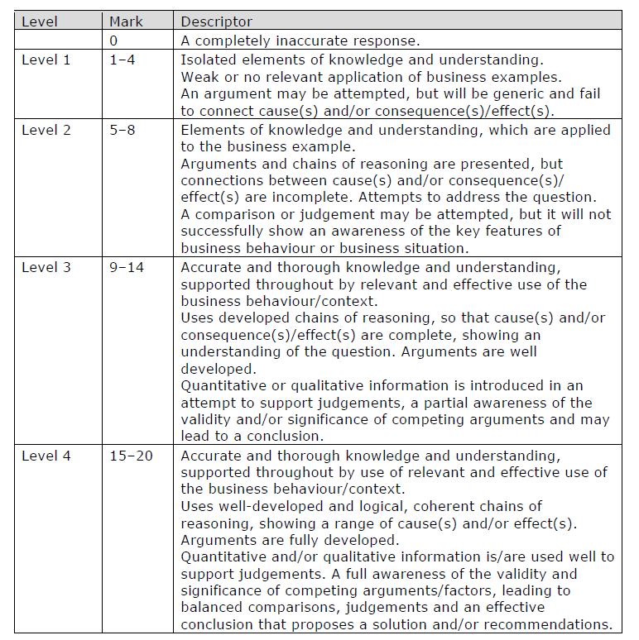
How to level sample question 1

Slide 38
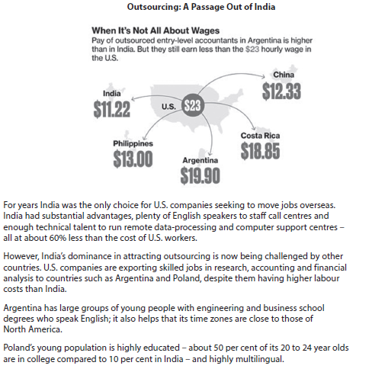
Case study for question 2

Slide 39
Sample question 2
[15]
Level 1
1-2
Level 2
3
Level 3
4-7
Level 3
8-15
Notes:
No 15 mark questions on the paper – this is from the legacy paper, still good for practice

Slide 40
Level | Mark | Content
1 | 1-2 | defines or identifies what is meant by growing economic power e.g. expansion of GDP e.g. increasing levels of consumption
2 | 3 | e.g. ability to compete in global markets - growth of Indian pharmaceutical companies e.g. consumption in India worth $.85 trillion, world’s fifth largest consumer market by 2025
3 | 4-7 | e.g. as India’s GDP and levels of consumer spending increases patterns of demand may change. Some UK and US businesses will flourish as a direct result of this. Individuals who work for these businesses will benefit in secure employment and possibly increased incomes. e.g. individuals will also benefit if Indian pharmaceutical companies grow enough to successfully penetrate western markets and so provide cheaper medicines and other cheaper products/substitutes.
4 | 8-15 | Candidates begin to contrast those individuals that will benefit from India’s growth as opposed to those that may be threatened and lose their jobs. e.g. workers in the western pharmaceutical companies may lose their jobs as a result of Indian competition Takes these points further and looks at the degree and scope of the impact e.g. the growing power of Indian businesses may also provide a problem for individuals if they out-compete western businesses. The short term impacts may be contrasted with differing long term impacts. e.g. many individuals will be totally unaffected by India’s growth such as hairdressers and public sector workers e.g. Growing economic power can lead to improvements in education and better qualified Indian workers who may then compete with western individuals for employment

Slide 41
Glossary
BRIC; Brazil, Russia, India, and China
BRICS; Includes South Africa
MINT; Mexico, Indonesia, Nigeria, Turkey
GDP; Gross domestic product
HDI; Human development index

