Slide 1
The BIG Idea
3.2.4 Staying small
Think about…
Small business survival in competitive markets:
product differentiation and USPs
flexibility in responding to customer needs
customer service
e-commerce
Notes:
Students identify key words to underline

Slide 2
Small businesses survival in competitive markets:
Product differentiation and USP’s – Smaller businesses may be able to offer a more personal service than bigger business and therefore create brand loyalty. Furthermore, the products that they sell may be unique. This is especially the case in niche markets.
Flexibility in responding to customer needs – As the business is smaller it is able to respond to changes in customer tastes and fashions. This is in contrast to bigger businesses where poor co-ordination and communication can make it longer for them to react to changes in customer needs and wants.
Customer service – Smaller businesses are able to offer a more personal service than bigger businesses. This is likely to attract customers to smaller stores rather than larger ones.
E-commerce – The growth of businesses selling on the internet has resulted in a number of stores closing. This is a big threat to small businesses as the increasing accessibility of the internet and e-commerce has resulted in an increasing amount of people buying online rather than in stores.

Slide 3
Product differentiation and USP’s
Maintaining a level of product differentiation is important to a small firm.
Differentiation can stifle growth because it limits the product to a small niche market.
Expansion/growth might mean moving away from the very point of differentiation that created the success in the first place

Slide 4
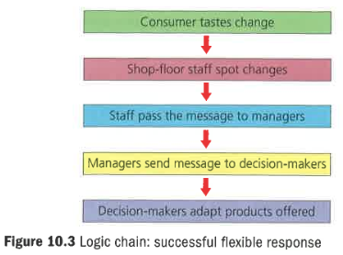
Flexibility in responding to customer needs
Firms needs to adapt to changing customer tastes
This is most easily done by shop floor staff who directly interact with the customer.
Feedback from staff is invaluable – this is made more difficult in tall hierarchically structured firms.
Middle management can often stifle feedback from below reaching senior decision makers
Smaller companies do not have such internal communication difficulties

Slide 5
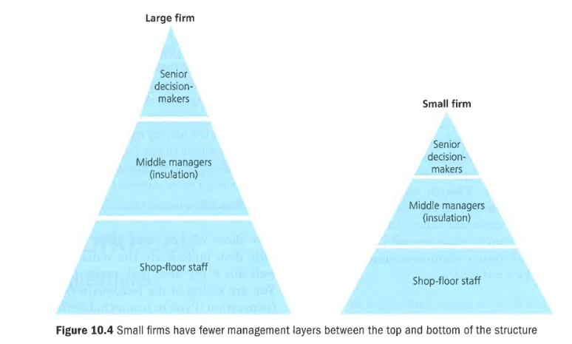
Flexibility in responding to customer needs

Slide 6
Customer service
Delivering excellent customer service needs staff who care about how they treat customers. This is easier when staff see how there contribution contributes to overall business success.
Herzberg – workers more motivated when results of your work are more clearly identified
Staff within larger companies may feel that their efforts make little difference.

Slide 7
Ecommerce
Electronically generated commerce occurs when commercial transactions take place online.
Ecommerce in the UK exceeded £50 billion by 2015
Prospect for further growth is huge
A lot of that growth will come from `m-commerce` i.e. making purchases on the move via a mobile device.
Specialised small businesses can break-even by selling to a much greater geographical market place
Reduction of entry barriers

Slide 9
Review - reasons to stay small
Explain two possible problems arising from growing as a business. (6)
Explain why customer service may be better in a small local garage than at a national chain such as Kwik Fit. (4)
As an organisation takes on more staff, explain briefly two possible impacts of this growth on the shape of its organisational structure. (6)
Explain two possible consequences for small business of starting to sell via a website (6)
Assess two possible impacts of opening three new outlets on a small cafe which is differentiated by the friendliness and customer service of its proprietor. (8)

Slide 10
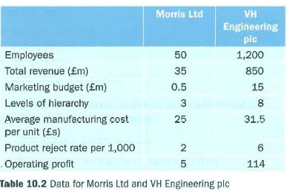
Data response 1
Morris Ltd and VH Engineering pic are both manufacturers of components used in UK car factories. Although both were founded in the 1980s, Morris Ltd has remained small, in contrast with VH Engineering pic which has pursued a strategy of rapid growth over the past 20 years.
Shareholders at VH Engineering pic are concerned that the company has developed a reputation of being slow to respond to market change. Although sales remain high, analysts attribute this to the firm's willingness to cut prices on its products which tend to offer fewer features than those of market-leading businesses.

