Slide 1
Edexcel A2 Business
4.4.2 Ethics
Revisionstation

Slide 2
Worksheet

Slide 3
From Edexcel
a) Stakeholder conflicts
b) Pay and working conditions
c) Environmental considerations:
emissions
waste disposal
d) Supply chain considerations:
exploitation of labour
child labour
e) Marketing considerations:
misleading product labelling
inappropriate promotional activities

Slide 4
Starter – an article to read and answer the questions
1. Where is the factory that Apple is investigating?
2. Who carried out the research according to the article?
3. What is an Apple Internship a disguise for?
4. How long is a working day for the students?
5. Do you consider this kind of business practice to be ethical?
Notes:
South West China
SACOM (always good to know the source of research)
Filling labour shortages on the production line
*am - *pm = 12 hours

Slide 5
Ethics defined
Ethics mean having moral principals that govern how a company does business. A moral principal is one that knows right from wrong.

Slide 6
Stakeholder conflicts

Slide 7
Stakeholder conflict map

Slide 8
Stakeholder conflict map
Owners want high profits so there are good dividends for their shareholders
Suppliers want to charge high prices for their goods and to keep costs of production low
stakeholders
owners
customers
managers
employees
government
suppliers
Customers want low prices, high quality, availability and ethical products
The Government wants tax payments and lawful, ethical businesses
Managers want promotion prospects and bonuses on high profits
Employees want job security and good working conditions

Slide 9
MNC objectives vs stakeholders
Owners seek high profits…
High profits means keeping wages low which means that workers may not be paid a living wage
High profits means keeping costs as low as possible so working conditions may suffer
High profits mean that labour laws may not be kept to
High profits mean that work might be subcontracted out to third parties who use child labour or forced labour

Slide 10
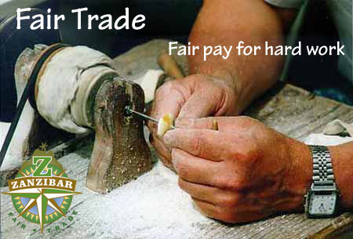
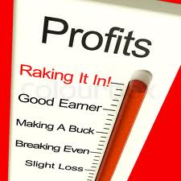
Shareholder objectives vs ethical objectives
Shareholder objectives
Ethical corporate objectives
High profits
High dividends
Growth
Return on their investment
A positive corporate image
Low emissions
Safe waste disposal
Paying fair wage rates to employees in other countries
Sourcing sustainable raw materials
Notes:
http://www.tata.com/aboutus/articlesinside/Tata-Code-of-Conduct Tata Ethical objectives

Slide 11
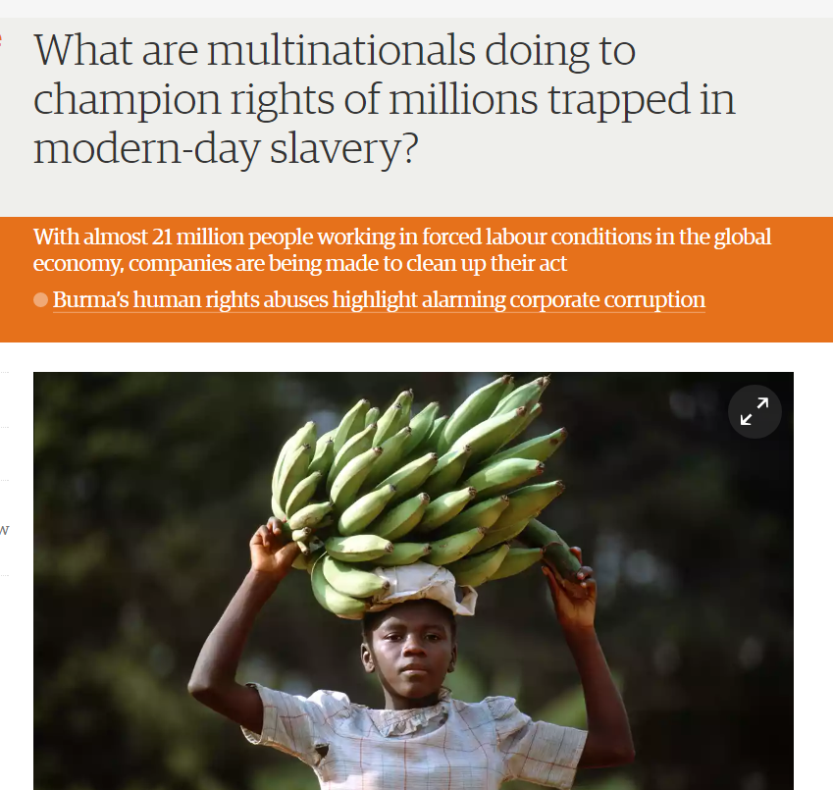
Stakeholders – labour exploitation
In a world of complex supply chains, migrant workers, sub-suppliers and a constant squeeze on costs, corporate leaders and their stakeholders are keenly aware of the risk of labour exploitation
There is scope for MNC leaders to champion against forced labour, which would help an estimated 21million people in the world today

Slide 12
Pay and working conditions

Slide 13
Pay
Pay varies around the world, as does the cost of living
There are thousands of videos on the internet which explain that MNCs don’t pay fair wages that the locals can live on – which is exploitation
Owners want low costs and low wages, employees want higher wages that they can live on

Slide 14
Working conditions
Working conditions in developing nations can be well below those of industrialised nations
Owners want high profits and so may cost cut health and safety measures e.g. no fire escapes
Safety violations in garment factories see HERE

Slide 15
Working conditions
Labour intensive production at Apple
Congo cobalt mines that use child labour

Slide 16
Working conditions
Amazon’s 80 hour week and culture come under scrutiny
Stone wash jeans – a deadly but cheap process

Slide 17
Environmental considerations

Slide 18
Environmental considerations
Is it ethical for MNCs in developing nations to only adhere to less severe environmental legislation than the UK?
Do MNCs have an ethical duty to be as environmentally responsible as possible? This is the debate.
There are lots of environmental considerations that effect business, but your exam board would like you to know about:
Emissions
Waste disposal

Slide 19
MNCs and emissions
An emission means the production and discharge of something, especially gas or radiation
The climate crisis of the 21st century has been caused largely by just 90 companies, which between them produced nearly two-thirds of the greenhouse gas emissions generated
Chevron, Exxon and BP being the three worst polluters interactive diagram here

Slide 20
MNCs and pollution

Slide 21
MNC and waste disposal
MNCs regularly flout or ignore “weak” environmental laws in India and other developing nations
The owners want to keep costs down, good waste management is expensive and so there is a stakeholder conflict with those that live near these toxic dumps

Slide 22
MNCs and waste disposal
Sweden is buying rubbish from other countries
Toxic city in Ghana

Slide 23
Supply chain considerations

Slide 24
Supply chain defined
A supply chain is a system of businesses, people, activities, information, and resources involved in moving a product or service from supplier to customer.

Slide 25
Supply chain problems
Having part of a supply chain in a developing nation can be a problem for the MNCs
Many garment factories or labour intensive production processes outsource to slums, refugee camps and unlicensed back street businesses with poor working conditions
This can mean that labour is intentionally or unessentially exploited by the MNCs
30 mins but worth it

Slide 26
Forced labour
To better understand what forced labour constitutes in practice, the ILO initially developed a list of six forced labour indicators:
• threats or actual physical harm to the worker
• restriction of movement or confinement to the workplace
• debt bondages
• withholding of wages or excessive wage reductions
• retention of identity documents
• threat of denunciations to the authorities

Slide 27
Forced labour examples
Forced labour around the world
Forced labour and the Qatar world cup

Slide 28
Child labour
Some children are trapped in forms of slavery in armed conflicts, forced labour and debt bondage (to pay off debts incurred by parents and grandparents), drug trafficking and organised begging and in many other forms of labour.
For some work, children receive no payment, only food and a place to sleep
Poverty is the most common reason why children work
Poor households spend the bulk of their income on food and the income provided by working children is often critical to their survival

Slide 29
Child labour and MNCs
Child labour in the beauty supply chain
Child labour used in the chocolate supply chain

Slide 30
Marketing considerations

Slide 31
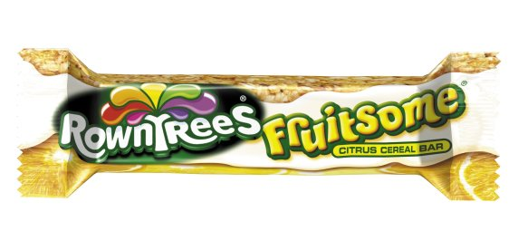
Ethics and misleading marketing
If your cereal says its has no added sugar - it may still be high in sugar, hidden as fructose or glucose
Rowntrees fruitsome bar is 38% sugar
None of these products is breaking the law, but they are giving a false impression to consumers

Slide 32
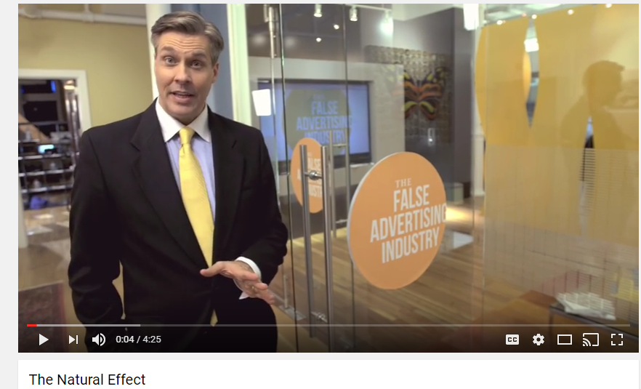
Misleading advertising

Slide 33
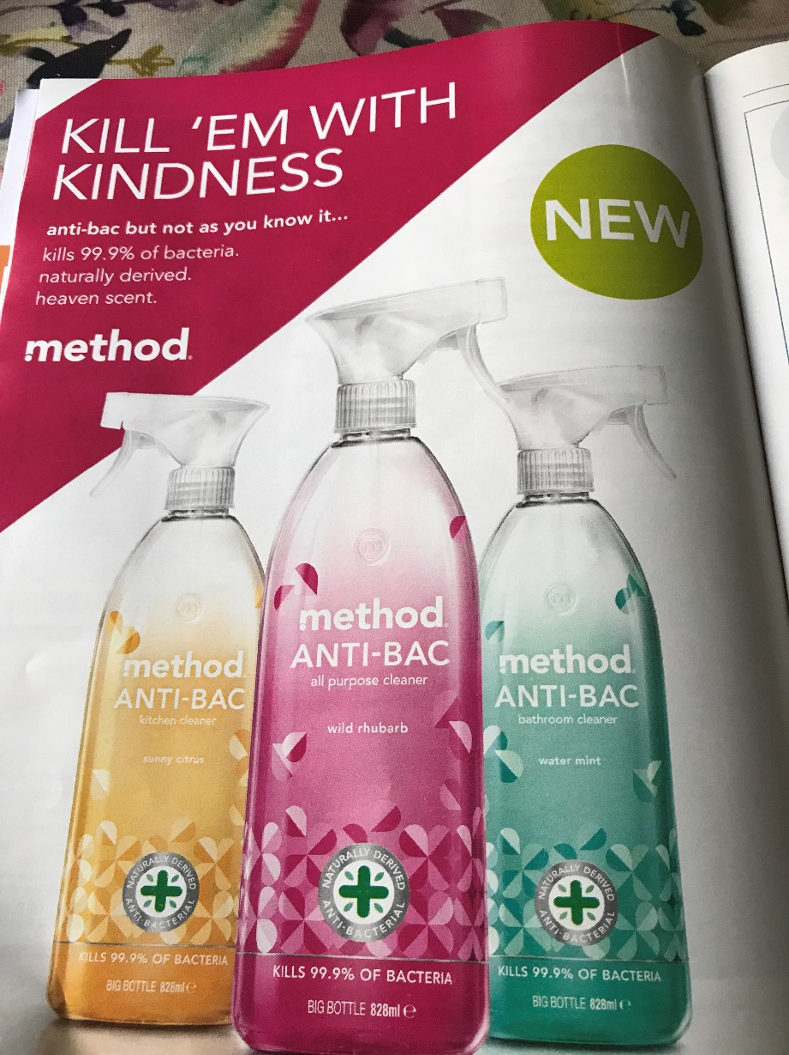
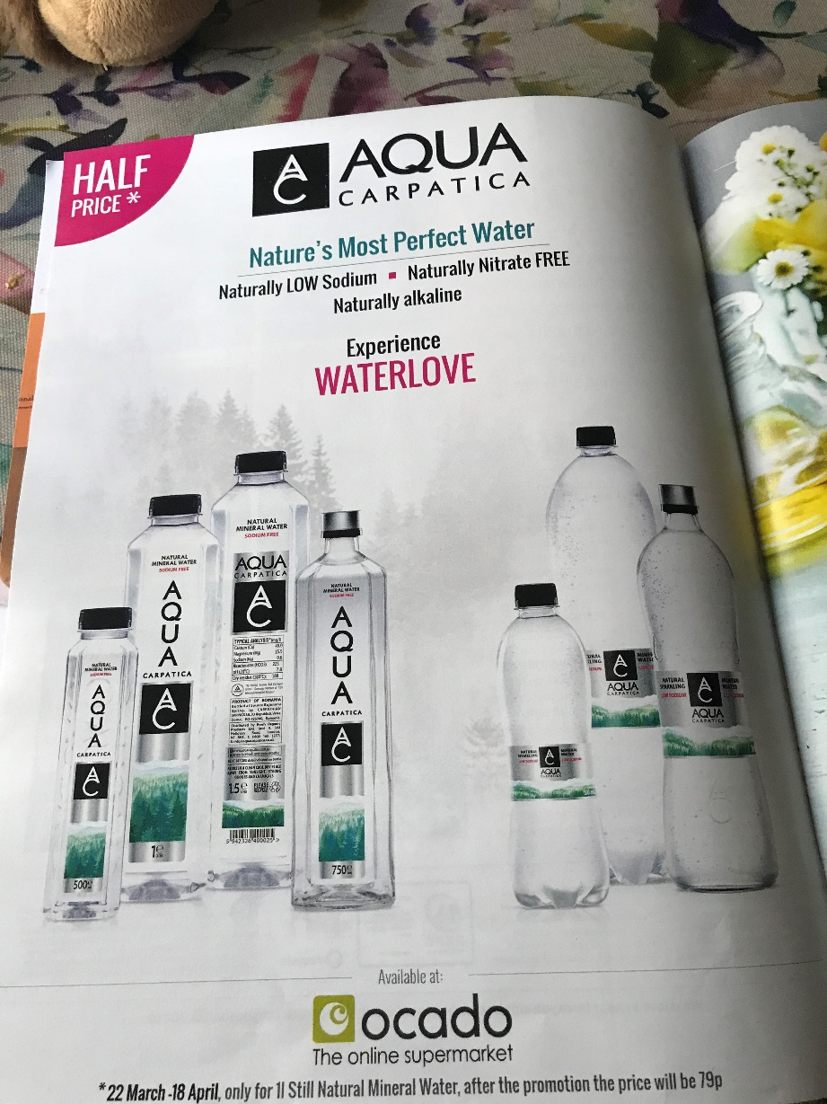
Misleading examples

Slide 34
Inappropriate promotional activities
Discussion: American Apparel; accused of sexualising kids in their marketing:
Warning graphic content – remove shape for discussion – article and short video here

Slide 35
Energy drinks being marketed to kids
The energy drink market is booming and children are among the consumers. Many are ignoring warning labels and opting for energy drinks, often marketed as a stamina enhancing, natural part of a young person’s high-octane lifestyle.
Music, gaming and extreme sports; this is what greets you on the website of the best-selling energy drink in the world – Red Bull
Article here

Slide 36
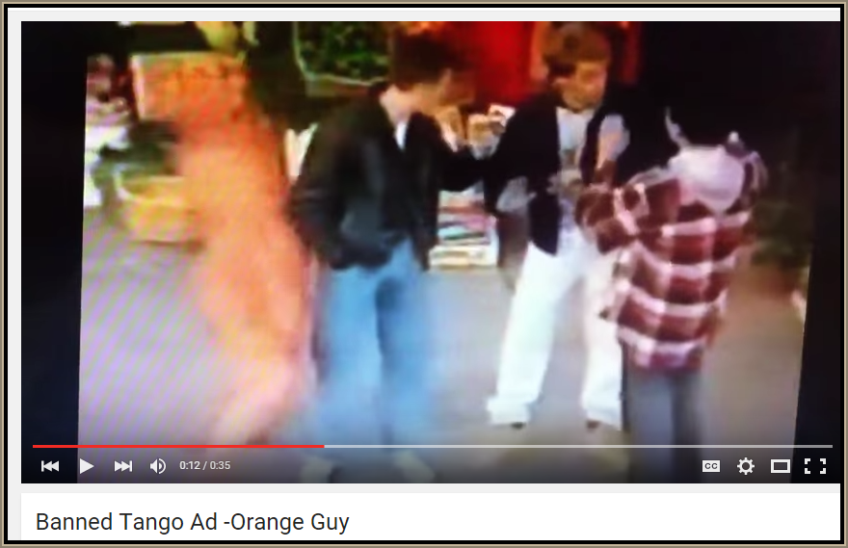
Inappropriate promotional activities
Banned Tango Ad – why do you think it was banned?

Slide 37
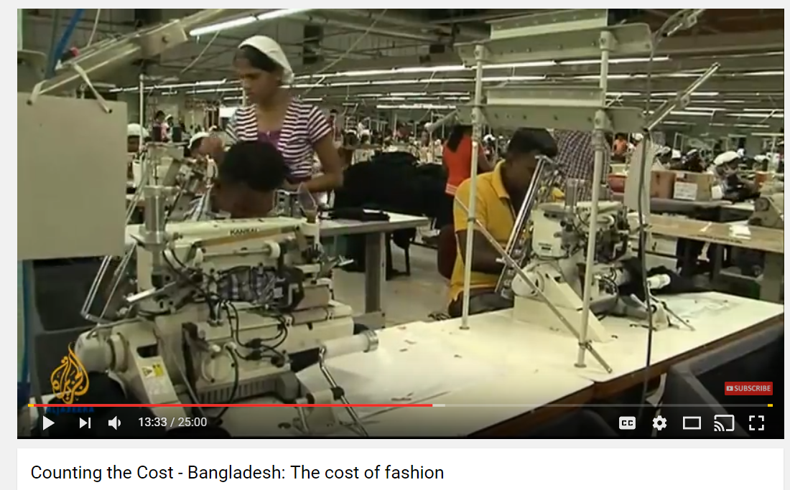
Revision video 1

Slide 38
Sample Edexcel A2 questions

Slide 39
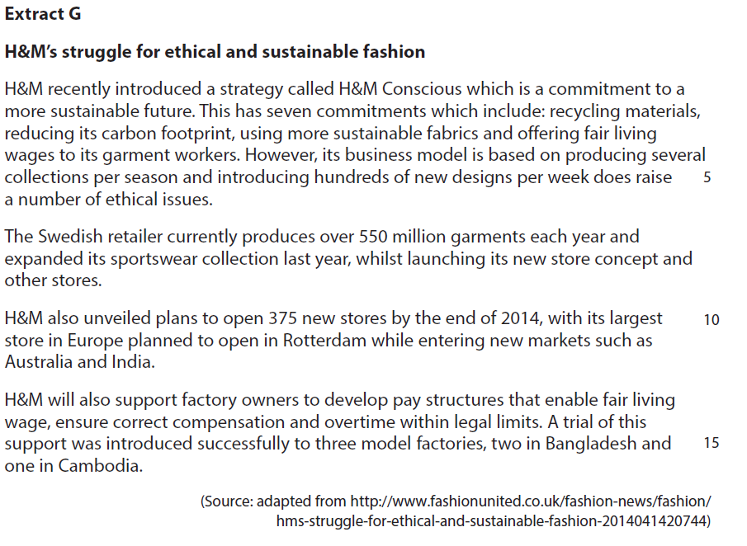
Case study for question 1

Slide 40
Sample question 1
Knowledge 2
Application 2
Analysis
3
Evaluation
3

Slide 41
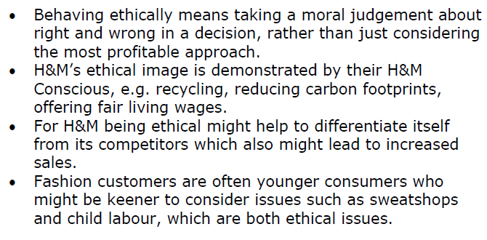
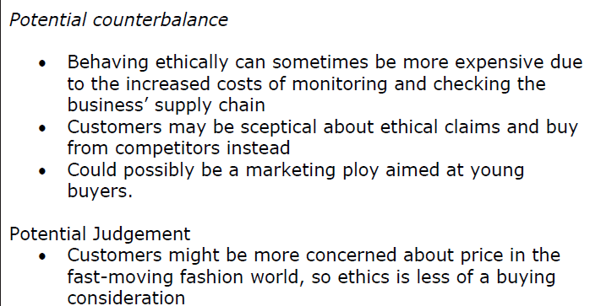
Answer sample question 1

Slide 42
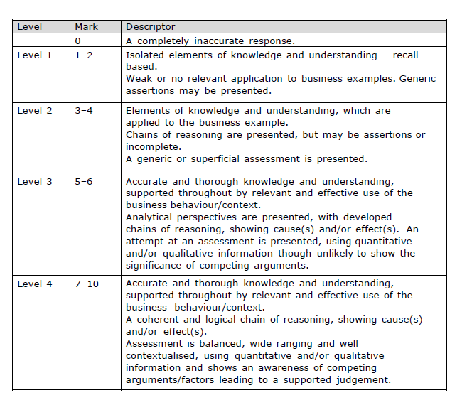
How to level sample question 1

Slide 43
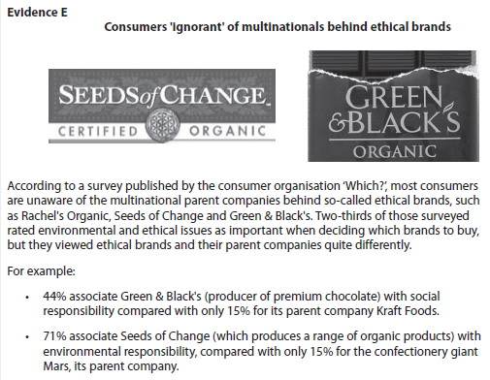
Case study for question 2

Slide 44
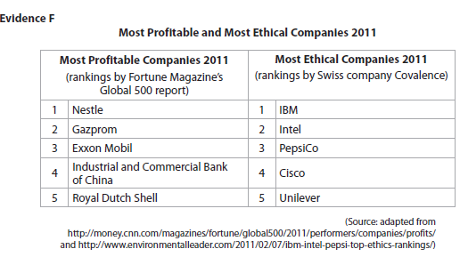

Slide 45
Sample question 2
[10]
Knowledge 2
Application 2
Analysis
3
Evaluation
3

Slide 46
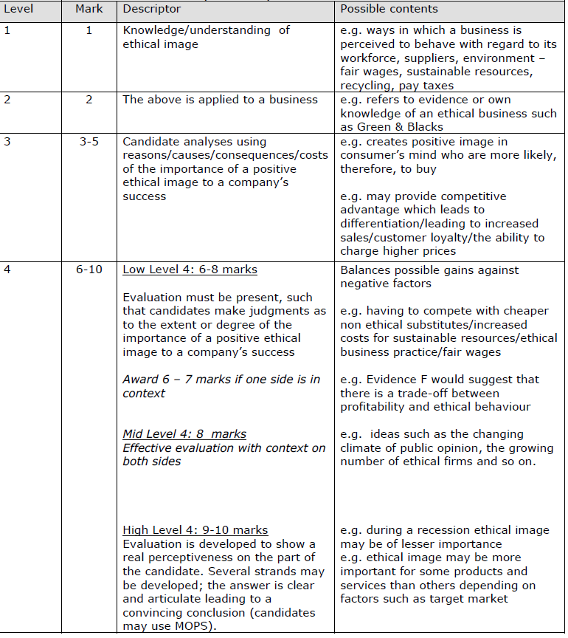
Answer sample question 2

Slide 47
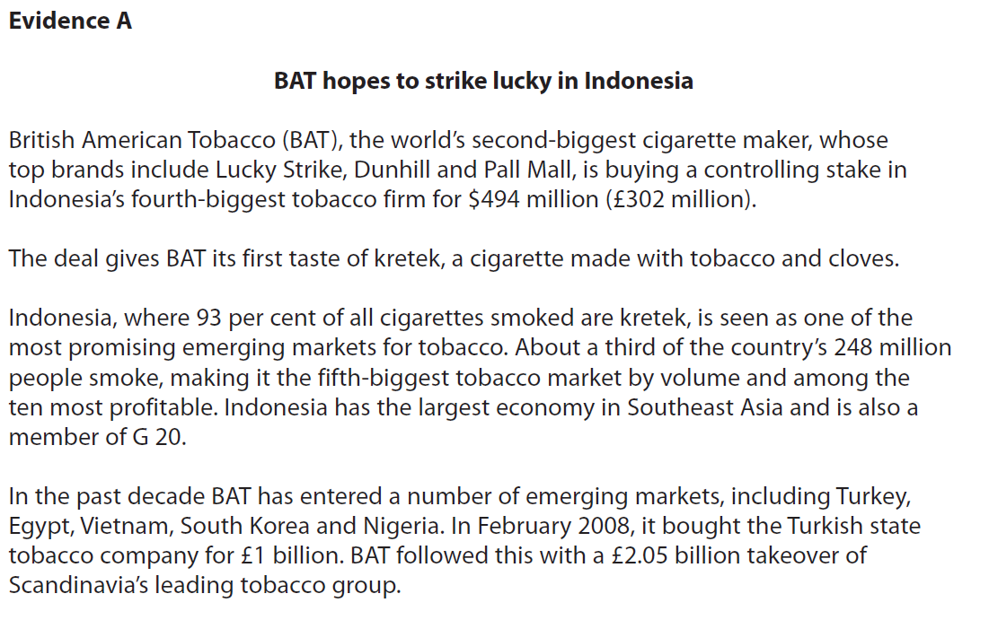
Case study for question 3

Slide 48
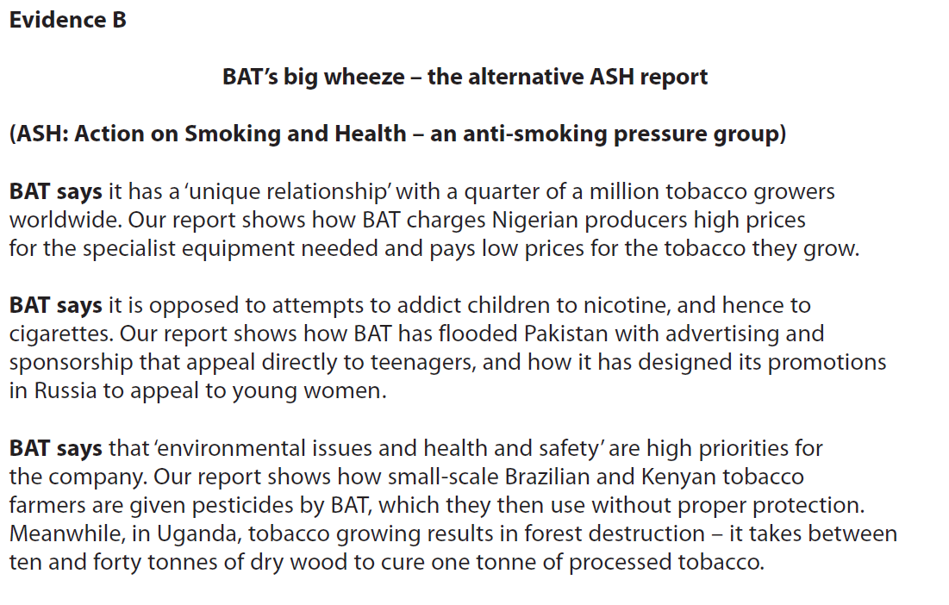

Slide 49
Sample question 3
[6]
Knowledge 2
Application 2
Analysis
2
Notes:
Legacy question – no six mark questions on the actual paper but good practice

Slide 50
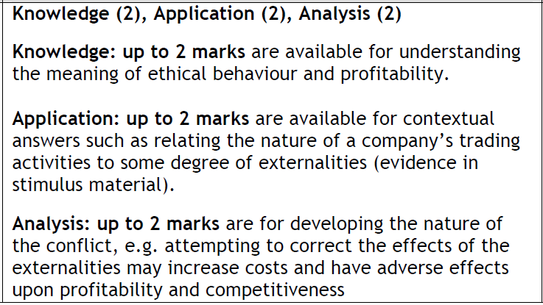
Answer sample question 3

Slide 51
Glossary
Stakeholder conflicts; When the objectives of one stakeholder in a business conflict with that of another e.g. customers desire for ethical products and shareholders desire for profits
Emissions; This means pollutants from production going into the air
Enforced labour; is any work or services which people are forced to do against their will under the threat of some form punishment
Child labour; It is work that children should not be doing because they are too young to work, or if they are old enough to work, because it is dangerous or otherwise unsuitable for them.
Slave labour; labour which is coerced and inadequately rewarded, or people that do it
Waste disposal; The disposal of waste products from production

