Slide 1
From Edexcel
a) Product and market orientation
b) Primary and secondary market research data
(quantitative and qualitative) used to:
identify and anticipate customer needs and wants
quantify likely demand
gain insight into consumer behaviour
c) Limitations of market research, sample size and bias
d) Use of ICT to support market research:
websites
social networking
databases
e) Market segmentation

Slide 2
Watch the advertisements below. What do you think is meant by market segmentation?
​How would a business achieve it?

Slide 3
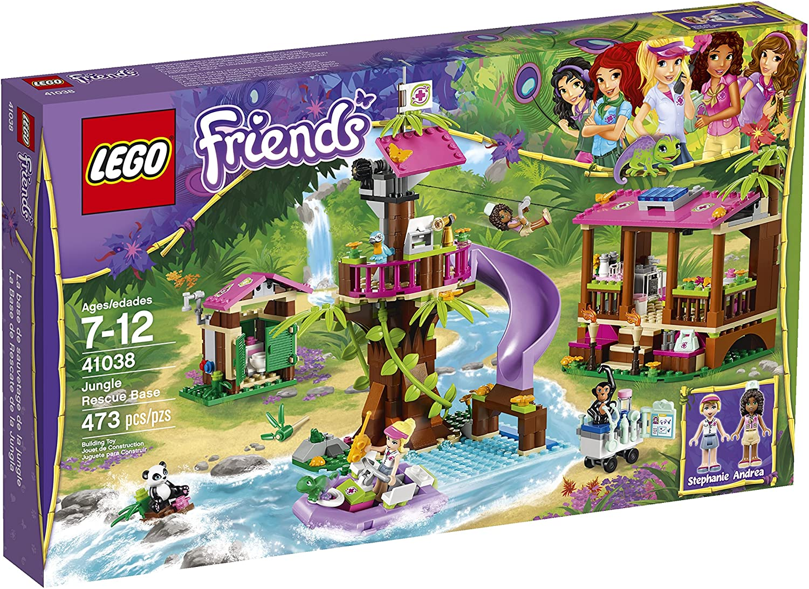
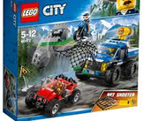
Who are the following products aimed at?
Why would they aim their products at a particular audience?

Slide 4
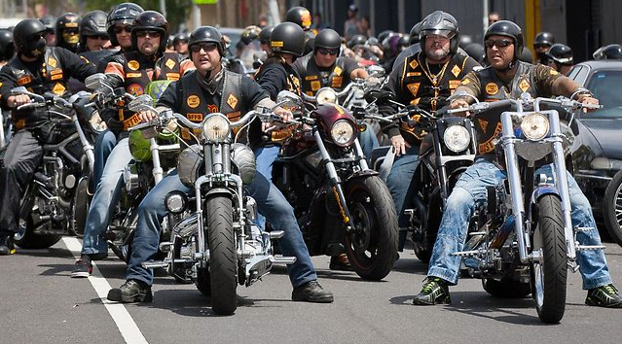
Definition of market segments
Market segmentation splits up a market into different types (segments) to enable a business to better target its products to the relevant customers.
A market segment is an identifiable group of individuals or part of a market where consumers share one or more characteristics or needs
Harley Davidson bikers club

Slide 5
Segments are usually measured in terms of sales value or volume. In the diagram below, segment B is twice the size of segment C

Slide 6
(Lifestyle) or
Income
E.g. “customers with disposable income over £150,000”
The population can also be divided into; low income, middle income and high income

Slide 7
On what basis would you segment the following?
National Newspapers
TV/Film Streaming services
Magazines
Holidays
Personal hygiene/grooming products
Confectionary

Slide 8
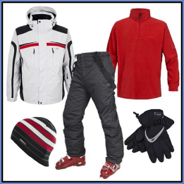
Segmentation by location
A business may decide to sell its product in just one country, one region (like the Midlands), or in an even smaller area
A business may target its product at rural rather than urban areas
A business may target its products depending if the market area is hot or cold
What countries could you sell the snow gear in?
Notes:
USA, Germany, Italy, UK (Scotland), Austria, Switzerland, Russia, Finland, Iceland and so on..

Slide 9
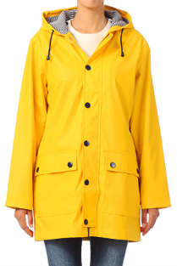
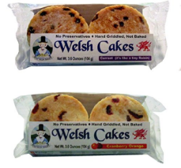
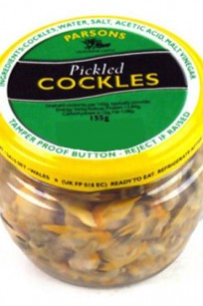
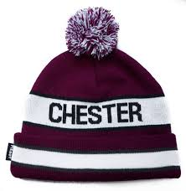
Segmentation by location
Which location segment are these products aimed at?

Slide 10
Market segment - demographics
Statistical data relating to the population and particular groups within it
For example market segmentation helps book publishers target customers as we won’t all read the same books (not everyone wants to read Harry Potter)

Slide 11
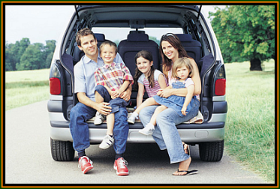
Segmentation by lifestyle (Psychographic)
Customers can be grouped according to the way they lead their lives and the attitudes they share
For example, young professionals may drive a sports car because of the image they want to project
Parents might want the same things, but have to provide for their children, which is a large extra cost. They will need a family car to suit their lifestyle

Slide 12
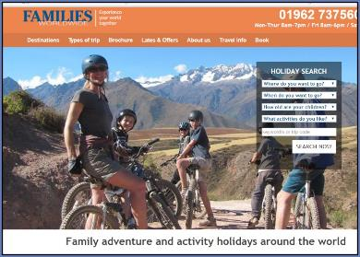
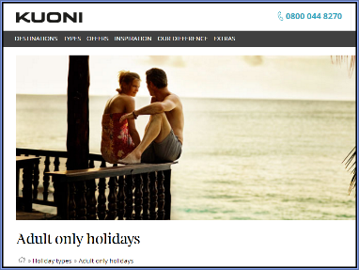
Segmentation by lifestyle (Psychographic)
A business may decide to segment the market according to lifestyle
This may be a combination of; values attitudes, perceptions, beliefs
This may also include hobbies and interests
This may also include family situation (living on own or living with five kids)
For example the two different type of holidays in the pictures

Slide 13
Segmentation by lifestyle (Psychographic) - discussion
Look at these 4 holidays – can you describe the type of lifestyle segment that they are aimed at?

Slide 14
Segmentation by Income
The population can be segmented according to annual salary (e.g. £15,000, £30,000 etc.) or type of job and social class
The population can also be divided into; low income, middle income and high income
Establishing a group's disposable income is important so that products can be targeted to the relevant income group
What is disposable income, can you explain the term?
Notes:
Disposable income is what is left after all the bills have been paid

Slide 15
Segmentation by income - discussion
Can you explain which income group these products are aimed at?

Slide 16
Segmentation by Age
Market segmentation could be on age groups;
0-10
11-16
17-19
20-25
26-35
36-50
51+
Each age group will have different needs and wants in terms of products and services and the business can develop a targeted marketing strategy to appeal to that age group

Slide 17
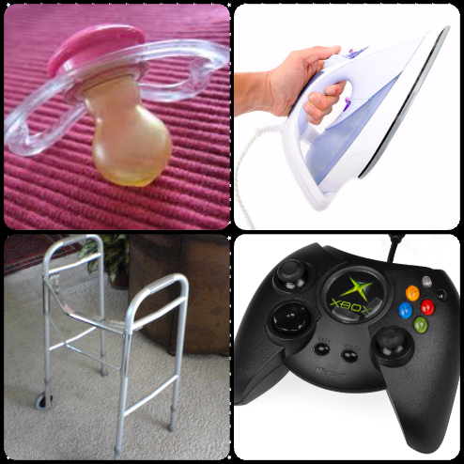
Segmentation by age - discussion
Can you explain which age group segment are these four products are aimed at?

Slide 18
Segmentation by age - discussion
Can you explain? Kellogg’s product portfolio of cereals, why does the business produce so many?
Notes:
Answer because at different ages you want different cereals, to satisfy the needs of customers in different segments

Slide 19
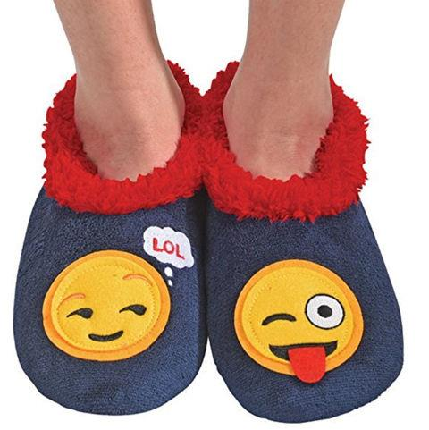
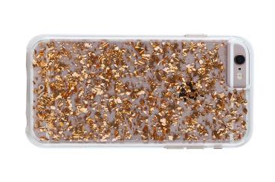
Can you explain which age group segment are these products aimed at?

Slide 20
Can you explain which age group segments these products are aimed at?

Slide 21
Segmentation by gender
Many products are aimed at either men or women
A business may produce or adapt its products to ensure they can be marketed effectively
For example these razors made originally for men now adapted for women
Notice the use of blue and pink in packaging so customers know which one to choose!

Slide 22
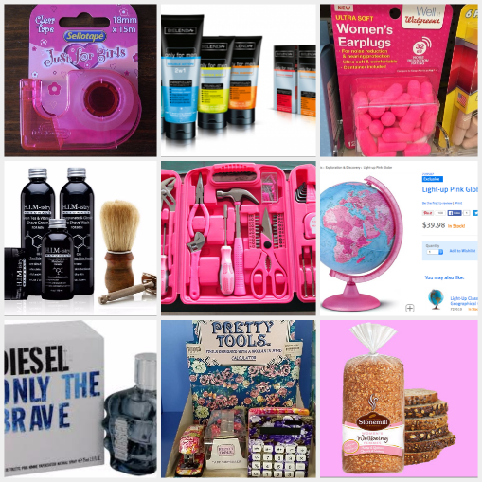
Segmentation by gender - discussion
Can you explain which gender segment these products are aimed at?

Slide 25
Segmentation
Advantages - Helps business to get to know its customers - Focuses business strategy on a specific target audience - Encourages the business to specialise in meeting needs of specific segments ​- Provides focus for allocation of business resources
Disadvantages - Costly and time consuming process - Could lead to manufacture of too many different products ​- Could over narrow focus of business

Slide 26
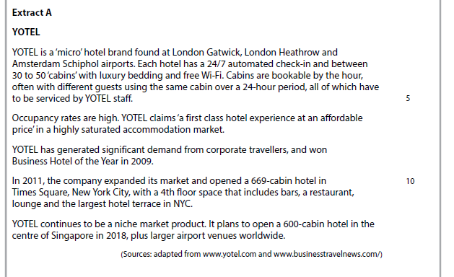
Case study for question 1 – from 2017 paper

Slide 27
Sample question 1
Knowledge 1
Application 2
Analysis
1
Notes:
There was no suitable A2 question on this topic so I have borrowed an Edexcel AS question

