Slide 1
Edexcel A2 Business
4.2.2 Assessment of a country as a market
Revisionstation

Slide 2
Worksheet

Slide 3
From Edexcel
a) Factors to consider:
levels and growth of disposable income
ease of doing business
infrastructure
political stability
exchange rate

Slide 4
Starter
You work in the marketing department for an international business. You have been given the task of identifying a new market where you can sell your company’s products. You are keen to impress at the first meeting with your boss to discuss the potential markets…
What are the questions that you should be asking your boss before you make suggestions of what country to trade in?
Notes:
What is the product?
Where is it already sold?
What is the competition in those potential markets?
Does the business have any data?
Are there any possible joint ventures or mergers on the horizon?

Slide 5
Assessment of a country as a market
You need to be able to consider a range of factors which can make some countries more attractive than others to SELL IN*
Of course there are a huge variety of factors, but the ones that your exam board would like you to be able to discuss are:
levels and growth of disposable income
ease of doing business
infrastructure
political stability
exchange rate
Notes:
Production is dealt with in a different topic and PowerPoint so try and remain focussed on the selling

Slide 6
You have identified three possible markets where there is potential demand for your products, rank each from 1-5 with 5 being the best and see which country you should sell to*
 | Venezuela | Russia | Switzerland
levels and growth of disposable income
ease of doing business
infrastructure
political stability
exchange rate
Notes:
They could choose these countries or you could choose or keep the ones suggested

Slide 7
Disposable income

Slide 8
#1 Disposable income
Disposable income is the amount that a customer has to spend after all their bills have been paid
If a business wants to move into another country it may assess the level of disposable income in that country
This helps a business to see if the citizens of the country will be able to afford the products that they want to sell there

Slide 9
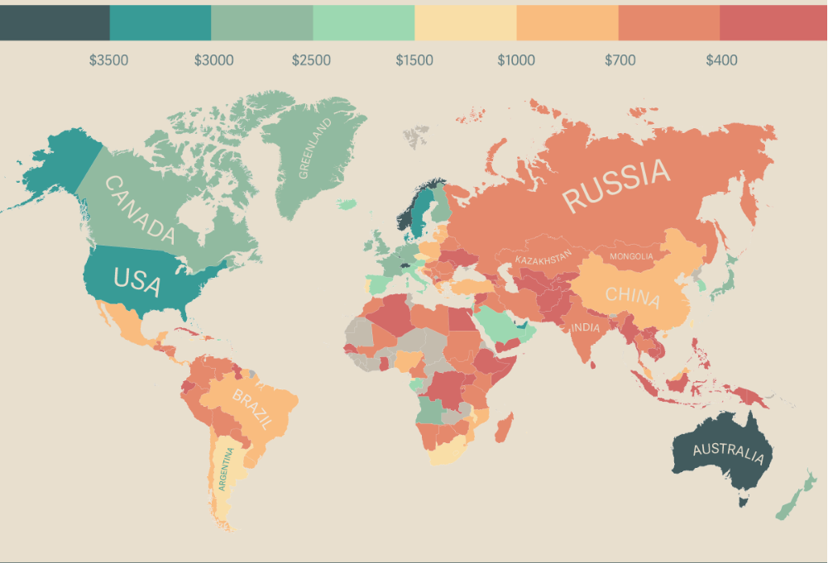
Monthly disposable income around the world

Slide 10
Disposable income per household
Household disposable income is the amount of money that a household earns, or gains, each year after taxes.
It represents the money available to a household for spending on goods or services.
A minimum wage is the least amount that a business is allowed to pay a worker in that country

Slide 11
Disposable income – better life index
OECD have a better life index of income
Click the graphic to the right to have a look at the differences
Where does the UK come, how do we compare?
Which markets are you not interested in now?

Slide 12
Growth of disposable income
The growth rate of disposable income can signal potential opportunities in that country to sell to
Use this OECD interactive online graphic to see which countries have the best growth rates
Have a look at the growth rate for Russia

Slide 13
Ease of doing business

Slide 14
#2 Ease of doing business
The ease of doing business index is an index created by the World Bank Group.
Higher rankings (a low number) indicate better, usually simpler, regulations for businesses and stronger protections of property rights e.g. patents
Click on the graphic to search for your countries

Slide 15
Infrastructure

Slide 16
#3 Infrastructure
Infrastructure is the basic physical and organisational structures and facilities (e.g. buildings, roads, power supplies) needed for the operation of a society or business
Many developing nations have been slow to get their infrastructure in place, and through failure to maintain it have let it decline
Have a look on the global competitiveness rankings to see how your countries do page 17

Slide 17
Global competitiveness index
The World Economic Forum's Global Competitiveness Survey looks at the financial health and risks of countries around the world.
One of the sub-indexes ranks countries' infrastructure after scoring them from 1-7. A score of 7 is the best you can get.
How did your countries do?

Slide 18
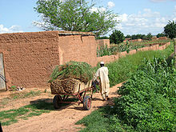
Why infrastructure is important to sales
Infrastructure can mean road, rail and transport. Without this a business cannot deliver to its customers on time
Infrastructure can also mean telecommunications, without this a business cannot communicate with its suppliers and its customers

Slide 19
Political stability

Slide 20
#4 political stability
The world bank has a series of worldwide governance indicators, one of which is the political stability and absence of violence and terrorism
Click the graphic to look at the data on an interactive data map

Slide 21
Political stability – risk factor
Political instability in a country could be a major risk factor so should be taken into consideration when assessing a potential country as a market for your products
Each new government may seek to impose a series of laws which will need to be adhered to e.g. environment laws, employment laws which could have an impact on the business
2013 Egyptians riot in the streets – can your business set up a shop here?

Slide 22
Why is political stability important?
An aggressive takeover of a government, a coup could lead to riots, protests and looting
It can also lead to civil war, notable recent examples are Egypt, Syria and Sri Lanka
Even more recently the government in Venezuela has faced challenges which have led to a great deal of political unrest
Click graphic and scroll down page to watch the BBC video on Venezuela

Slide 23
Exchange rates

Slide 24
Exchange rates
When assessing a country as a potential market a business will look at the exchange rates:
Strong
Pound
Imports
Cheaper
Exports
Dearer
Notes:
Video is long and all about USA so check before you show it – I thought it was OK and had some good examples, but it may not be suitable for your kids.

Slide 25
More data?
If you would like to look at more data for your chosen countries in order to better assessment as a potential market then try the website:
Trading economics and search for your countries and compare data sets
Click the graphic to go to the site

Slide 26
Sample Edexcel A2 questions

Slide 27
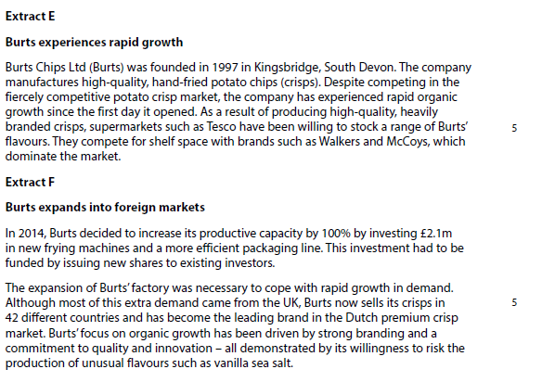
Case study for question 1

Slide 28
Sample question 1
Knowledge 2
Application 2
Analysis
2
Evaluation
2

Slide 29
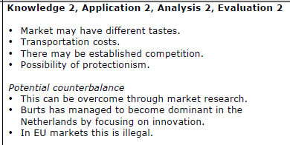
Answer sample question 1

Slide 30
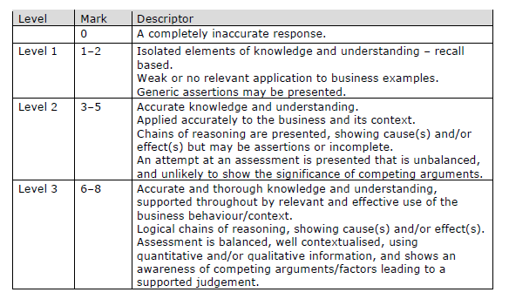
How to level sample question 1

Slide 31
Case study for question 2

Slide 32
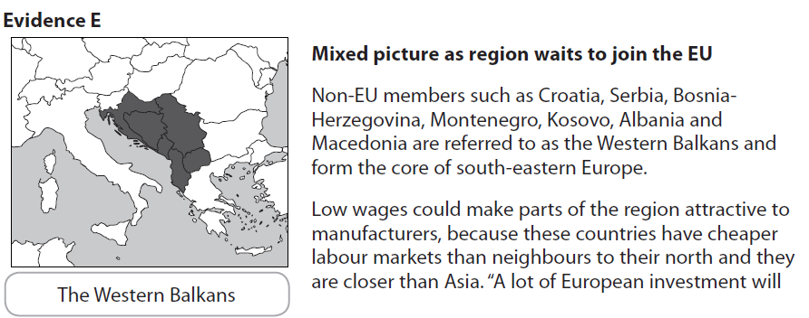
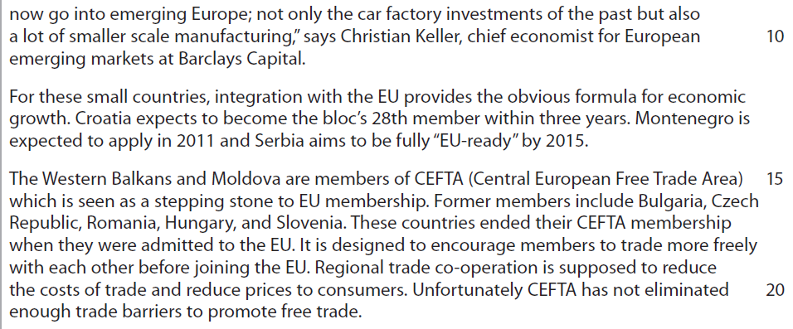

Slide 33
Sample question 2
[10]
Knowledge 2
Application 2
Analysis
3
Evaluation
3

Slide 34
Answer sample question 2
e.g. moving production to another country, production which is more Flexible
e.g. advantages in locating in potential new member states of EU, cost advantages and govt. incentives leading to greater profitability, closer to new potential and expanding markets
e.g. Western Balkans are still relatively unknown locations, recent political stability, EU accession may not happen, infrastructure not developed enough, need for training etc., all of which increases costs. Benefits might depend on overcoming cultural and political differences in the region.

Slide 35
Case study for question 3

Slide 36
Sample question 3
[6]
Knowledge 2
Application 2
Analysis
2
Notes:
Legacy question which is why it is 6 marks – no 6 mark questions on the paper

Slide 37
Answer sample question 3
Knowledge: up to 2 marks (one for each reason) for identifying possible reasons. e.g. saturated domestic markets, wanting to increase revenues and profits, extend product life cycle, spread risk question is about expanding sales – do not reward lower production costs/production
Application: up to 2 marks (one for each reason) for contextual answers such as linking the above specifically to the Chinese economy or the nature of PPRs brands. e.g. average 10% growth in GDP, million millionaires, western markets in recession, Gucci and YSL.
Analysis: up to 2 marks (one for each reason) are for developing the reasons e.g. Luxury goods are income elastic and not necessities therefore PPR can expect strong sales and increased profitability, because saturated/declining domestic markets have cut off future growth prospects

Slide 38
Case study for question 4

Slide 39
Sample question 4
Knowledge 4
Application 4
Analysis
6
Evaluation
6

Slide 40
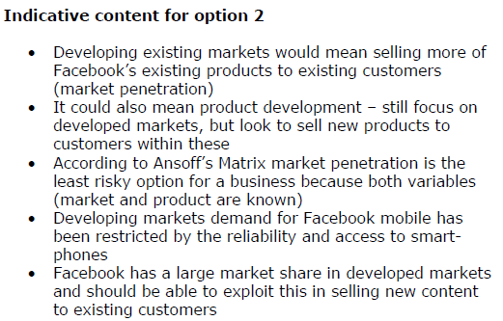
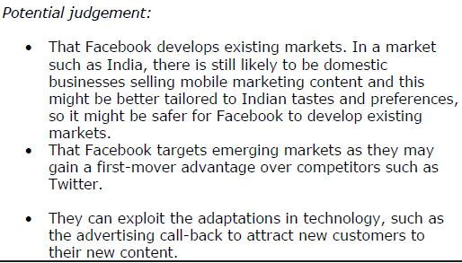
Answer sample question 4

Slide 41
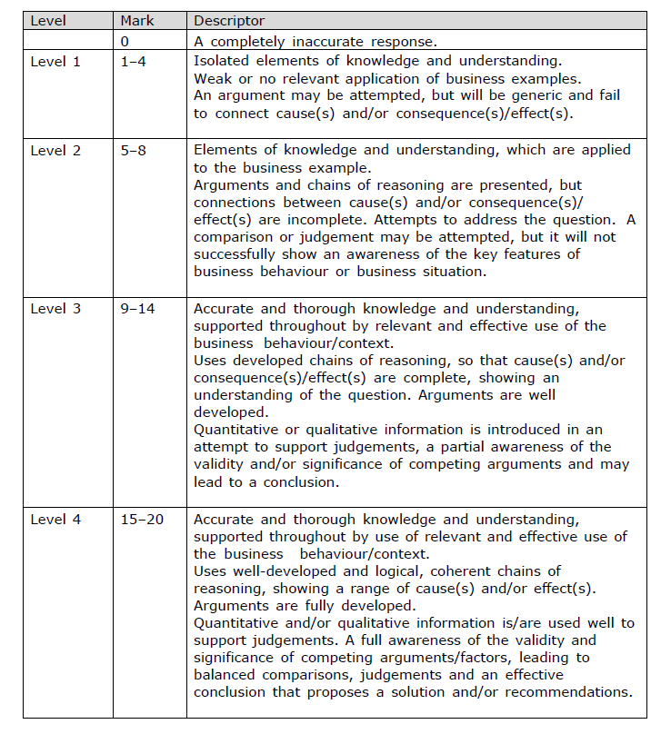
How to level sample question 4

Slide 42
Glossary
Disposable income; what is left over from a personal income, after all bills have been paid
Exchange rate; The price of one nation’s currency in terms of another currency
Infrastructure; the basic physical and organisational structures and facilities (e.g. buildings, roads, power supplies) needed for the operation of a society or business.

